Slide 1
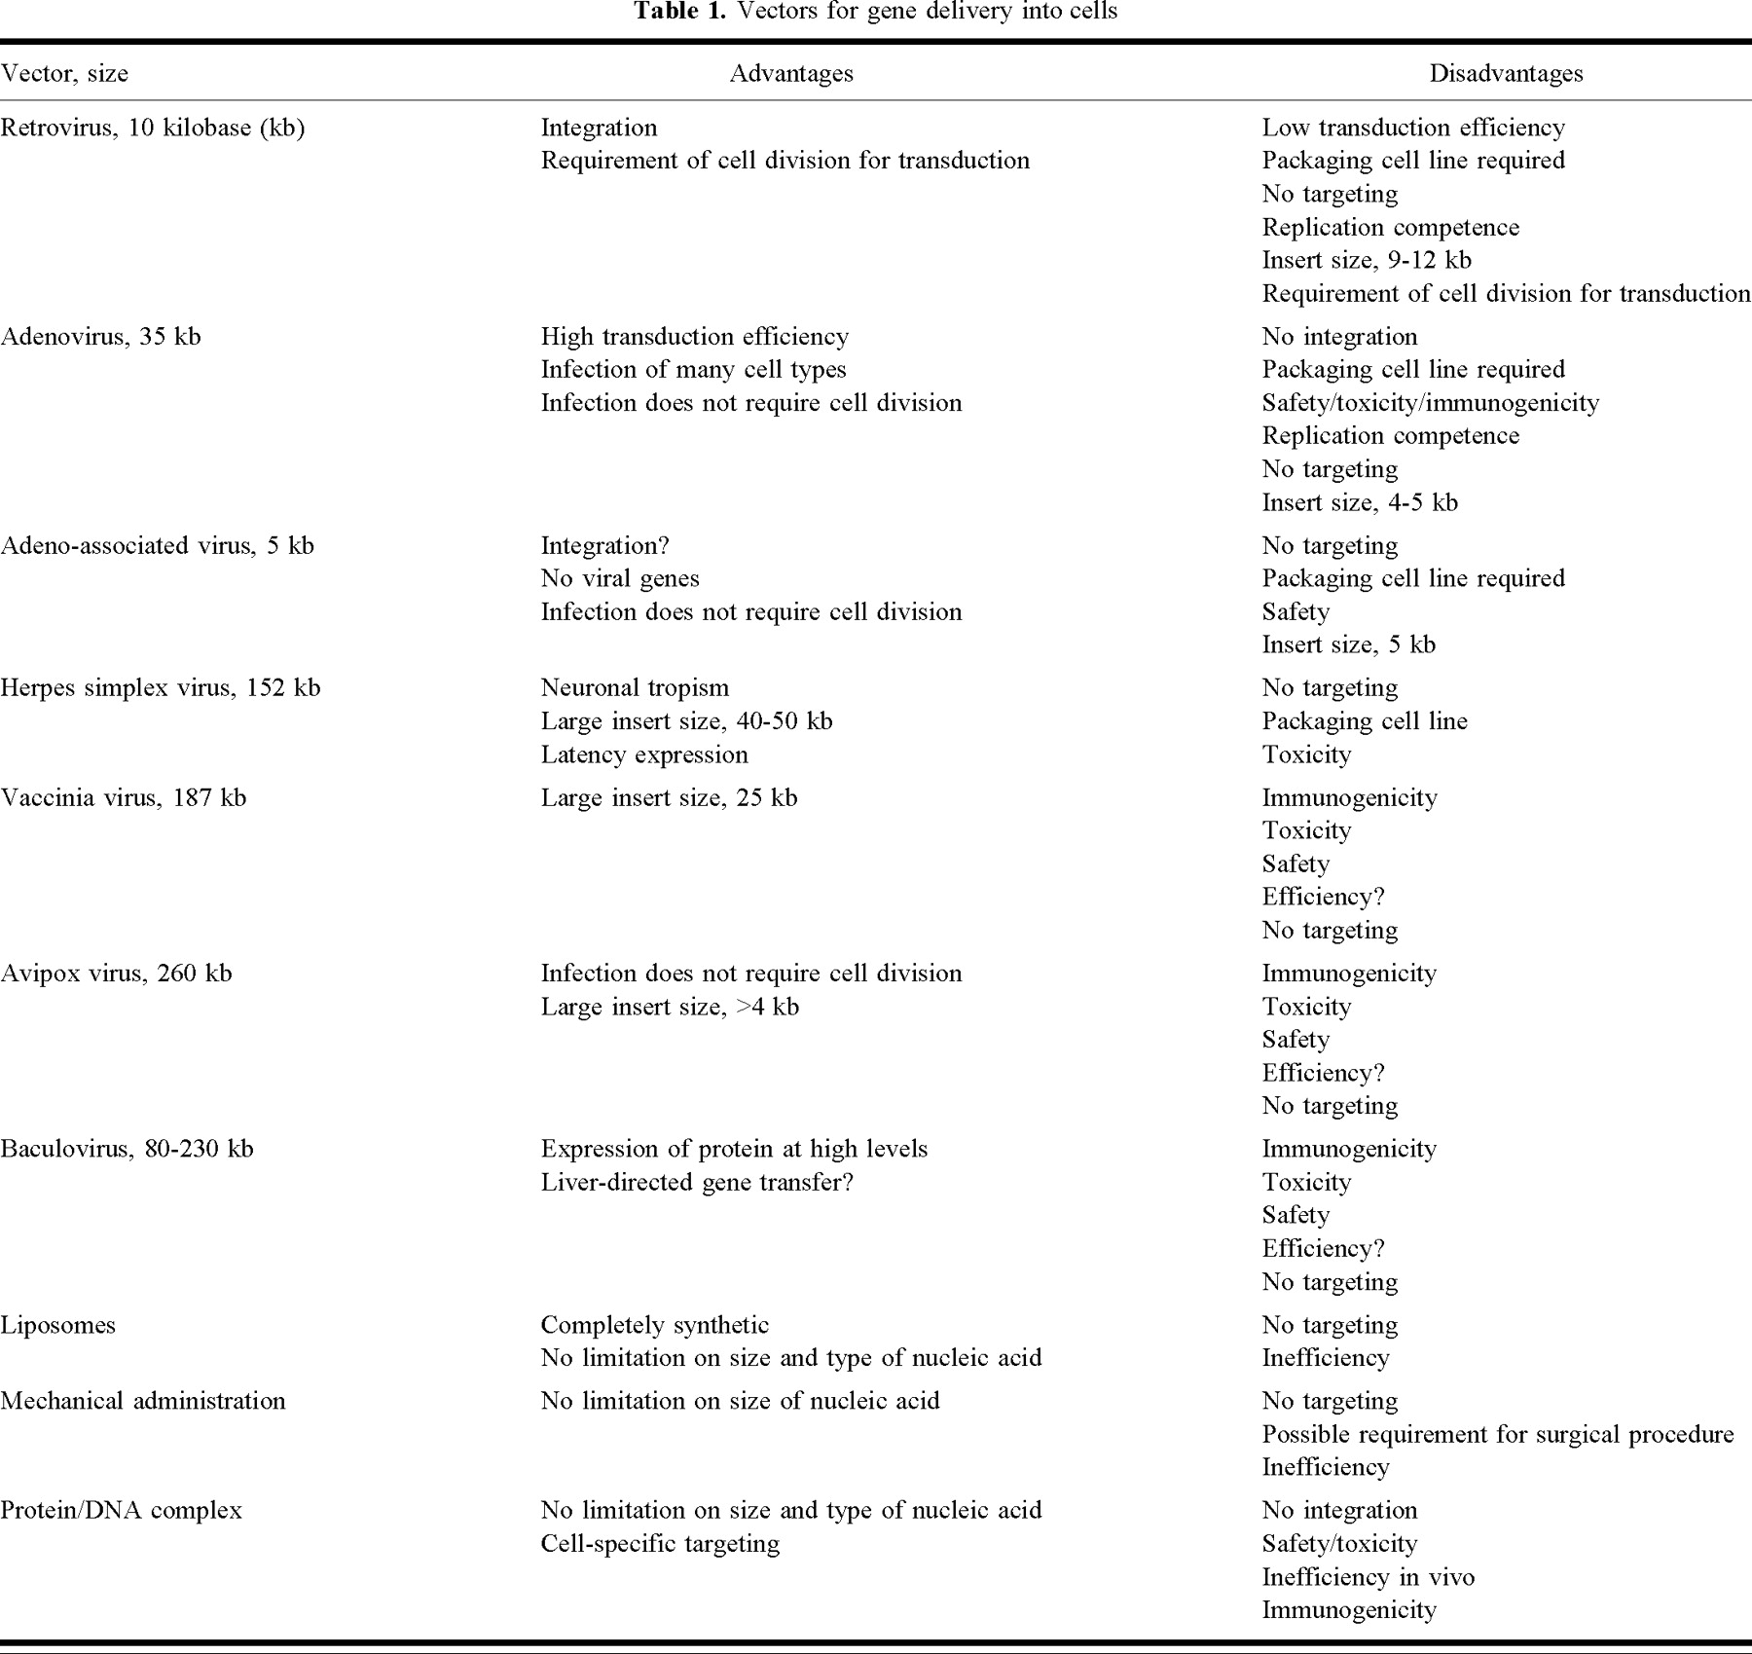
Notes:
Unless provided in the caption above, the following copyright applies to the content of this slide:

Slide 2
Notes:
Unless provided in the caption above, the following copyright applies to the content of this slide:

