Slide 1
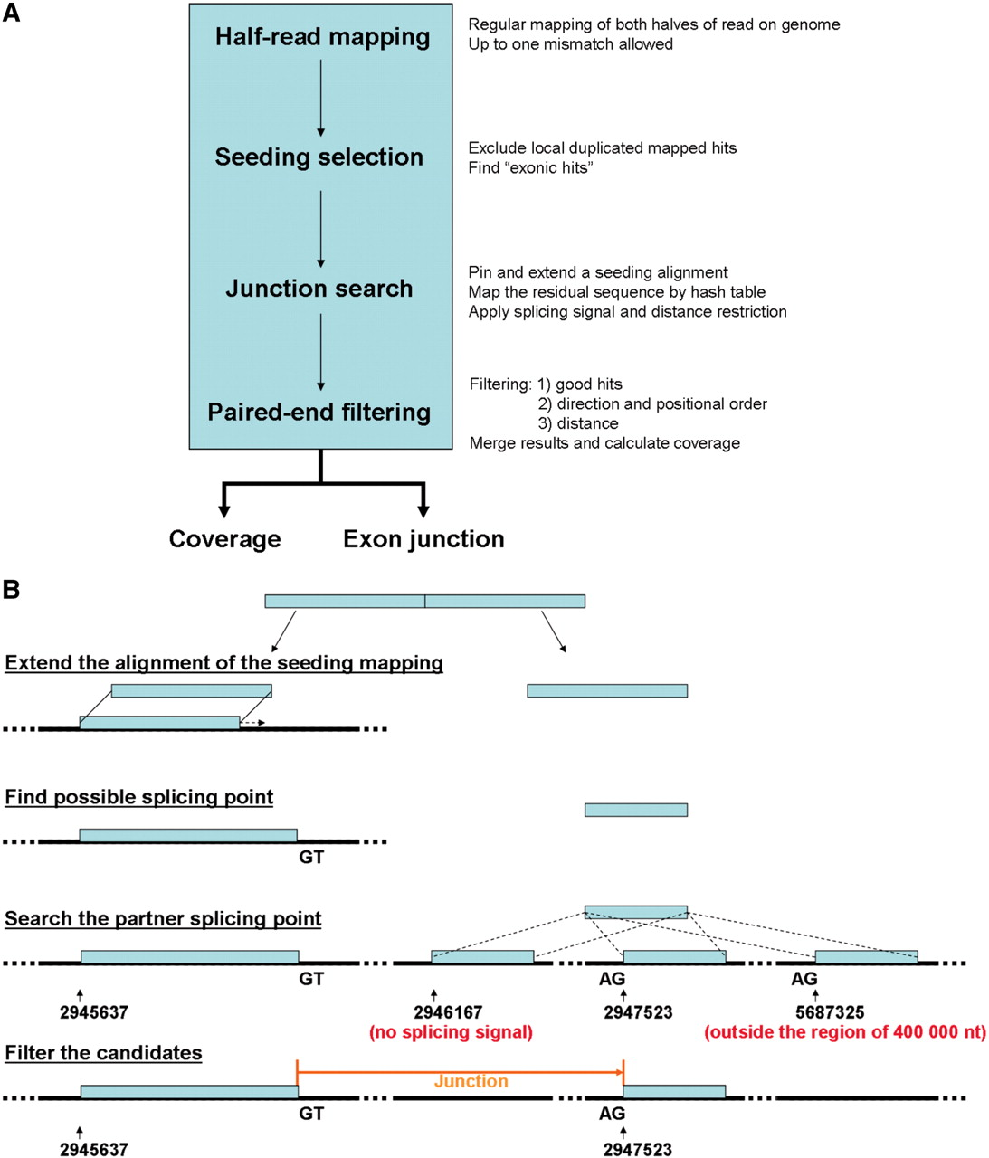
Figure 1. Workflow of standard SpliceMap and outline of junction search based on half-read mapping: ( a ) SpliceMap ...
Notes:
Figure 1. Workflow of standard SpliceMap and outline of junction search based on half-read mapping: ( a ) SpliceMap consists of four steps: half-read mapping, seeding selection, junction search and paired-end filtering. SpliceMap outputs coverage plot and junctions detected. ( b ) Each half-read is aligned to the genome and extended to obtain the partial alignment. The remaining part of the read, if at least 10 nt, will be used to search for its matches within a neighborhood (400000 nt). The GT–AG splicing signal is also used to filter the matches.
Unless provided in the caption above, the following copyright applies to the content of this slide: © The Author(s) 2010. Published by Oxford University Press.This is an Open Access article distributed under the terms of the Creative Commons Attribution Non-Commercial License (http://creativecommons.org/licenses/by-nc/2.5), which permits unrestricted non-commercial use, distribution, and reproduction in any medium, provided the original work is properly cited.

Slide 2
Figure 2. The direction and positional order of the paired-end reads (R1–R2). If the sequencing sample is the same as ...
Notes:
Figure 2. The direction and positional order of the paired-end reads (R1–R2). If the sequencing sample is the same as the original copy, the read R1 should be mappable in forward direction in 5′-end and R2 in reverse direction in 3′-end. If the sequencing sample is the complementary copy, the read R1 should be mappable in reverse direction in 3′-end and R1 in forward direction in 5′-end.
Unless provided in the caption above, the following copyright applies to the content of this slide: © The Author(s) 2010. Published by Oxford University Press.This is an Open Access article distributed under the terms of the Creative Commons Attribution Non-Commercial License (http://creativecommons.org/licenses/by-nc/2.5), which permits unrestricted non-commercial use, distribution, and reproduction in any medium, provided the original work is properly cited.

Slide 3
Figure 3. Schematic of the parameters to assess junctions in SpliceMap. The deep green reads are uniquely mapped ...
Notes:
Figure 3. Schematic of the parameters to assess junctions in SpliceMap. The deep green reads are uniquely mapped supporting reads (nUM = 4) and the wheat reads are multiply mapped supporting reads. Thus, nR of this junction is 6. But some supporting reads are redundant, so nNR = 4. There are four and three uniquely mapped reads (grey green) in upstream and downstream adjacent regions of 40 nt respectively, so nUP = 4 and nDOWN = 3.
Unless provided in the caption above, the following copyright applies to the content of this slide: © The Author(s) 2010. Published by Oxford University Press.This is an Open Access article distributed under the terms of the Creative Commons Attribution Non-Commercial License (http://creativecommons.org/licenses/by-nc/2.5), which permits unrestricted non-commercial use, distribution, and reproduction in any medium, provided the original work is properly cited.

Slide 4
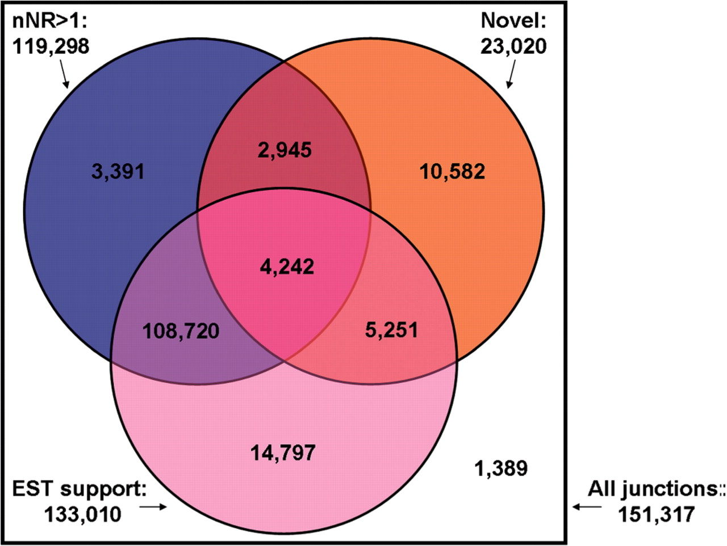
Figure 4. The Venn diagram of the distribution of redundancy, novelty and EST evidence of the junctions predicted by ...
Notes:
Figure 4. The Venn diagram of the distribution of redundancy, novelty and EST evidence of the junctions predicted by SpliceMap. Only 1389 known junctions are with single non-redundant read and not supported by EST evidence.
Unless provided in the caption above, the following copyright applies to the content of this slide: © The Author(s) 2010. Published by Oxford University Press.This is an Open Access article distributed under the terms of the Creative Commons Attribution Non-Commercial License (http://creativecommons.org/licenses/by-nc/2.5), which permits unrestricted non-commercial use, distribution, and reproduction in any medium, provided the original work is properly cited.

Slide 5
Figure 5. Filtering by paired-end information. The top two tracks are the results from single-end SpliceMap and ...
Notes:
Figure 5. Filtering by paired-end information. The top two tracks are the results from single-end SpliceMap and paired-end SpliceMap before nUP, nDOWN and nUM filtering, respectively. The known junctions detected are in black and the novel ones in red. Single read analysis predicts several junctions that are very long and jump across genes. These are false positive results and the paired-end information helps to remove them.
Unless provided in the caption above, the following copyright applies to the content of this slide: © The Author(s) 2010. Published by Oxford University Press.This is an Open Access article distributed under the terms of the Creative Commons Attribution Non-Commercial License (http://creativecommons.org/licenses/by-nc/2.5), which permits unrestricted non-commercial use, distribution, and reproduction in any medium, provided the original work is properly cited.

