Slide 1
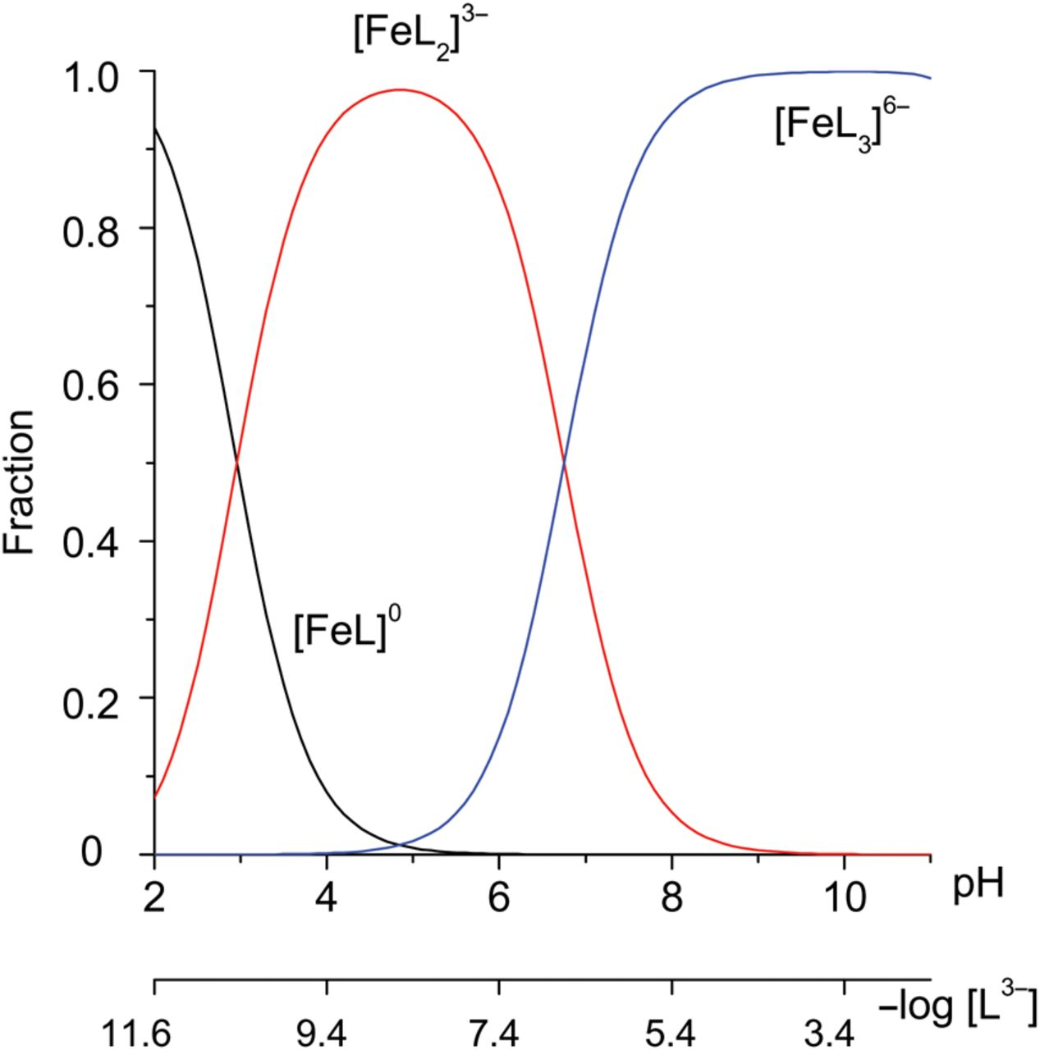
(3) pK Values of 5-Sulfosalicylic Acid and log β for ISC I = 0.05 at 25°C. Figure 1.The fraction diagram of ISC ...
Notes:
(3) pK Values of 5-Sulfosalicylic Acid and log β for ISC I = 0.05 at 25°C. Figure 1.The fraction diagram of ISC as a function of pH and –log [L3−]. I = 0.0500. This figure is available in black and white in print and in color at JCS online.
Unless provided in the caption above, the following copyright applies to the content of this slide: © The Author 2016. Published by Oxford University Press. All rights reserved. For Permissions, please email: journals.permissions@oup.com

Slide 2
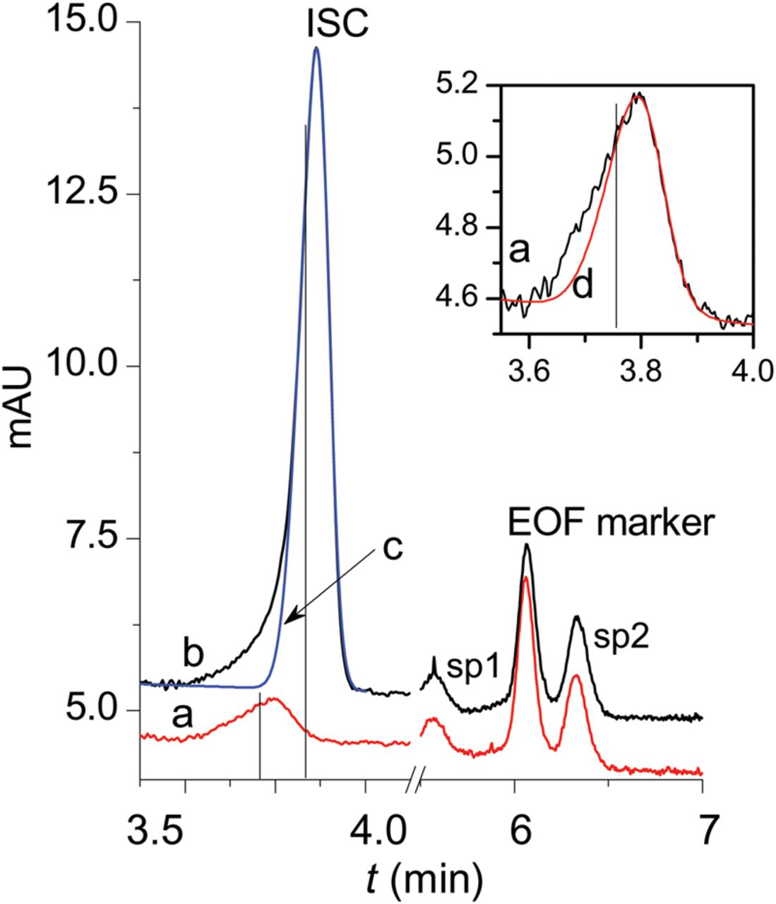
Figure 2. (a, b) The shift of the ISC peak with increasing the analyte concentration and (c, d) ISC peaks fitted the ...
Notes:
Figure 2. (a, b) The shift of the ISC peak with increasing the analyte concentration and (c, d) ISC peaks fitted the HVL function. CL0/CM0 is (a, d) 100 and (b, c) 10. The insert shows an extension of the ISC peak fitted with the HVL function for CL0/CM0 is 100. The vertical lines indicate migration time obtained as the parameters a1 of the HVL function. BGE: 1.6 mM H3L, 2.1 mM KH2L, 15.4 mM K2HL, pH 2.803. U = −20 kV. sp1 and sp2 are the system peaks. This figure is available in black and white in print and in color at JCS online.
Unless provided in the caption above, the following copyright applies to the content of this slide: © The Author 2016. Published by Oxford University Press. All rights reserved. For Permissions, please email: journals.permissions@oup.com

Slide 3
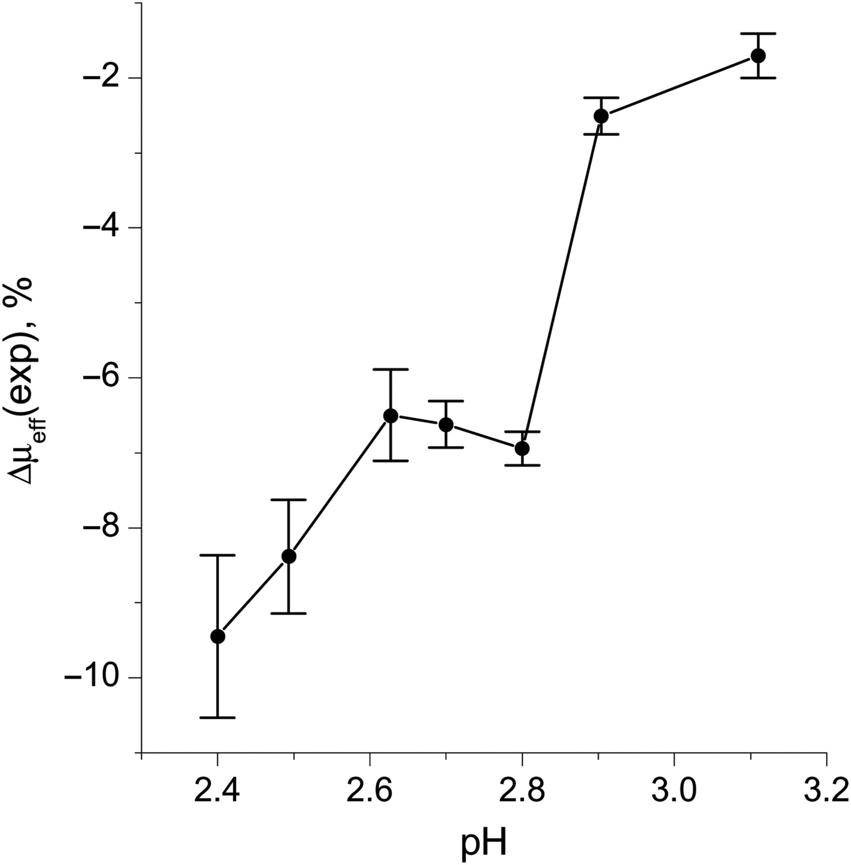
(32) The dependence of the relative difference of electrophoretic mobilities on pH of the BGE.
Notes:
(32) The dependence of the relative difference of electrophoretic mobilities on pH of the BGE.
Unless provided in the caption above, the following copyright applies to the content of this slide: © The Author 2016. Published by Oxford University Press. All rights reserved. For Permissions, please email: journals.permissions@oup.com

Slide 4
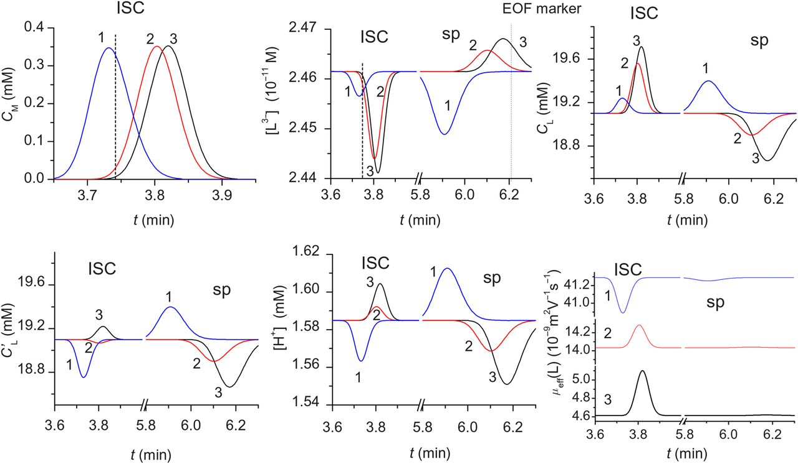
Figure 4. The simulated electropherograms of ISC with CL0/CM0=10. μ(HL²⁻), μ(H₂L⁻) ...
Notes:
Figure 4. The simulated electropherograms of ISC with CL0/CM0=10. μ(HL2−), μ(H2L−) (10−9 m2 V−1 s−1) are (1) 44 and 30, (2) 15 and 10, and (3) 5 and 3. The dashed lines indicate theoretical top peak positions for the ISC and EOF marker. Nslice = 82,000. leff = 40 cm. μeof= 26·10−9 m2 V−1 s−1. BGE: 1.6 mM H3L, 2.1 mM KH2L, 15.4 mM K2HL, pH 2.803. U = −20 kV. This figure is available in black and white in print and in color at JCS online.
Unless provided in the caption above, the following copyright applies to the content of this slide: © The Author 2016. Published by Oxford University Press. All rights reserved. For Permissions, please email: journals.permissions@oup.com

Slide 5
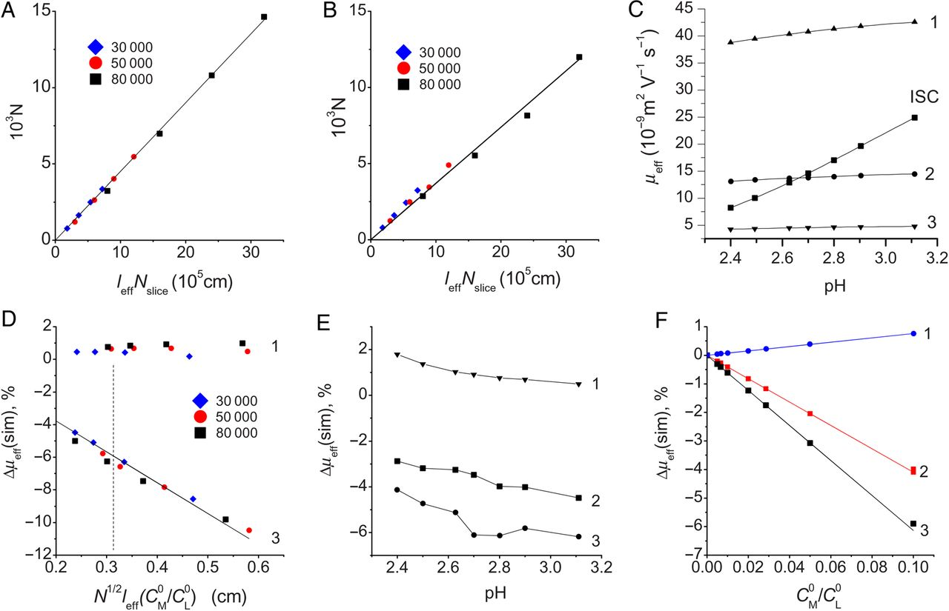
(33) The dependences of theoretical plate numbers on l_{eff}·N_{slice} for μ(HL²⁻), ...
Notes:
(33) The dependences of theoretical plate numbers on leff·Nslice for μ(HL2−), μ(H2L−) (10−9 m2 V−1 s−1) are (A) 44 and 30, (B) 5 and 3. (C) The ISC and ligand effective electrophoretic mobilities as a рН function. The dependences of Δμeff(sim) on (D) N/leff×CM0/CL0, on (E) pH and on (F) CM0/CL0 for the constant N/leff (BGE as in Figure 1). Signs (1)–(3) are as in Figure 4. The legends indicate the slice number. The dashed line in D indicates the value satisfying the experimental conditions: N = 16,400, leff= 40 cm, CL0/CM0=10. This figure is available in black and white in print and in color at JCS online.
Unless provided in the caption above, the following copyright applies to the content of this slide: © The Author 2016. Published by Oxford University Press. All rights reserved. For Permissions, please email: journals.permissions@oup.com

