Slide 1
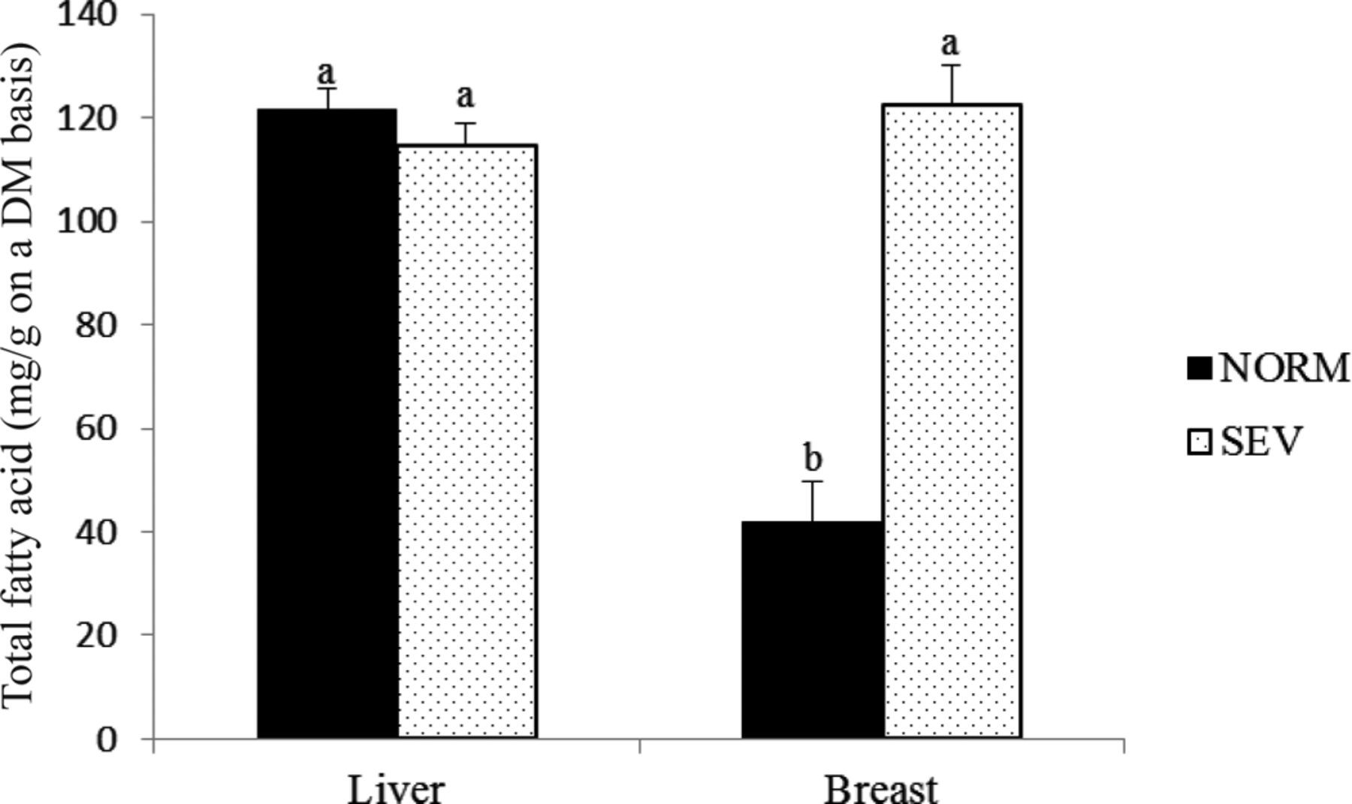
Figure 1 Fatty acid content in liver (n = 5) and breast (n = 5) muscle samples collected from broilers exhibiting ...
Notes:
Figure 1 Fatty acid content in liver (n = 5) and breast (n = 5) muscle samples collected from broilers exhibiting normal or severe degree of white striping in breast fillets. NORM = normal (no white striping); SEV = severe degree of white striping. a,bMeans with different letters are significantly different (P < 0.05).
Unless provided in the caption above, the following copyright applies to the content of this slide: © 2013 Poultry Science Association Inc.

