Slide 1
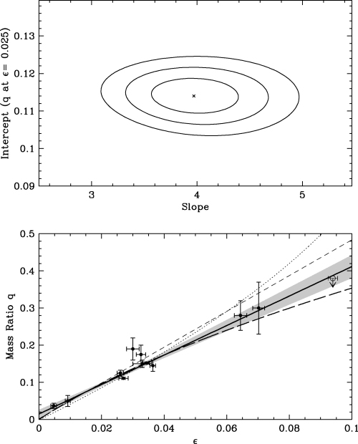
Figure 1 Calibration of the q−ε relation for superhumping CVs. Top panel: constraints on the slope and intercept of ...
Notes:
Figure 1 Calibration of the q−ε relation for superhumping CVs. Top panel: constraints on the slope and intercept of the preferred linear calibration. The cross marks the best-fitting parameter combination. The ellipses correspond to 1σ, 2σ and 3σ contours on both parameters jointly. Bottom panel: mass ratio versus period excess for the calibrating stars. The thick solid line is the best-fitting linear calibration, with the shaded area marking the statistical 1σ range. The thick long-dashed line shows P05's calibration, the thin dotted line is Pearson's (2006) calibration, and the thin short-dashed line is the calibration of Goodchild & Ogilvie (2006). The data point shown as a thin open symbol shows the upper limit on the mass ratio of BB Dor proposed by P05.
Unless provided in the caption above, the following copyright applies to the content of this slide: © 2006 The Authors. Journal compilation © 2006 RASThis article is published and distributed under the terms of the Oxford University Press, Standard Journals Publication Model (https://academic.oup.com/journals/pages/open_access/funder_policies/chorus/standard_publication_model)

Slide 2
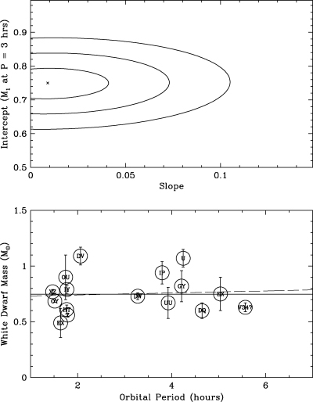
Figure 2 Constraints on white dwarf mass evolution with orbital period. Top panel: results of a linear fit to ...
Notes:
Figure 2 Constraints on white dwarf mass evolution with orbital period. Top panel: results of a linear fit to MWD versus Porb for eclipsing systems with well-determined white dwarf mass. The cross marks the best-fitting parameter combination. The ellipses correspond to 1σ, 2σ and 3σ contours on both parameters jointly. Bottom panel: MWD versus Porb for eclipsers. The thick solid line shows the optimally estimate mean white dwarf mass for all systems: MWD= 0.75 ± 0.05 M⊙ The thin dashed line shows the best linear fit to the data.
Unless provided in the caption above, the following copyright applies to the content of this slide: © 2006 The Authors. Journal compilation © 2006 RASThis article is published and distributed under the terms of the Oxford University Press, Standard Journals Publication Model (https://academic.oup.com/journals/pages/open_access/funder_policies/chorus/standard_publication_model)

Slide 3
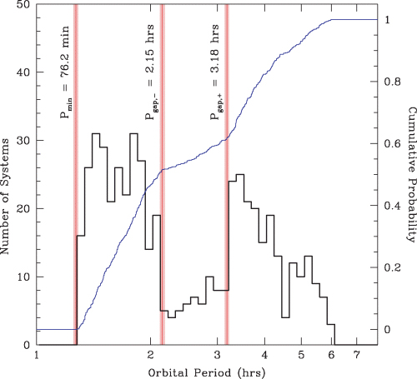
Figure 4 Differential and cumulative orbital period distribution of CVs, based on data taken from Edition 7.6 of the ...
Notes:
Figure 4 Differential and cumulative orbital period distribution of CVs, based on data taken from Edition 7.6 of the Ritter & Kolb (2003) catalogue. Our adopted values for the minimum period and the period gap edges are shown as vertical lines. The shaded regions around them indicate our estimate of the errors on these values.
Unless provided in the caption above, the following copyright applies to the content of this slide: © 2006 The Authors. Journal compilation © 2006 RASThis article is published and distributed under the terms of the Oxford University Press, Standard Journals Publication Model (https://academic.oup.com/journals/pages/open_access/funder_policies/chorus/standard_publication_model)

Slide 4
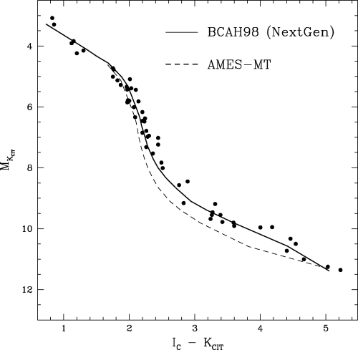
Figure 5 The I−K colour–magnitude diagram for the solar-metallicity main-sequence sample. The solid line shows the ...
Notes:
Figure 5 The I−K colour–magnitude diagram for the solar-metallicity main-sequence sample. The solid line shows the 5-Gyr BCAH98 isochrone, which is based on the NextGen atmosphere models of Hauschildt et al. (1999). The dashed line corresponds to a 5-Gyr isochrone based on a later version of these models (AMES-MT), which makes use of an updated TiO line list (Allard, Hauschildt & Schwenke 2000). Note that the BCAH98 models actually provide a much better match to the data.
Unless provided in the caption above, the following copyright applies to the content of this slide: © 2006 The Authors. Journal compilation © 2006 RASThis article is published and distributed under the terms of the Oxford University Press, Standard Journals Publication Model (https://academic.oup.com/journals/pages/open_access/funder_policies/chorus/standard_publication_model)

Slide 5
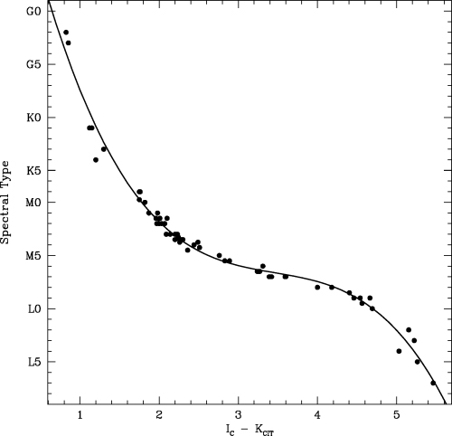
Figure 6 The spectral type versus (I−K) relation for the solar-metallicity main-sequence sample. The line shows the ...
Notes:
Figure 6 The spectral type versus (I−K) relation for the solar-metallicity main-sequence sample. The line shows the third-order polynomial fit given by equation (12).
Unless provided in the caption above, the following copyright applies to the content of this slide: © 2006 The Authors. Journal compilation © 2006 RASThis article is published and distributed under the terms of the Oxford University Press, Standard Journals Publication Model (https://academic.oup.com/journals/pages/open_access/funder_policies/chorus/standard_publication_model)

Slide 6
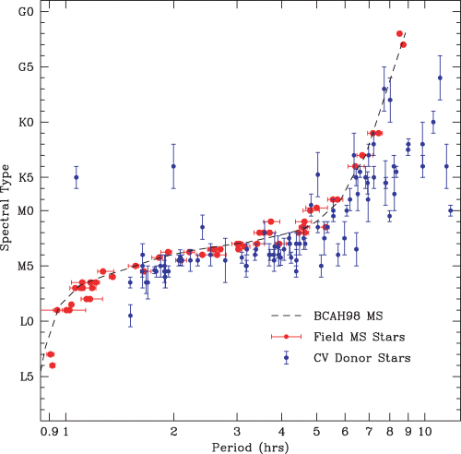
Figure 7 The empirical spectral type–orbital period relation for CVs and main-sequence stars. Blue points are CV ...
Notes:
Figure 7 The empirical spectral type–orbital period relation for CVs and main-sequence stars. Blue points are CV donors from Table 2 and red points are MS stars. The dashed line is the relation predicted by the 5-Gyr BCAH98 isochrone, with the SpT(I−K) calibration given by equation (12).
Unless provided in the caption above, the following copyright applies to the content of this slide: © 2006 The Authors. Journal compilation © 2006 RASThis article is published and distributed under the terms of the Oxford University Press, Standard Journals Publication Model (https://academic.oup.com/journals/pages/open_access/funder_policies/chorus/standard_publication_model)

Slide 7
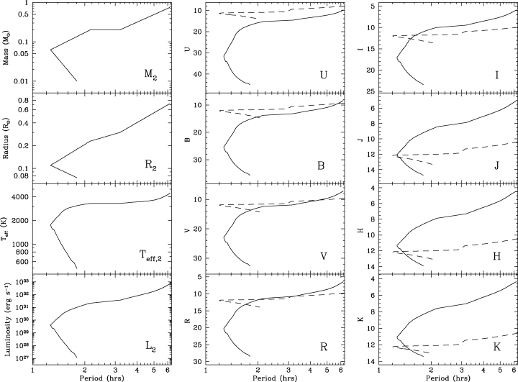
Figure 8 Physical and photometric parameters along the CV donor sequence. In the left-hand column, we show the ...
Notes:
Figure 8 Physical and photometric parameters along the CV donor sequence. In the left-hand column, we show the physical donor parameters (M2, Teff,2, R2 and L2) as a function of orbital period. In the middle column, the solid lines show the optical absolute magnitudes (MU, MB, MV and MR) as a function of Porb. Finally, in the right-hand column, the solid lines correspond to the red optical and near-infrared absolute magnitudes (MI, MJ, MH and MK). In the middle and right-hand columns, we also show estimates of the absolute magnitude sequences expected for the accretion-heated white dwarfs in CVs (dashed lines); see text for details.
Unless provided in the caption above, the following copyright applies to the content of this slide: © 2006 The Authors. Journal compilation © 2006 RASThis article is published and distributed under the terms of the Oxford University Press, Standard Journals Publication Model (https://academic.oup.com/journals/pages/open_access/funder_policies/chorus/standard_publication_model)

Slide 8
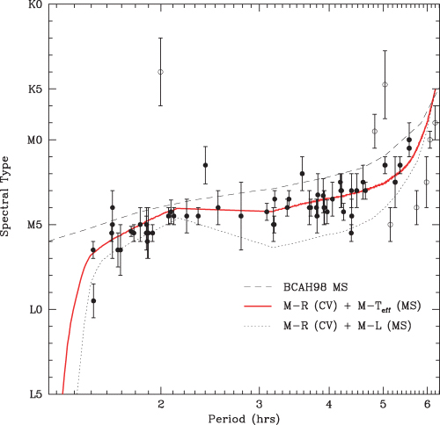
Figure 9 Observed versus predicted spectral types of CV donors. Points correspond to empirically determined SpTs for ...
Notes:
Figure 9 Observed versus predicted spectral types of CV donors. Points correspond to empirically determined SpTs for CVs with Porb≲ 6 h, taken from Table 2. Likely evolved donors are shown as open symbols and were excluded from the statistics quoted in the text. The solid red line shows the SpT (Porb) relation predicted by the semi-empirical donor sequence. The dashed line shows the relation predicted by the BCAH98 5-Gyr isochrone. The dotted line shows the relation that would be obtained if CV donors obeyed the MS mass–luminosity relation, rather than the MS mass–effective temperature relation.
Unless provided in the caption above, the following copyright applies to the content of this slide: © 2006 The Authors. Journal compilation © 2006 RASThis article is published and distributed under the terms of the Oxford University Press, Standard Journals Publication Model (https://academic.oup.com/journals/pages/open_access/funder_policies/chorus/standard_publication_model)

Slide 9
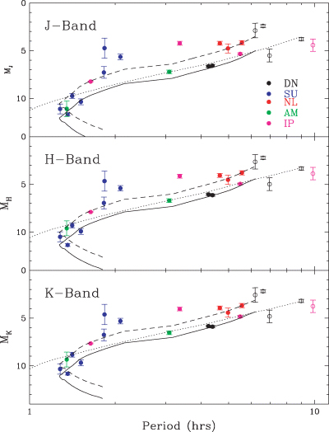
Figure 10 Infrared absolute magnitudes of CVs as a function of P_{orb}. Points correspond to absolute ...
Notes:
Figure 10 Infrared absolute magnitudes of CVs as a function of Porb. Points correspond to absolute magnitudes for CVs with trigonometric parallaxes and reliable 2MASS observations (Table 4). Colours correspond to various CV subtypes, as indicated (DN = dwarf nova; SU = SU UMa star; NL = non-magnetic nova-like; AM = AM Her star; IP = intermediate polar). Systems with Porb > 6 h are shown as open symbols. Solid lines show the tracks predicted by the semi-empirical donor sequence, and dotted lines show the tracks corresponding to the BCAH98 5-Gyr isochrone. The dashed lines show the CV donor tracks offset by the average offset between the data points and the pure donor predictions; see text for details.
Unless provided in the caption above, the following copyright applies to the content of this slide: © 2006 The Authors. Journal compilation © 2006 RASThis article is published and distributed under the terms of the Oxford University Press, Standard Journals Publication Model (https://academic.oup.com/journals/pages/open_access/funder_policies/chorus/standard_publication_model)

