Slide 1
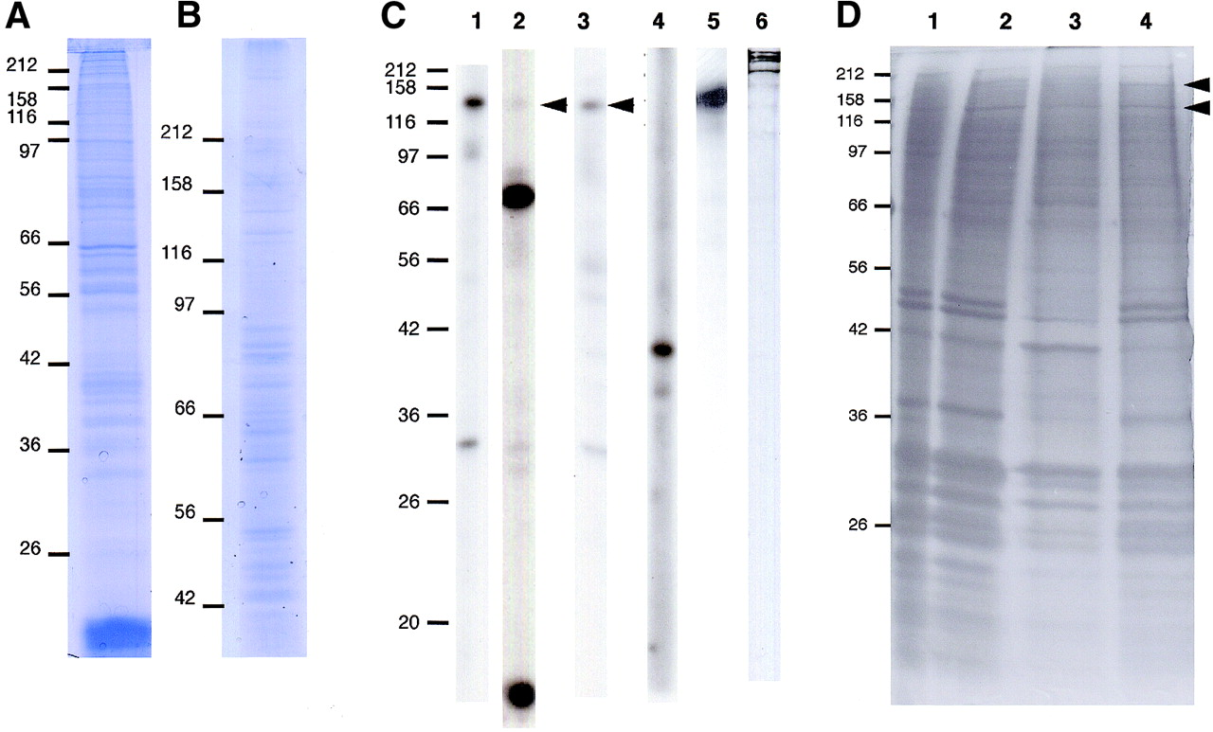
Figure 1. Preparation of chromosome scaffold fractions from colcemid‐treated HeLa S3 cells. Proteins were ...
Notes:
Figure 1. Preparation of chromosome scaffold fractions from colcemid‐treated HeLa S3 cells. Proteins were separated by 12.5% (A) and 7.5% (B) SDS–PAGE and gels stained with Coomassie Blue. Apparent molecular masses are shown in kDa on the left. (C) Immunoblot characterisation of the partially‐extracted chromosome scaffold fraction. After SDS–PAGE, proteins were transferred to a nitrocellulose membrane and strips of the same membrane were hybridised with antibodies as follows: lane 1, anti‐INCENP; lane 2, anti‐centromere antibodies (ACA); lane 3, anti‐CENP‐C; lane 4, anti‐Aurora B; lane 5, anti‐ScII; lane 6, MPM‐2 monoclonal. Arrowheads indicate the CENP‐C polypeptide recognised by the ACA and the CENP‐C‐specific antibody. Apparent molecular masses are shown in kDa on the left. (D) Comparison of scaffold fractions resulting from extraction under different conditions. A 12.5% polyacrylamide gel was silver stained after separation of proteins by electrophoresis. To control for protein loading, different cell equivalents were used as follows: lane 1, total chromosomes from 106 cells; lane 2, partially‐extracted chromosome scaffold prepared as described in this paper from 5 × 106 cells; lane 3, chromosome scaffolds extracted by dextran sulphate‐heparin as described (36) from 12.5 × 106 cells; lane 4, chromosome scaffolds extracted by NaCl as described (36) from 12.5 × 106 cells. Arrowheads indicate the two abundant protein bands typically found in chromosome scaffolds, ScI and ScII. Apparent molecular masses are shown in kDa on the left.
Unless provided in the caption above, the following copyright applies to the content of this slide:

Slide 2
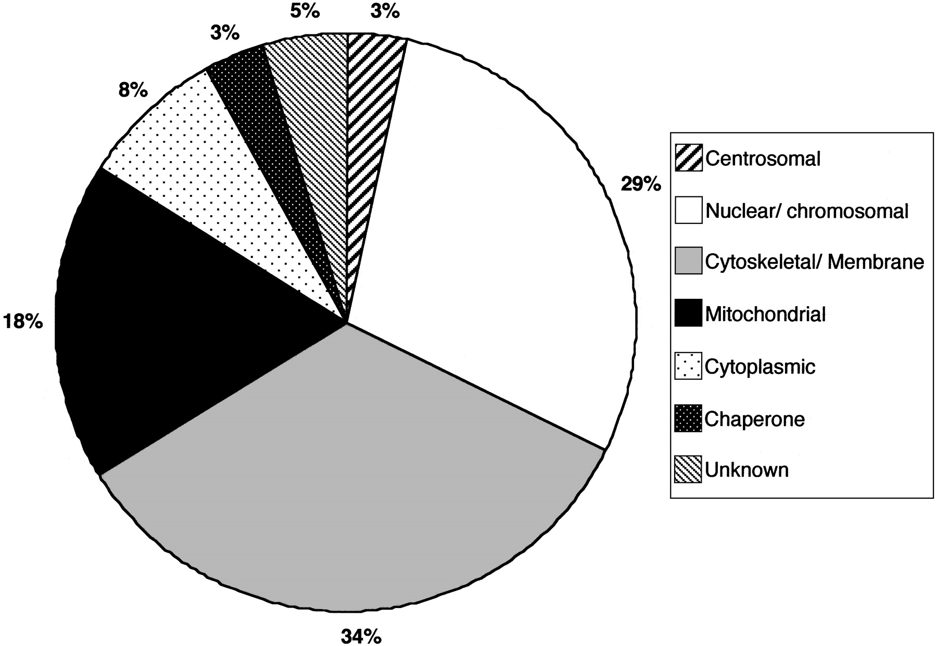
Figure 2. Putative subcellular distribution of 62 proteins identified by MALDI‐TOF in the extracted ...
Notes:
Figure 2. Putative subcellular distribution of 62 proteins identified by MALDI‐TOF in the extracted chromosome fraction. Only one localisation was given for any one protein. Table 1 lists these proteins and their individual assignations to a subcellular localisation.
Unless provided in the caption above, the following copyright applies to the content of this slide:

Slide 3
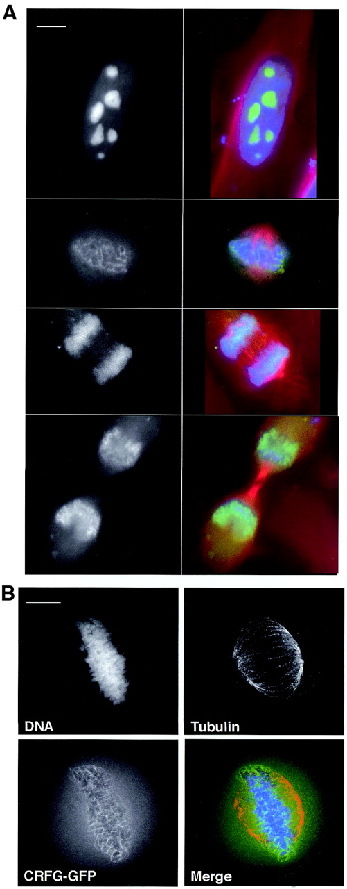
Figure 3. Localisation of NGB/CRFG as a chromosomal protein in mitosis. (A) 10⁵ HeLa JW cells were ...
Notes:
Figure 3. Localisation of NGB/CRFG as a chromosomal protein in mitosis. (A) 105 HeLa JW cells were transiently transfected with 2 µg pEGFP‐C1‐CRFG. Cells were fixed 24 h after transfection as described, and were immunostained for α‐tubulin and stained with DAPI. Cells in interphase and in different stages of mitosis are shown. Black‐and‐white images show GFP‐CRFG staining, which is shown in green in the merged images. Tubulin staining is shown in red and DNA in blue. Images are of single focal planes. Scale bar is 10 µm. (B) Deconvolved image of a transfected cell in metaphase to show the perichromosomal localisation of the GFP‐CRFG signal more clearly. Separate channels are shown as indicated and the merged image uses the same colour scheme as in (A).
Unless provided in the caption above, the following copyright applies to the content of this slide:

Slide 4
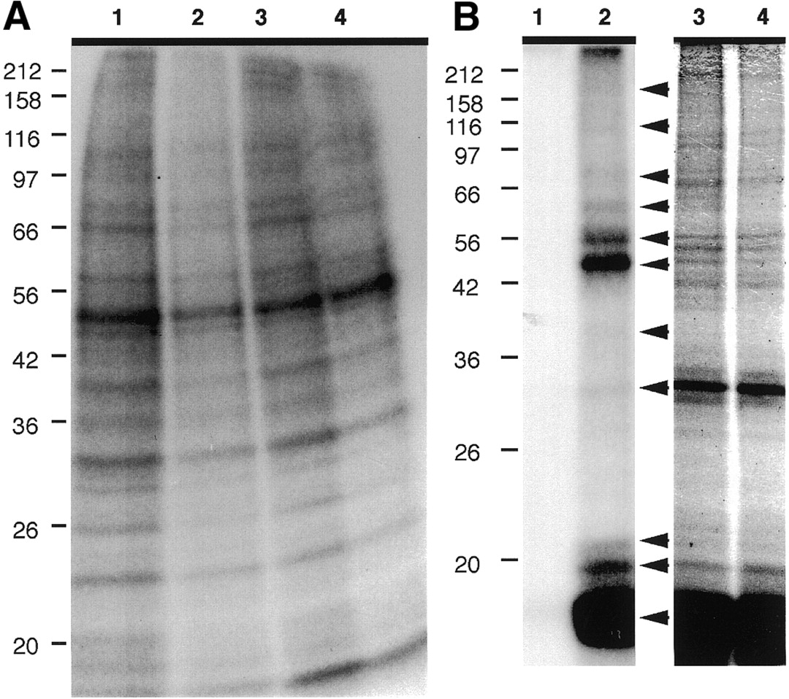
Figure 4. (A) Assay for kinase activity in chromosome scaffold fraction. Lanes 1–4 show autoradiographic ...
Notes:
Figure 4. (A) Assay for kinase activity in chromosome scaffold fraction. Lanes 1–4 show autoradiographic image of an SDS–polyacrylamide gel used to separate proteins after chromosomes in kinase buffers 1–4, respectively, were incubated with [γ‐32P]dATP and then extracted. Apparent molecular masses are shown in kDa on the left. (B) Assay for Aurora B kinase substrates in chromosome scaffold fraction. Chromosomes were heat‐treated and then incubated in the presence of [γ‐32P]dATP without (lanes 1 and 3) or with (lanes 2 and 4) recombinant Aurora B and extracted before being subjected to SDS–PAGE. Lanes 1 and 2 show an autoradiographic image of a 12.5% gel and lanes 3 and 4 show the same gel stained with Coomassie Blue. Arrowheads indicate phosphorylated proteins and apparent molecular masses are shown in kDa on the left.
Unless provided in the caption above, the following copyright applies to the content of this slide:

Slide 5
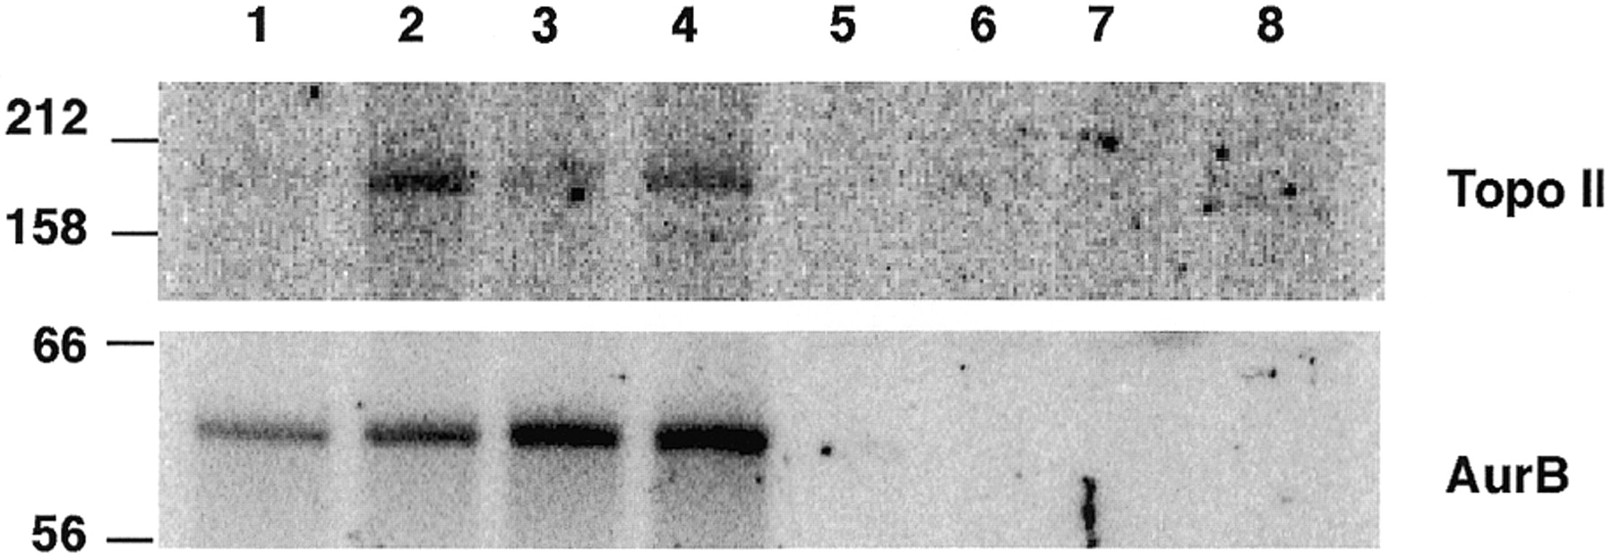
Figure 5. Confirmation of topo IIα as an Aurora B substrate in vitro, showing an autoradiograph of an ...
Notes:
Figure 5. Confirmation of topo IIα as an Aurora B substrate in vitro, showing an autoradiograph of an SDS–polyacrylamide gel on which recombinant, heat‐treated topo IIα was resolved following incubation with wild‐type GST‐Aurora B (lanes 1–4) or GST‐Aurora B K106R (lanes 5–8) in kinase buffer 1 (lanes 1 and 5), kinase buffer 2 (lanes 2 and 6), kinase buffer 3 (lanes 3 and 7) or kinase buffer 4 (lanes 4 and 8). Apparent molecular masses are shown in kDa on the left.
Unless provided in the caption above, the following copyright applies to the content of this slide:

Slide 6
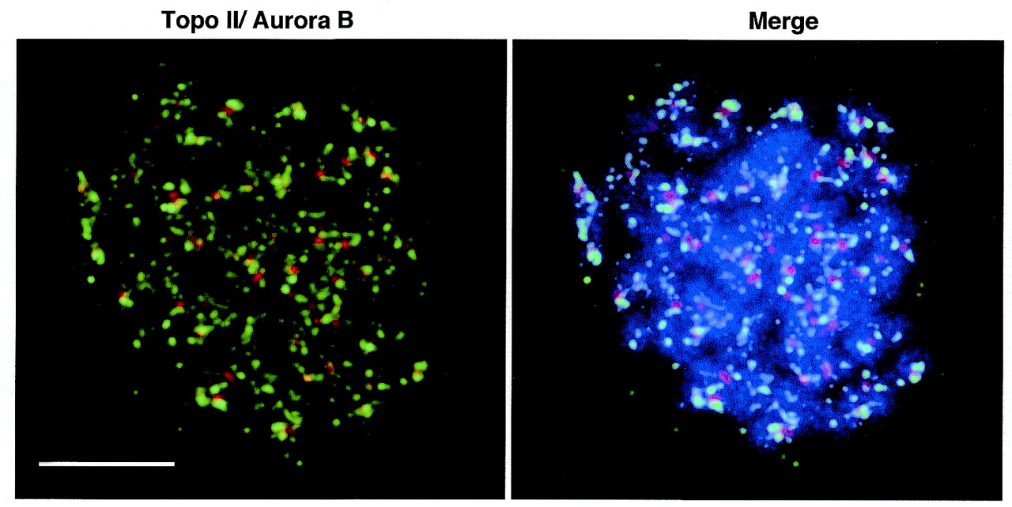
Figure 6. Immunofluorescence localisation of topo IIα and Aurora B. Colcemid‐treated, hypotonically swollen ...
Notes:
Figure 6. Immunofluorescence localisation of topo IIα and Aurora B. Colcemid‐treated, hypotonically swollen HeLa S3 cells were spread and immunostained as described. Deconvolved images show staining for topoisomerase II (green) and Aurora B (red). DNA is shown in blue. Scale bar is 5 µm.
Unless provided in the caption above, the following copyright applies to the content of this slide:

