Slide 1
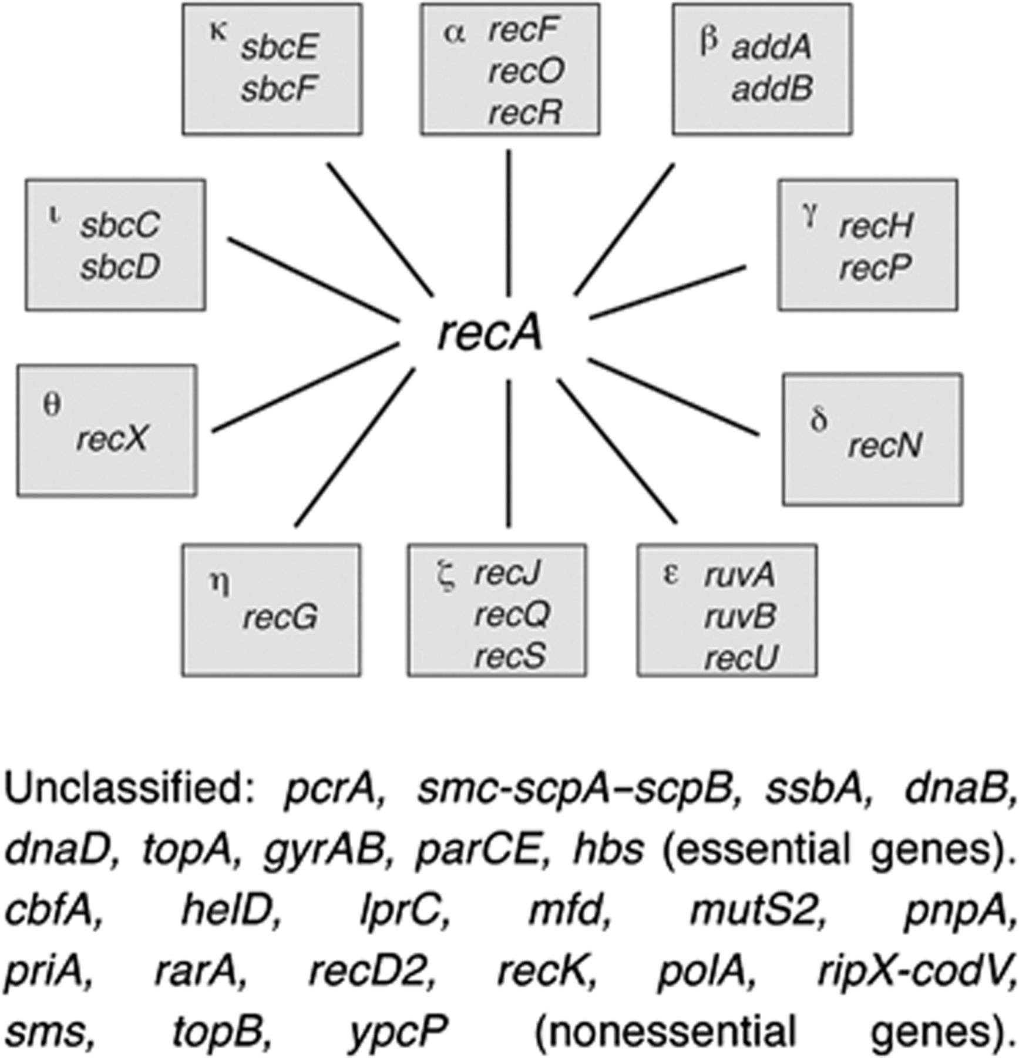
Figure 1 Schematic grouping of Bacillus subtilis RecA-dependent DNA recombinational repair genes into different ...
Notes:
Figure 1 Schematic grouping of Bacillus subtilis RecA-dependent DNA recombinational repair genes into different epistatic groups. Because a recA mutation is epistatic with any representative mutation in the different epistatic groups (α–κ), it was placed in the center. The set of as yet unclassified essential or nonessential genes also involved in RecA-dependent or RecA-independent DNA repair are presented.
Unless provided in the caption above, the following copyright applies to the content of this slide: © 2011 Federation of European Microbiological Societies.

Slide 2
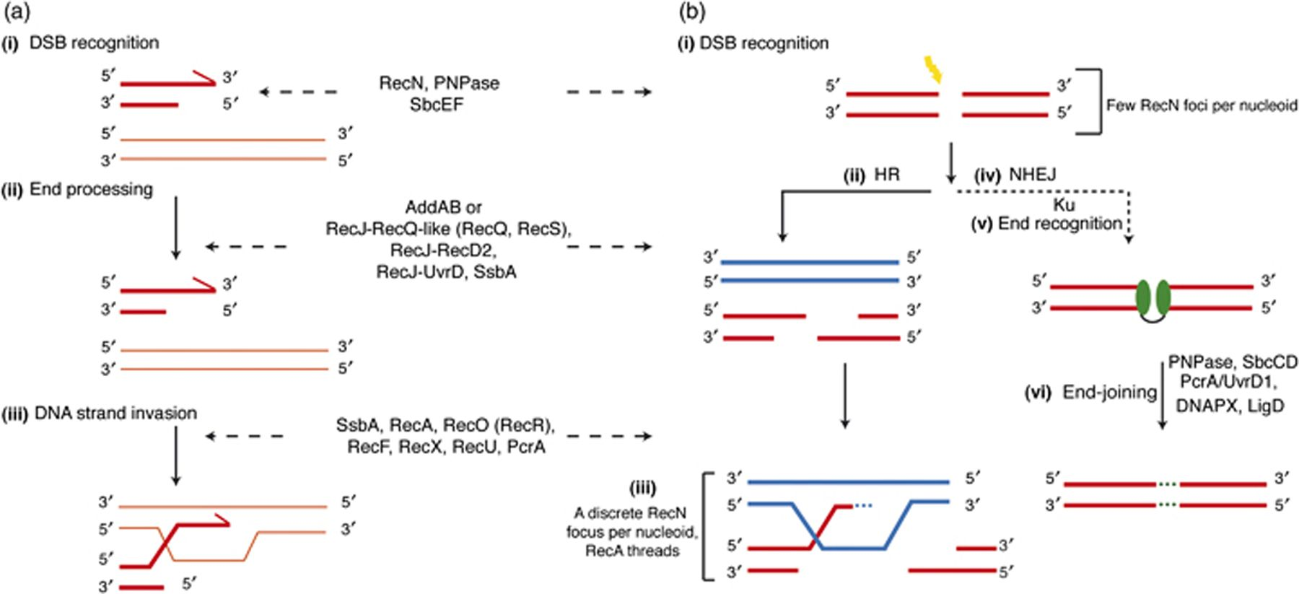
Figure 2 Early steps of DSB repair in Bacillus subtilis. (a) A physical or a chemical agent introduces an ssDNA nick ...
Notes:
Figure 2 Early steps of DSB repair in Bacillus subtilis. (a) A physical or a chemical agent introduces an ssDNA nick that collapses the replication fork, leading to one-ended DSB. This can be repaired by HR at all stages of the cell cycle. (i) The RecN protein, in concert with PNPase, recognizes damaged ends and promotes basal end processing. If the ends already have an ssDNA region, SsbA binds to them. A RecN ‘backup system’, SbcEF, is present in some bacteria. (ii) The long-range resection of the 5′-ends can be catalyzed by RecJ, in concert with a RecQ-like (RecQ or RecS) or a UvrD-like (PcrA, RecD2?) helicase, with SsbA/SSB stimulating the nuclease and helicase activities. Alternatively, long-range resection is performed by the AddAB nuclease–helicase complex (AdnAB, RecBCD), which, under some circumstances, might also load RecA directly onto naked ssDNA (e.g. RecBCDEco). (iii) RecO alone or the RecOR(F) complex promotes the disassembly of the SsbA protein and the loading of RecA onto SsbA-coated ssDNA. RecA-polymerized onto SsbA/SSB-coated ssDNA promotes the search for a homologous template. RecA modulators (RecF, RecX, PcrA/UvrD, RecU, etc.) control RecA by modulation of RecA filament extension. (b) A physical or a chemical agent (in yellow) introduces a two-ended DSB that can be repaired by HR at all stages of the cell cycle or by NHEJ that functions primarily if HR is impaired or during the stationary phase. (i) RecN, in concert with PNPase, recognizes damaged ends and tethers them, promoting commitment to HR. If the ends already have an ssDNA region, SsbA binds to them. Steps ii and iii are similar to one-ended DSB. (iv) In the absence of HR during vegetative growth or in the absence of a sister chromatid (stationary phase), the NHEJ system is activated. (v) Long-range resection is blocked and the DNA ends are tethered by the action of the homodimeric Ku protein (bridged green ovals). (vi) The ends are ligated by LigD or are processed before ligation by redundant pathways consisting of nucleases (SbcCD, PNPase or DNAP X) and a UvrD-like DNA helicase (PcrA). This step is performed by as yet poorly characterized functions. For simplicity, only the names of B. subtilis functions are described.
Unless provided in the caption above, the following copyright applies to the content of this slide: © 2011 Federation of European Microbiological Societies.

Slide 3
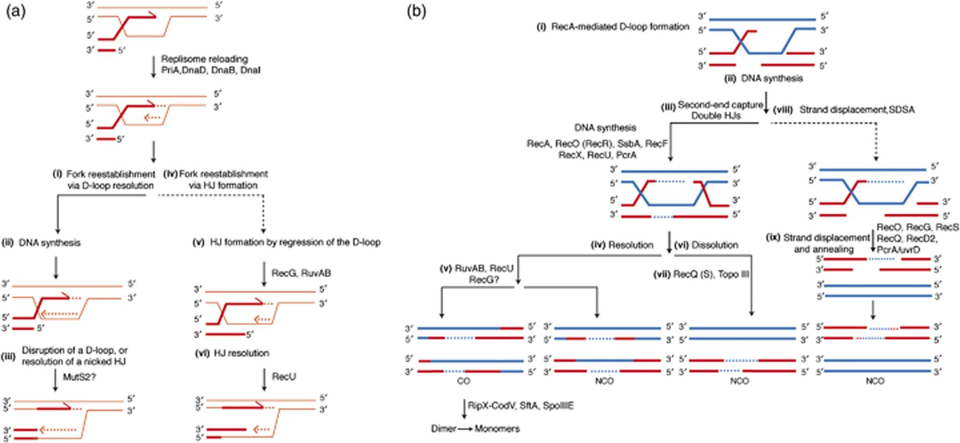
Figure 3 Late steps of DSB repair in Bacillus subtilis. (a) Repair of one-ended DSBs. RecA-mediated strand invasion ...
Notes:
Figure 3 Late steps of DSB repair in Bacillus subtilis. (a) Repair of one-ended DSBs. RecA-mediated strand invasion leads to the formation of a D-loop intermediate. The invading strand primes DNA synthesis using the intact homologous chromosome as a template to restore the lost genetic information. The replisome assembly machinery reloads the replicative helicase in the lagging strand template. In steps i–iii, replication continues up to encountering the invading strand forming an extended D-loop or a nicked HJ-like structure, which might be disrupted by MutS2 (absent in Alpha-, Beta- and Gammaproteobacteria) or any uncharacterized endonuclease. In steps iv–vi, by the action of a branch migration translocase (RecG or RuvAB), the D-loop is partially regressed to form a HJ intermediate that is resolved to a fork structure by RecU/RuvC. (b) Repair of two-ended DSBs. The steps i and ii are shared by one- and two-ended DSB repair. (iii–v) Capture of the second DNA end, derived from the other end of the DSB, by RecO (RecOR) leads to a double HJ that is branch migrated by RuvAB and resolved by RecU. The role of the RecG branch migration translocase in RecU-mediated resolution of HJs is poorly understood. Differential cleavage of the double HJs, gap filling and ligation leads to CO or NCO products. The unwanted dimers (CO products) are disentangled by SMC-Topo IV and converted into monomers by a tyrosine site-specific recombinase RipX-CodV in concert with one or two translocases (SpoIIIE or SftA). The double HJ formed in step iii could also be processed by a Topo III enzyme, in concert with a RecQ-like or a UvrD-like helicase and SsbA, by branch migration and strand decatenation that dissolve the double HJs, producing only NCO products. The 3′-invading end, extended by the replisome, can be displaced from the joint molecule and reannealed with the complementary strand of the other resected end of the break (steps viii and ix). This repair mechanism, which is termed SDSA, produces only NCO products. This putative avenue is poorly characterized in Bacteria. For simplicity, only the names of B. subtilis functions are described.
Unless provided in the caption above, the following copyright applies to the content of this slide: © 2011 Federation of European Microbiological Societies.

Slide 4
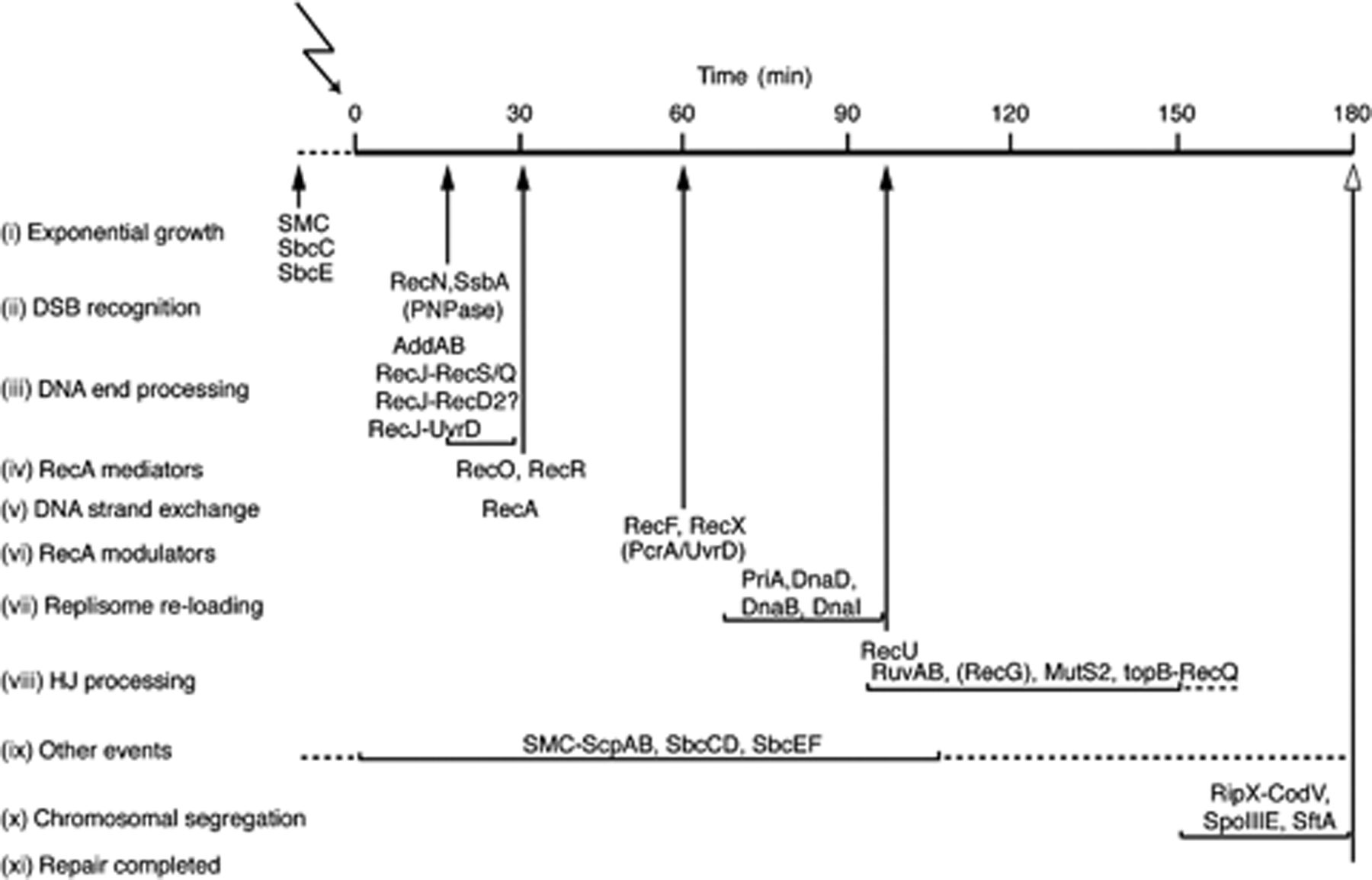
Figure 4 Temporal order of protein assembly at DSBs in Bacillus subtilis. Chromosome replication is not a continuous ...
Notes:
Figure 4 Temporal order of protein assembly at DSBs in Bacillus subtilis. Chromosome replication is not a continuous process. SMC, SbcC and SbcE form discrete foci during exponential growth (stage i). Upon induction of random one- or two-ended DSBs or a single site-specific two-ended DSB (time 0), RecN acts as a sensor and, in concert with PNPase, assembles on DNA, forming few repair centers (RCs) (stage ii). After basal resection, the 5′ ends are further resected either by the nuclease(s)–helicase(s) AddAB complex or by the RecJ ssDNA exonuclease, in concert with a RecQ-like (RecQ and/or RecS) or a UrvD-like DNA helicase (RecD2?, PcrA) in association with SsbA (stage iii). Stages ii and iii are closely related in vivo. The long-range end resection leads to SsbA binding and protection of the ssDNA and to RecN tethering of the DNA ends, leading to a discrete RC (15–30 min) and ‘DSB coordination’. Stages iv–vi are visualized by the temporal RecO, RecR and RecA recruitment (30–45 min). These proteins are directly or indirectly recruited to the RecN-promoted RC. At a later stage, RecF (min 60, stage vi) is recruited to the RecN-mediated RC and RecX modulates RecA threads (as probably PcrA/UvrD). Replisome assembly via PriA, DnaD, DnaB and DnaI might take place during 60 and 90 min after DNA damage (stage vii). The recruitment of RecU to a recombination intermediate, in the presence of RuvAB, is visualized at min 100–110 after DNA damage (stage vii). Concomitant with stages ii–viii, other processes such as SMC maintenance of the chromosome condensation and SbcCD- and SbcEF-dependent repair take place (stage ix). Once DNA replication is ended and cell division begins, the RipX-CodV/XerCD/XerS tyrosine recombinase, in concert with SpoIIIA/FtsK or SftA, resolves the accumulated dimeric chromosomes (stage x). Growth resumption in minimal medium at 22°C takes place ∼180 min upon DNA damage in wt cells.
Unless provided in the caption above, the following copyright applies to the content of this slide: © 2011 Federation of European Microbiological Societies.

