Slide 1
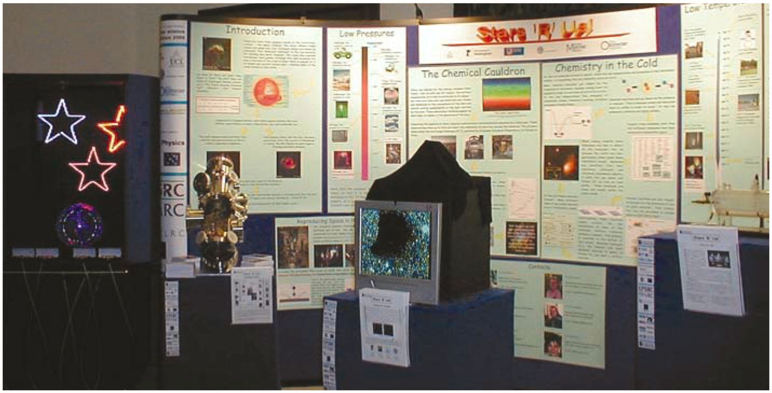
1 (right): Stars ’R’ Us! in place at the Royal Society. As well as a series of posters, it included four hands-on ...
Notes:
1 (right): Stars ’R’ Us! in place at the Royal Society. As well as a series of posters, it included four hands-on exhibits: from left to right, Seeing Stars, Reproducing Space, Seeing the Unseen and Life in a Bottle.
Unless provided in the caption above, the following copyright applies to the content of this slide:

Slide 2
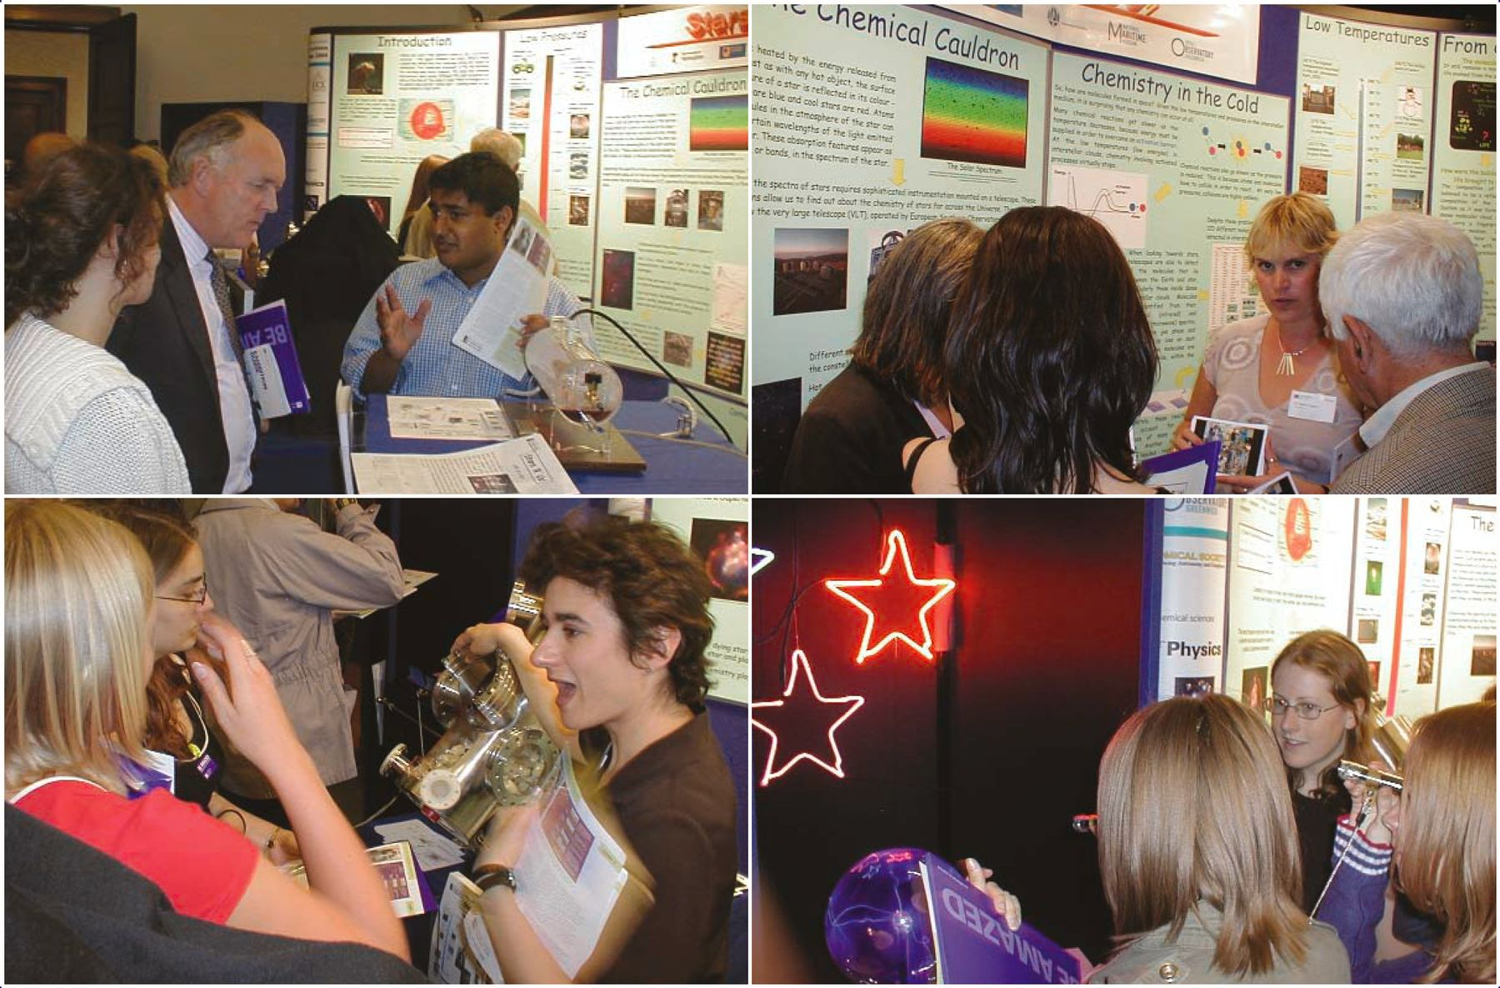
2 (below): The exhibit proved popular throughout the week.
Notes:
2 (below): The exhibit proved popular throughout the week.
Unless provided in the caption above, the following copyright applies to the content of this slide:

