Slide 1
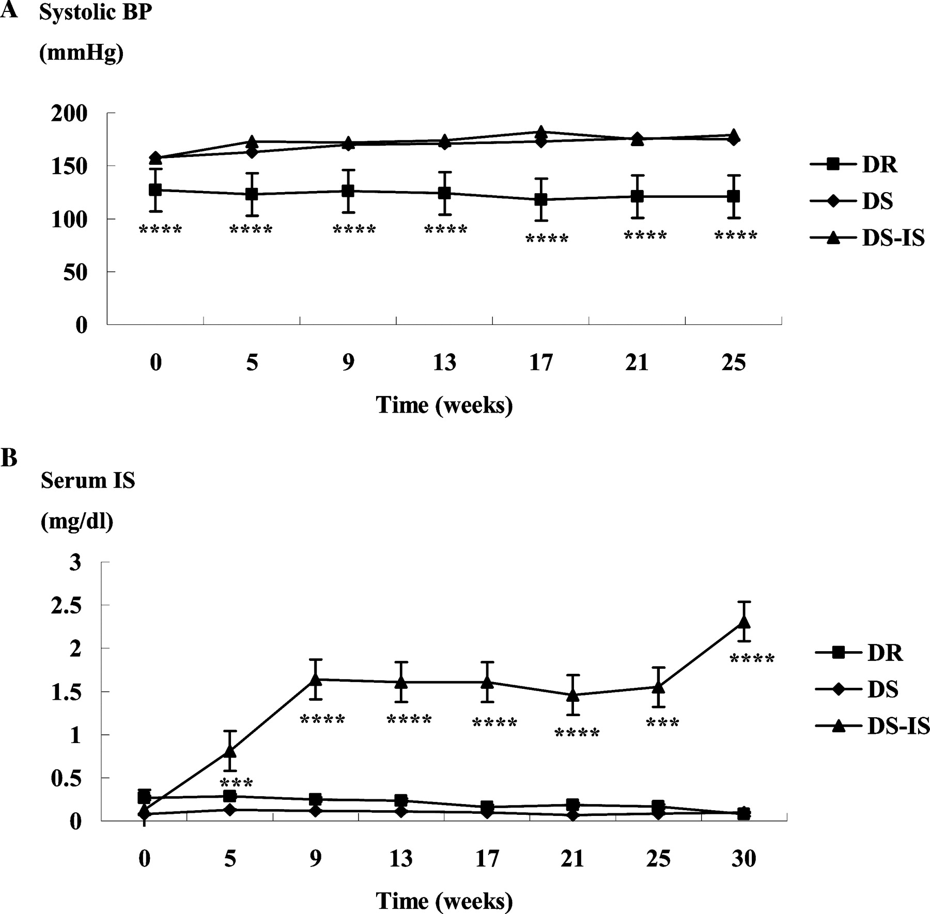
Fig. 1 Time course of systolic BP and serum IS in DR, DS and DS-IS rats. *** P < 0.001, **** P < 0.0001 vs. DS.
Notes:
Fig. 1 Time course of systolic BP and serum IS in DR, DS and DS-IS rats. *** P < 0.001, **** P < 0.0001 vs. DS.
Unless provided in the caption above, the following copyright applies to the content of this slide: © Oxford University Press 2008

Slide 2
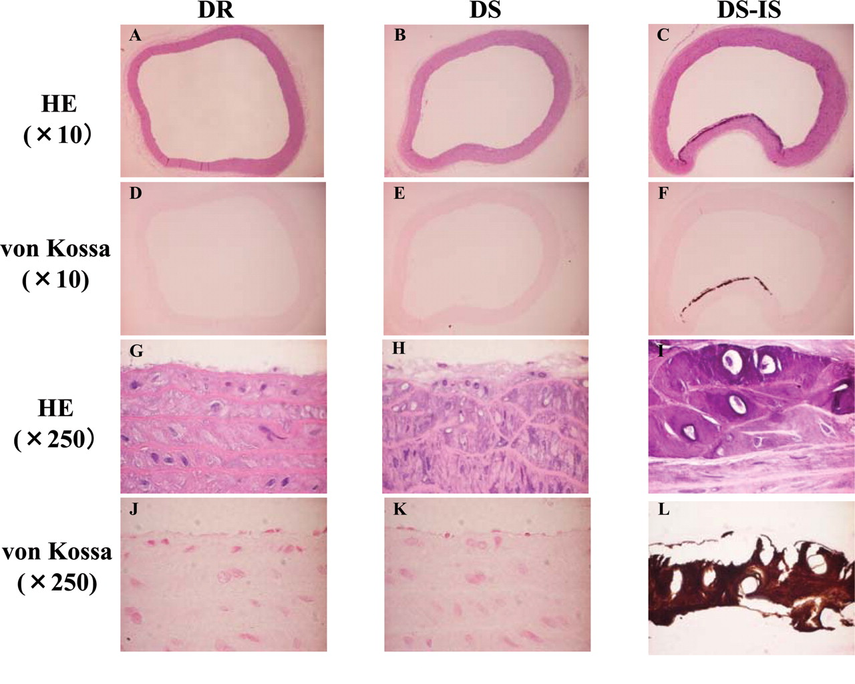
Fig. 2 H&E and von Kossa staining of arcuate aorta in DR, DS and DS-IS rats.
Notes:
Fig. 2 H&E and von Kossa staining of arcuate aorta in DR, DS and DS-IS rats.
Unless provided in the caption above, the following copyright applies to the content of this slide: © Oxford University Press 2008

Slide 3
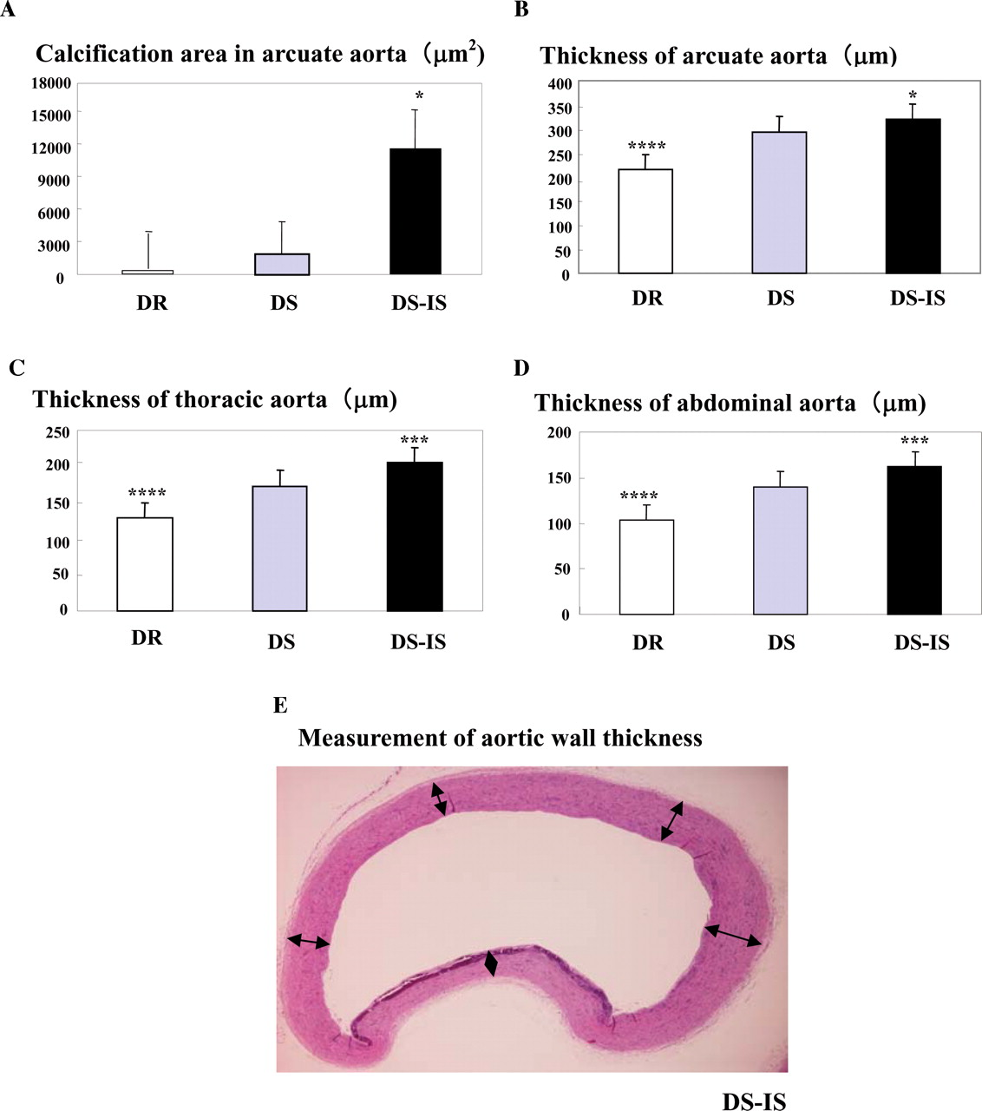
Fig. 3 Calcification area in arcuate aorta ( A ), wall thickness of the arcuate ( B ), thoracic ( C ), and ...
Notes:
Fig. 3 Calcification area in arcuate aorta ( A ), wall thickness of the arcuate ( B ), thoracic ( C ), and abdominal aortas ( D ) in DR, DS and DS-IS rats, and the measurement of aortic wall thickness ( E ). Average of five measurements was considered representative of each rat. * P < 0.05, *** P < 0.001, **** P < 0.0001 vs. DS.
Unless provided in the caption above, the following copyright applies to the content of this slide: © Oxford University Press 2008

Slide 4
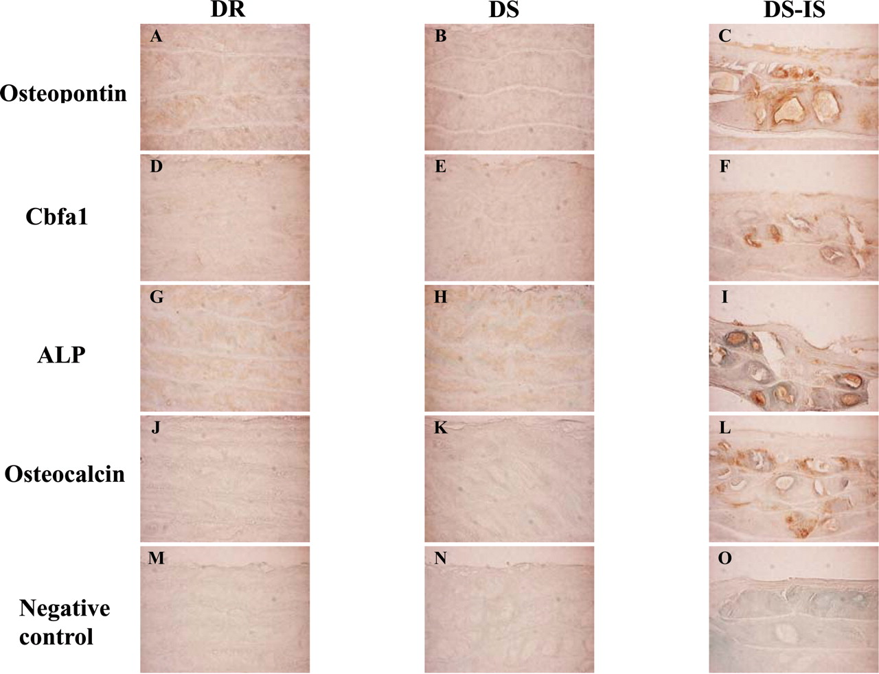
Fig. 4 Immunostaining of osteopontin, Cbfal, ALP and osteocalcin in the arcuate aorta of DR, DS and DS-IS rats ...
Notes:
Fig. 4 Immunostaining of osteopontin, Cbfal, ALP and osteocalcin in the arcuate aorta of DR, DS and DS-IS rats (×250).
Unless provided in the caption above, the following copyright applies to the content of this slide: © Oxford University Press 2008

Slide 5
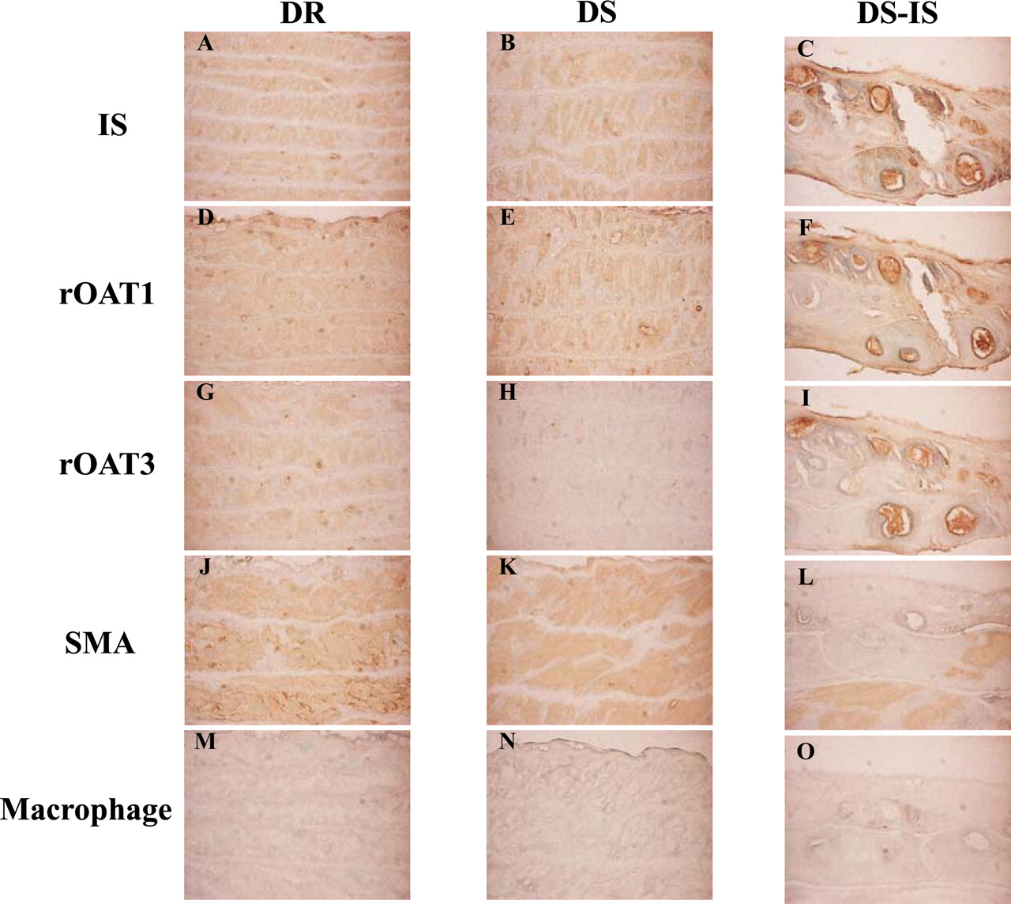
Fig. 5 Immunostaining of IS, rOATl, rOAT3, SMA and macrophages in the arcuate aorta of DR, DS and DS-IS rats ...
Notes:
Fig. 5 Immunostaining of IS, rOATl, rOAT3, SMA and macrophages in the arcuate aorta of DR, DS and DS-IS rats (×250).
Unless provided in the caption above, the following copyright applies to the content of this slide: © Oxford University Press 2008

Slide 6
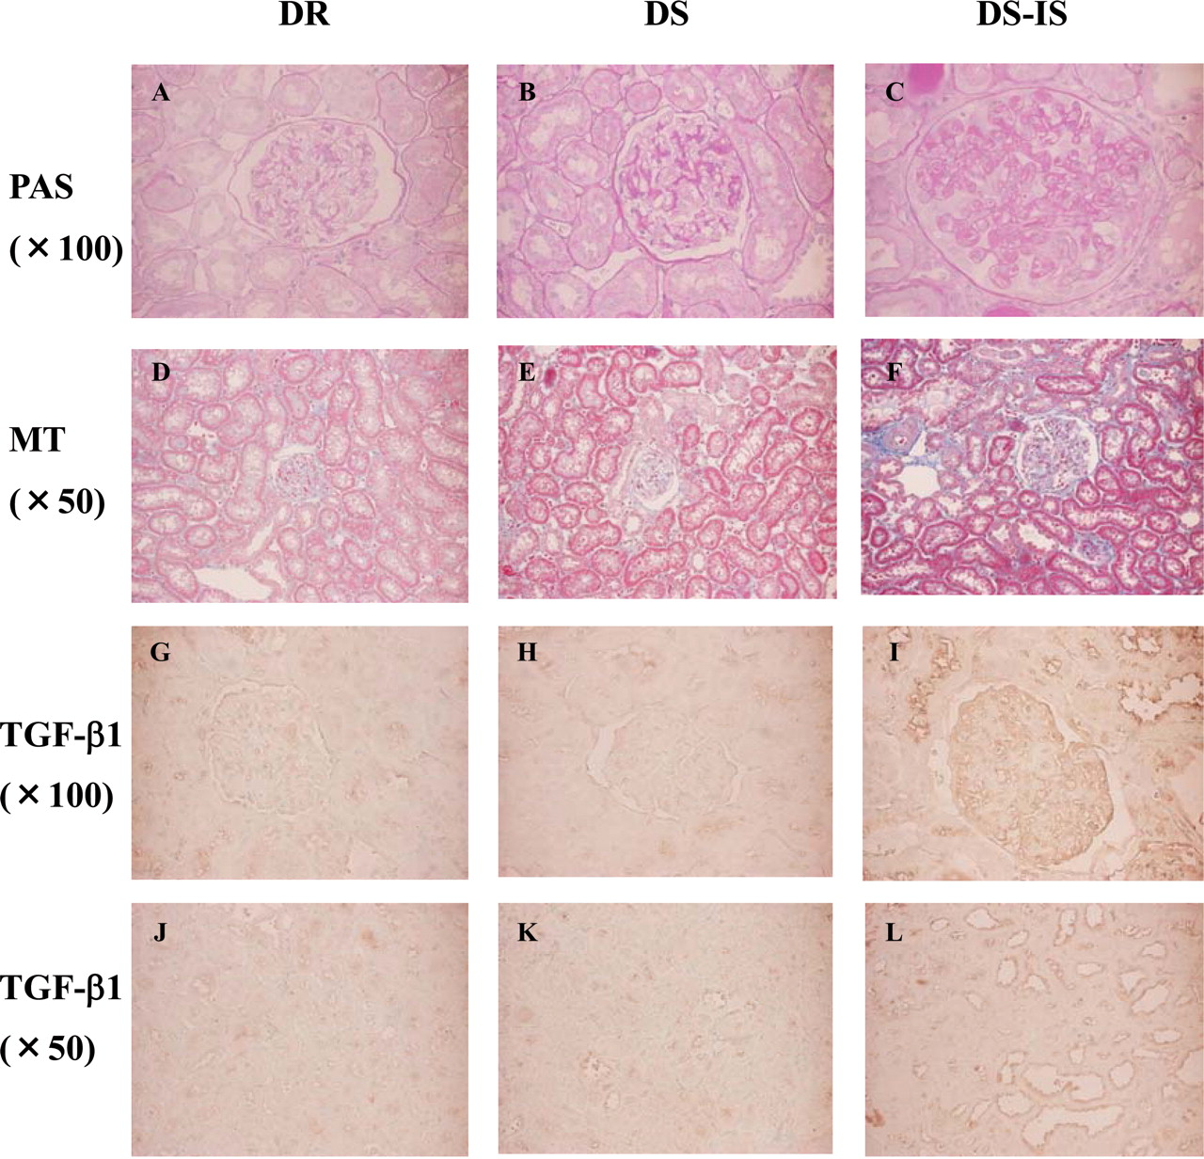
Fig. 6 PAS and Masson trichrome (MT) staining, and immunostaining of TGF-ßl in the kidneys of DR, DS, and DS-IS ...
Notes:
Fig. 6 PAS and Masson trichrome (MT) staining, and immunostaining of TGF-ßl in the kidneys of DR, DS, and DS-IS rats.
Unless provided in the caption above, the following copyright applies to the content of this slide: © Oxford University Press 2008

Slide 7
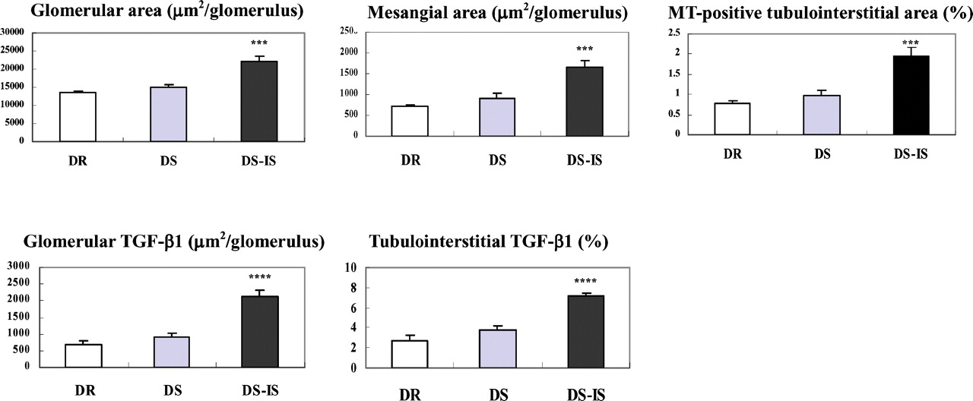
Fig. 7 Glomerular area, mesangial area, MT-positive tubulointerstitial area, TGF-ßl-positive glomerular area and ...
Notes:
Fig. 7 Glomerular area, mesangial area, MT-positive tubulointerstitial area, TGF-ßl-positive glomerular area and TGF-ßl-positive tubulointerstitial area in the kidneys of DR, DS, and DS-IS rats. *** P < 0.001, **** P < 0.0001 vs. DS
Unless provided in the caption above, the following copyright applies to the content of this slide: © Oxford University Press 2008

