Slide 1
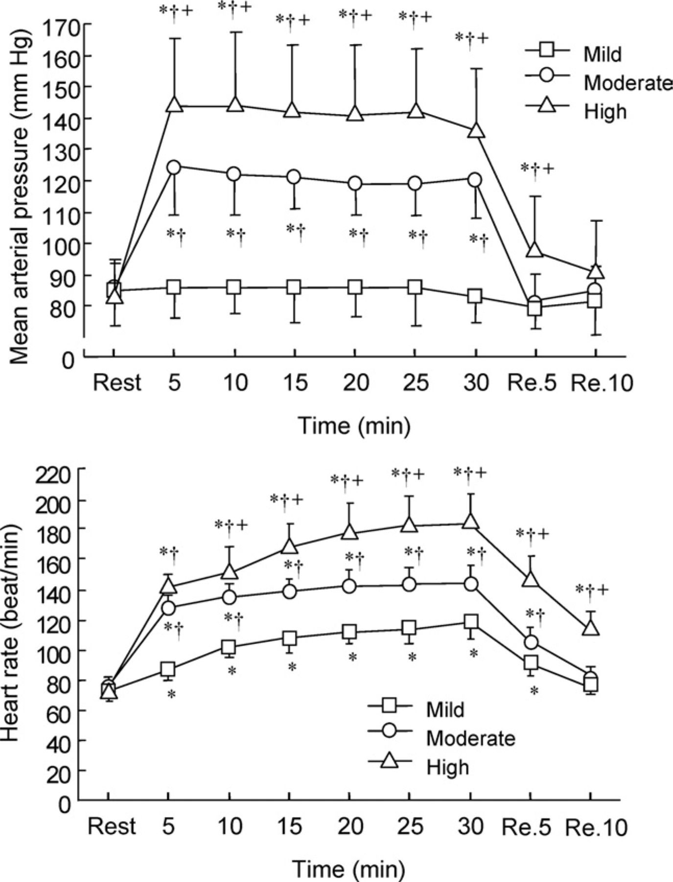
Figure 1. Line graphs show the changes in mean arterial pressure (top) and heart rate (bottom) during mild-intensity, ...
Notes:
Figure 1. Line graphs show the changes in mean arterial pressure (top) and heart rate (bottom) during mild-intensity, moderate-intensity, and high-intensity exercises. *P < .05 v rest; †P < .05 v mild-intensity exercise; +P < .05 v moderate-intensity exercise. Re, recovery.
Unless provided in the caption above, the following copyright applies to the content of this slide: © American Journal of Hypertension, Ltd. 2007

Slide 2
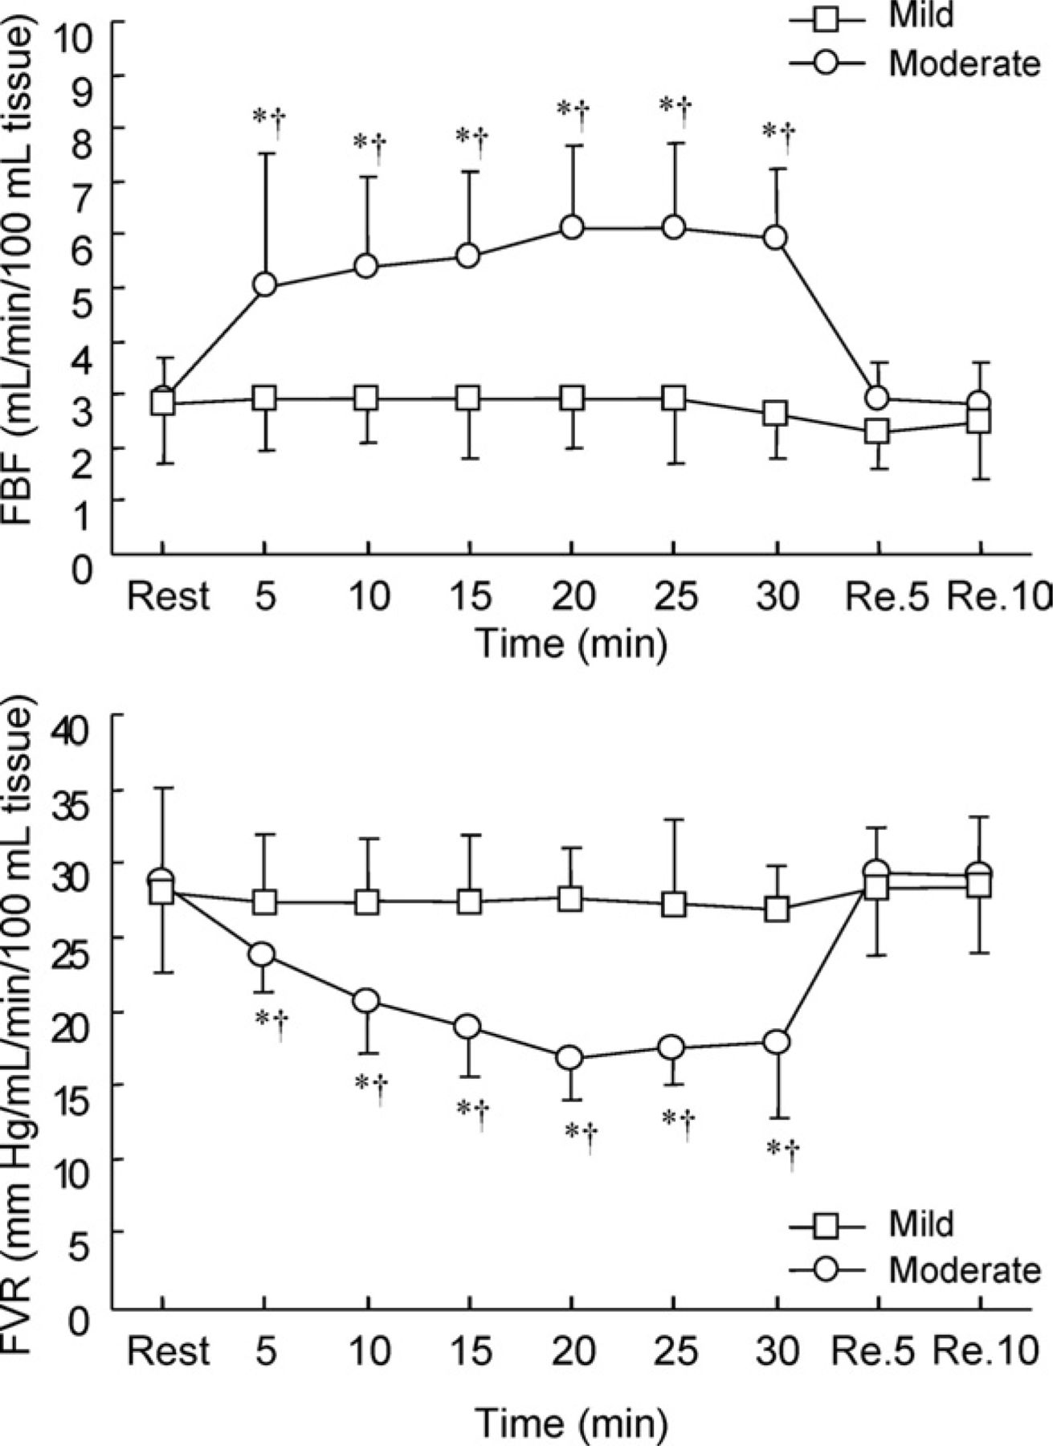
Figure 2. Line graphs show the changes in forearm blood flow (FBF) (top) and forearm vascular resistance (FVR) (bottom) ...
Notes:
Figure 2. Line graphs show the changes in forearm blood flow (FBF) (top) and forearm vascular resistance (FVR) (bottom) during mild-intensity and moderate-intensity exercises. *P < .05 v rest; †P < .05 v mild-intensity exercise. Re, recovery.
Unless provided in the caption above, the following copyright applies to the content of this slide: © American Journal of Hypertension, Ltd. 2007

Slide 3
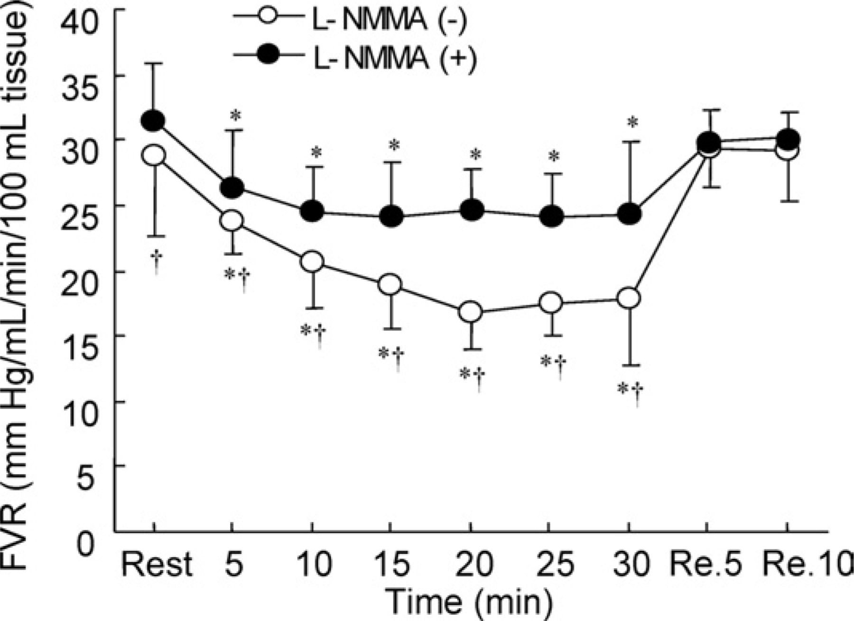
Figure 3. Line graphs show the changes in forearm vascular resistance (FVR) in the absence and presence of ...
Notes:
Figure 3. Line graphs show the changes in forearm vascular resistance (FVR) in the absence and presence of NG-monomethyl-L-arginin (L-NMMA) during moderate-intensity exercise. *P < .05 v rest; †P < .05 v L-NMMA (−). Re, recovery.
Unless provided in the caption above, the following copyright applies to the content of this slide: © American Journal of Hypertension, Ltd. 2007

Slide 4
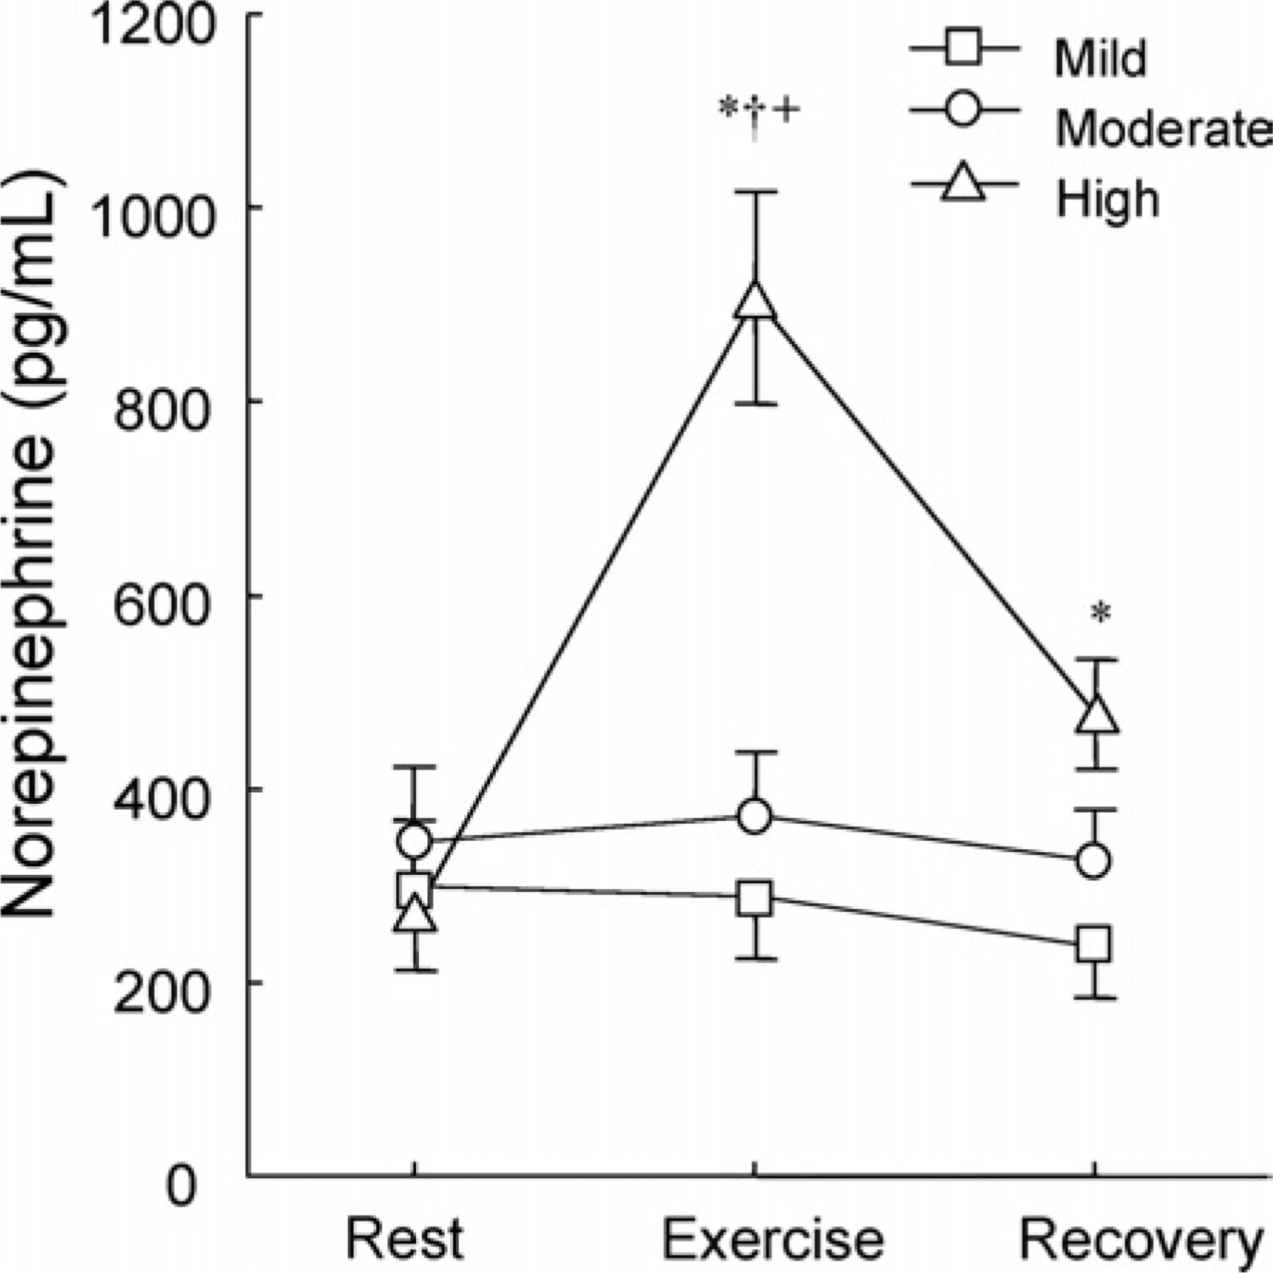
Figure 4. Line graphs show the changes in norepinephrine during mild-intensity, moderate-intensity, and high-intensity ...
Notes:
Figure 4. Line graphs show the changes in norepinephrine during mild-intensity, moderate-intensity, and high-intensity exercises. *P < .05 v rest; †P < .05 v mild-intensity exercise; +P < .05 v moderate-intensity exercise.
Unless provided in the caption above, the following copyright applies to the content of this slide: © American Journal of Hypertension, Ltd. 2007

Slide 5
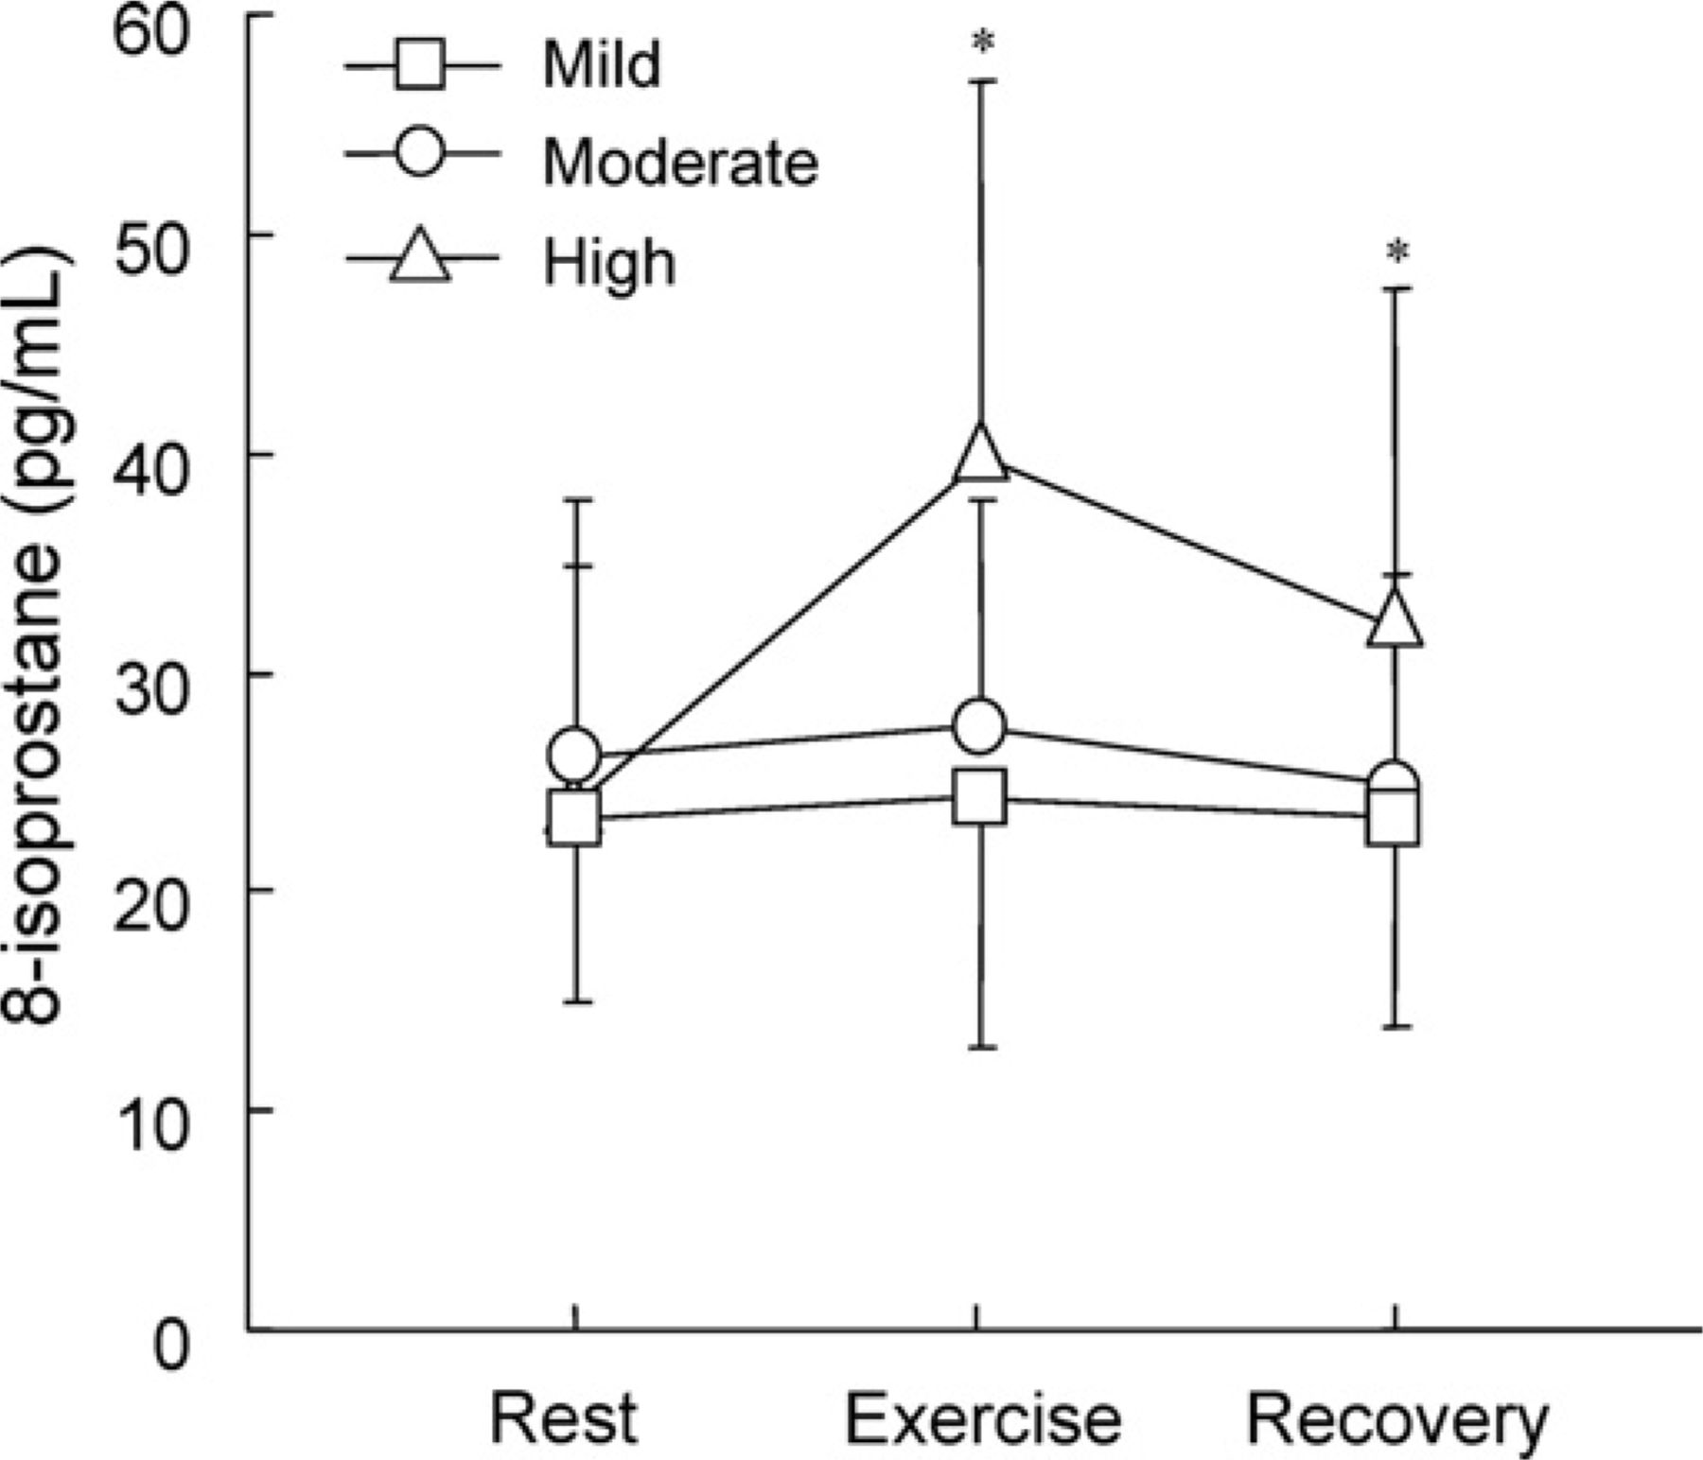
Figure 5. Line graphs show the changes in 8-isoprostane during mild-intensity, moderate-intensity, and high-intensity ...
Notes:
Figure 5. Line graphs show the changes in 8-isoprostane during mild-intensity, moderate-intensity, and high-intensity exercises. *P < .05 v rest.
Unless provided in the caption above, the following copyright applies to the content of this slide: © American Journal of Hypertension, Ltd. 2007

