Slide 1
Figure 1. Distribution of participants in a population-based cohort study on celiac disease (CD) and risk of cataract, ...
Notes:
Figure 1. Distribution of participants in a population-based cohort study on celiac disease (CD) and risk of cataract, Sweden, 1969–2008. A total of 1,012 controls were excluded because their matched patient undergoing biopsy had been excluded (and all analyses were matched on strata; see Materials and Methods).
Unless provided in the caption above, the following copyright applies to the content of this slide: American Journal of Epidemiology © The Author 2011. Published by Oxford University Press on behalf of the Johns Hopkins Bloomberg School of Public Health. All rights reserved. For permissions, please e-mail: journals.permissions@oup.com.

Slide 2
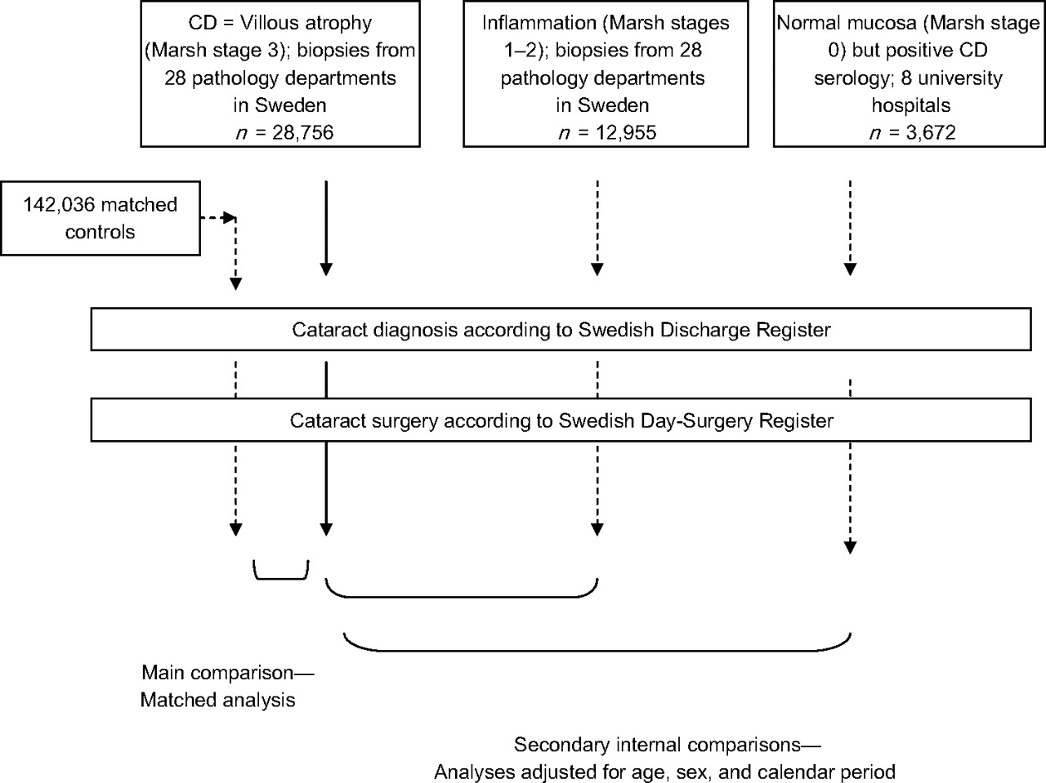
Figure 2. Overview of a population-based cohort study on celiac disease (CD) and risk of cataract, Sweden, 1969–2008. ...
Notes:
Figure 2. Overview of a population-based cohort study on celiac disease (CD) and risk of cataract, Sweden, 1969–2008. Dashed lines indicate control groups.
Unless provided in the caption above, the following copyright applies to the content of this slide: American Journal of Epidemiology © The Author 2011. Published by Oxford University Press on behalf of the Johns Hopkins Bloomberg School of Public Health. All rights reserved. For permissions, please e-mail: journals.permissions@oup.com.

