Slide 1
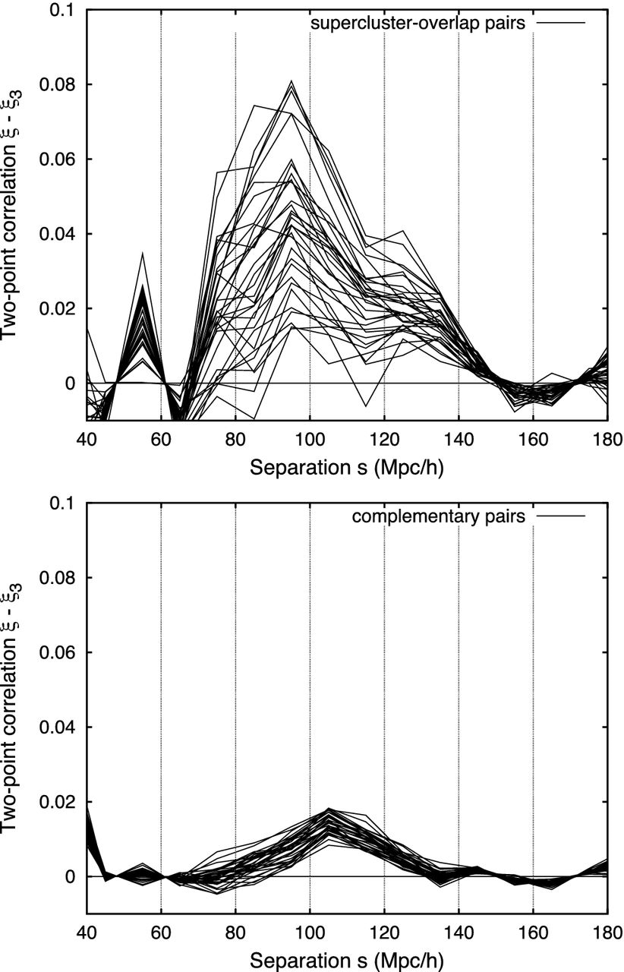
Figure 1. Compression of the BAO peak. Upper panel: BAO peak (cubic-subtracted correlation function) for pairs of LRGs ...
Notes:
Figure 1. Compression of the BAO peak. Upper panel: BAO peak (cubic-subtracted correlation function) for pairs of LRGs whose paths either overlap with superclusters by ω ≥ ωmin = 60 h−1 Mpc or are entirely contained within the superclusters. The overlap ω is the chord length defined (Roukema et al. 2015, section 2.3, fig. 1) by the intersection of the path joining two LRGs and the supercluster modelled as a sphere. Individual curves represent 32 bootstrap resamplings of the supercluster catalogue (235 objects) and the ‘random’ galaxies (484 352 selected from 1521 736). The real galaxies (30 272) are not resampled. Most of the curves peak sharply at 95 h−1 Mpc; a few peak at 85 h−1 Mpc. The high amplitude (in comparison with the lower panel) is consistent with biasing that modifies the amplitude of ξ. Lower panel: BAO peak for the complementary subset of galaxy pairs. The peak occurs at the standard value of about 105 h−1 Mpc.
Unless provided in the caption above, the following copyright applies to the content of this slide: © 2015 The Authors Published by Oxford University Press on behalf of the Royal Astronomical Society

Slide 2
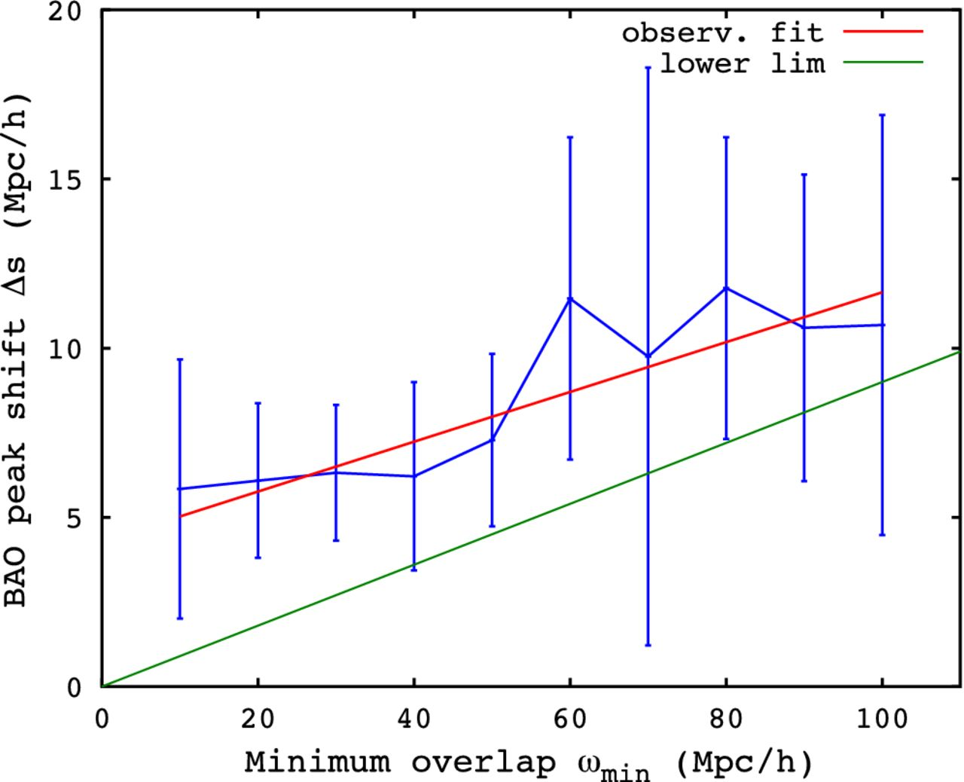
Figure 2. Overlap dependence of the BAO peak shift. BAO peak shift $\Delta s : = s_{\rm non\text{-}sc} - ...
Notes:
Figure 2. Overlap dependence of the BAO peak shift. BAO peak shift $\Delta s : = s_{\rm non\text{-}sc} - s_{\mathrm{sc}}$, where ssc and $s_{\rm non\text{-}sc}$ are the median estimates of the centres of the best-fitting Gaussians to ξ − ξ3 for LRG pairs that overlap superclusters (sc) and those that do not (non-sc), respectively. The error bars show a robust estimate of the standard deviation, σ(Δs), defined here as 1.4826 times the median absolute deviation of Δs. At each ωmin , these statistics are calculated over 32 bootstrap resamplings of the observational data. Four out of the 320 Gaussian fits in the supercluster-overlap case failed and were ignored in calculating these statistics; no failures occurred for the 320 non-supercluster-overlap cases. A linear least-squares best-fitting relation Δs = 4.3 h−1 Mpc + 0.07ωmin is shown with a red line. The most significant individual rejection of a zero shift is Δs = (6.3 ± 2.0) h−1 Mpc for ωmin = 30 h−1 Mpc, a 3.1σ (Gaussian) rejection. Since bootstraps are used, this estimate is conservative: σ(Δs) is expected to be an overestimate of the true uncertainty (Fisher et al. 1994, section 2.2). A 9 per cent shift [equation (1)] would give Δs = 0.09ω. Since ω ≥ ωmin , a scalar-averaging lower expected limit Δs > 0.09ωmin is shown as a green line.
Unless provided in the caption above, the following copyright applies to the content of this slide: © 2015 The Authors Published by Oxford University Press on behalf of the Royal Astronomical Society

