Slide 1
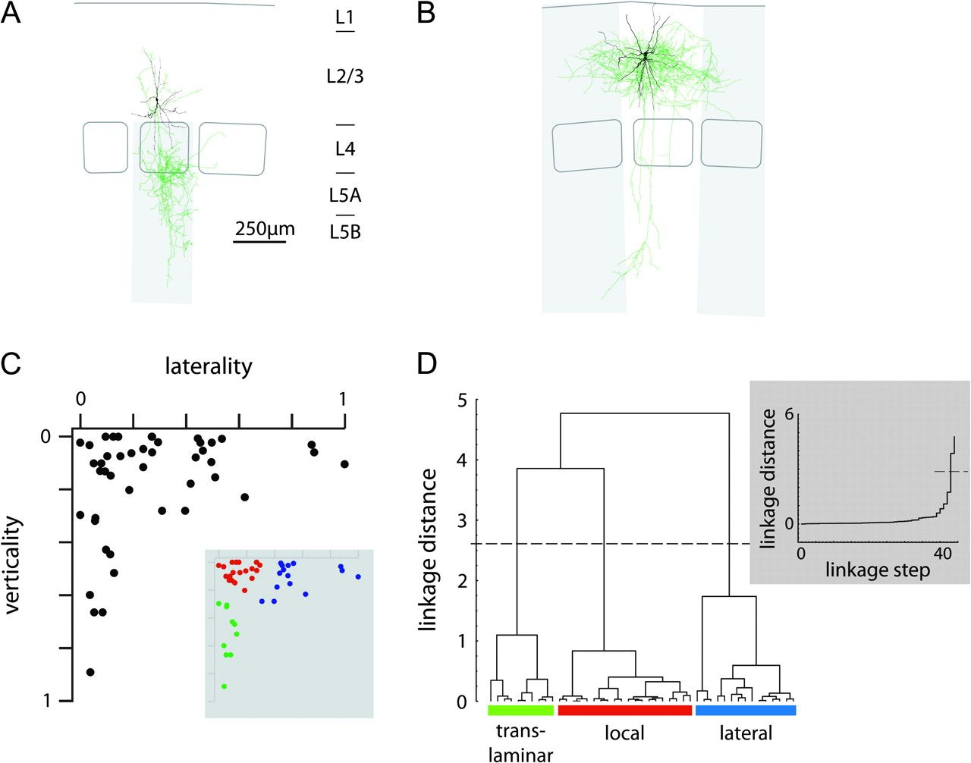
Figure 1. Quantitative analysis of axonal projection domains. (A) Reconstruction of a L2/3 interneuron from rat barrel ...
Notes:
Figure 1. Quantitative analysis of axonal projection domains. (A) Reconstruction of a L2/3 interneuron from rat barrel cortex. Soma and dendrites, black; axon, green. The verticality of axonal projection was defined as the ratio of axonal path length that extended below the upper border of L4 (gray area). (B) Reconstruction of a L2/3 interneuron, same color code as in (A). The laterality of axonal projection was defined as a linear combination of the ratio of axonal path length extending beyond the home column and the adjacent septa (gray area), and the total lateral extent of the axonal projection measured in units of home column width (for details cf., Materials and methods). (C) Distribution of laterality and verticality of axonal projections of 45 L2/3 interneurons. The inset shows clusters that were determined by a cluster analysis (Euclidean distances, Ward's linkage method; Ward 1963). (D) The linkage dendrogram for the cluster analysis. The dashed line indicates the cutoff as determined by Thorndike's procedure (Thorndike 1953): the inset shows the plot of linkage distance versus linkage step. The maximum increase in linkage distance is determined as linkage cutoff. The resulting 3 clusters are coded in red, blue, green, and respectively, and are designated local, lateral, and translaminar L2/3-to-L4/5 inhibitors, respectively.
Unless provided in the caption above, the following copyright applies to the content of this slide: © The Author 2008. Published by Oxford University Press. All rights reserved. For permissions, please e-mail: journals.permissions@oxfordjournals.org

Slide 2
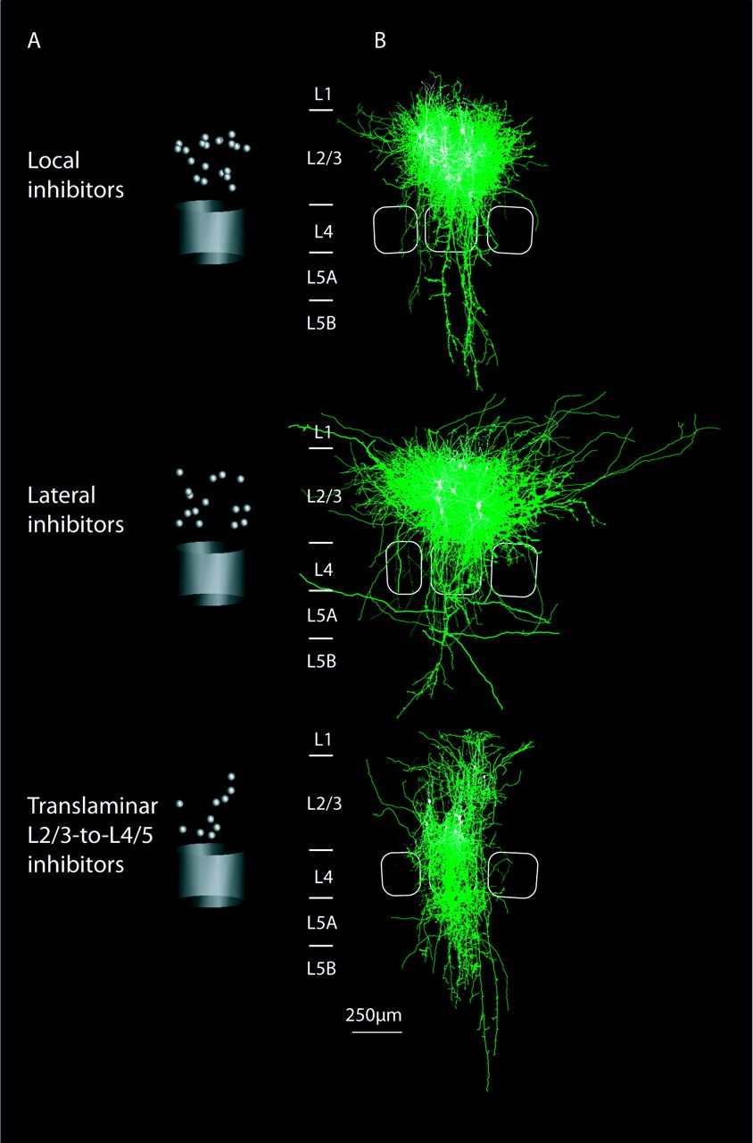
Figure 2. Soma locations and average axonal projections of local, lateral, and translaminar L2/3-to-L4/5 inhibitors ...
Notes:
Figure 2. Soma locations and average axonal projections of local, lateral, and translaminar L2/3-to-L4/5 inhibitors with reference to cortical columns. (A) Schematic indication of the recorded soma locations depicted in a normalized cortical column (distance of upper L4 border to L1 border approximately equals the width of column plus adjacent septa, 400 ± 40 vs. 370 ± 85 μm). Soma locations perpendicular to the slice plane were drawn from a random distribution within the measured column radius. (B) Overlay of dendritic and somatic reconstructions sorted by the type of axonal projection as determined by cluster analysis (Fig. 1). Axons, green; dendrites and somata, white. Top, local; middle, lateral; bottom, translaminar L2/3-to-L4/5 inhibitors. The average barrel outlines are drawn in light gray.
Unless provided in the caption above, the following copyright applies to the content of this slide: © The Author 2008. Published by Oxford University Press. All rights reserved. For permissions, please e-mail: journals.permissions@oxfordjournals.org

Slide 3
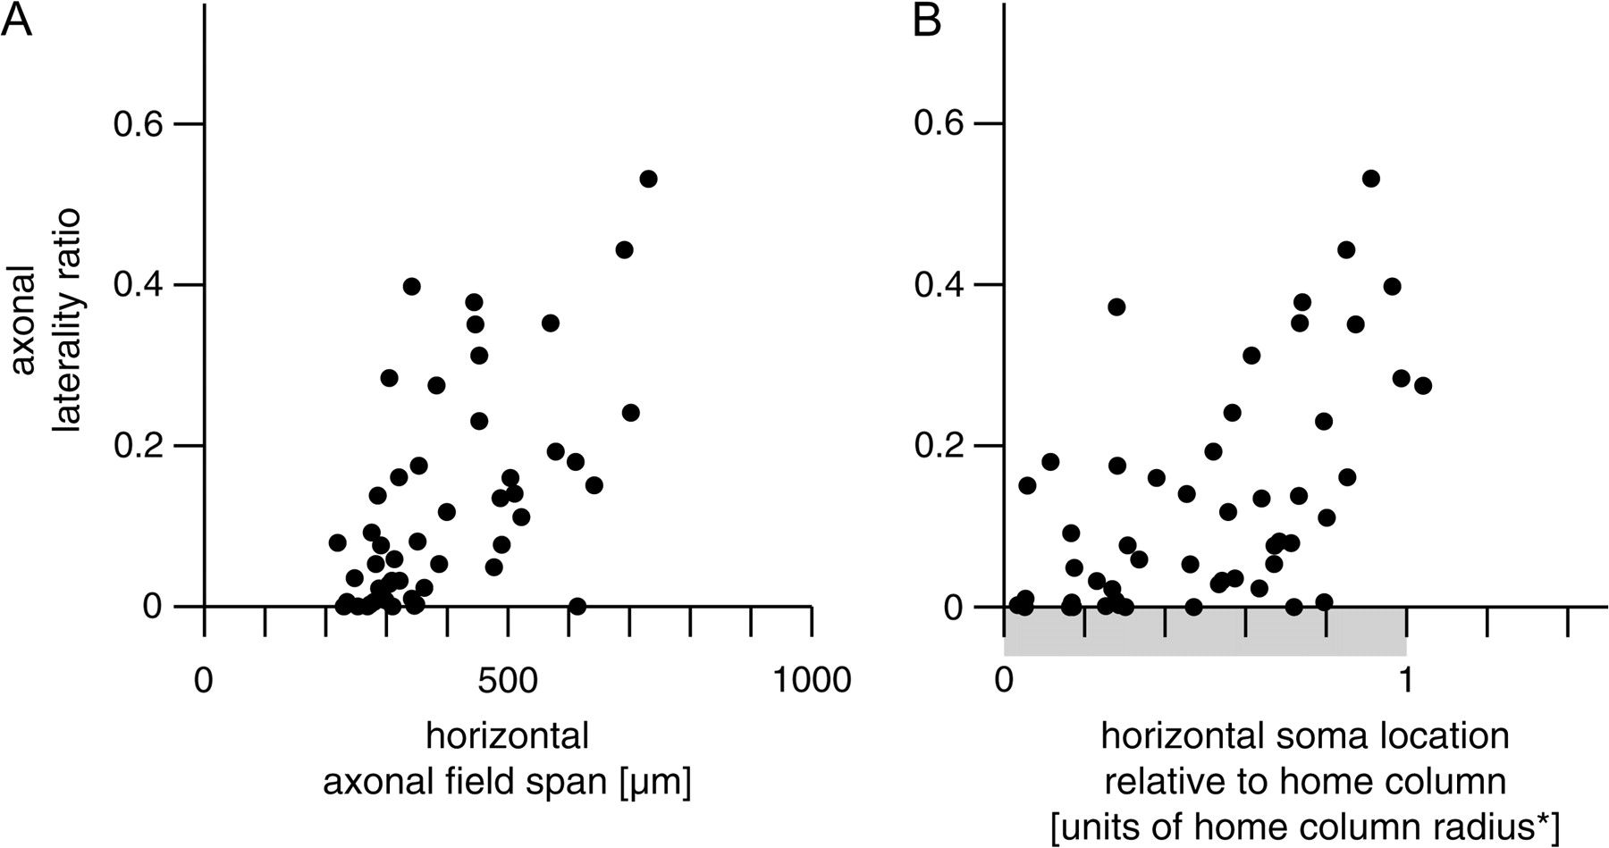
Figure 3. Relation between axonal field span, laterality of axonal projection, and soma location in a column. (A) ...
Notes:
Figure 3. Relation between axonal field span, laterality of axonal projection, and soma location in a column. (A) Relation between the ratio of axonal path length extended to neighboring columns (“axonal laterality ratio,” cf., Materials and methods) and the horizontal axonal field span measured as the horizontal extent of the isodensity contour containing 80% of a single neuron's axonal projection (cf., Materials and methods; rs = 0.63, P < 10−4). For a broad range of axonal field spans (ca., 300–600 μm), the axonal laterality ratio varied between 30% (a significantly lateral axonal projection). Thus, axonal field span could not serve as a surrogate parameter for the laterality of axonal projection (cf., Results and Discussion). (B) Relation between the ratio of axonal path length extending to neighboring columns (as in A) and the position of the soma along the horizontal axis within the home column (rs = 0.56, P < 10−4). The horizontal soma position was measured relative to the radius of the home column (for details, cf., Materials and methods) and was rendered symmetrical such that “0” corresponds to the center of the home column and “1” corresponds to the border of the home column (for details, cf., Materials and methods). Interneurons with significant axonal projection to neighboring columns (axonal laterality ratio >30%) had a tendency to be located close to the border of the home column (relative horizontal position >0.7). Note, however, that a large fraction of neurons located at the home column border also had purely local axonal projections (axonal laterality ratio <10%).
Unless provided in the caption above, the following copyright applies to the content of this slide: © The Author 2008. Published by Oxford University Press. All rights reserved. For permissions, please e-mail: journals.permissions@oxfordjournals.org

Slide 4
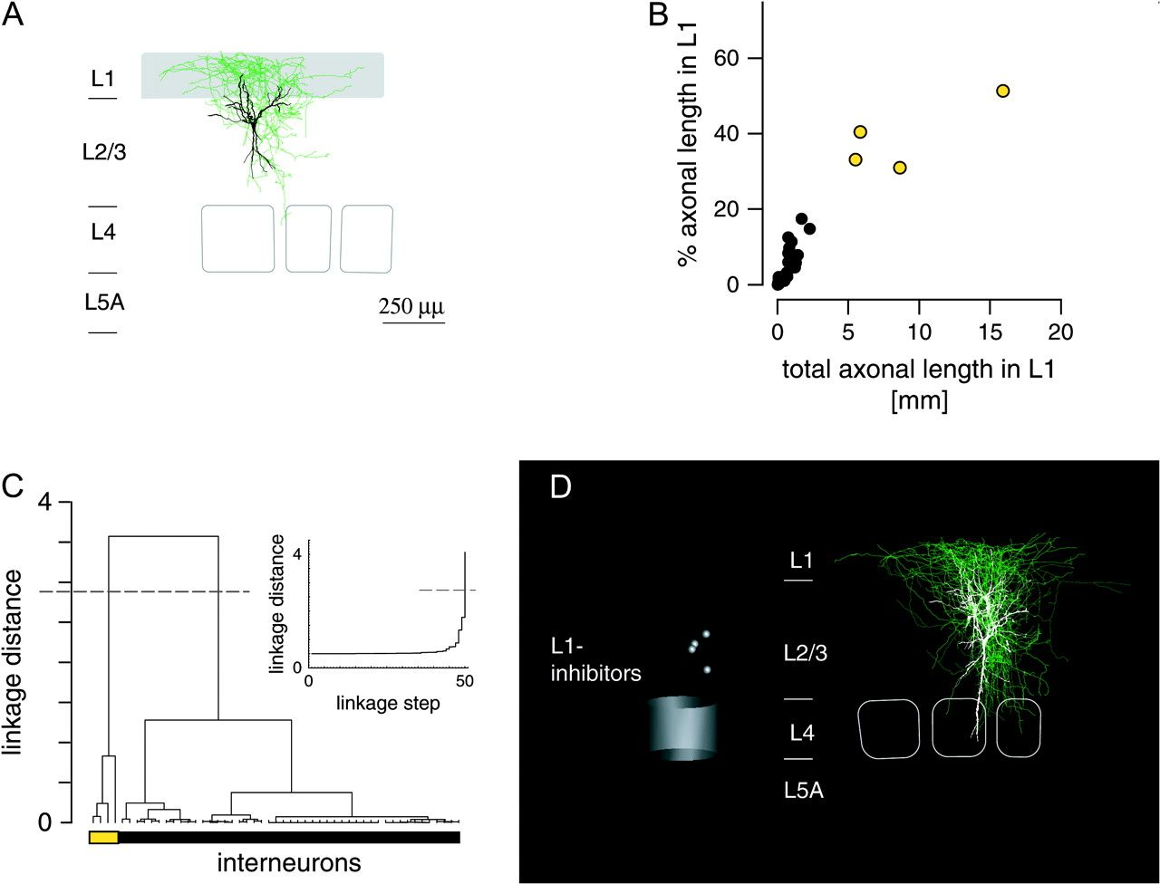
Figure 4. Quantitative analysis of axonal projections to L1. (A) Reconstruction of an interneuron with extensive ...
Notes:
Figure 4. Quantitative analysis of axonal projections to L1. (A) Reconstruction of an interneuron with extensive projections to L1. The L1 projection ratio was determined as the ratio of axonal path length extended into L1 (gray area). Color code as in Figure 1. (B) Distribution of L1 projection ratio and total axonal path length extended to L1 for the sample of 51 interneurons. Note that most (47 of 51) neurons showed virtually no axonal projection to L1 (black circles, only 3 ± 4% L1 projection ratio and 420 ± 550–μm axonal path length in L1). (C) A cluster analysis defines a small cluster of 4 neurons with more than 30% and more than 5 mm of axon extended to L1 (Ward's method, Euclidean distances, Thorndike procedure for cluster cutoff). (D) Soma positions (left panel) and overlay of reconstructions of the 4 L1 inhibitors found in the sample.
Unless provided in the caption above, the following copyright applies to the content of this slide: © The Author 2008. Published by Oxford University Press. All rights reserved. For permissions, please e-mail: journals.permissions@oxfordjournals.org

Slide 5
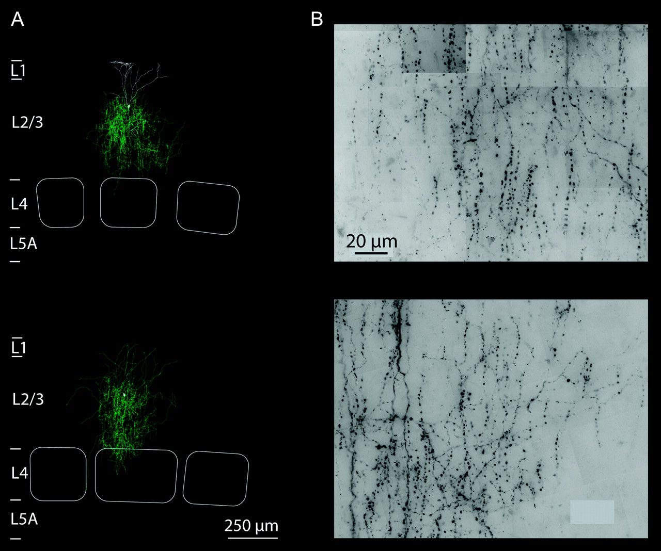
Figure 5. Chandelier neurons. (A) Reconstructions and barrel patterns for 2 chandelier neurons found in the sample. ...
Notes:
Figure 5. Chandelier neurons. (A) Reconstructions and barrel patterns for 2 chandelier neurons found in the sample. Note the confinement of axonal projection to the home column (axon colored green). (B) Representative images of the diaminobenzidene-stained axons of the 2 neurons (z projections of bright-field images). The sections show approximately 40–50 vertically oriented axonal segments from part of the axonal tree. Scale bar applies to both panels.
Unless provided in the caption above, the following copyright applies to the content of this slide: © The Author 2008. Published by Oxford University Press. All rights reserved. For permissions, please e-mail: journals.permissions@oxfordjournals.org

Slide 6
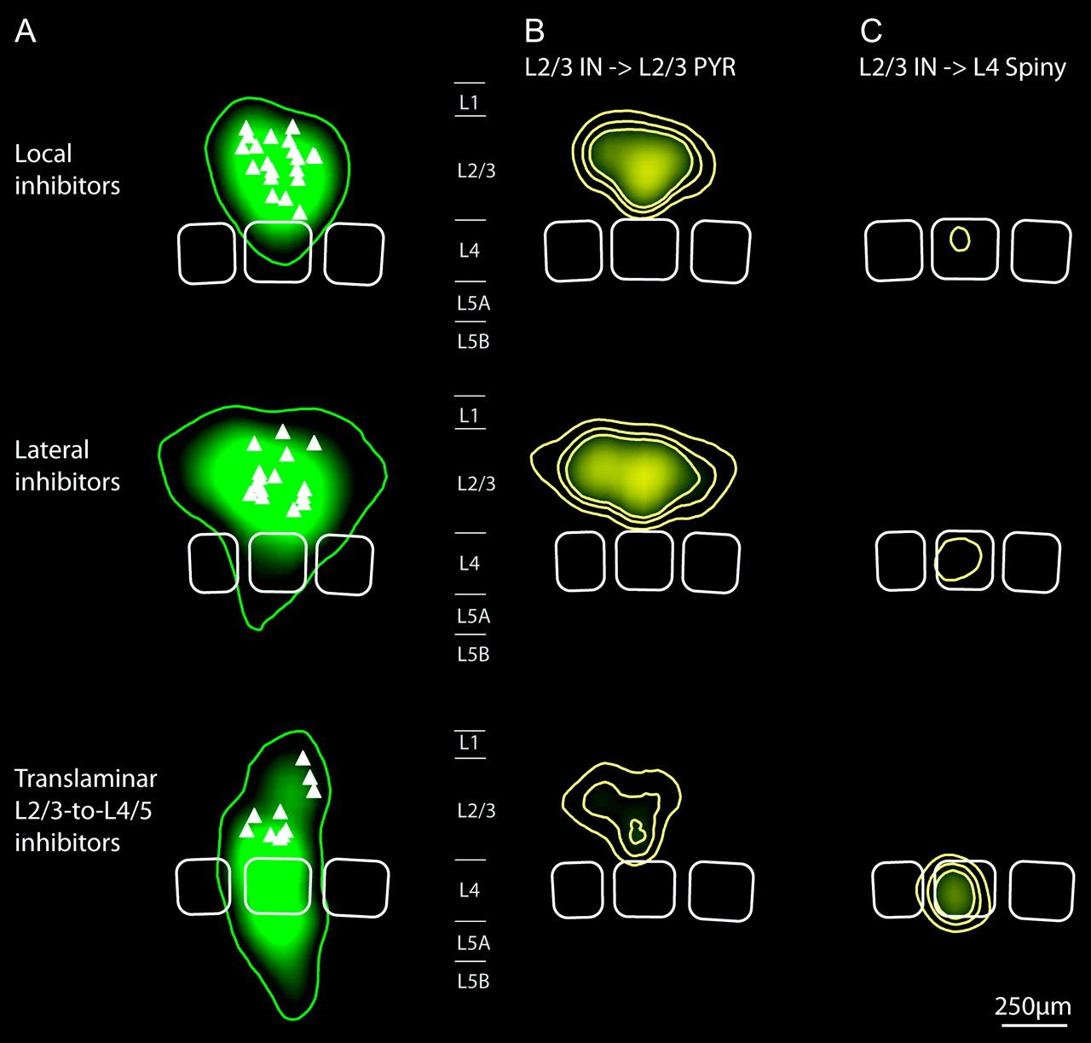
Figure 6. Average axonal projections for local, lateral, and translaminar L2/3-to-L4/5 inhibitors and corresponding ...
Notes:
Figure 6. Average axonal projections for local, lateral, and translaminar L2/3-to-L4/5 inhibitors and corresponding innervation domains. (A) Maps of axonal path length density, averaged for local inhibitors (n = 20, top panel), lateral inhibitors (n = 15, middle panel), and translaminar L2/3-to-L4/5 inhibitors (n = 10, bottom panel) and aligned to the average barrel pattern for each type (white outlines). Isodensity contours that contained 90% of the total axonal length density were superimposed (green lines). Soma locations are indicated by white triangles. Maps were sampled at 50 × 50 voxel size, convolved with a Gaussian kernel and interpolated 10-fold (cf., Materials and methods). (B) Maps of average putative innervation domains for local, lateral, and translaminar L2/3-to-L4/5 inhibitors (top to bottom). At each point in the map, axonal density was multiplied with the average dendritic density of a sample of 25 L2/3 pyramidal neurons in the home and neighboring columns, each. Yellow lines are 3 isodensity contours normalized to the peak innervation density of all innervation maps for comparison. Note the extent of innervation domains of lateral inhibitors to the neighboring columns (middle panel). Both local and lateral inhibitors show innervation domains that exclude L1 (top and middle panels, compare Fig. 7). (C) Average putative innervation domains for the 3 types projecting to L4 spiny neurons. Average dendritic maps of 36 L4 spiny neurons were computed, and the innervation density was calculated as above. Note that only translaminar L2/3-to-L4/5 inhibitors show significant innervation probability in L4 (bottom panel). The innervation domain of lateral inhibitors (B, middle panel) suggests an asymmetry toward the “left” neighboring column. In the thalamocortical slice preparation, however, a clear identification of rows or arcs is not possible (cf., Land and Kandler 2002).
Unless provided in the caption above, the following copyright applies to the content of this slide: © The Author 2008. Published by Oxford University Press. All rights reserved. For permissions, please e-mail: journals.permissions@oxfordjournals.org

Slide 7
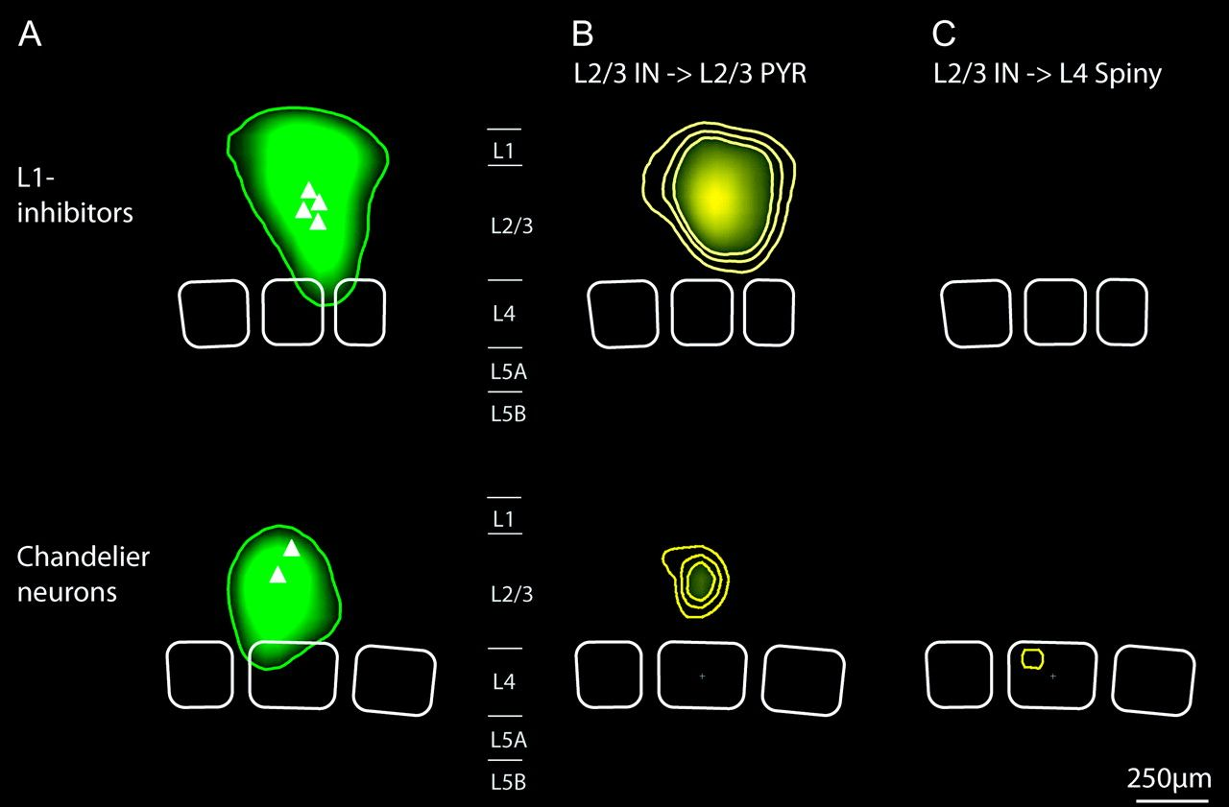
Figure 7. Average axonal projections of L1 inhibitors and chandelier neurons and corresponding innervation domains. (A) ...
Notes:
Figure 7. Average axonal projections of L1 inhibitors and chandelier neurons and corresponding innervation domains. (A) Maps of average axonal length density computed as in Figure 6. (B, C) Maps of putative innervation density of connections from L2/3 interneurons to excitatory neurons in layers 2/3 and 4. Note that L1 inhibitors have significant innervation probabilities at the apical tufts of L2/3 pyramidal neurons. L1 is, however, excluded by all other inhibitory projection types (cf., Fig. 6). For chandelier neurons, axonal initial segments of 20-μm approximated length each were used as putative postsynaptic targets (Somogyi 1977) for innervation density calculation (cf., Materials and methods). Note that the axonal projection and putative innervation domain of the 2 chandelier neurons is confined to L2/3 of the home column.
Unless provided in the caption above, the following copyright applies to the content of this slide: © The Author 2008. Published by Oxford University Press. All rights reserved. For permissions, please e-mail: journals.permissions@oxfordjournals.org

