Slide 1
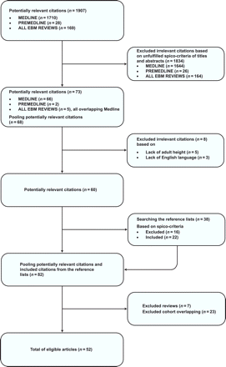
Figure 1 The Quality of Reporting of Meta-analysis flow diagram.
Notes:
Figure 1 The Quality of Reporting of Meta-analysis flow diagram.
Unless provided in the caption above, the following copyright applies to the content of this slide: Published on behalf of the European Society of Cardiology. All rights reserved. © The Author 2010. For permissions please email: journals.permissions@oxfordjournals.org

Slide 2
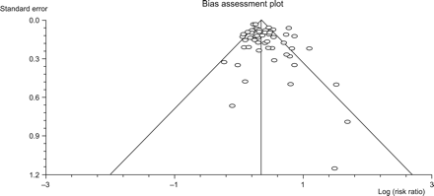
Figure 2 Bias test.
Notes:
Figure 2 Bias test.
Unless provided in the caption above, the following copyright applies to the content of this slide: Published on behalf of the European Society of Cardiology. All rights reserved. © The Author 2010. For permissions please email: journals.permissions@oxfordjournals.org

Slide 3
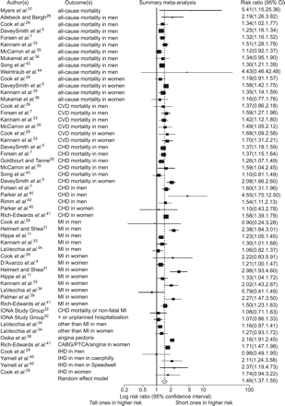
Figure 3 Meta-analysis of 22 articles.
Notes:
Figure 3 Meta-analysis of 22 articles.
Unless provided in the caption above, the following copyright applies to the content of this slide: Published on behalf of the European Society of Cardiology. All rights reserved. © The Author 2010. For permissions please email: journals.permissions@oxfordjournals.org

