Slide 1
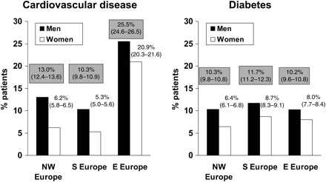
Figure 1 Age-adjusted frequency of cardiovascular disease and diabetes in Northwest (NW), Southern (S), and Eastern ...
Notes:
Figure 1 Age-adjusted frequency of cardiovascular disease and diabetes in Northwest (NW), Southern (S), and Eastern (E) Europe. Mean values with 95% confidence intervals: males dark columns and grey highlight, females light columns and no highlight.
Unless provided in the caption above, the following copyright applies to the content of this slide: Published on behalf of the European Society of Cardiology. All rights reserved. © The Author 2009. For permissions please email: journals.permissions@oxfordjournals.org

Slide 2
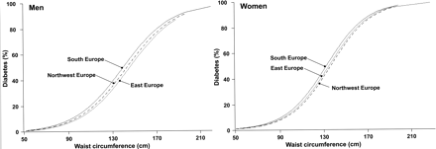
Figure 2 Regional frequency of diabetes for men and women according to distribution of waist circumference (without ...
Notes:
Figure 2 Regional frequency of diabetes for men and women according to distribution of waist circumference (without adjustment for body mass index). For values with waist circumference adjusted for body mass index and body mass index adjusted for waist circumference, see Table 2.
Unless provided in the caption above, the following copyright applies to the content of this slide: Published on behalf of the European Society of Cardiology. All rights reserved. © The Author 2009. For permissions please email: journals.permissions@oxfordjournals.org

Slide 3
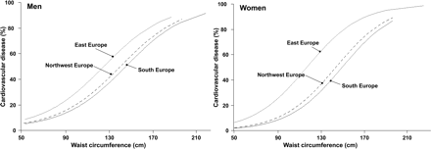
Figure 3 Regional frequency of cardiovascular disease for men and women according to distribution of waist ...
Notes:
Figure 3 Regional frequency of cardiovascular disease for men and women according to distribution of waist circumference (without adjustment for body mass index). For values with waist circumference adjusted for body mass index and body mass index adjusted for waist circumference, see Table 2.
Unless provided in the caption above, the following copyright applies to the content of this slide: Published on behalf of the European Society of Cardiology. All rights reserved. © The Author 2009. For permissions please email: journals.permissions@oxfordjournals.org

Slide 4
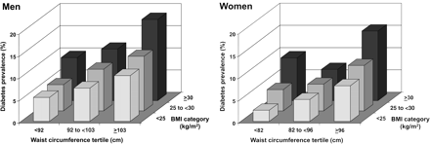
Figure 4 Frequency of diabetes in men and women across Europe adjusted for age, region, and smoking status, by ...
Notes:
Figure 4 Frequency of diabetes in men and women across Europe adjusted for age, region, and smoking status, by gender-specific waist circumference tertiles and body mass index categories. Table 4 below the figure shows the values by category of waist circumference and gender, and 95% confidence intervals.
Unless provided in the caption above, the following copyright applies to the content of this slide: Published on behalf of the European Society of Cardiology. All rights reserved. © The Author 2009. For permissions please email: journals.permissions@oxfordjournals.org

