Slide 1
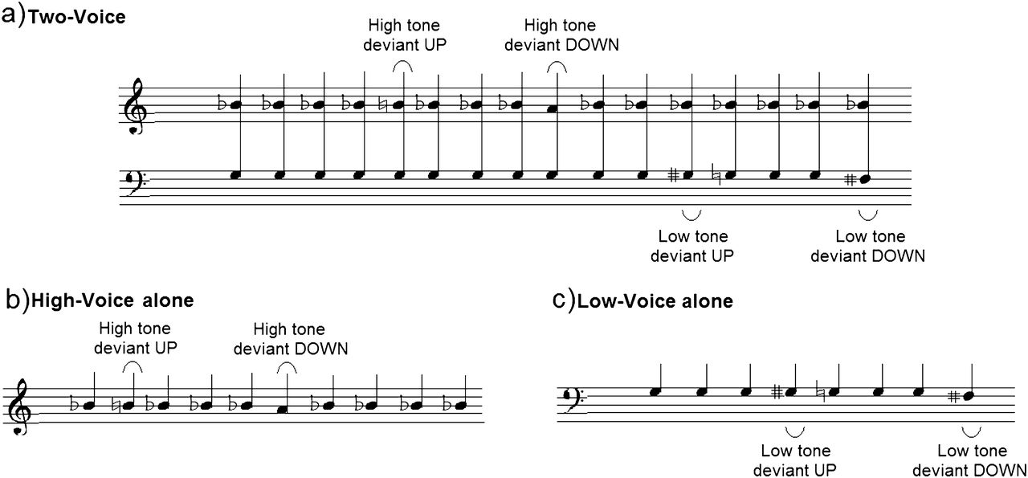
Figure 1. Description of the stimulus sequences illustrated in musical notation. (a) Two-Voice condition, (b) ...
Notes:
Figure 1. Description of the stimulus sequences illustrated in musical notation. (a) Two-Voice condition, (b) High-Voice-alone condition, and (c) Low-Voice-alone condition.
Unless provided in the caption above, the following copyright applies to the content of this slide: © The Author 2012. Published by Oxford University Press. All rights reserved. For permissions, please e-mail: journals.permissions@oup.com

Slide 2
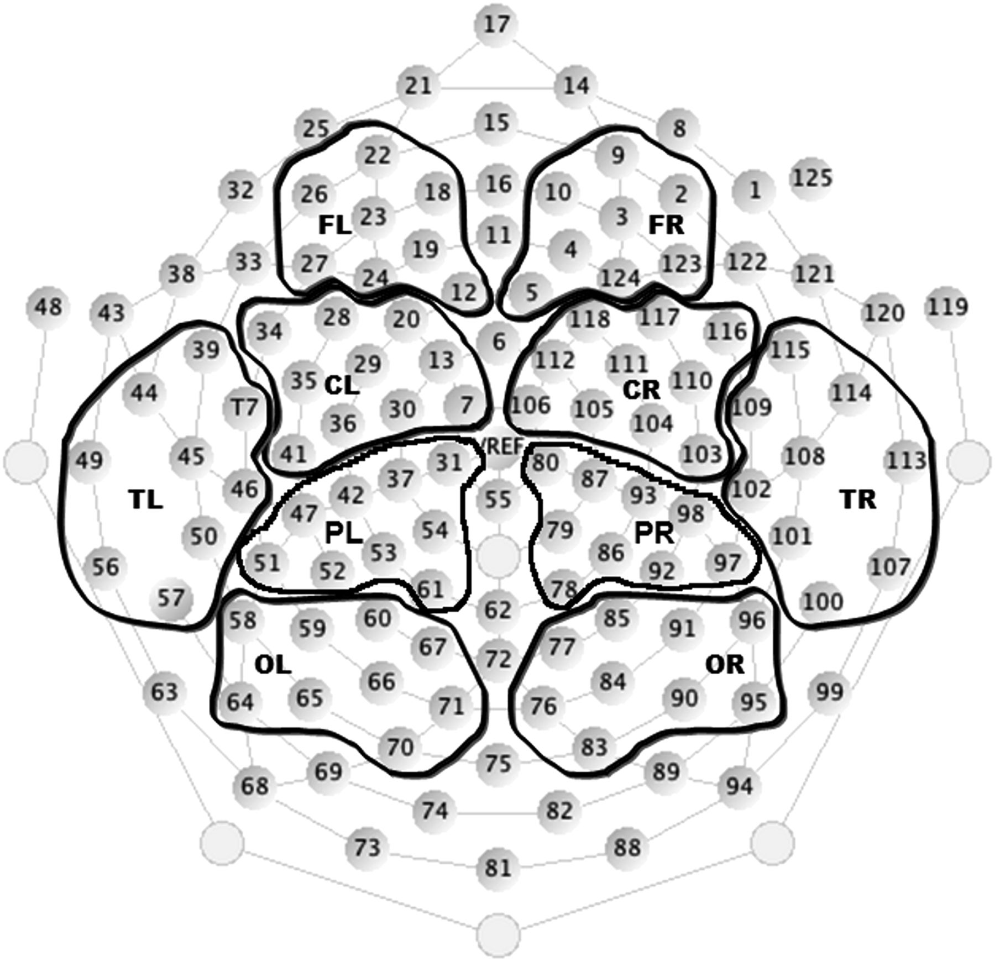
Figure 2. The grouping of electrodes in the Geodesic net (for details, see Materials and Methods). Eighty-four of 124 ...
Notes:
Figure 2. The grouping of electrodes in the Geodesic net (for details, see Materials and Methods). Eighty-four of 124 electrodes were selected to be divided into 5 groups (frontal, central, parietal, occipital, and temporal) for each hemisphere. The waveforms for all channels in each region were averaged together to represent EEG responses from that scalp region. The other 36 channels were excluded from further analysis to avoid artifacts and enable comparisons across hemispheres.
Unless provided in the caption above, the following copyright applies to the content of this slide: © The Author 2012. Published by Oxford University Press. All rights reserved. For permissions, please e-mail: journals.permissions@oup.com

Slide 3
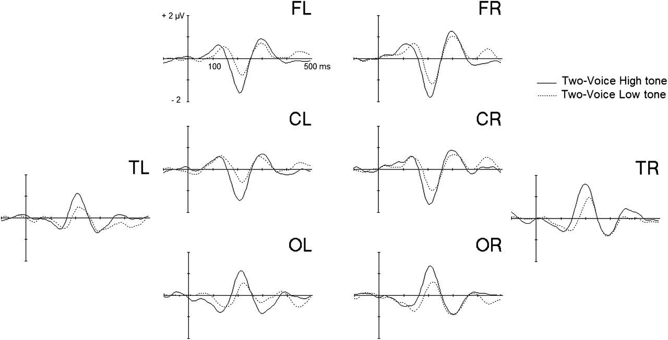
Figure 3. Difference waveforms (deviant–standard) in the Two-Voice condition with all infants (n = 16) for the High ...
Notes:
Figure 3. Difference waveforms (deviant–standard) in the Two-Voice condition with all infants (n = 16) for the High voice (black line) and the Low voice (dashed line). Deviants up and down were combined for each voice.
Unless provided in the caption above, the following copyright applies to the content of this slide: © The Author 2012. Published by Oxford University Press. All rights reserved. For permissions, please e-mail: journals.permissions@oup.com

Slide 4
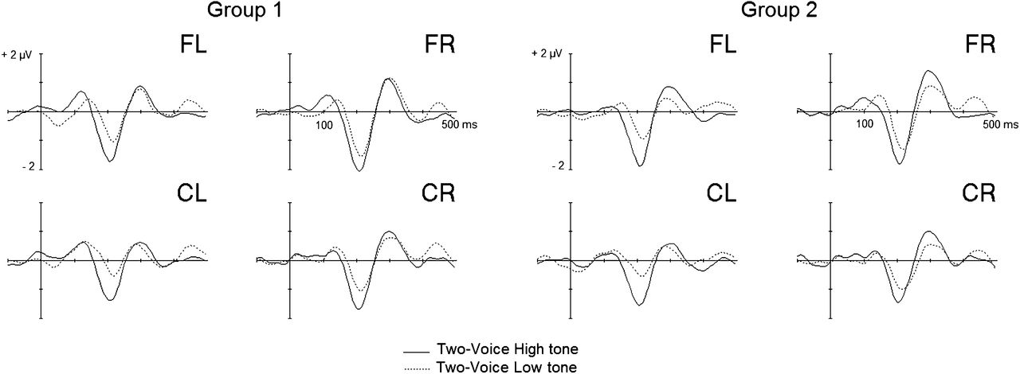
Figure 4. Difference waveforms in the Two-Voice condition for each group: Group 1 (Left side, see text) and Group 2 ...
Notes:
Figure 4. Difference waveforms in the Two-Voice condition for each group: Group 1 (Left side, see text) and Group 2 (Right side, see text) for the High voice (black line) and the Low voice (dashed line). Deviants up and down were combined for each voice.
Unless provided in the caption above, the following copyright applies to the content of this slide: © The Author 2012. Published by Oxford University Press. All rights reserved. For permissions, please e-mail: journals.permissions@oup.com

Slide 5
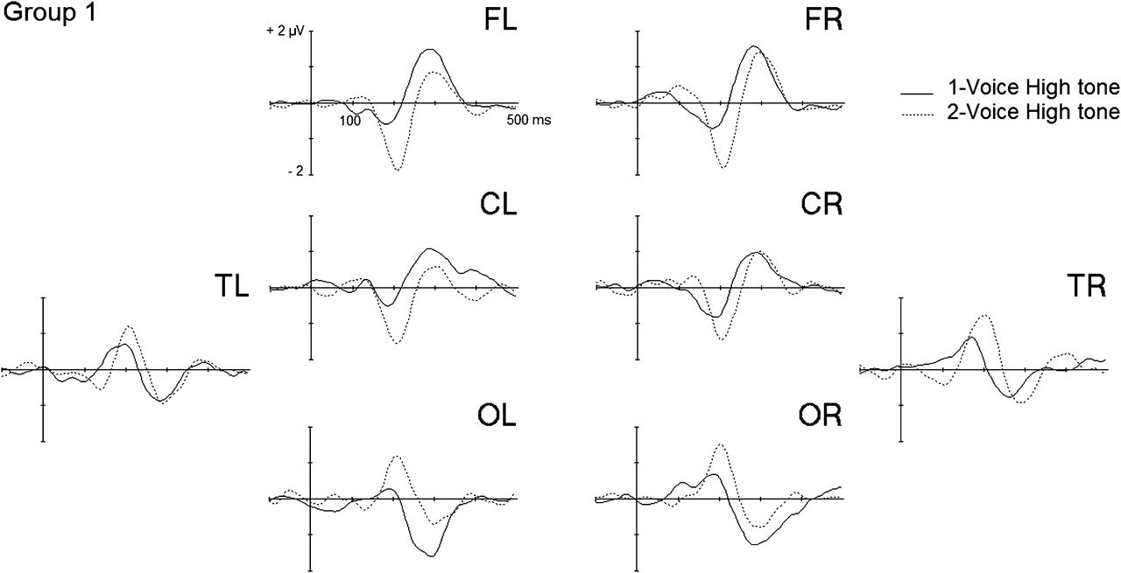
Figure 5. Difference waveforms for Group 1 (n = 10) in the High-Voice-alone (black line) and Two-Voice High tone ...
Notes:
Figure 5. Difference waveforms for Group 1 (n = 10) in the High-Voice-alone (black line) and Two-Voice High tone conditions (dashed line).
Unless provided in the caption above, the following copyright applies to the content of this slide: © The Author 2012. Published by Oxford University Press. All rights reserved. For permissions, please e-mail: journals.permissions@oup.com

Slide 6
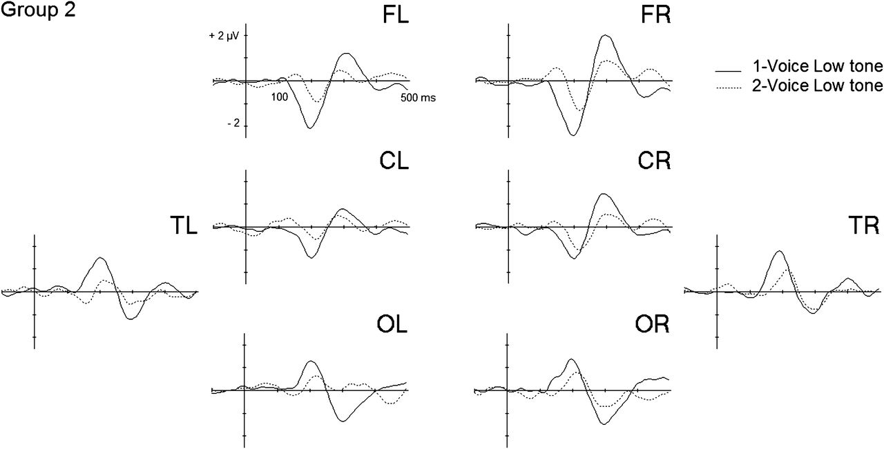
Figure 6. Difference waveforms for Group 2 (n = 10) in the Low-Voice-alone (black line) and Two-Voice Low tone ...
Notes:
Figure 6. Difference waveforms for Group 2 (n = 10) in the Low-Voice-alone (black line) and Two-Voice Low tone conditions (dashed line).
Unless provided in the caption above, the following copyright applies to the content of this slide: © The Author 2012. Published by Oxford University Press. All rights reserved. For permissions, please e-mail: journals.permissions@oup.com

