Slide 1
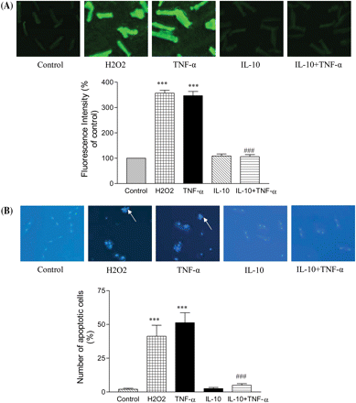
Figure 1 Effects of H₂O₂ (100 µM), TNF-α (10 ng/mL), IL-10 (10 ng/mL), and IL-10 + TNF-α (ratio ...
Notes:
Figure 1 Effects of H2O2 (100 µM), TNF-α (10 ng/mL), IL-10 (10 ng/mL), and IL-10 + TNF-α (ratio 1) on ROS generation (A) as well as apoptosis (B) in cardiomyocytes. (A) Representative images of cardiomyocytes as visualized by DCFDA fluorescence. Fluorescent images of 100 cells from multiple fields per dish were recorded with the Olympus BX 51 fluorescent microscope. Quantification of the fluorescence intensity is shown in the histograms. The results from different treatment groups were normalized by a random setting for the control value as 100%. (B) Apoptosis in cardiomyocytes by Hoescht 33258 staining. Representative images of cardiomyocytes in different groups. Nuclear fragmentation due to H2O2 and TNF-α is shown by arrows. A total of six different fields per dish were counted to quantify the number of apoptotic cells. Study was done in duplicate for each condition tested. Data are mean ± SEM from four to six independent cardiomyocyte isolations. In both the histograms, the P-value (***P < 0.001) is significantly different from the respective control group; ###P < 0.001 when compared with the TNF-α group.
Unless provided in the caption above, the following copyright applies to the content of this slide: Published on behalf of the European Society of Cardiology. All rights reserved. © The Author 2009. For permissions please email: journals.permissions@oxfordjournals.org.

Slide 2
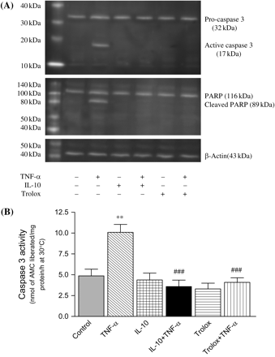
Figure 2 (A) Western blot analysis of the effects of TNF-α (10 ng/mL), IL-10 (10 ng/mL), IL-10 + TNF-α (ratio 1), ...
Notes:
Figure 2 (A) Western blot analysis of the effects of TNF-α (10 ng/mL), IL-10 (10 ng/mL), IL-10 + TNF-α (ratio 1), trolox (20 µmol/L), and trolox + TNF-α on caspase-3 activation and PARP cleavage in adult rat cardiomyocytes. β-Actin was used as an internal control. (B) Histograms show caspase-3 activity as measured in terms of fluoro-chrome, amino methyl coumarin (AMC), liberated in the fluorometric assay system (CaspACE™). Data are expressed as mean ± SEM from four to six independent cardiomyocyte isolations. The P-value (**P < 0.01) is significantly different from its control; ###P < 0.001 when compared with the TNF-α group.
Unless provided in the caption above, the following copyright applies to the content of this slide: Published on behalf of the European Society of Cardiology. All rights reserved. © The Author 2009. For permissions please email: journals.permissions@oxfordjournals.org.

Slide 3
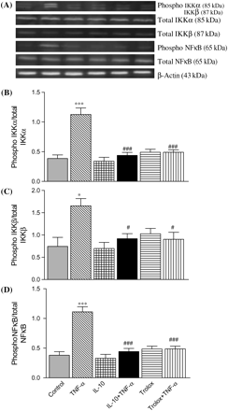
Figure 3 (A) Western blot analysis of the effects of TNF-α (10 ng/mL), IL-10 (10 ng/mL), IL-10 + TNF-α (ratio 1), ...
Notes:
Figure 3 (A) Western blot analysis of the effects of TNF-α (10 ng/mL), IL-10 (10 ng/mL), IL-10 + TNF-α (ratio 1), trolox (20 µmol/L), and trolox + TNF-α on IKKα, IKKβ, and NFκB phosphorylation in adult rat cardiomyocytes. β-Actin was used as an internal control. Histograms in each figure show densitometric analysis and the values are ratio of phosphorylated to total, IKKα (B), IKKβ (C), and NFκB (D) expression. The relative levels of protein expression were normalized to β-actin. Data are expressed as mean ± SEM from four to six independent cardiomyocyte isolations. P-values (*P < 0.05, ***P < 0.001) are significantly different from the respective control group; #P < 0.05, ###P < 0.001 vs. the respective TNF-α group.
Unless provided in the caption above, the following copyright applies to the content of this slide: Published on behalf of the European Society of Cardiology. All rights reserved. © The Author 2009. For permissions please email: journals.permissions@oxfordjournals.org.

Slide 4
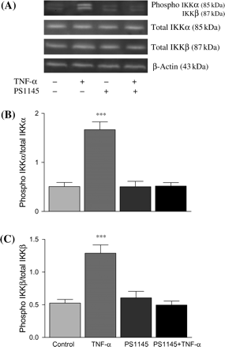
Figure 4 (A) Western blot analysis of the effects of PS-1145 on TNF-α-induced IKKα and IKKβ phosphorylation in ...
Notes:
Figure 4 (A) Western blot analysis of the effects of PS-1145 on TNF-α-induced IKKα and IKKβ phosphorylation in cardiomyocytes. Cells were pre-treated with 25 µM of PS-1145 for 15 min and then treated with TNF-α (10 ng/mL), for 4 h. β-Actin was used as an internal control. Histograms in each figure show densitometric analysis and the values are ratio of phosphorylated to total, IKKα (B), and IKKβ (C) expression. The relative levels of protein expression were normalized to β-actin. Data are expressed as mean ± SEM from four to six independent cardiomyocyte isolations. The P-value (***P < 0.001) is significantly different from the respective control group.
Unless provided in the caption above, the following copyright applies to the content of this slide: Published on behalf of the European Society of Cardiology. All rights reserved. © The Author 2009. For permissions please email: journals.permissions@oxfordjournals.org.

Slide 5
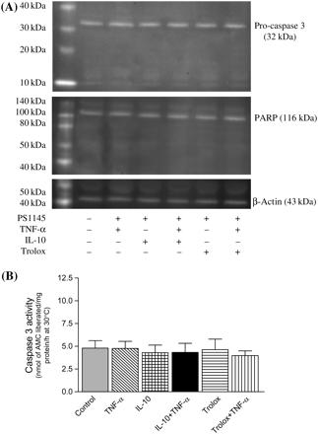
Figure 5 (A) Western blot analysis of the effects of IKK inhibition on caspase-3 activation and PARP cleavage in ...
Notes:
Figure 5 (A) Western blot analysis of the effects of IKK inhibition on caspase-3 activation and PARP cleavage in cardiomyocytes after different treatments: TNF-α (10 ng/mL), IL-10 (10 ng/mL), IL-10 + TNF-α (ratio 1), trolox (20 µmol/L), and trolox+TNF-α. Cells were pre-treated with 25 µM of PS1145 (IKK inhibitor) for 15 min. β-Actin was used as an internal control. (B) Histograms show caspase-3 activity as measured by fluorometric assay kit. Data are expressed as mean ± SEM from four to six independent cardiomyocyte isolations.
Unless provided in the caption above, the following copyright applies to the content of this slide: Published on behalf of the European Society of Cardiology. All rights reserved. © The Author 2009. For permissions please email: journals.permissions@oxfordjournals.org.

Slide 6
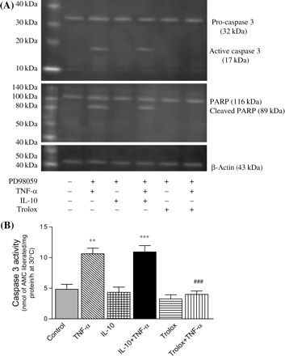
Figure 6 (A) Western blot analysis of the effects of ERK inhibition on caspase-3 activation and PARP cleavage in ...
Notes:
Figure 6 (A) Western blot analysis of the effects of ERK inhibition on caspase-3 activation and PARP cleavage in cardiomyocytes after treatment with TNF-α (10 ng/mL), IL-10 (10 ng/mL), IL-10 + TNF-α (ratio 1), trolox (20 µmol/L), and trolox + TNF-α. Cells were pre-treated with 25 µM of PD98059 (ERK inhibitor) for 15 min. β-Actin was used as an internal control. Histograms (B) show caspase-3 activity as measured by fluorometric assay kit. Data are expressed as mean ± SEM from four to six independent cardiomyocyte isolations. P-values (**P < 0.01, ***P < 0.001) are significantly different from its control; ###P < 0.001 when compared with the TNF-α group.
Unless provided in the caption above, the following copyright applies to the content of this slide: Published on behalf of the European Society of Cardiology. All rights reserved. © The Author 2009. For permissions please email: journals.permissions@oxfordjournals.org.

Slide 7
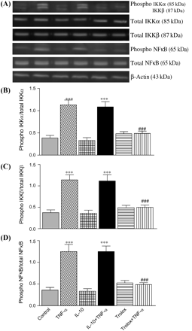
Figure 7 Effects of ERK inhibition on IKKα, IKKβ, and NFκB phosphorylation in adult rat cardiomyocytes after treatment ...
Notes:
Figure 7 Effects of ERK inhibition on IKKα, IKKβ, and NFκB phosphorylation in adult rat cardiomyocytes after treatment with TNF-α (10 ng/mL), IL-10 (10 ng/mL), IL-10 + TNF-α (ratio 1), trolox (20 µmol/L), and trolox + TNF-α. Cardiomyocytes were pre-treated with 25 µM of PD98059 (ERK inhibitor) for 15 min. β-Actin was used as an internal control. Histograms in each figure show densitometric analysis and the values are ratio of phosphorylated to total, IKKα (B), IKKβ (C), and NFκB (D) expression. The relative level of protein expression was normalized to β-actin. Data are expressed as mean ± SEM from four to six independent cardiomyocyte isolations. The P-value (***P < 0.001) is significantly different from its respective control; ###P < 0.001 when compared with the respective TNF-α group.
Unless provided in the caption above, the following copyright applies to the content of this slide: Published on behalf of the European Society of Cardiology. All rights reserved. © The Author 2009. For permissions please email: journals.permissions@oxfordjournals.org.

Slide 8
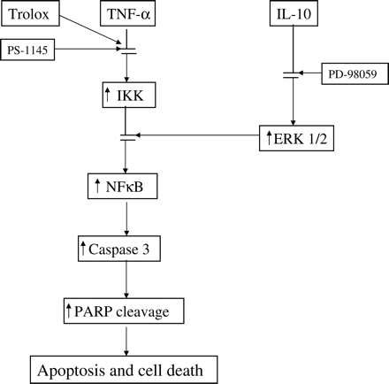
Figure 8 Schematic representation of the events in the involvement of NFκB pathway in the interplay of TNF-α and IL-10 ...
Notes:
Figure 8 Schematic representation of the events in the involvement of NFκB pathway in the interplay of TNF-α and IL-10 in the regulation of cardiomyocyte apoptosis. TNF-α-induced activation of NFκB via IKK phosphorylation leads to caspase-3 as well as PARP cleavage and cardiomyocyte apoptosis. On the other hand, IL-10 up-regulation of ERK 1/2 phosphorylation builds up a negative regime targeting IKK, thus blocking TNF-α-induced cardiomyocyte apoptosis by suppressing NFκB activation.
Unless provided in the caption above, the following copyright applies to the content of this slide: Published on behalf of the European Society of Cardiology. All rights reserved. © The Author 2009. For permissions please email: journals.permissions@oxfordjournals.org.

