Slide 1
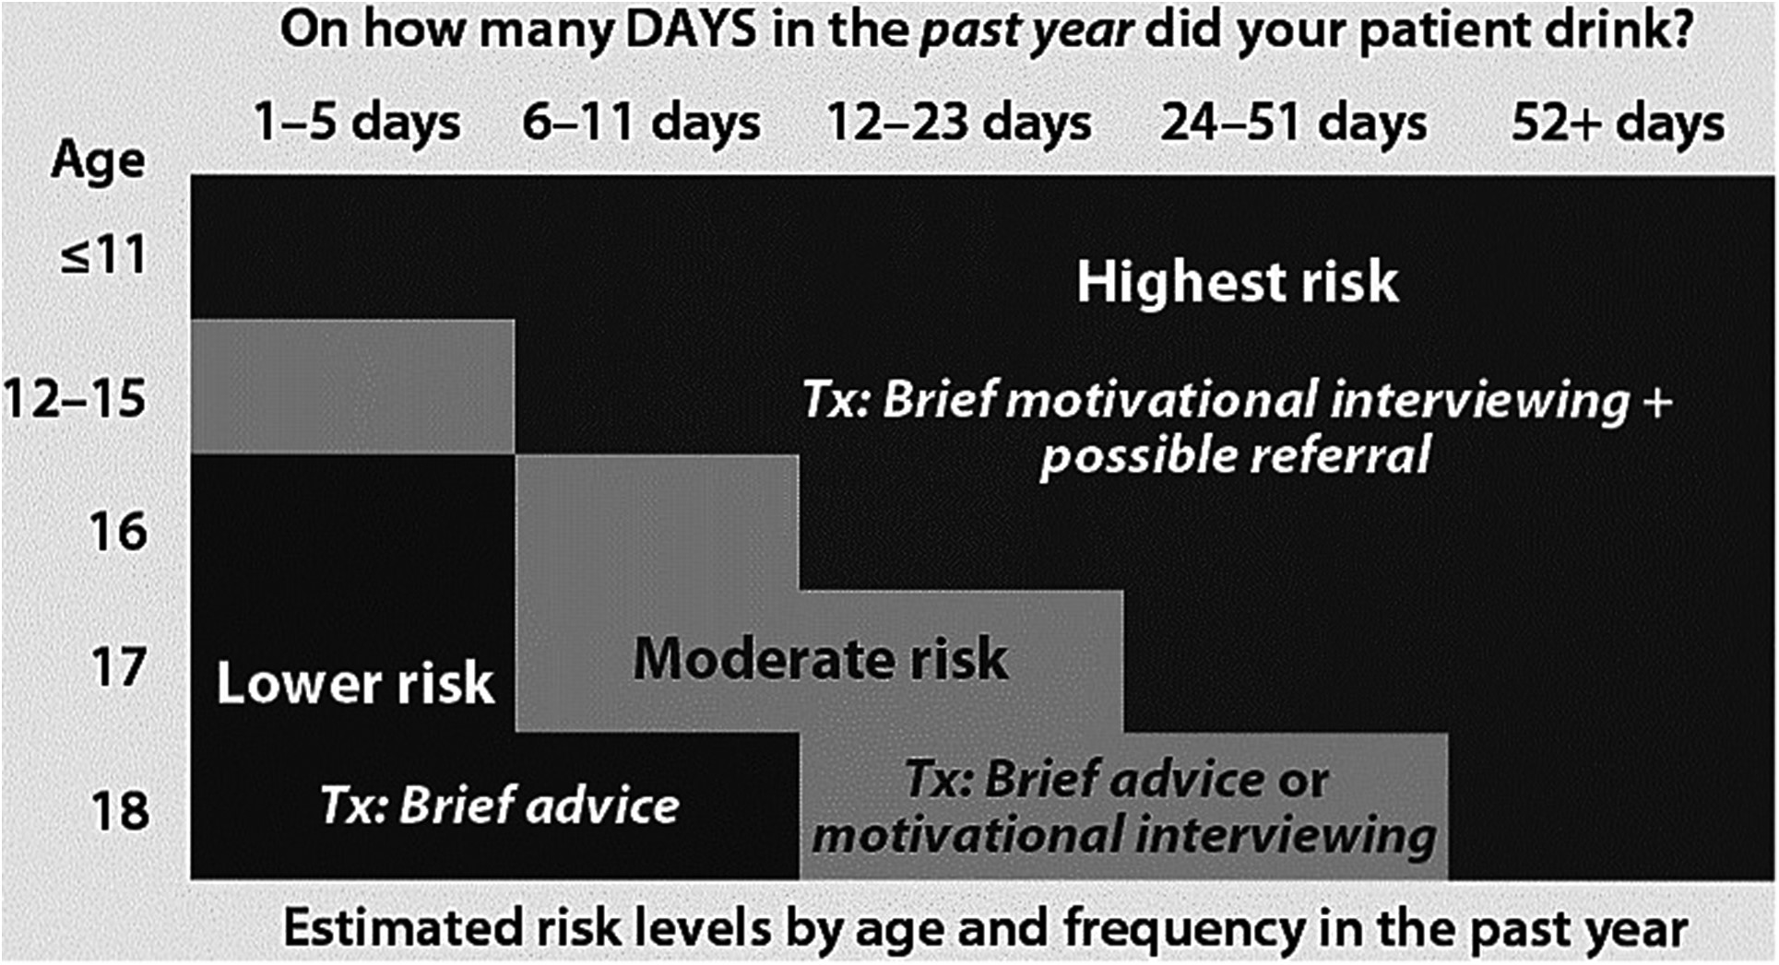
Fig. 1. NIAAA/AAP screener categorization of felf-use item. Description of NIAAA/AAP risk categorization for the ...
Notes:
Fig. 1. NIAAA/AAP screener categorization of felf-use item. Description of NIAAA/AAP risk categorization for the self-risk profile taken from the NIAAA (2011).
Unless provided in the caption above, the following copyright applies to the content of this slide: © The Author 2017. Medical Council on Alcohol and Oxford University Press. All rights reserved

