Slide 1
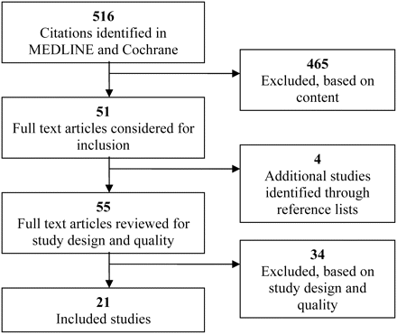
Figure 1 Flow chart of study selection process.
Notes:
Figure 1 Flow chart of study selection process.
Unless provided in the caption above, the following copyright applies to the content of this slide: © The Author 2009. Published by Oxford University Press in association with the International Society for Quality in Health Care; all rights reserved

