Slide 1
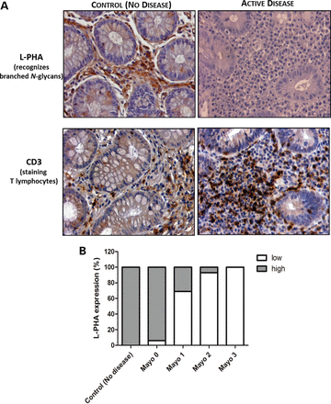
Figure 1. Relationship between the levels of lymphocytic branched N-glycans expression and the inflammatory activity. ...
Notes:
Figure 1. Relationship between the levels of lymphocytic branched N-glycans expression and the inflammatory activity. (A) A total number of 64 colonic biopsies were analyzed for L-PHA expression in the intestinal lamina propria lymphocytic infiltrate positive to CD3 expression (B). There was a significant association (P 75%) in intestinal lymphocytic infiltrates CD3+ (left figures). On the contrary, right figures represent a case of active UC (Mayo subscore 3) showing a significant decrease of L-PHA reactivity in the lamina propria T lymphocytes (<25%) displaying heavy CD3 cell infiltrates. Amplification ×400. (The evaluation of the relationship between the expression of lymphocytic β1,6 GlcNAc branched structures and the inflammatory activity considering the four percentual categories (75%) is statistically significant (CI:95%) and the table is provided in Supplementary Material, Table S1. The regrouping in two categories (Low and High) did not change the P value and did not influence statistically the results.)
Unless provided in the caption above, the following copyright applies to the content of this slide: © The Author 2013. Published by Oxford University Press. All rights reserved. For Permissions, please email: journals.permissions@oup.com

Slide 2
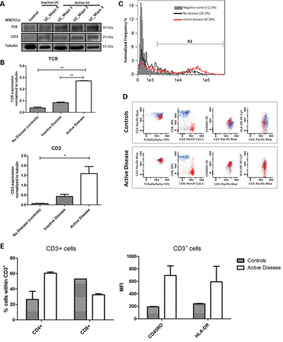
Figure 2. TCR and CD3 expression levels. (A) The results showed that active UC patients had significantly higher levels ...
Notes:
Figure 2. TCR and CD3 expression levels. (A) The results showed that active UC patients had significantly higher levels of both TCRβ and CD3 expression compared with normal controls. UC patients with severe disease (Mayo subscore 3) showed the highest levels of TCRβ and CD3 protein expression. Inactive UC patients (Mayo endoscopic subscore 0) exhibited an increased TCRβ and CD3 expression levels compared with normal controls. (B) Bar graphs, quantification of TCRβ and CD3 densities normalized to tubulin. Results are described as mean ± SEM of three independent experiments (Student's t-test: *P ≤ 0.05; **P ≤ 0.01). In order to confirm the differential expression levels of TCR between normal controls and active UC patients, LPLs obtained from the fresh colonic biopsies were analyzed for this marker by imaging flow cytometry (C). The percentage of cells expressing TCRαβ in gate R2 is indicated in brackets. The results showed that isolated LPLs from active UC patients express higher TCRαβ expression levels compared with normal controls. Negative control refers to unstained cells (C). Lanes in (A) were on the different gels (black lines). Characterization of the T cells subsets and activation state. (D) Flow cytometry dot-plots illustrating the CD4+ (red) and CD8+ (blue) T cells populations and expression of CD45RO and HLA-DR on intestinal T cells from normal individuals (n = 2 biological replicates) and UC patients (n = 2 biological replicates). (E) Bar graphs, showing that CD3+ T cells are predominantly represented by CD4+ cells in UC patients and by CD8+ cells in normal individuals (left graph). The activation state of CD3+ T cells was evaluated by the MFI due to antigen staining of the activation-related markers, HLA-DR and CD45RO. Intestinal T cells from UC patients exhibit a higher level of expression of these activation-related markers (right graph).
Unless provided in the caption above, the following copyright applies to the content of this slide: © The Author 2013. Published by Oxford University Press. All rights reserved. For Permissions, please email: journals.permissions@oup.com

Slide 3
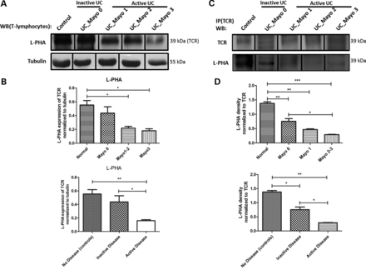
Figure 3. Alteration of intestinal TCR N-glycosylation in UC patients. (A) Protein lysates from the isolated LPLs were ...
Notes:
Figure 3. Alteration of intestinal TCR N-glycosylation in UC patients. (A) Protein lysates from the isolated LPLs were subjected to L-PHA lectin blot in order to evaluate the expression levels of β1,6 GlcNAc branched N-glycans on the TCR (39 kDa). The results showed a decreased TCR branched glycosylation in UC patients compared with normal controls. Patients with severe disease (Mayo subscore 3) had the lowest branched N-glycosylation modification of TCR. (B) Bar graphs, quantification of L-PHA densities on TCR band normalized to tubulin. Results are described as mean ± SEM of three independent experiments (Student's t-test: *P ≤ 0.05; **P ≤ 0.01). (C) Immunoprecipiation of TCR followed by β1,6 GlcNAc branched N-glycans recognition. As observed in (A) and (B), the intestinal TCR from UC patients (with inactive and active disease) suffered a decreased modification with branched N-glycans compared with normal controls. UC patients with severe disease (Mayo subscore 3) showed the lowest levels of TCR branched N-glycosylation. (D) Bar graphs, amounts of branched N-glycan structures were determined from the ratios of densities of L-PHA reactivity normalized to TCR. Results are described as mean ± SEM of three independent experiments (Student's t-test: *P ≤ 0.05; **P ≤ 0.01; ***P ≤ 0.005). Lanes in (A) and (C) were on the different gels (black lines).
Unless provided in the caption above, the following copyright applies to the content of this slide: © The Author 2013. Published by Oxford University Press. All rights reserved. For Permissions, please email: journals.permissions@oup.com

Slide 4
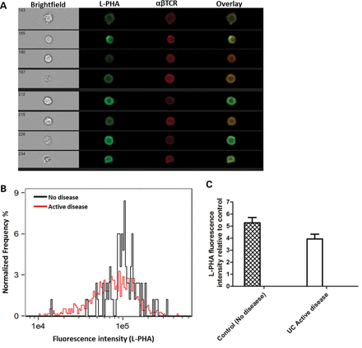
Figure 4. Imaging flow cytometry analysis of L-PHA membrane distribution in TCR positive cells. Intestinal LPLs were ...
Notes:
Figure 4. Imaging flow cytometry analysis of L-PHA membrane distribution in TCR positive cells. Intestinal LPLs were surface stained for TCRαβ and branched N-glycans (L-PHA) and analyzed on an ImageStreamX. (A) Examples of brightfield, L-PHA (green), TCRαβ (red) and overlaid images showing co-localization between TCRαβ and L-PHA. (B) Histogram representing the intensity of L-PHA staining on the TCRαβ+ cells. (C) The intensity of L-PHA staining on the cell membrane of TCRαβ+ cells was measured by imaging flow cytometry, and normalized relatively to cells stained only with streptavidin-FITC (negative control). Data show the average of two independent experiments. Error bars represent the mean ± SEM. The results indicate that UC patients with active disease (Mayo subscore ≥1) exhibit decreased levels of L-PHA staining at the cell membrane of TCRαβ+ cells comparing with normal controls.
Unless provided in the caption above, the following copyright applies to the content of this slide: © The Author 2013. Published by Oxford University Press. All rights reserved. For Permissions, please email: journals.permissions@oup.com

Slide 5
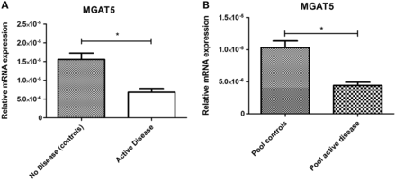
Figure 5. Deficiency of MGAT5 gene expression in LPLs from UC patients. (A) qRT-PCR analysis for mRNA expression of ...
Notes:
Figure 5. Deficiency of MGAT5 gene expression in LPLs from UC patients. (A) qRT-PCR analysis for mRNA expression of MGAT5 from intestinal LPLs from normal controls and active UC patients (Mayo subscore 1,2,3). Results in (A) are an average of three independent experiments, performed in triplicate, using RNA from three independent normal controls and three independent active UC patients. (B) Represents the average of two independent experiments using RNA of intestinal LPLs pooled from four different normal controls and four different UC patients, performed in triplicate. There is a significant decrease of MGAT5 mRNA expression from intestinal LPLs of UC patients (with active disease) compared with normal controls. The mRNA expression levels are expressed as mean ± SEM (Student's t-test: *P ≤ 0.01).
Unless provided in the caption above, the following copyright applies to the content of this slide: © The Author 2013. Published by Oxford University Press. All rights reserved. For Permissions, please email: journals.permissions@oup.com

Slide 6
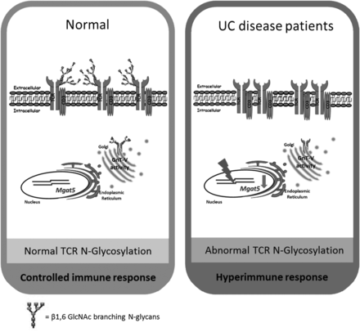
Figure 6. A model for the dysregulation of TCR N-glycosylation in UC. In intestinal homeostasis and under normal ...
Notes:
Figure 6. A model for the dysregulation of TCR N-glycosylation in UC. In intestinal homeostasis and under normal conditions, the T cell activation (TCR signaling) induces up-regulation of MGAT5 gene which in turns leads to GnT-V-mediated glycosylation of the TCR. The increased β1,6GlcNAc branching synthesis on TCR, catalyzed by GnT-V, negatively regulates T cell response promoting growth arrest of T cells by raising T cell activation thresholds via limiting TCR clustering at the immune synapse. This GnT-V-mediated branched glycosylation of the TCR is associated with a controlled immune response. In UC patients, we propose the existence of a dysregulation of the intestinal TCR N-glycosylation catalyzed by GnT-V. Alterations on the transcription levels of MGAT5 glycogene of the intestinal T cells appear to underlie the deficiency of GnT-V-mediated glycosylation on the TCR. This dysregulation of TCR branched N-glycosylation contribute to decrease the threshold of T-cell activation leading to a hyperimmune response, which is a feature of UC patients.
Unless provided in the caption above, the following copyright applies to the content of this slide: © The Author 2013. Published by Oxford University Press. All rights reserved. For Permissions, please email: journals.permissions@oup.com

