Slide 1
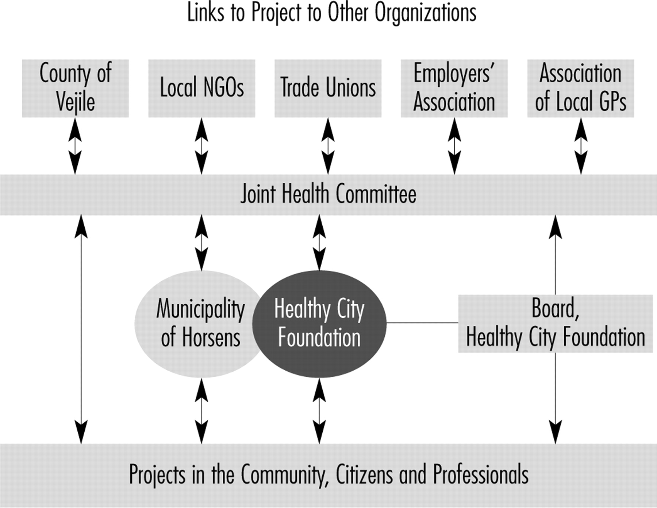
Fig. 1: Partnership arrangements of the Horsens Healthy Cities Project in 1994.
Notes:
Fig. 1: Partnership arrangements of the Horsens Healthy Cities Project in 1994.
Unless provided in the caption above, the following copyright applies to the content of this slide: © The Author (2009). Published by Oxford University Press. All rights reserved. For Permissions, please email: journals.permissions@oxfordjournals.org

Slide 2
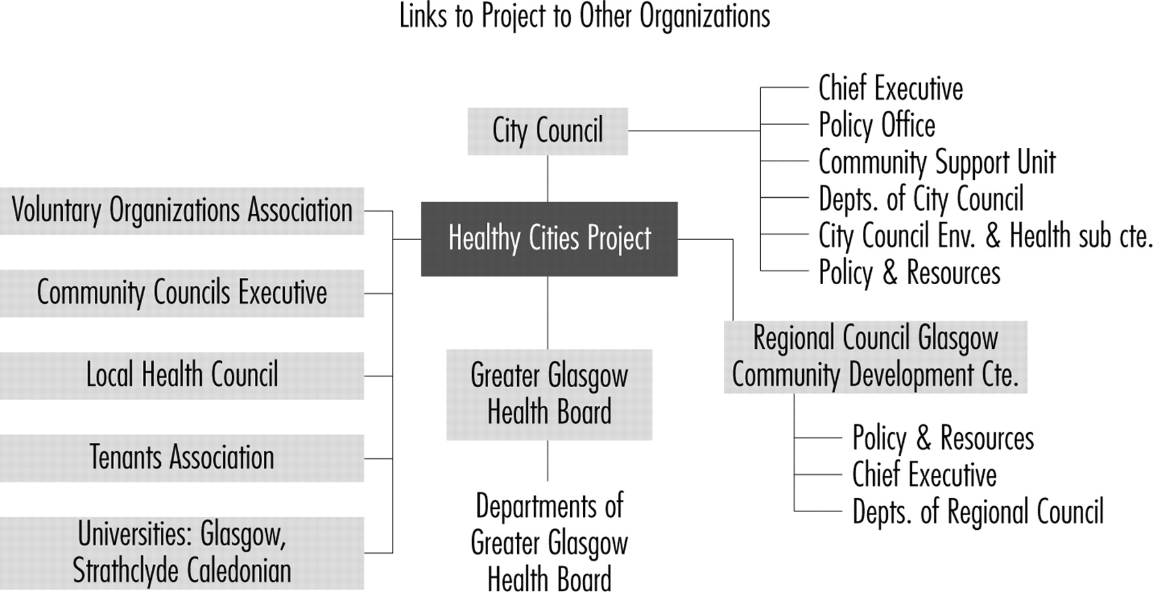
Fig. 2: Partnership arrangements of the Glasgow Healthy Cities Project in 1994.
Notes:
Fig. 2: Partnership arrangements of the Glasgow Healthy Cities Project in 1994.
Unless provided in the caption above, the following copyright applies to the content of this slide: © The Author (2009). Published by Oxford University Press. All rights reserved. For Permissions, please email: journals.permissions@oxfordjournals.org

Slide 3
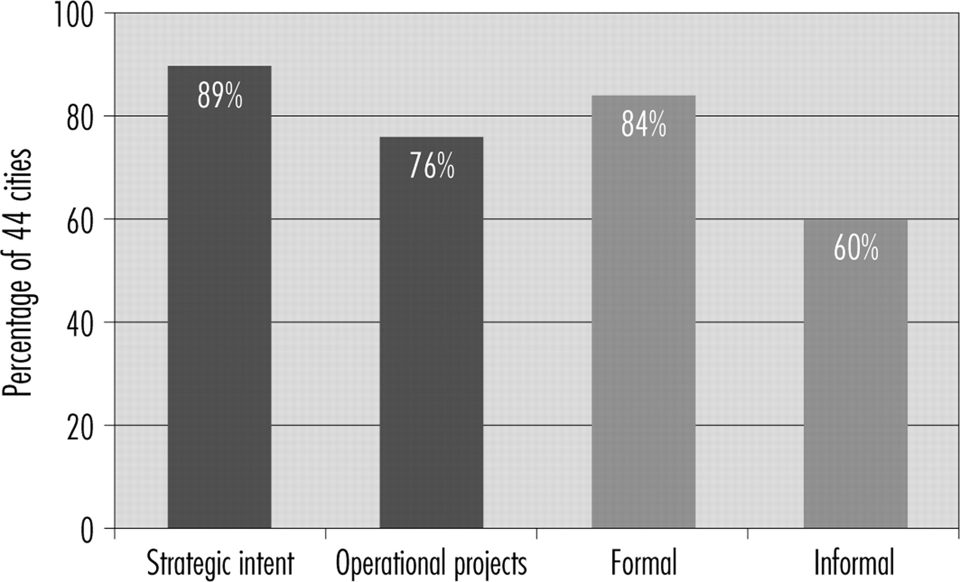
Fig. 3: Scope and focus of 44 Healthy Cities Projects.
Notes:
Fig. 3: Scope and focus of 44 Healthy Cities Projects.
Unless provided in the caption above, the following copyright applies to the content of this slide: © The Author (2009). Published by Oxford University Press. All rights reserved. For Permissions, please email: journals.permissions@oxfordjournals.org

Slide 4
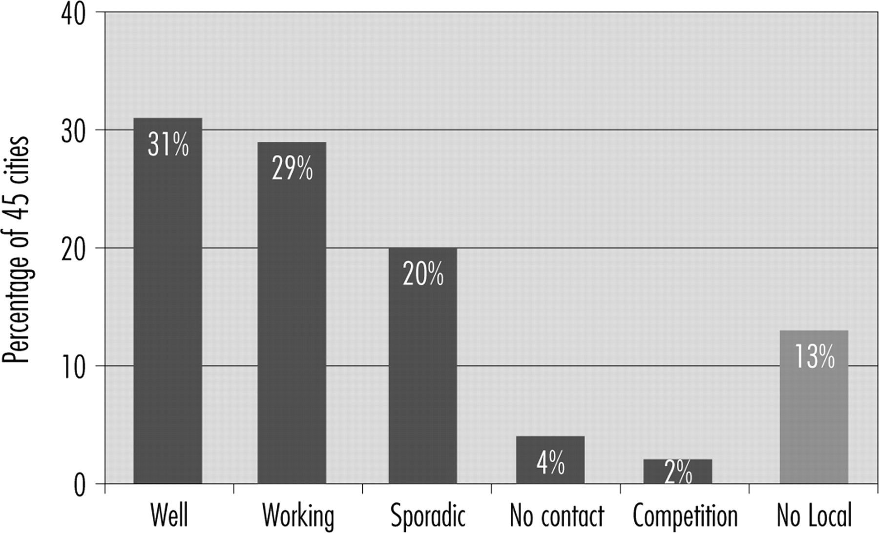
Fig. 4: Self-rated relationship between Healthy Cities projects and Local Agenda 21.
Notes:
Fig. 4: Self-rated relationship between Healthy Cities projects and Local Agenda 21.
Unless provided in the caption above, the following copyright applies to the content of this slide: © The Author (2009). Published by Oxford University Press. All rights reserved. For Permissions, please email: journals.permissions@oxfordjournals.org

