Slide 1
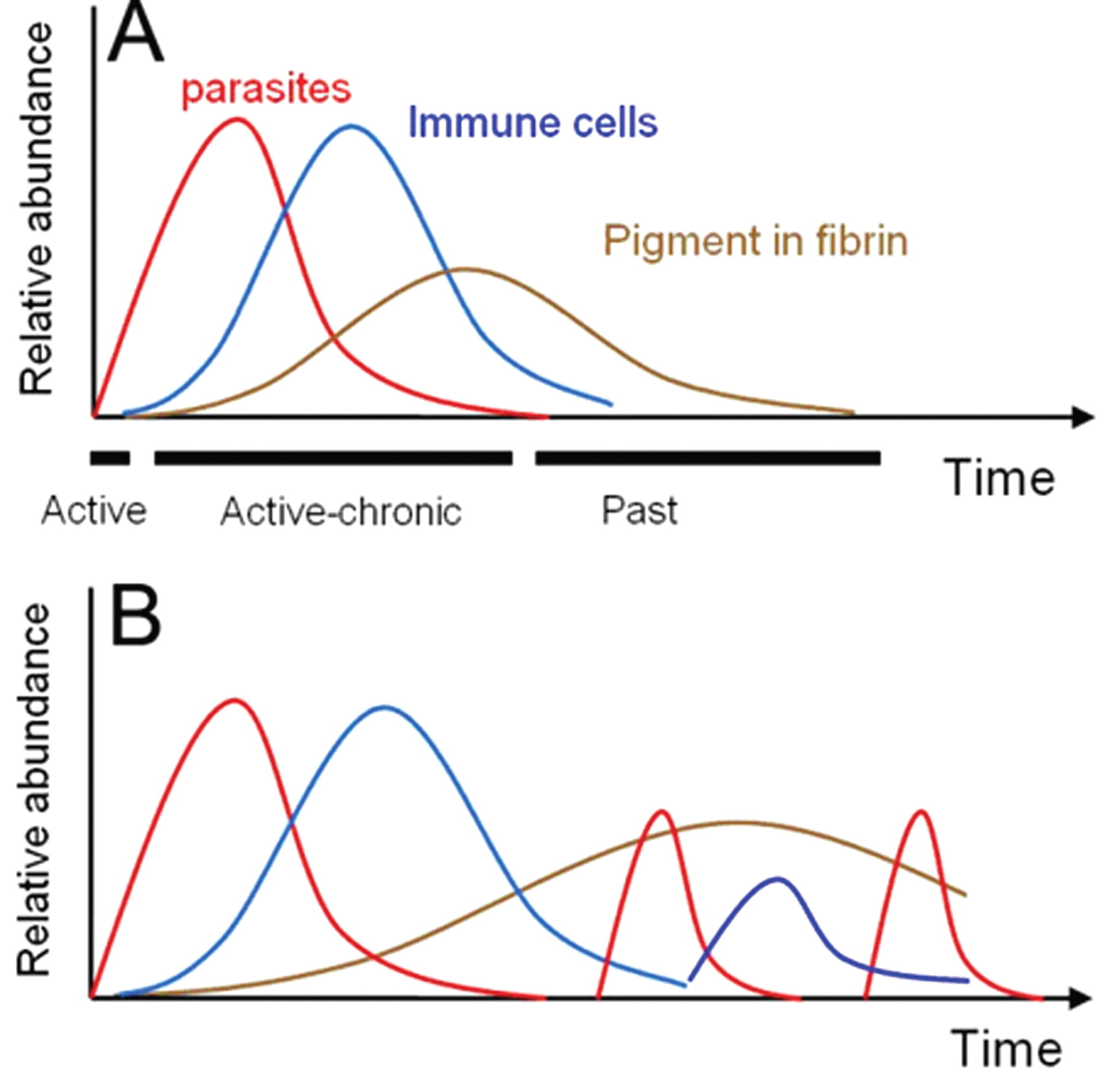
Figure 1 Schematics of a hypothetical single placental malaria (PM) episode in a susceptible woman (A) and ...
Notes:
Figure 1 Schematics of a hypothetical single placental malaria (PM) episode in a susceptible woman (A) and recrudescences and reinfections in a single woman that can lead to varying degrees of parasitemia, inflammation, and pigment (B), especially when the drugs for intermittent preventive treatment or treatment are not effective.
Unless provided in the caption above, the following copyright applies to the content of this slide: © 2010 by the Infectious Diseases Society of America

Slide 2
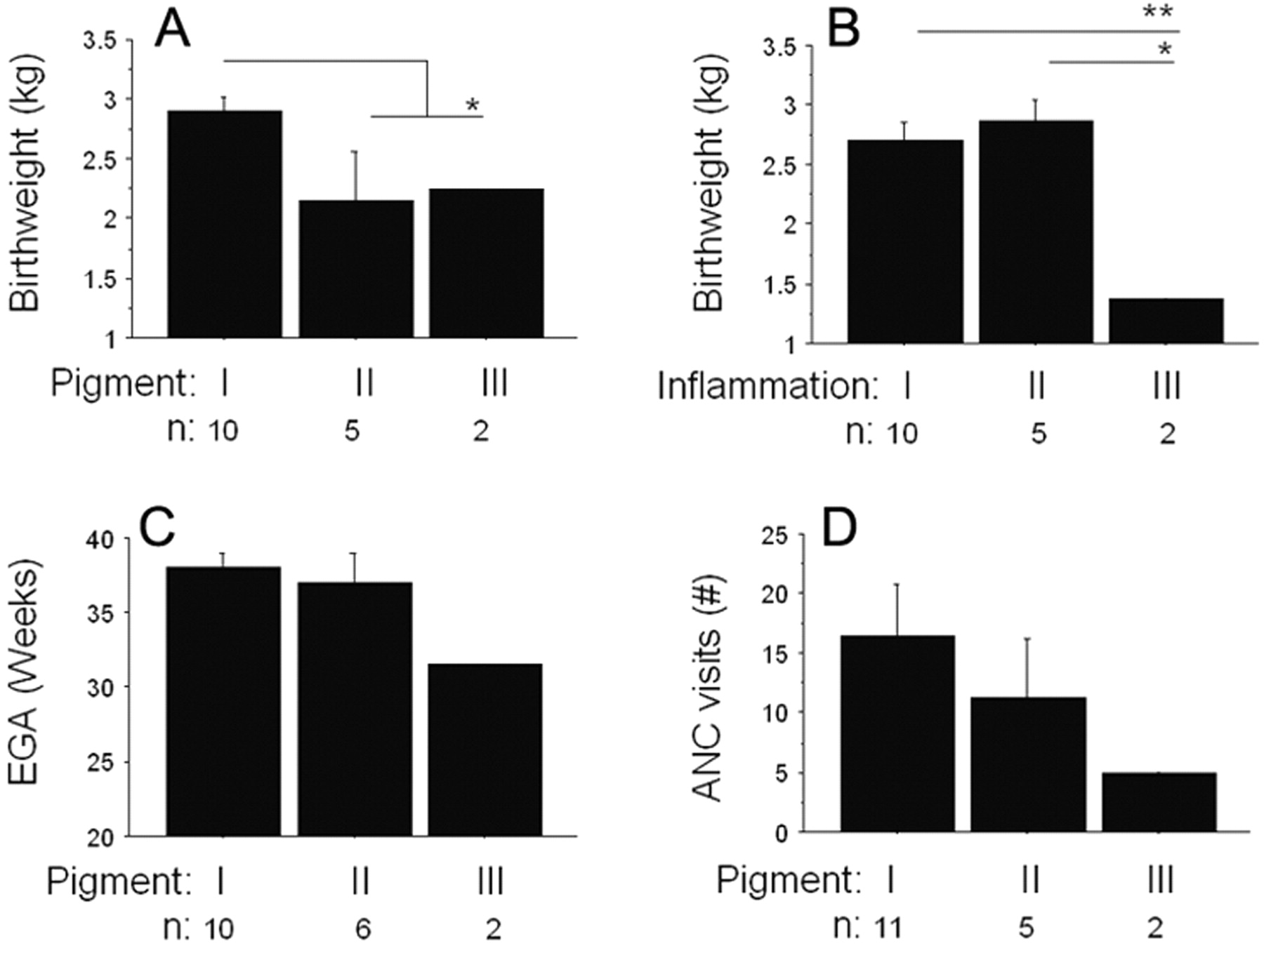
Figure 6 Inflammation and pigment scores in Karen women who had received a diagnosis of Plasmodium falciparum malaria ...
Notes:
Figure 6 Inflammation and pigment scores in Karen women who had received a diagnosis of Plasmodium falciparum malaria within 2 weeks before delivery. Shown are the relationships between birth weight and pigment score (A), birth weight and inflammation score (B), estimated gestational age (EGA) and pigment score (C), and number of antenatal clinic (ANC) visits and pigment score (D). *P < .05; **P < .01.
Unless provided in the caption above, the following copyright applies to the content of this slide: © 2010 by the Infectious Diseases Society of America

Slide 3
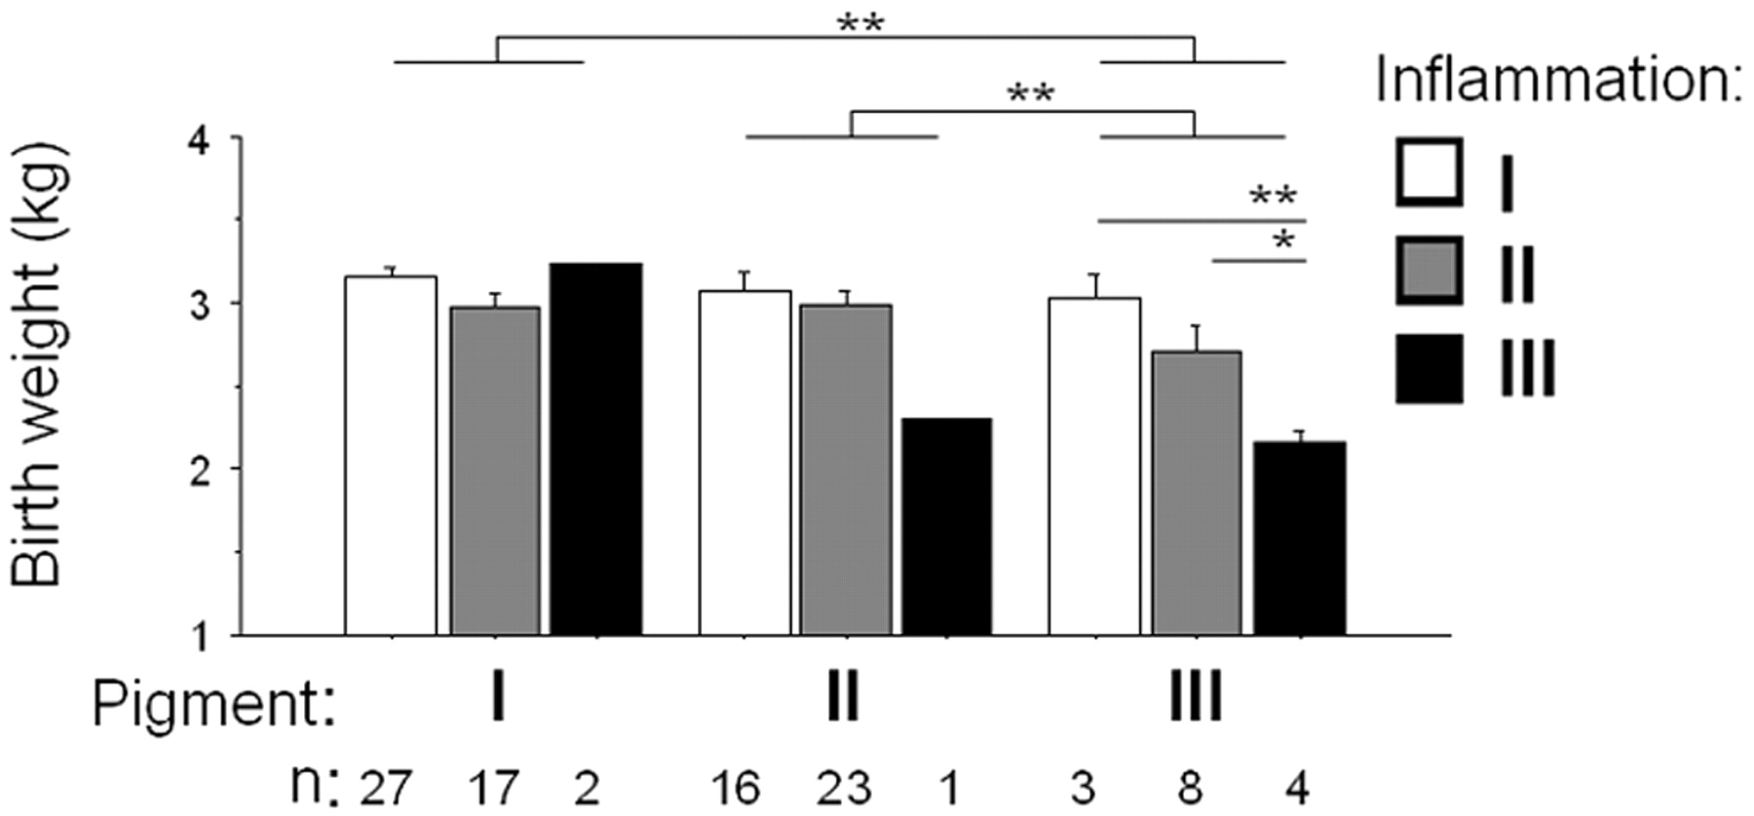
Figure 4 Inflammation and pigment scores in relation to birth weight in Tanzanian women of all parities. *P < .05; **P ...
Notes:
Figure 4 Inflammation and pigment scores in relation to birth weight in Tanzanian women of all parities. *P < .05; **P < .01.
Unless provided in the caption above, the following copyright applies to the content of this slide: © 2010 by the Infectious Diseases Society of America

Slide 4
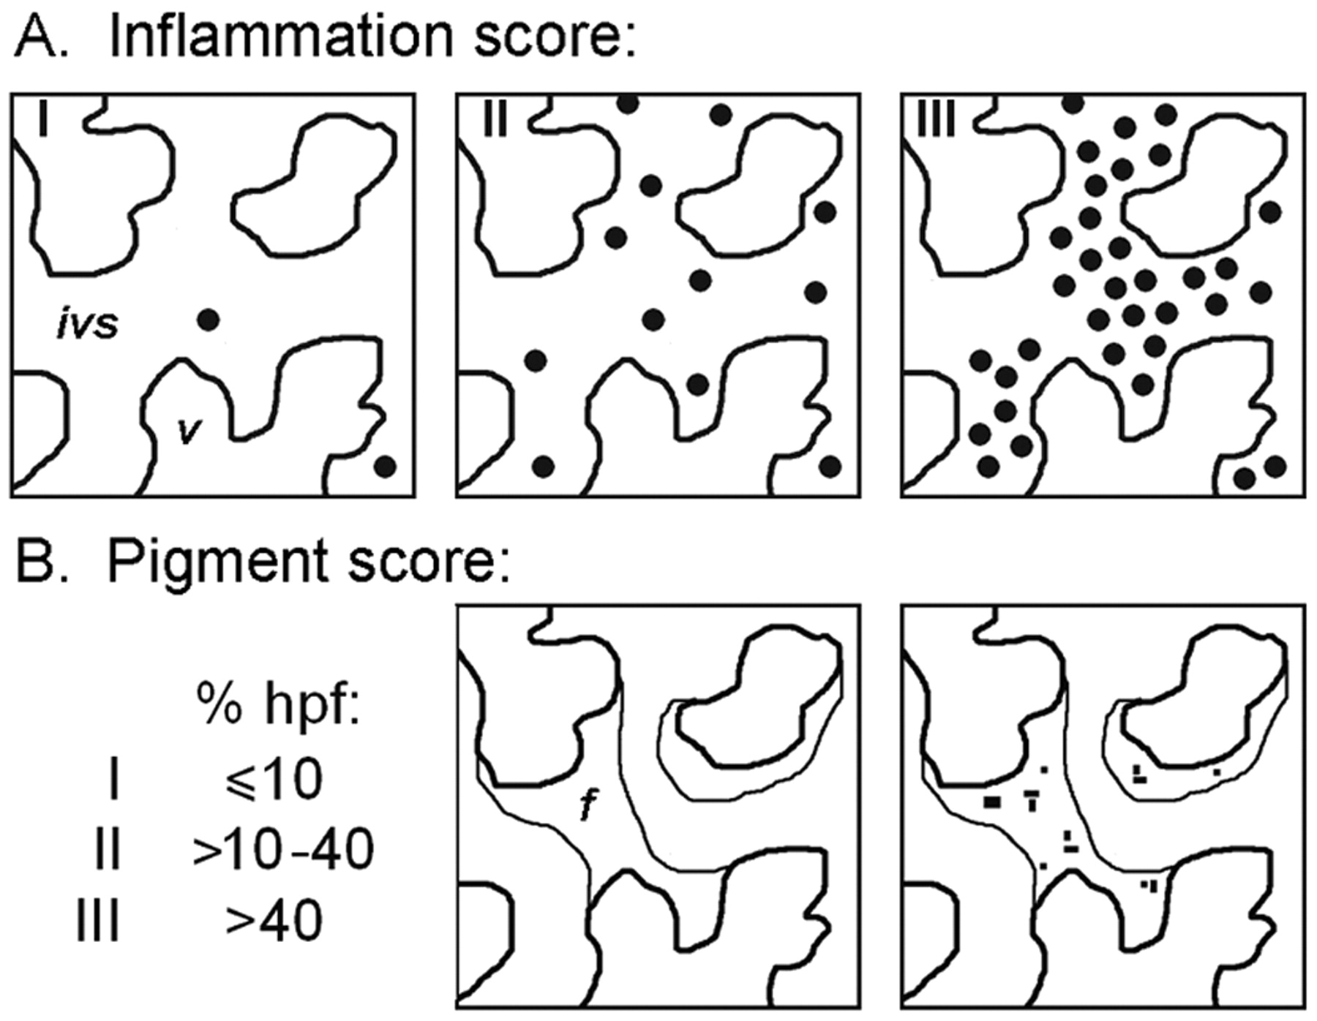
Figure 3 Schematic demonstrating placental villi (v) for grading the histologic features of placental malaria (PM). A, ...
Notes:
Figure 3 Schematic demonstrating placental villi (v) for grading the histologic features of placental malaria (PM). A, Categories of maternal inflammation in the intervillous spaces (ivs): I, minimal; II, present; and III, massive. B, Cutoff values (percentage of 60× high-power fields [hpf]) for categorizing malarial pigment deposition in intervillous fibrin (f).
Unless provided in the caption above, the following copyright applies to the content of this slide: © 2010 by the Infectious Diseases Society of America

Slide 5
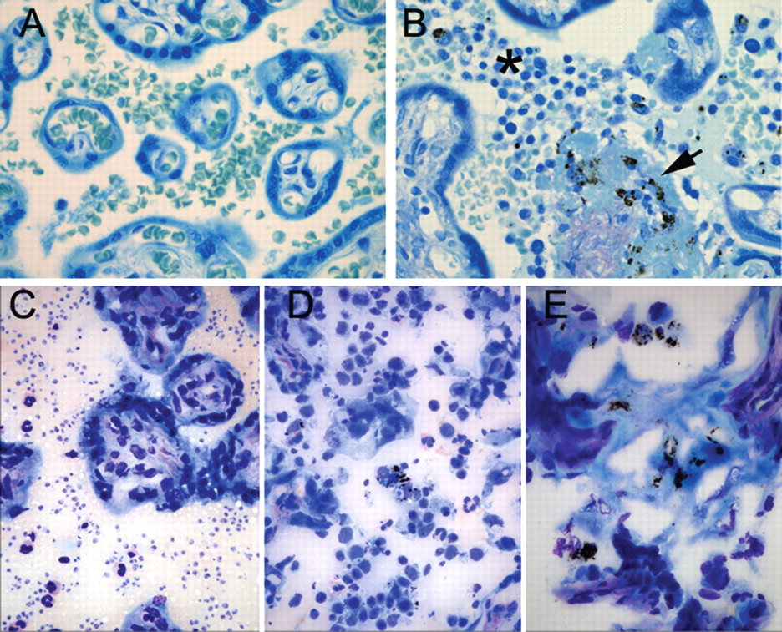
Figure 2 A and B, Formalin-fixed, paraffin-embedded placental tissue section from women with placental malaria (PM) at ...
Notes:
Figure 2 A and B, Formalin-fixed, paraffin-embedded placental tissue section from women with placental malaria (PM) at the Thai-Burma border. A, Remote infection, with no histologic alteration. B, Plasmodium falciparum infection at delivery, with inflammatory infiltrate (asterisk) and pigment deposition in fibrin (arrow). C–E, Fresh-frozen, Giemsa-stained sections from women with PM in Tanzania. The features of placental malaria are readily identified: parasites (C), inflammation (D), and pigment (E) deposition in fibrin. Original magnification, ×400.
Unless provided in the caption above, the following copyright applies to the content of this slide: © 2010 by the Infectious Diseases Society of America

Slide 6
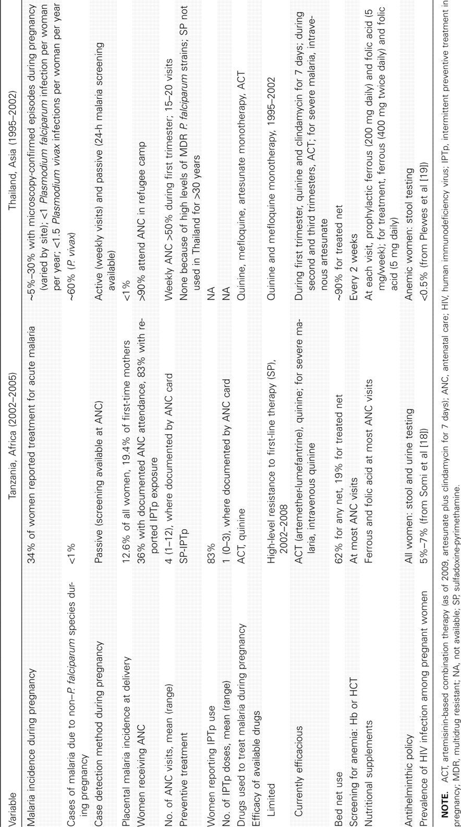
Table 1 Malaria Epidemiology, Therapy, and Antenatal Care during Pregnancy in the Tanzania and Thailand Cohorts
Notes:
Table 1 Malaria Epidemiology, Therapy, and Antenatal Care during Pregnancy in the Tanzania and Thailand Cohorts
Unless provided in the caption above, the following copyright applies to the content of this slide: © 2010 by the Infectious Diseases Society of America

Slide 7
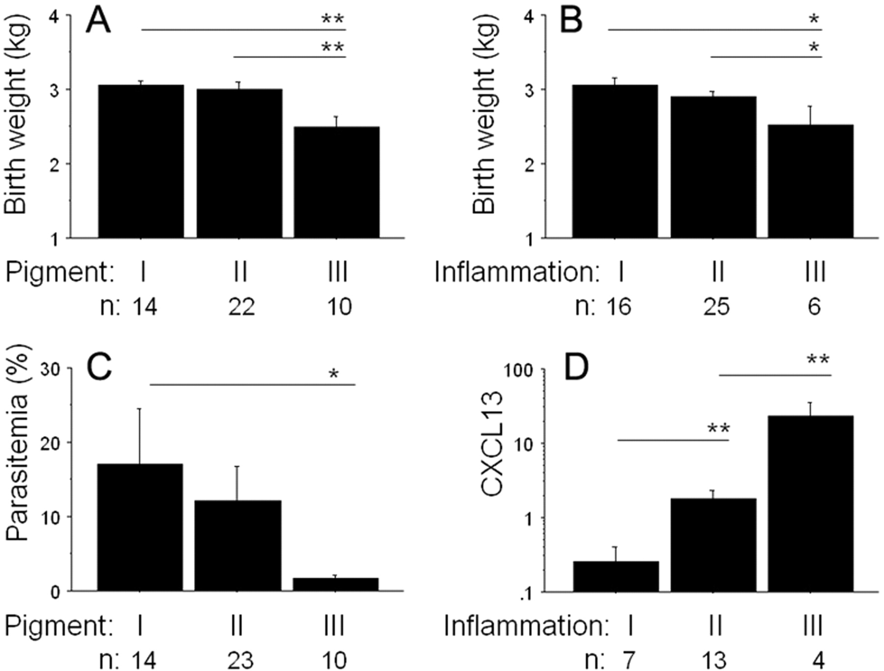
Figure 5 Inflammation and pigment scores examined in Tanzanian first-time mothers. Shown are the relationships between ...
Notes:
Figure 5 Inflammation and pigment scores examined in Tanzanian first-time mothers. Shown are the relationships between birth weight and pigment score (A), birth weight and inflammation score (B), placental parasitemia and pigment score (C), and placental CXCL13 transcript levels (fold change over cytokeratin 7 expression) and inflammation score (D). *P < .05; **P < .01.
Unless provided in the caption above, the following copyright applies to the content of this slide: © 2010 by the Infectious Diseases Society of America

