Slide 1
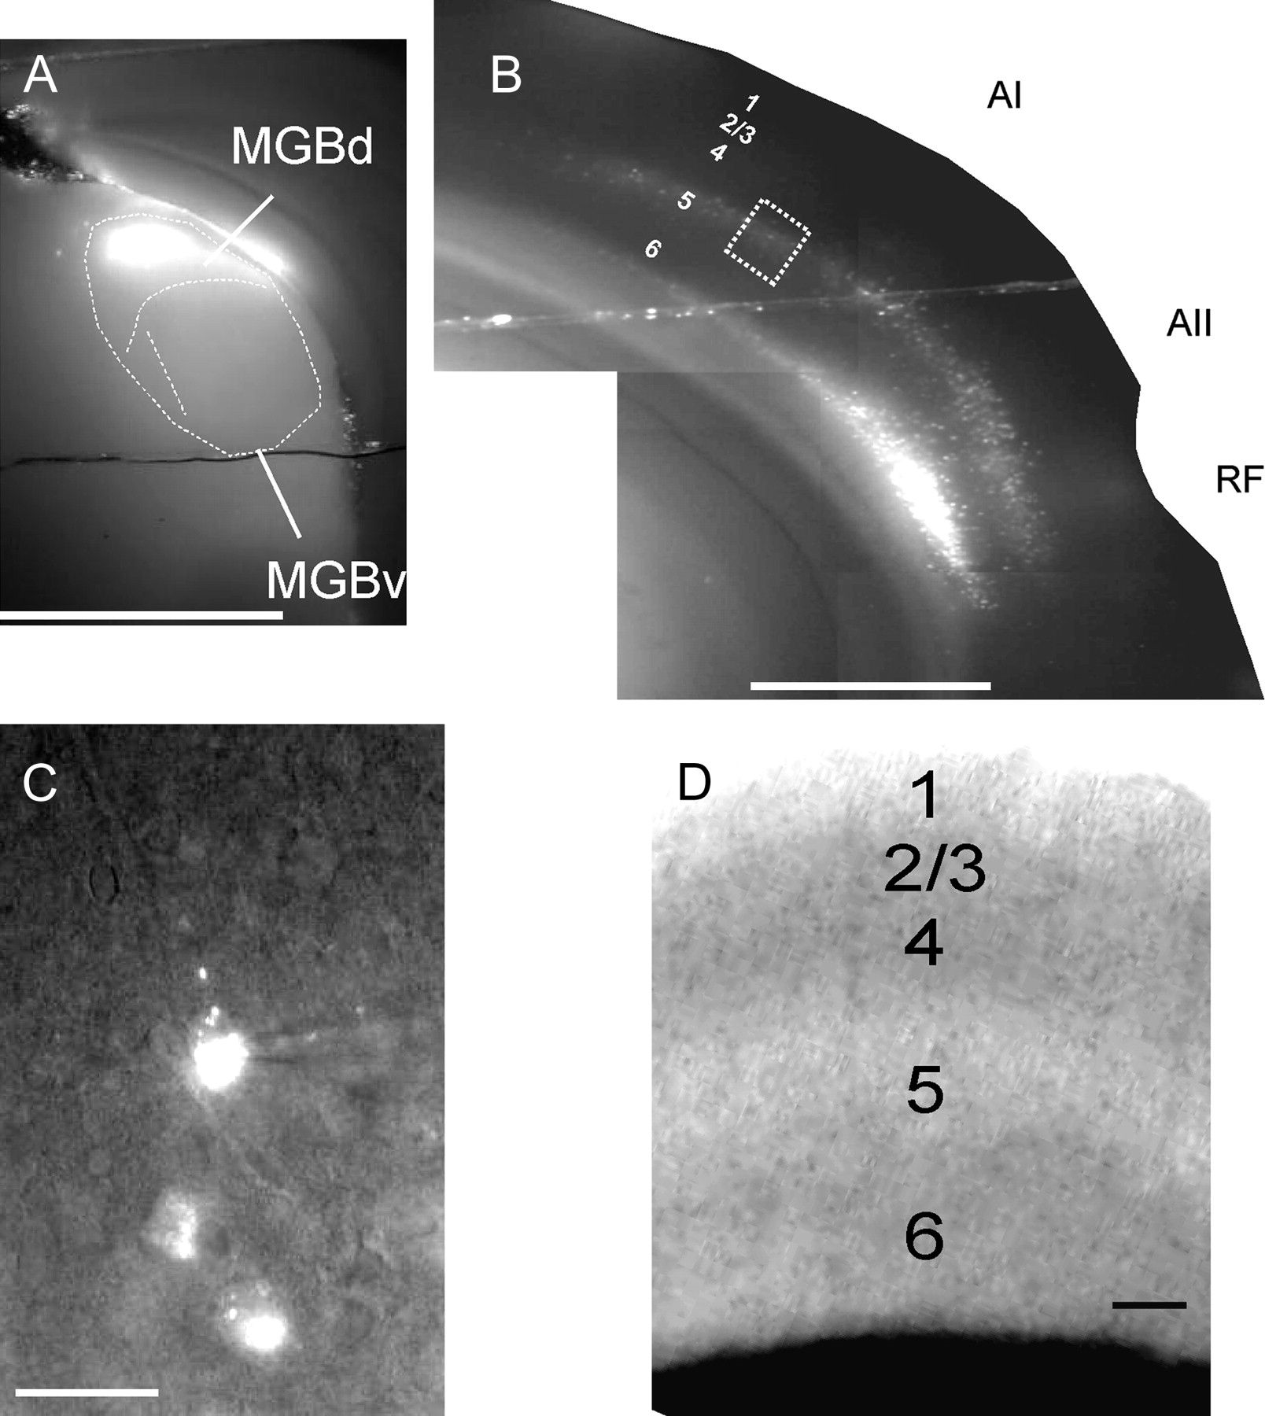
Figure 1. Fluorescent (Zeiss filter set #15: Excitation filter BP 546/12, Emission filter LP 590, Dichroic FT 580) ...
Notes:
Figure 1. Fluorescent (Zeiss filter set #15: Excitation filter BP 546/12, Emission filter LP 590, Dichroic FT 580) photos, taken as monochrome and of a slice while in the recording apparatus. (A) The ×5 photograph of typical injection site in the medial geniculate body. MGBd = dorsal division of the MGB. MGBv = ventral division of the medial geniculate body. (B) Retrograde cortical labeling in the same slice. Note that the MGBd injection produces retrogradely labeled neurons in layers 5 and 6 of the auditory cortex, with a predominance of layer 5 label in the primary auditory cortex (AI) and both layers 5 and 6 of the secondary auditory cortex (AII). RF = rhinal fissure. Scale bar for (A, B) = 1mm. (C) The ×40 view of labeled cells from dotted box in (B). A patch pipette is shown patched onto the top cell. Scale bar = 25 μm. (D) The ×10 IR-DIC photograph of the primary auditory cortex while in the recording chamber to illustrate the lamination patterns used to designate individual layers in this study. Scale bar = 100 μm.
Unless provided in the caption above, the following copyright applies to the content of this slide: © The Author 2009. Published by Oxford University Press. All rights reserved. For permissions, please e-mail: journals.permissions@oxfordjournals.org

Slide 2
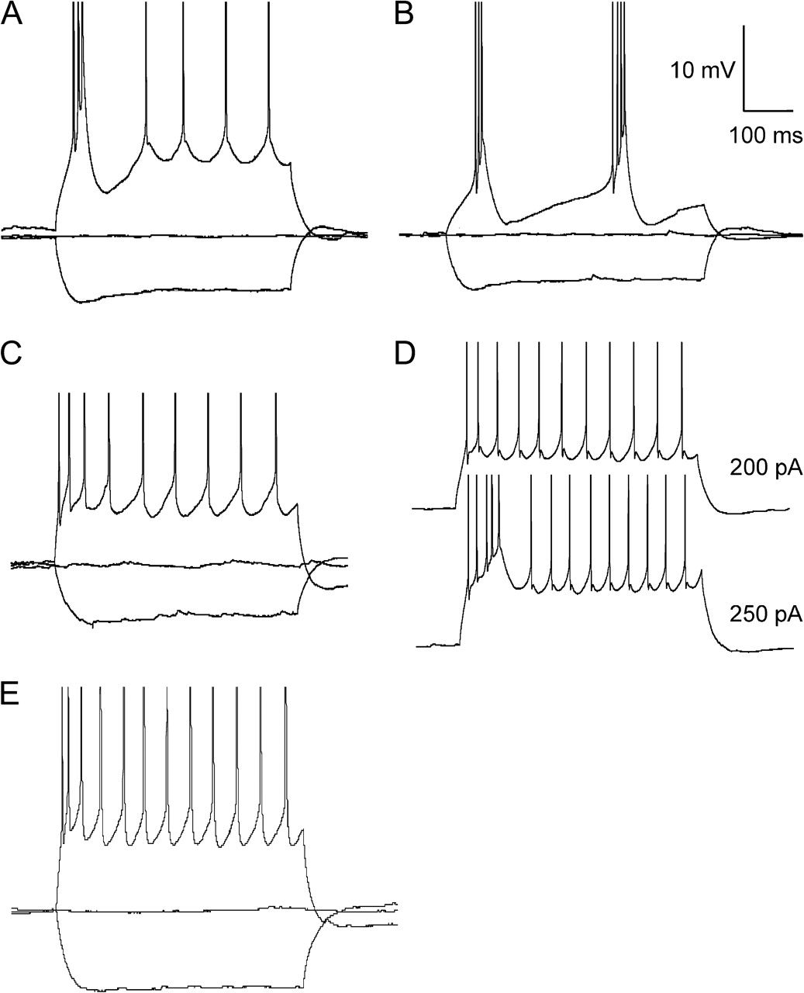
Figure 2. Examples of firing modes observed in corticothalamic neurons. (A) Layer 5 low-threshold bursting neuron, ...
Notes:
Figure 2. Examples of firing modes observed in corticothalamic neurons. (A) Layer 5 low-threshold bursting neuron, demonstrating a burst of fast action potentials riding a slow depolarizing wave at stimulus onset. (B) A small number (7/34) of layer 5 low-threshold bursting cells showed repetitive bursting at low threshold. (C) Regular spiking layer 5 corticothalamic neuron. (D) Example of a high-threshold bursting neuron. In this case, the neuron fires a train of individual action potentials in response to a 200 pA current step and then fires a burst of action potentials in response to a 250 pA current step. (E) Example of a layer 6 corticothalamic neuron. This neuron fires a train of individual action potentials in response to a depolarizing pulse. Action potential heights are truncated for clarity.
Unless provided in the caption above, the following copyright applies to the content of this slide: © The Author 2009. Published by Oxford University Press. All rights reserved. For permissions, please e-mail: journals.permissions@oxfordjournals.org

Slide 3
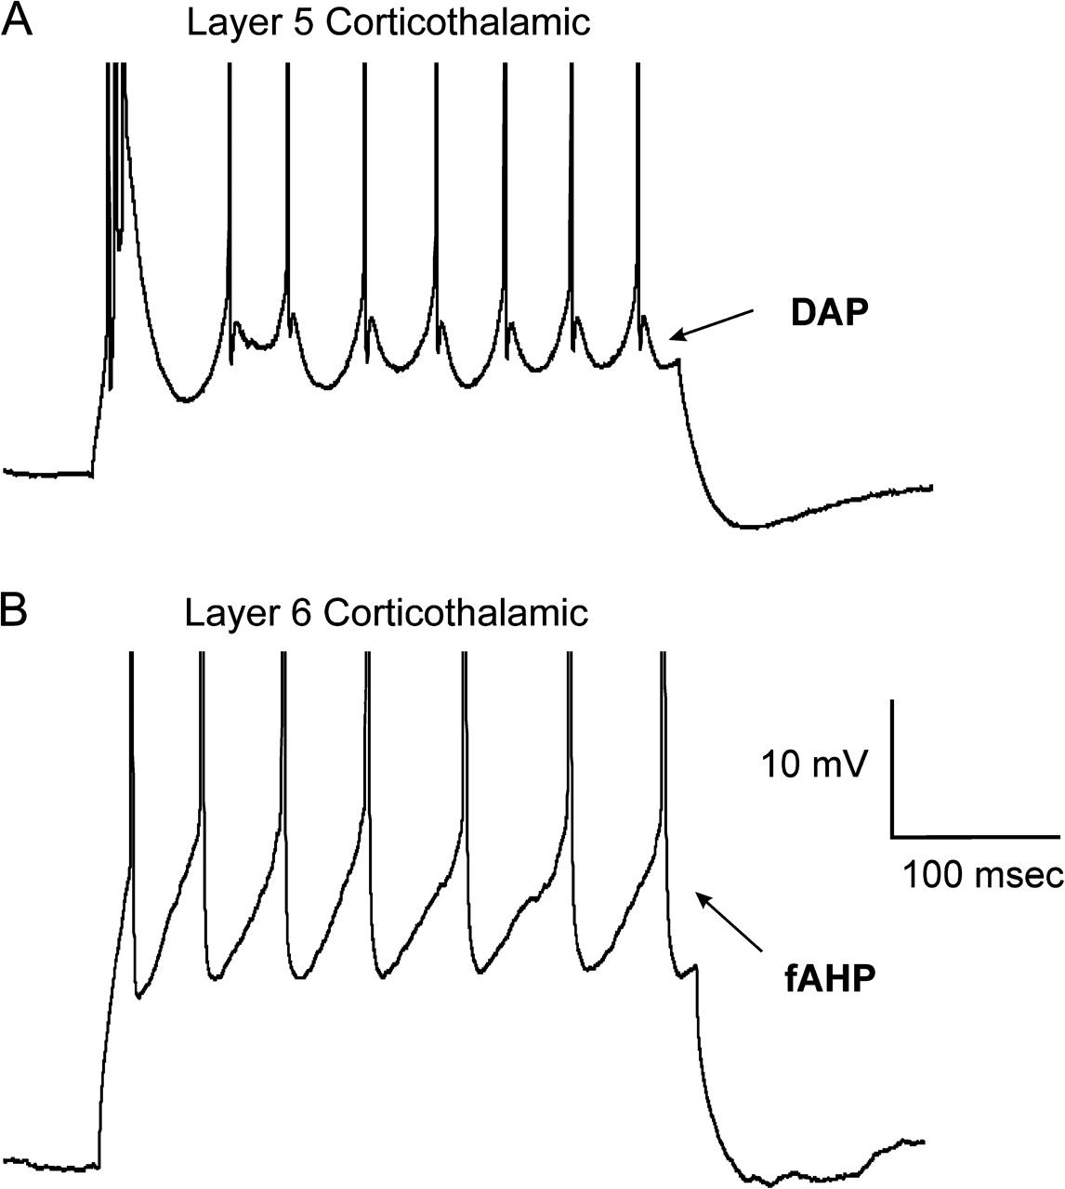
Figure 3. Examples of postspike potentials from (A) a layer 5 corticothalamic neuron and (B) a layer 6 corticothalamic ...
Notes:
Figure 3. Examples of postspike potentials from (A) a layer 5 corticothalamic neuron and (B) a layer 6 corticothalamic neuron illustrating the prominent DAP in the layer 5 neuron and the prominent fAHP in the layer 6 neuron. Only spikes after the initial burst in bursting neurons were used to measure both the fAHP and the DAP. Action potential heights are truncated for clarity.
Unless provided in the caption above, the following copyright applies to the content of this slide: © The Author 2009. Published by Oxford University Press. All rights reserved. For permissions, please e-mail: journals.permissions@oxfordjournals.org

Slide 4
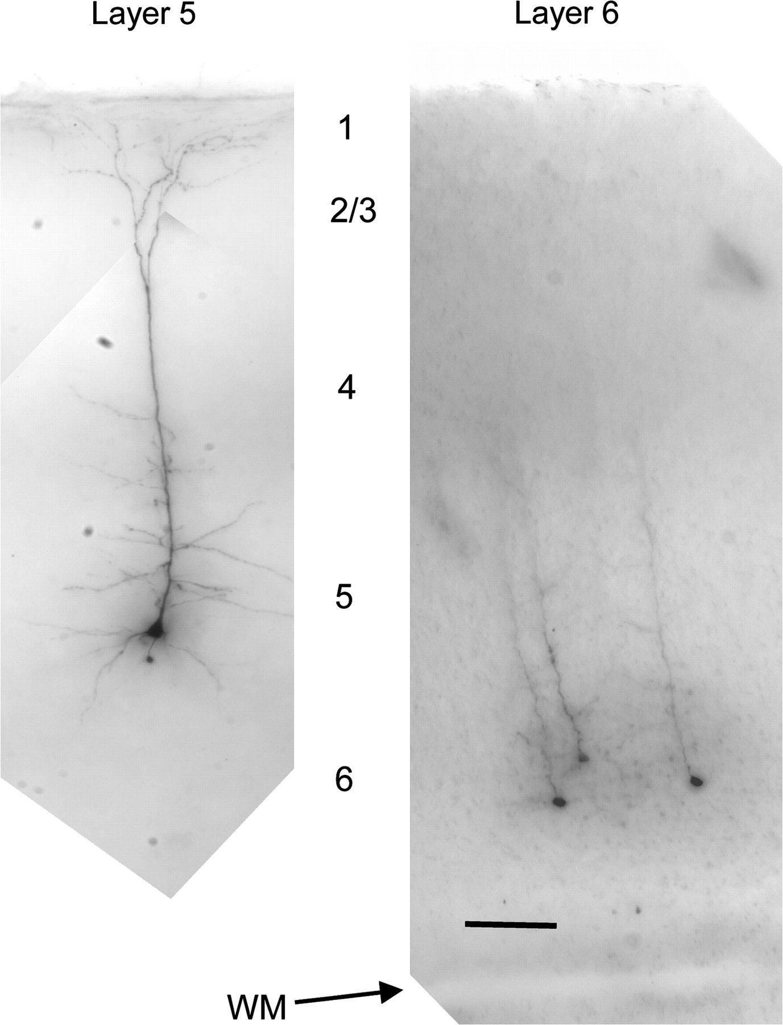
Figure 4. Examples of morphology of layer 5 and layer 6 corticothalamic neurons. (A) Minimum intensity projection of a ...
Notes:
Figure 4. Examples of morphology of layer 5 and layer 6 corticothalamic neurons. (A) Minimum intensity projection of a typical biocytin-filled layer 5 corticothalamic neuron. (B) Minimum intensity projection of 3 biocytin-filled layer 6 corticothalamic neurons. These neurons have thin apical dendrite that do not extend above layer 4. Scale bar = 100 μm.
Unless provided in the caption above, the following copyright applies to the content of this slide: © The Author 2009. Published by Oxford University Press. All rights reserved. For permissions, please e-mail: journals.permissions@oxfordjournals.org

Slide 5
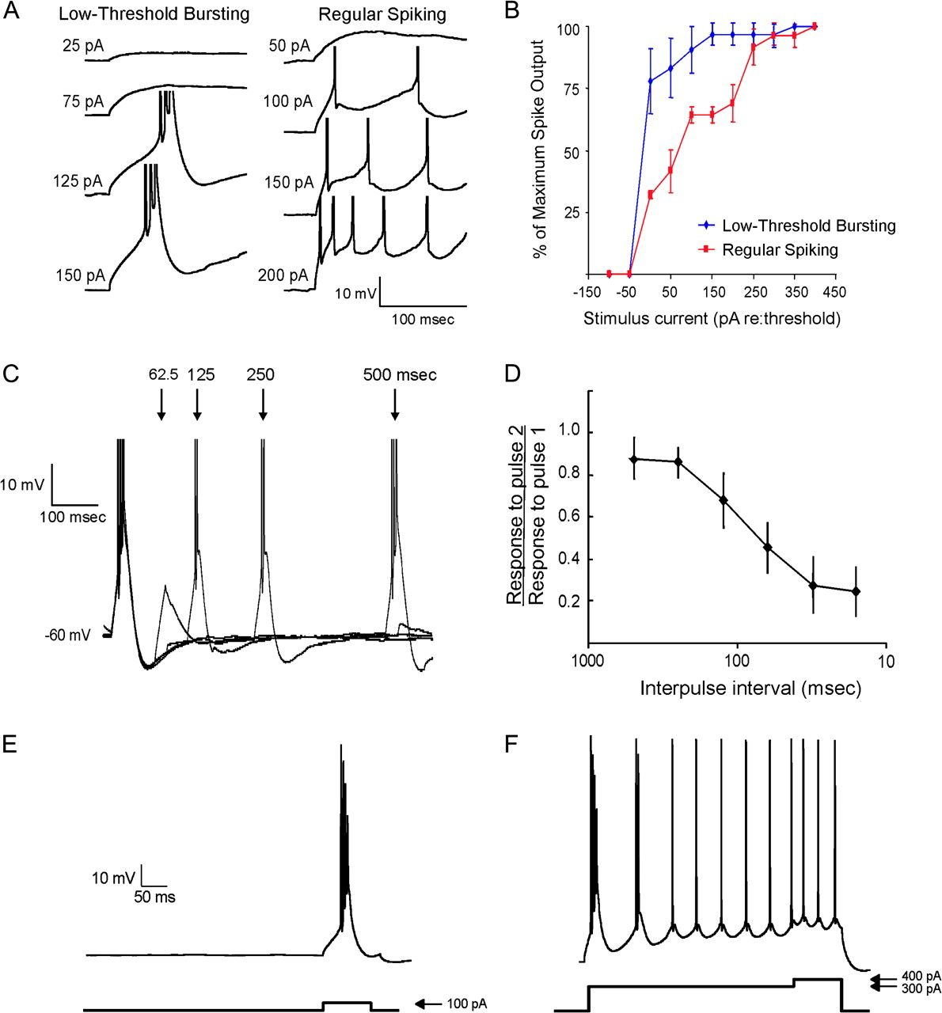
Figure 5. Characteristics of bursting: input–output functions, time dependence, and voltage-dependence. (A) Left: ...
Notes:
Figure 5. Characteristics of bursting: input–output functions, time dependence, and voltage-dependence. (A) Left: example of a low-threshold bursting neuron's response to increasing depolarizing pulse amplitude. Right: example of a regular spiking neuron's response to increasing depolarizing pulse amplitude. Both neurons are layer 5 corticothalamic neurons. Spikes are truncated in height for clarity. (B) Mean input–output functions for low-threshold bursting (blue) and regular spiking (red) layer 5 corticothalamic neurons. Error bars represent the standard deviation (SD). The y-axis shows number of spikes expressed as a percentage of the maximum number of spikes fired in a 25-ms window after response onset. (C) Response of low-threshold bursting neurons to paired-pulse stimulation. Shown in an overlay of 4 traces of a single neuron in response to interstimulus intervals of 62.5, 125, 250, and 500 ms. Action potential heights are truncated for clarity. (D) Interpulse interval versus average of the ratio of spike output in response to the second pulse to spike output in response to the first pulse. Error bars represent the SD at each point. (E) Response of a low-threshold bursting neuron to a depolarizing prepulse. This neuron responded to a 100 pA depolarizing pulse with a typical low-threshold burst. (F) After this cell is depolarized by about 10 mW by a 300 pA depolarizing pulse and rechallenged with 100 pA positive current pulse, this cell fired only individual spikes rather than a burst.
Unless provided in the caption above, the following copyright applies to the content of this slide: © The Author 2009. Published by Oxford University Press. All rights reserved. For permissions, please e-mail: journals.permissions@oxfordjournals.org

Slide 6
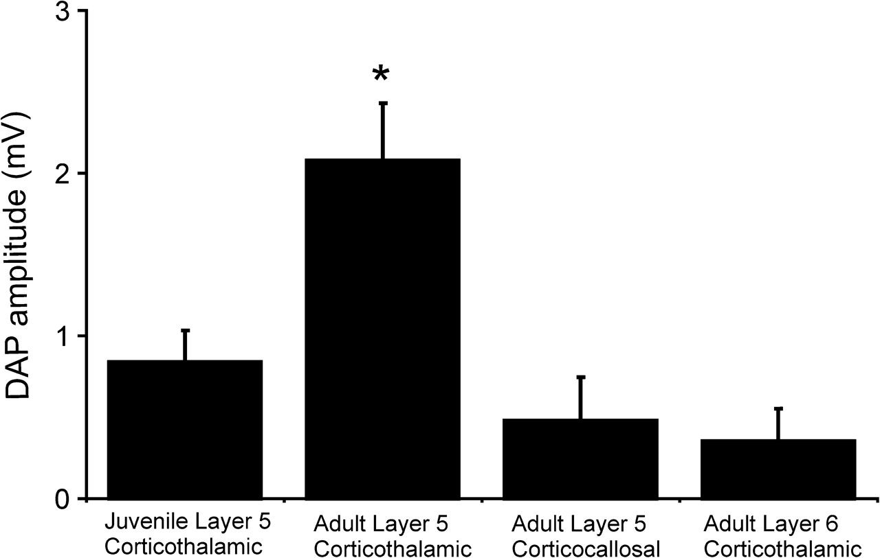
Figure 6. Bar graph illustrating differences in the magnitude of the DAP in 4 groups of neurons investigated in this ...
Notes:
Figure 6. Bar graph illustrating differences in the magnitude of the DAP in 4 groups of neurons investigated in this study. Error bars represent standard error. *P < 0.01, Kruskal–Wallis.
Unless provided in the caption above, the following copyright applies to the content of this slide: © The Author 2009. Published by Oxford University Press. All rights reserved. For permissions, please e-mail: journals.permissions@oxfordjournals.org

Slide 7
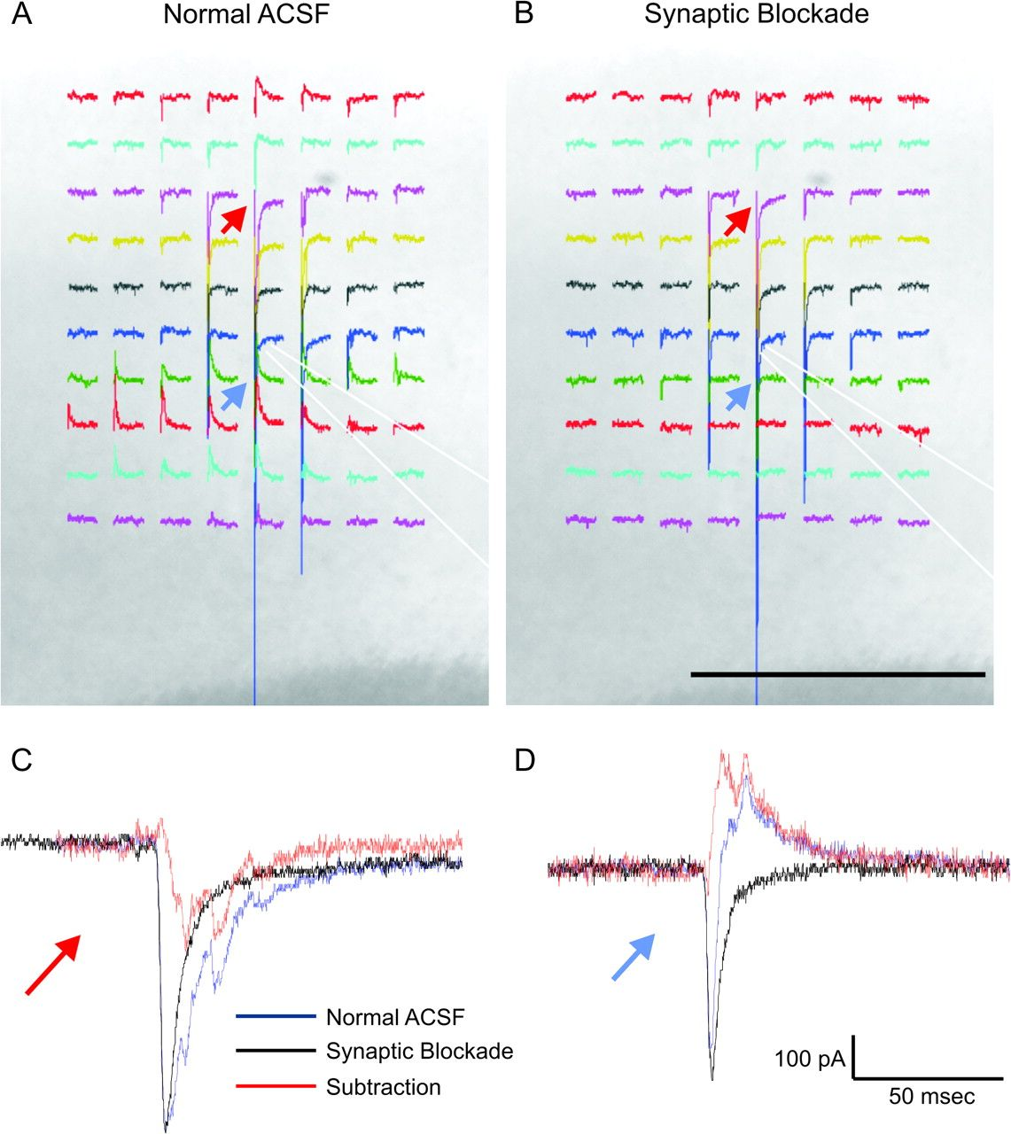
Figure 7. Illustration of synaptic blockade subtraction algorithm. (A) Photograph taken at ×5 of cortical slice with ...
Notes:
Figure 7. Illustration of synaptic blockade subtraction algorithm. (A) Photograph taken at ×5 of cortical slice with overlay of current traces at several photostimulation sites obtained in normal ACSF. Recording electrode location is outlined with white dotted lines. Recorded cell is held in voltage clamp at −40 mW. (B) Same stimulation sites with tissue bathed in 0 mM CaCl2 and 4 mM MgCl2. Scale bar = 500 μm. (C) Overlay of current traces at site in layer 2/3 with red arrow. Blue trace obtained in normal ACSF, black trace obtained in low calcium/high magnesium. Red trace is the difference of the normal ACSF and the low calcium/high magnesium traces. (D) Same description as (C) but for site in layer 5 with blue arrow.
Unless provided in the caption above, the following copyright applies to the content of this slide: © The Author 2009. Published by Oxford University Press. All rights reserved. For permissions, please e-mail: journals.permissions@oxfordjournals.org

Slide 8
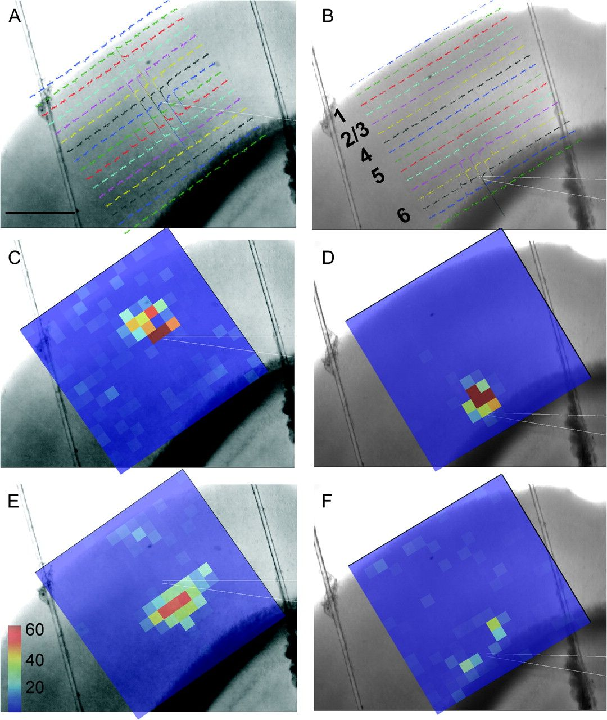
Figure 8. Example of input maps layer 5 and layer 6 corticothalamic neurons residing in vertical register. (A, B) ...
Notes:
Figure 8. Example of input maps layer 5 and layer 6 corticothalamic neurons residing in vertical register. (A, B) Photograph taken at ×5 of the slice while in the recording chamber. Scale bar = 500 μm. White dotted lines outline the recording electrode, which was patched onto a layer 5 (A) or layer 6 (B) corticothalamic cell. Currents recorded from the layer 5 cell (A) or layer 6 cell (B) held in voltage clamp at −40 mW are overlaid. Each of the 256 traces represents the poststimulus current trace in the recorded cell generated by uncaging glutamate at each site. (C–F) Pseudocolor maps of the total amount of inward (C, D) or outward (E or F) charge transfer in a 100-ms window after laser onset. Scale bar units = nanoCoulombs.
Unless provided in the caption above, the following copyright applies to the content of this slide: © The Author 2009. Published by Oxford University Press. All rights reserved. For permissions, please e-mail: journals.permissions@oxfordjournals.org

Slide 9
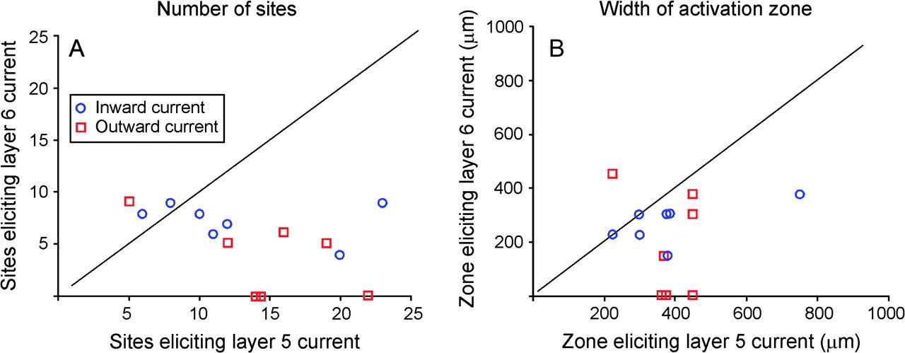
Figure 9. A) Scatterplot showing the relationship between the number of photostimulation sites from a 14 × 14 grid ...
Notes:
Figure 9. A) Scatterplot showing the relationship between the number of photostimulation sites from a 14 × 14 grid eliciting a significant inward (blue circle) or outward (red square) current for layer 5 and layer 6 corticothalamic neurons from the same cortical column. (B) Scatterplot showing the relationship between the horizontal width of the region eliciting a significant inward (blue circle) or outward (red square) current for layer 5 and layer 6 corticothalamic neurons from the same cortical column. In each case, the diagonal line represents unity slope or an equivalent number of sites (A) or width of activation zone (B) eliciting a response in intracolumnar layer 5 and layer 6 corticothalamic neurons.
Unless provided in the caption above, the following copyright applies to the content of this slide: © The Author 2009. Published by Oxford University Press. All rights reserved. For permissions, please e-mail: journals.permissions@oxfordjournals.org

Slide 10
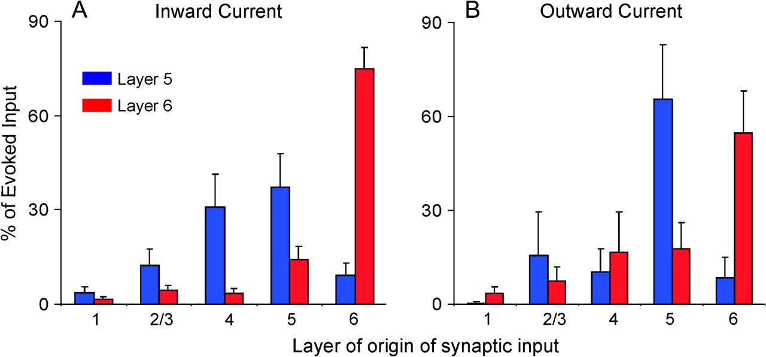
Figure 10. Distribution of inputs to corticothalamic neurons. (A) Percent of total evoked inward charge transfer onto ...
Notes:
Figure 10. Distribution of inputs to corticothalamic neurons. (A) Percent of total evoked inward charge transfer onto layer 5 corticothalamic cells (blue) and layer 6 corticothalamic cells (red). (B) Percent of total evoked outward charge transfer onto layer 5 corticothalamic cells (blue) and layer 6 corticothalamic cells (red). Error bars represent standard error.
Unless provided in the caption above, the following copyright applies to the content of this slide: © The Author 2009. Published by Oxford University Press. All rights reserved. For permissions, please e-mail: journals.permissions@oxfordjournals.org

Slide 11
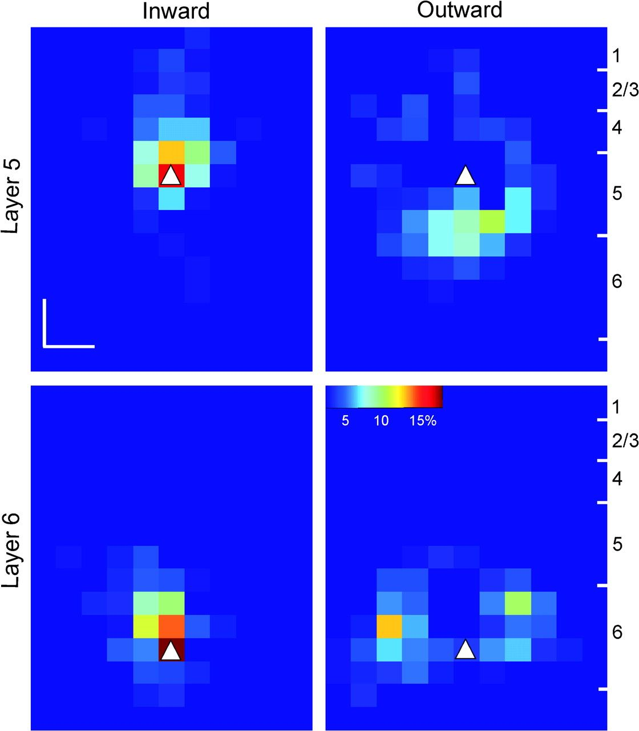
Figure 11. Mean normalized input maps for 7 layer 5 corticothalamic cells (top row) and 7 column-matched layer 6 ...
Notes:
Figure 11. Mean normalized input maps for 7 layer 5 corticothalamic cells (top row) and 7 column-matched layer 6 corticothalamic cells (bottom row) for both inward (left column) and outward total charge transfer (right column). Pseudocolor maps represent the total amount of current entering or exiting a cell in a 100-ms window after a laser pulse at each of the 256 sites. Layer designations computed from mean distance from recorded cell to layer borders directly above or below the cell. Scale bar = 150 μm.
Unless provided in the caption above, the following copyright applies to the content of this slide: © The Author 2009. Published by Oxford University Press. All rights reserved. For permissions, please e-mail: journals.permissions@oxfordjournals.org

Slide 12
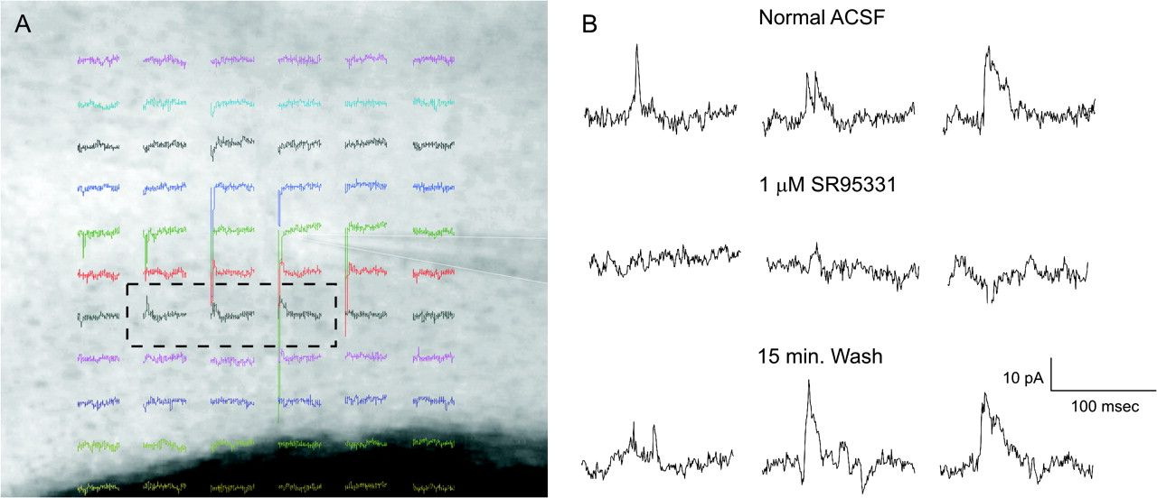
Figure 12. Blockade of outward currents with bath-applied SR 95531, a GABA_{A} receptor blocker, at 1 μM. (A) ...
Notes:
Figure 12. Blockade of outward currents with bath-applied SR 95531, a GABAA receptor blocker, at 1 μM. (A) Subset of currents recorded in voltage clamp at −40 mW of a layer 5 corticothalamic neuron (electrode outlined in white). Outward currents are seen in lower layer 5. (B) Expanded view of currents from 3 sites in black dashed box in (A), predrug (top), during drug (middle), and postwash (bottom).
Unless provided in the caption above, the following copyright applies to the content of this slide: © The Author 2009. Published by Oxford University Press. All rights reserved. For permissions, please e-mail: journals.permissions@oxfordjournals.org

Slide 13
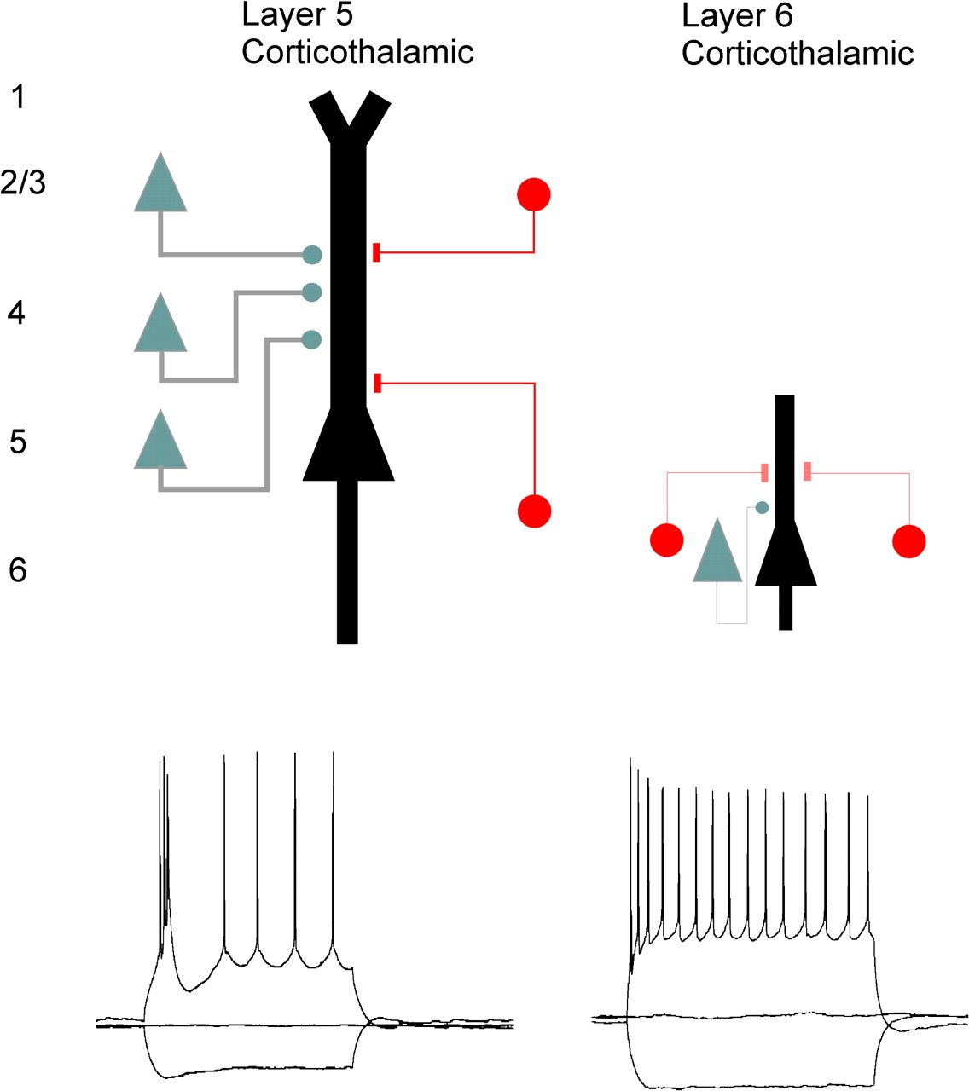
Figure 13. Proposed model of differences of synaptic input and response properties between auditory layer 5 and layer 6 ...
Notes:
Figure 13. Proposed model of differences of synaptic input and response properties between auditory layer 5 and layer 6 corticothalamic neurons. In our model, layer 5 corticothalamic neurons receive excitatory input from neurons in layers 2/3, 4, and 5 (gray) and GABAA-mediated inhibitory input mostly from lower layer 5 with a smaller contribution from layer 2/3 (red). In response to excitatory input, these neurons fire a burst of action potentials at low threshold. In contrast, layer 6 corticothalamic neurons integrate excitatory input primarily from layer 6 and receive inhibitory input from adjacent areas in layer 6. In response to excitatory input, these neurons fire a train of individual action potentials.
Unless provided in the caption above, the following copyright applies to the content of this slide: © The Author 2009. Published by Oxford University Press. All rights reserved. For permissions, please e-mail: journals.permissions@oxfordjournals.org

