Slide 1
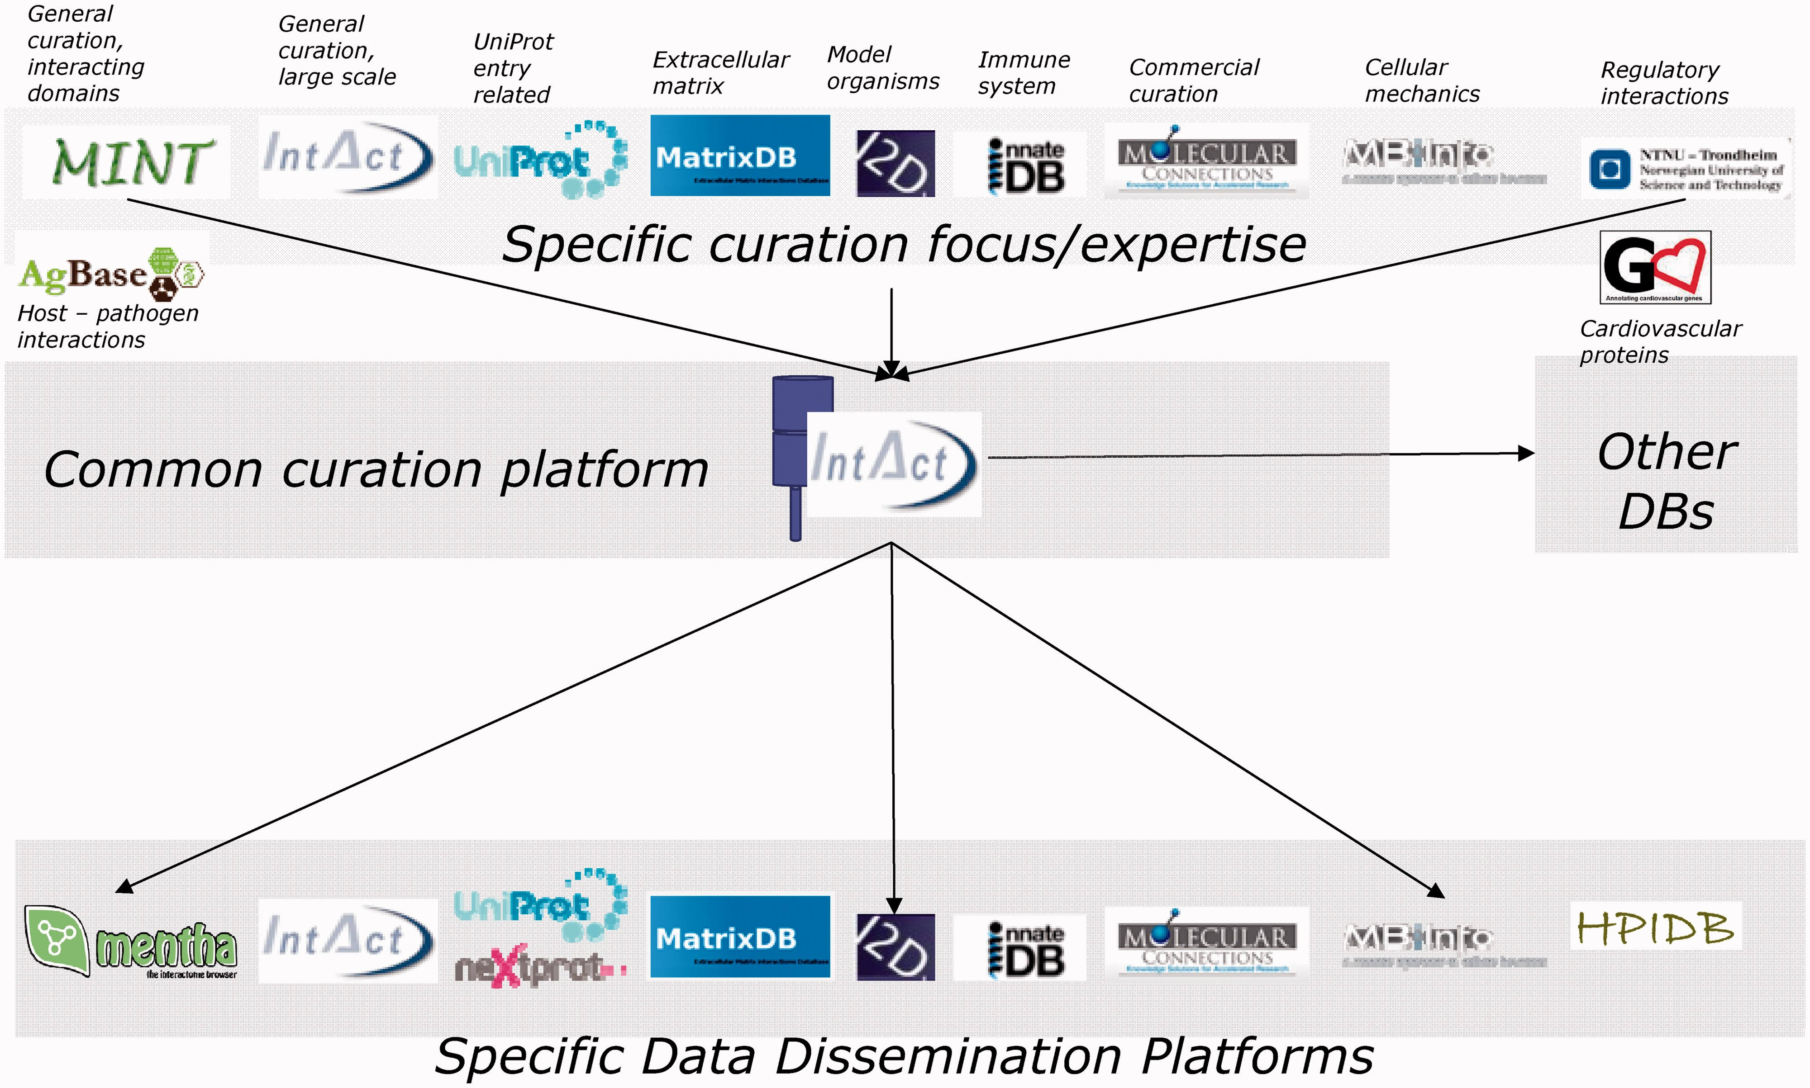
Figure 1. The web-based IntAct curation environment is used by currently 11 independent organizations, most of which ...
Notes:
Figure 1. The web-based IntAct curation environment is used by currently 11 independent organizations, most of which re-export the data and present it through their own web interfaces.
Unless provided in the caption above, the following copyright applies to the content of this slide: © The Author(s) 2013. Published by Oxford University Press.This is an Open Access article distributed under the terms of the Creative Commons Attribution License (http://creativecommons.org/licenses/by/3.0/), which permits unrestricted reuse, distribution, and reproduction in any medium, provided the original work is properly cited.

Slide 2
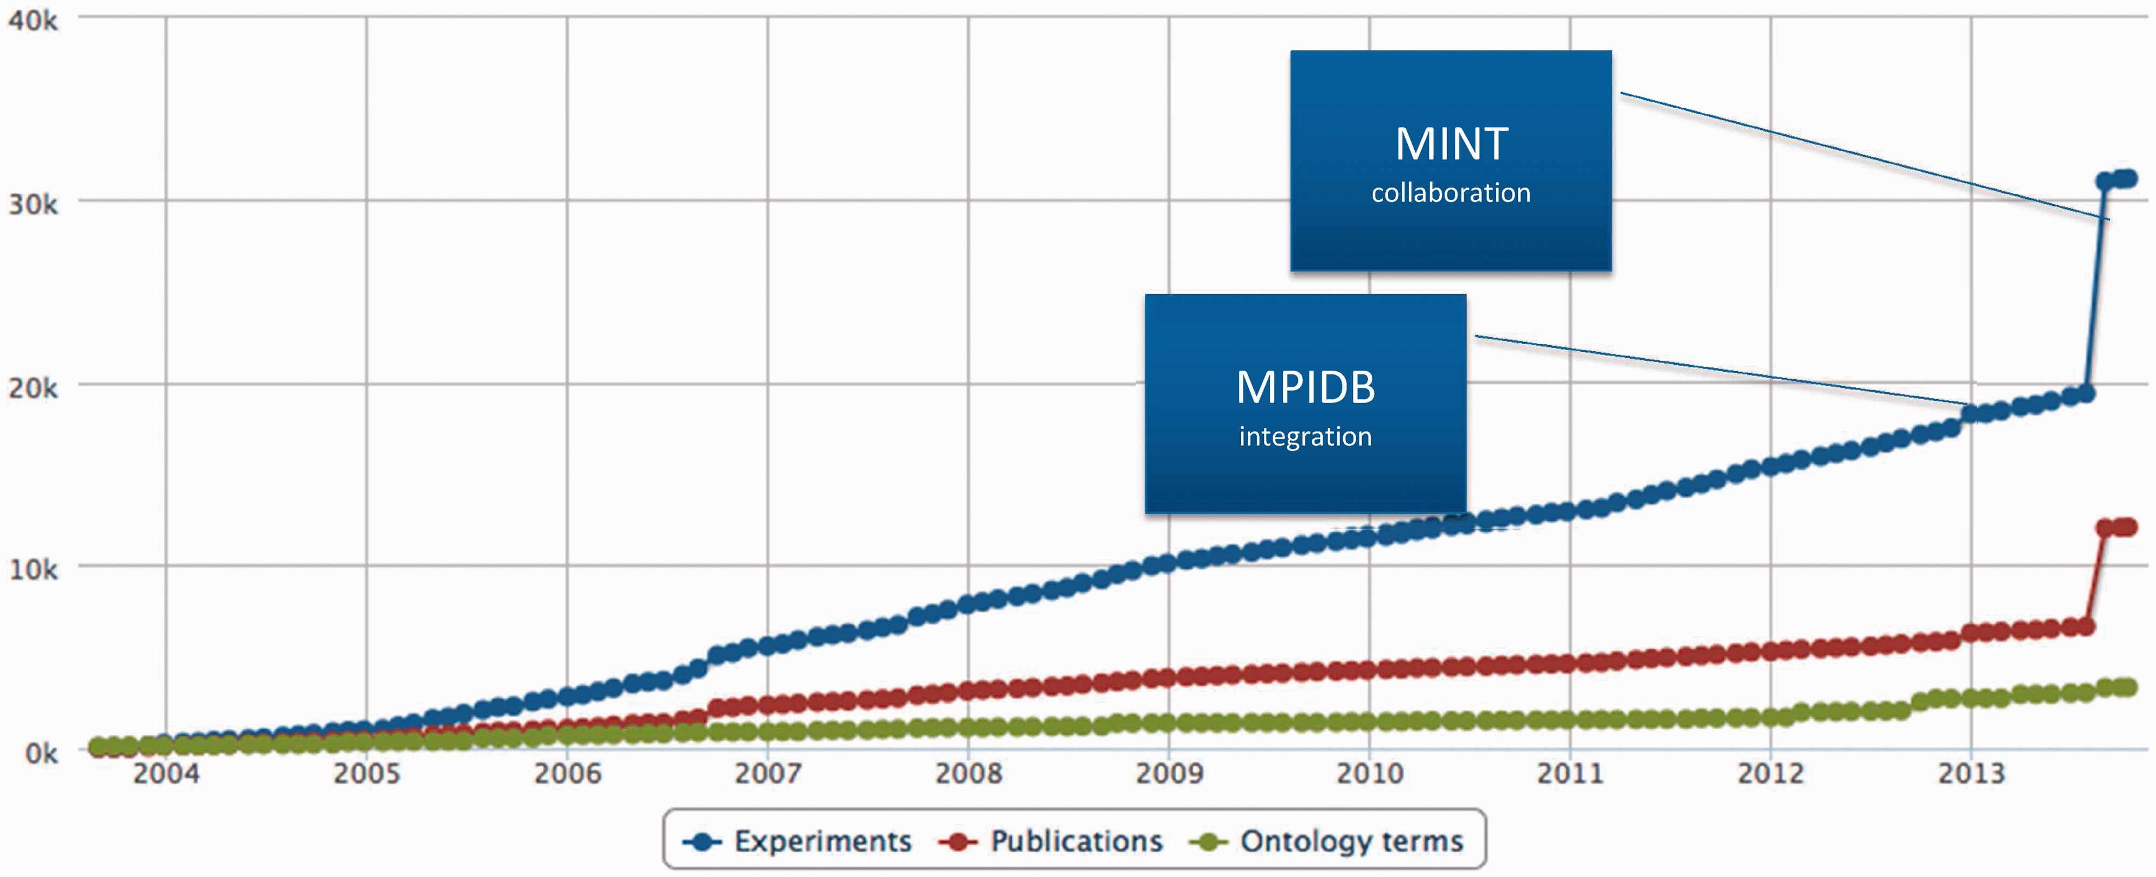
Figure 2. Growth of the IntAct database.
Notes:
Figure 2. Growth of the IntAct database.
Unless provided in the caption above, the following copyright applies to the content of this slide: © The Author(s) 2013. Published by Oxford University Press.This is an Open Access article distributed under the terms of the Creative Commons Attribution License (http://creativecommons.org/licenses/by/3.0/), which permits unrestricted reuse, distribution, and reproduction in any medium, provided the original work is properly cited.

