Slide 1
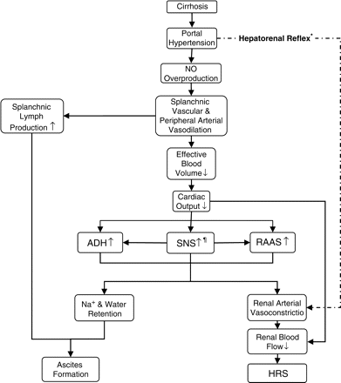
Figure 1. Pathophysiology of ascites and hepatorenal syndrome. Asterisk: adapted from Moller et al.⁹ ...
Notes:
Figure 1. Pathophysiology of ascites and hepatorenal syndrome. Asterisk: adapted from Moller et al.9 Paragraph symbol: liver regeneration following hepatic injuries is regulated by SNS. Hepatic stellate cells (major fibrogenic cells in the liver) seem to be targets for SNS, and SNS neurotransmitter levels are higher in cirrhotic patients and proportional to hepatic fibrosis. Based on this subject, in HRS, it is not clear whether SNS over activity is primary to the pathogenesis of cirrhosis or secondary to hemodynamic turbulence.10
Unless provided in the caption above, the following copyright applies to the content of this slide: © The Author 2008. Published by Oxford University Press on behalf of the Association of Physicians. All rights reserved. For Permissions, please email: journals.permissions@oxfordjournals.org

Slide 2
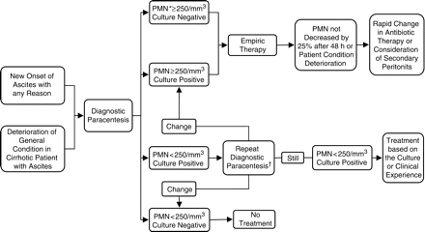
Figure 3. Guidelines for treatment of SBP. Asterisk: if PMN ⩾250/mm³ empiric therapy starts while awaiting ...
Notes:
Figure 3. Guidelines for treatment of SBP. Asterisk: if PMN ⩾250/mm3 empiric therapy starts while awaiting the culture results. Dagger: in the presence of signs and symptoms of infection, does not need to be done and treatment must be considered.
Unless provided in the caption above, the following copyright applies to the content of this slide: © The Author 2008. Published by Oxford University Press on behalf of the Association of Physicians. All rights reserved. For Permissions, please email: journals.permissions@oxfordjournals.org

Slide 3
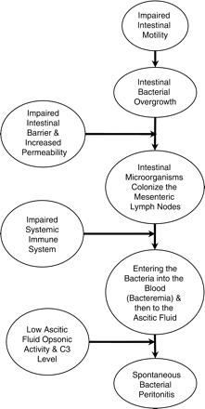
Figure 2. Pathophysiology of spontaneous bacterial peritonitis.
Notes:
Figure 2. Pathophysiology of spontaneous bacterial peritonitis.
Unless provided in the caption above, the following copyright applies to the content of this slide: © The Author 2008. Published by Oxford University Press on behalf of the Association of Physicians. All rights reserved. For Permissions, please email: journals.permissions@oxfordjournals.org

