Slide 1
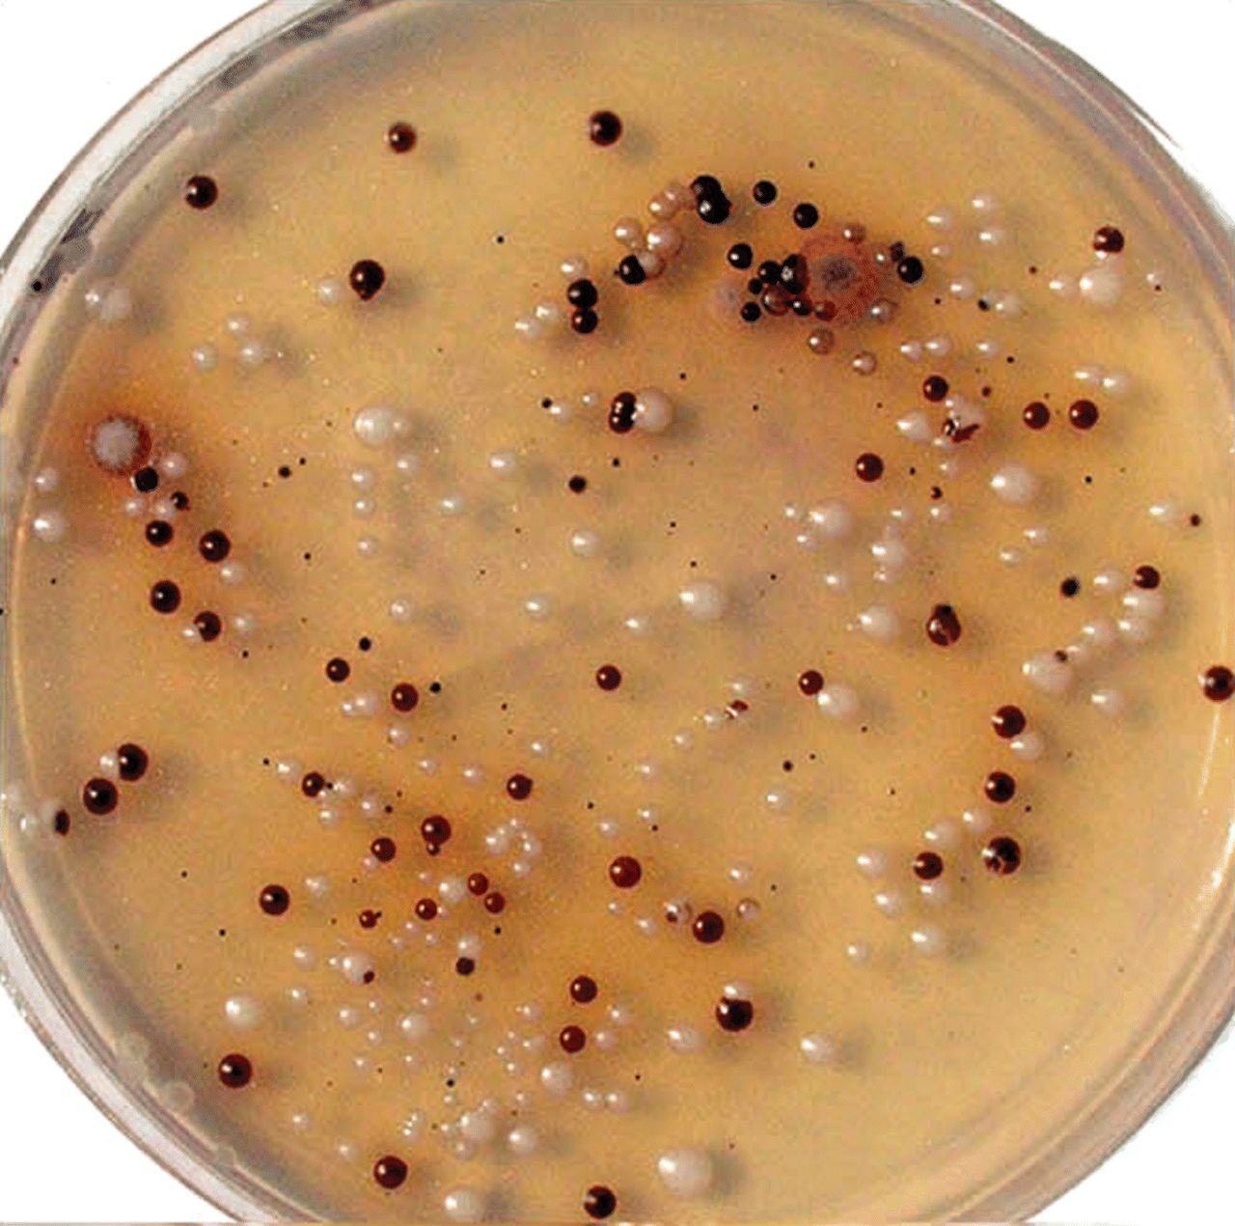
Fig. 2 Brown to dark brown, glistening colonies of a black yeast isolated from decayed wood of a pine tree, ...
Notes:
Fig. 2 Brown to dark brown, glistening colonies of a black yeast isolated from decayed wood of a pine tree, simulating those of the C. neoformans species complex in macroscopic morphology on a NSA plate after 6 days of incubation at 28°C.
Unless provided in the caption above, the following copyright applies to the content of this slide: © 2006 ISHAM

Slide 2
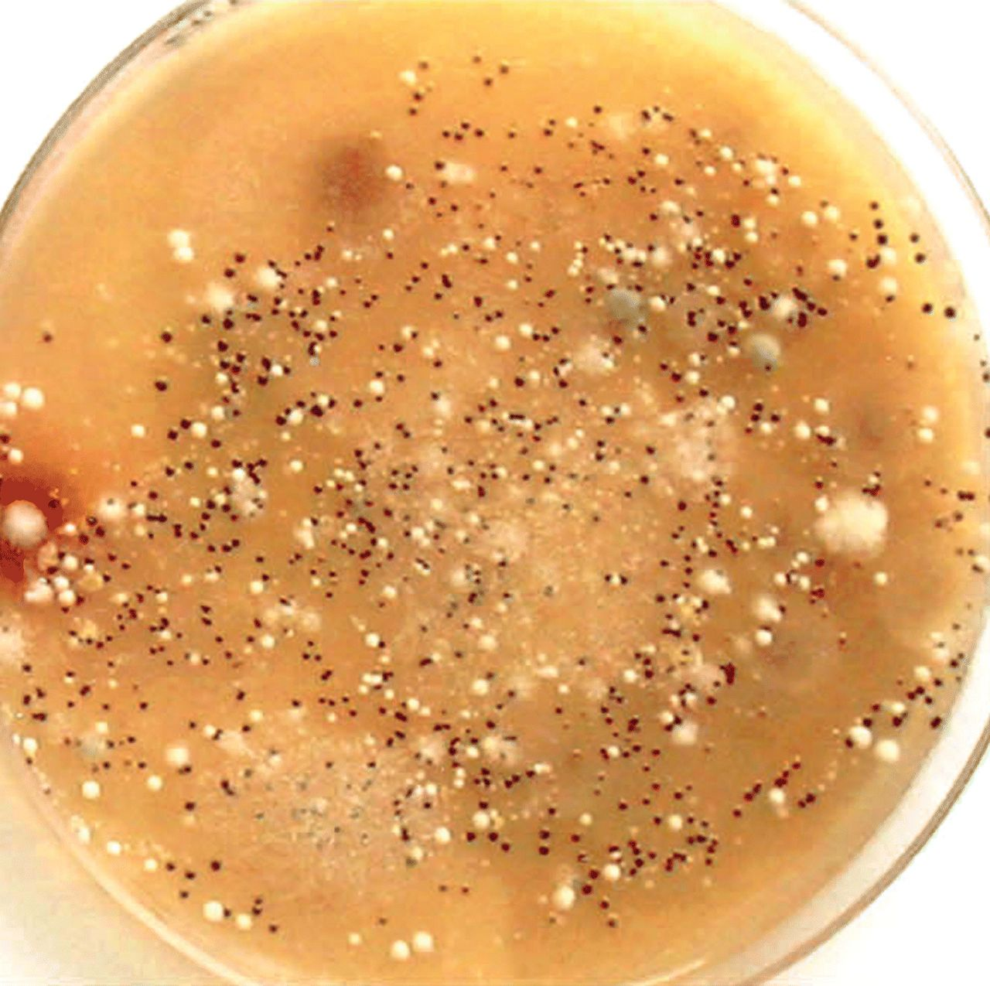
Fig. 1 Innumerable tiny, chocolate brown, yeast-like colonies of C. gattii on a simplified Staib's niger seed agar ...
Notes:
Fig. 1 Innumerable tiny, chocolate brown, yeast-like colonies of C. gattii on a simplified Staib's niger seed agar (NSA) plate, isolated from decayed wood inside trunk hollow of a S. cumini tree in Amritsar, seen after 6 days of incubation at 28° C. Interspersed among them are also many cottony white, fluffy mold colonies.
Unless provided in the caption above, the following copyright applies to the content of this slide: © 2006 ISHAM

