Slide 1
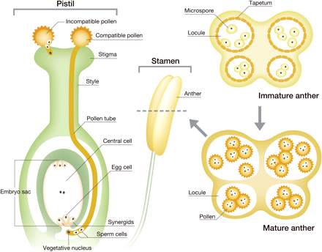
Fig. 1 Schematic representation of the reproductive organs in angiosperm. In the course of male gametophyte ...
Notes:
Fig. 1 Schematic representation of the reproductive organs in angiosperm. In the course of male gametophyte development (right), after meiosis, the haploid microspore develops in the locule surrounded by the tapetum in the immature anther. After disintegration of the tapetum, the pollen grain matures in the locule of the mature anther. At the time of flowering, anther dehiscence occurs to release the pollen, which is then carried by wind or insects onto the stigma of the pistil. The compatible pollen germinates, and its pollen tube penetrates into the stigma, elongates in the stylar transmitting tissue and is guided to the synergids of the embryo sac to achieve double fertilization (left). The two sperm cells in the pollen tube finally fertilize the egg cell and the central cell to form the embryo and the endosperm, respectively.
Unless provided in the caption above, the following copyright applies to the content of this slide: © The Author 2009. Published by Oxford University Press on behalf of Japanese Society of Plant Physiologists. All rights reserved. For permissions, please email: journals.permissions@oxfordjournals.org

