Slide 1
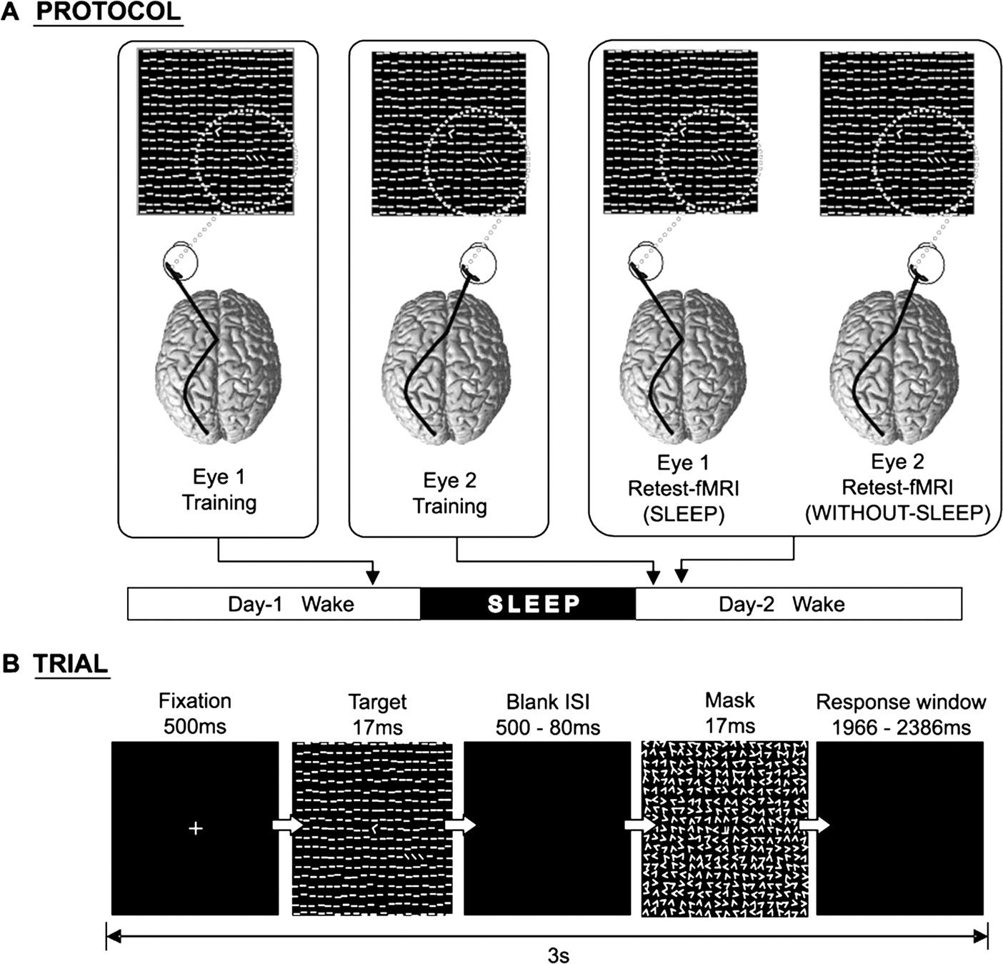
Figure 1. Texture discrimination task and experimental protocol. (a) Subjects training monocularly in the lower right ...
Notes:
Figure 1. Texture discrimination task and experimental protocol. (a) Subjects training monocularly in the lower right visual quadrant on day 1 (9 p.m.). After an intervening night of sleep, subjects trained monocularly in the same visual quadrant using the other eye (9 a.m.). Training of the left eye versus right eyes was counterbalanced across subjects and conditions, as was eye dominance. Each eye was then retested monocularly on one single block (ISI = 250 ms) in the visual quadrant during fMRI scanning. Retesting as either the first or second scanning session was also counterbalanced across each eye condition. (b) Each 3 s trial consisted of a series of stimulus screens, including a target stimulus containing either a ‘T’ or ‘L’ letter at the fixation point, and a horizontal or vertical array of three diagonal bars in the lower-right quadrant of the visual field. During the blank response screen, subjects indicated with a button press which letter was presented at the fixation point, and then whether the three diagonal line segments in the lower-right quadrant were arranged in a horizontal or vertical array. Monocular training consisted of 10 blocks containing 40 trials, with decreasing ISIs: 500, 400, 300, 250, 200, 160, 140, 120, 100 and 80 ms.
Unless provided in the caption above, the following copyright applies to the content of this slide: © The Author 2005. Published by Oxford University Press. All rights reserved. For permissions, please e-mail: journals.permissions@oupjournals.org

Slide 2
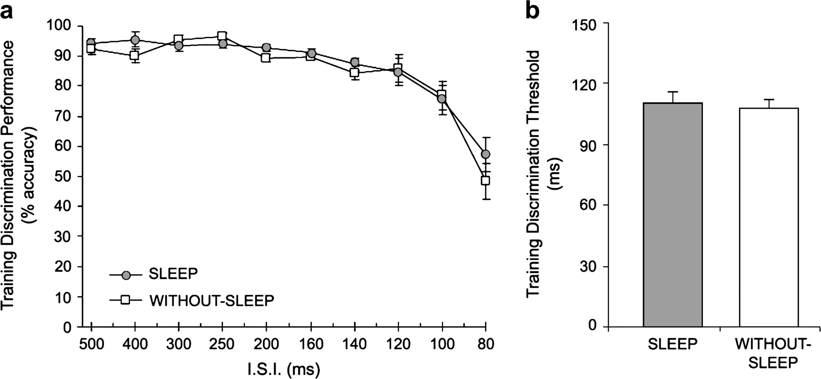
Figure 2. Monocular training curves and initial discrimination thresholds. (a) Training curves for performance in the ...
Notes:
Figure 2. Monocular training curves and initial discrimination thresholds. (a) Training curves for performance in the SLEEP and WITHOUT-SLEEP conditions across the 10 blocks of decreasing ISI (increasing difficulty, resulting in decreasing performance accuracy). (b) The detection thresholds, defined as the interpolated ISI which produced 80% accuracy, for the SLEEP and WITHOUT-SLEEP conditions.
Unless provided in the caption above, the following copyright applies to the content of this slide: © The Author 2005. Published by Oxford University Press. All rights reserved. For permissions, please e-mail: journals.permissions@oupjournals.org

Slide 3
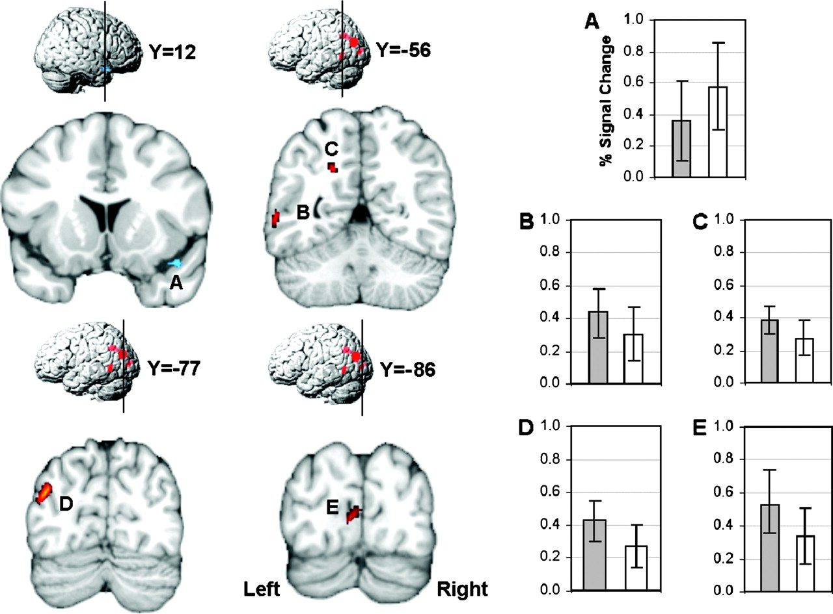
Figure 3. fMRI group (condition) effects. Increased fMRI signal activity (in red) and decreased signal activity (in ...
Notes:
Figure 3. fMRI group (condition) effects. Increased fMRI signal activity (in red) and decreased signal activity (in blue) during task retest following training with sleep, relative to training without sleep. Corresponding coronal sections (A–E) in ICBM152 (International Consortium for Brain Mapping) space are provided, with averaged BOLD signal change (in % with respect to the baseline signal) for each condition (gray: trained & SLEEP; white: trained & WITHOUT-SLEEP).
Unless provided in the caption above, the following copyright applies to the content of this slide: © The Author 2005. Published by Oxford University Press. All rights reserved. For permissions, please e-mail: journals.permissions@oupjournals.org

Slide 4
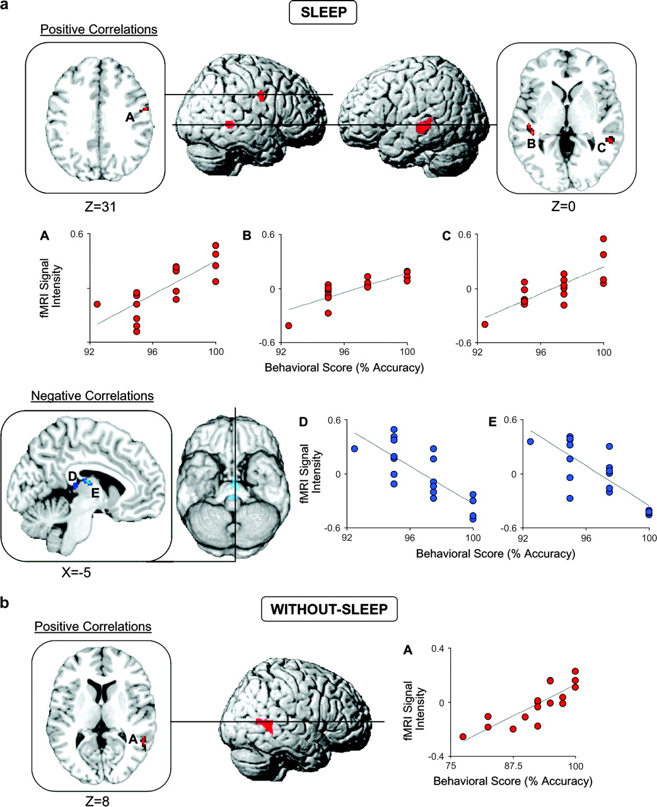
Figure 4. Correlational analyses between behavioural task performance and functional brain activity within each group ...
Notes:
Figure 4. Correlational analyses between behavioural task performance and functional brain activity within each group (condition). Positive correlations between task performance and increased fMRI signal activity (in red) and negative correlations (in blue) within each of the experimental conditions of (a) SLEEP and (b) WITHOUT-SLEEP. Corresponding axial and sagital sections in ICBM152 space are provided, together with correlational plots (positive in red, negative in blue) between peak signal intensity in each region and the associated behavioural task performance score.
Unless provided in the caption above, the following copyright applies to the content of this slide: © The Author 2005. Published by Oxford University Press. All rights reserved. For permissions, please e-mail: journals.permissions@oupjournals.org

