Slide 1
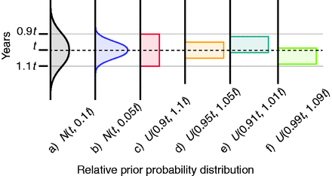
Fig. 1. Arbitrary sample-age distributions used to examine the impact of sample-dating error on estimates of ...
Notes:
Fig. 1. Arbitrary sample-age distributions used to examine the impact of sample-dating error on estimates of substitution rates and timescales. Distribution parameters are relative to each sample age (t). Normal distributions = N(mean, SD); uniform distributions = U(minimum bound, maximum bound). SD, standard deviation.
Unless provided in the caption above, the following copyright applies to the content of this slide: © The Author 2012. Published by Oxford University Press on behalf of the Society for Molecular Biology and Evolution. All rights reserved. For permissions, please e-mail: journals.permissions@oup.comThis article is published and distributed under the terms of the Oxford University Press, Standard Journals Publication Model ( https://academic.oup.com/journals/pages/open_access/funder_policies/chorus/standard_publication_model)

Slide 2
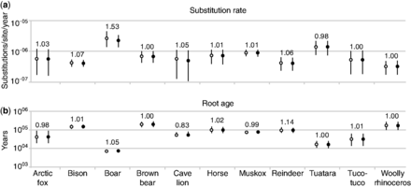
Fig. 2. Estimates of (a) substitution rate and (b) root age for the 11 data sets. For each species, age errors were ...
Notes:
Fig. 2. Estimates of (a) substitution rate and (b) root age for the 11 data sets. For each species, age errors were either incorporated into the estimates (empty circles) or not (full circles). Circles denote medians, and vertical bars denote 95% HPD intervals. Values above bars indicate the relative size of the 95% HPD interval of the analysis including age errors compared with the analysis using point calibrations.
Unless provided in the caption above, the following copyright applies to the content of this slide: © The Author 2012. Published by Oxford University Press on behalf of the Society for Molecular Biology and Evolution. All rights reserved. For permissions, please e-mail: journals.permissions@oup.comThis article is published and distributed under the terms of the Oxford University Press, Standard Journals Publication Model ( https://academic.oup.com/journals/pages/open_access/funder_policies/chorus/standard_publication_model)

Slide 3
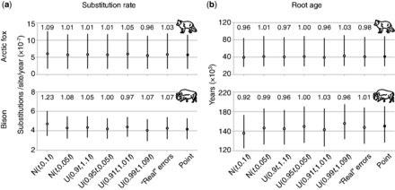
Fig. 3. Bayesian parameter estimates using arbitrary sample-age errors: (a) rate estimates and (b) root-age estimates ...
Notes:
Fig. 3. Bayesian parameter estimates using arbitrary sample-age errors: (a) rate estimates and (b) root-age estimates for arctic fox and bison. Estimates for analyses using point calibrations (point) and published sample-age errors (“real” errors) are shown for comparison. The value above each bar indicates the relative size of the 95% HPD interval of this estimate compared with the analysis using point calibrations.
Unless provided in the caption above, the following copyright applies to the content of this slide: © The Author 2012. Published by Oxford University Press on behalf of the Society for Molecular Biology and Evolution. All rights reserved. For permissions, please e-mail: journals.permissions@oup.comThis article is published and distributed under the terms of the Oxford University Press, Standard Journals Publication Model ( https://academic.oup.com/journals/pages/open_access/funder_policies/chorus/standard_publication_model)

Slide 4
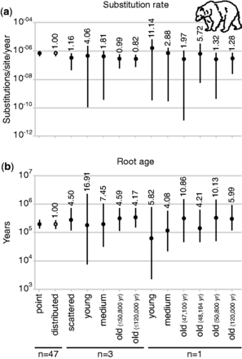
Fig. 4. Bayesian parameter estimates of sets of brown bear samples including a varying number of ancient samples. The ...
Notes:
Fig. 4. Bayesian parameter estimates of sets of brown bear samples including a varying number of ancient samples. The graph presents the median estimates and 95% HPD intervals of (a) substitution rate and (b) root age. Analyses were calibrated using all 66 modern samples and n = 47, n = 3, or n = 1 ancient sequences. In schemes n = 3 and n = 1, “old” denotes the three or one oldest sequence(s) (either including or excluding the 120,000-year sequence); “medium” denotes the three or one sequence(s) closest to 10% of the age of the oldest sample; “young” denotes the three or one sequence(s) closest to 1% of the age of the oldest sample; and “scattered” includes one sequence from each of the three age categories. Ages of sequences are given in supplementary figure S2, Supplementary Material online. For the comparison of estimation performance, estimates using all 47 ancient sequences, both with nonpoint (distributed) and point calibrations, are shown. Values above the bars indicate the relative size of the 95% HPD intervals when compared with that obtained using the complete data set (66 modern and 47 ancient) and using point calibrations for the ancient sequences.
Unless provided in the caption above, the following copyright applies to the content of this slide: © The Author 2012. Published by Oxford University Press on behalf of the Society for Molecular Biology and Evolution. All rights reserved. For permissions, please e-mail: journals.permissions@oup.comThis article is published and distributed under the terms of the Oxford University Press, Standard Journals Publication Model ( https://academic.oup.com/journals/pages/open_access/funder_policies/chorus/standard_publication_model)

Slide 5
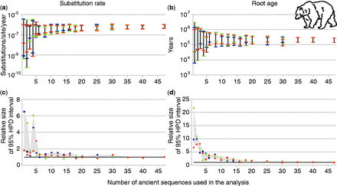
Fig. 5. Bayesian estimates of (a) substitution rate and (b) root age in brown bear using various numbers of ancient ...
Notes:
Fig. 5. Bayesian estimates of (a) substitution rate and (b) root age in brown bear using various numbers of ancient DNA sequences. All analyses included the 66 modern sequences. (a) and (b) show 95% HPD intervals, and (c) and (d) show the relative size of the 95% HPD interval compared with the analysis of the full data set (66 modern and 47 ancient sequences). Three replicates for each setting are shown in different shades. In (c) and (d), the shaded area indicates the difference between the highest and lowest values for each setting.
Unless provided in the caption above, the following copyright applies to the content of this slide: © The Author 2012. Published by Oxford University Press on behalf of the Society for Molecular Biology and Evolution. All rights reserved. For permissions, please e-mail: journals.permissions@oup.comThis article is published and distributed under the terms of the Oxford University Press, Standard Journals Publication Model ( https://academic.oup.com/journals/pages/open_access/funder_policies/chorus/standard_publication_model)

