Slide 1
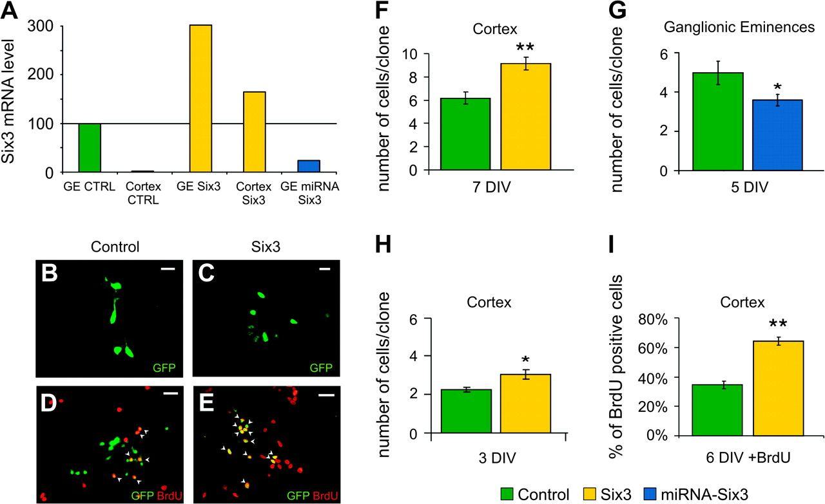
Figure 1. Effect of expression of Six3 on proliferation of telencephalic progenitor cells. (A) Relative level of Six3 ...
Notes:
Figure 1. Effect of expression of Six3 on proliferation of telencephalic progenitor cells. (A) Relative level of Six3 mRNA measured by real-time PCR in precursor cells of cortex or GEs, sorted basing on the expression of GFP reporter, 4 days after transduction with the indicated viral vector. Bars are normalized to the mRNA level of GEs transduced with the control vector. (B–C) Immunofluorescent stainings with anti-GFP antibody on cortical precursor cells 7 days after viral transduction. Examples of clones formed by a single progenitor cell transduced with control virus (B) or Six3-expressing virus (C). (D–E) Double immunofluorescent stainings with anti-GFP (green) and anti-BrdU (red) antibodies of cortical cells 7 days after transduction with the control (D) or the Six3 (E)-expressing virus. BrdU was added 31 h before fixation. Arrowheads point to GFP/BrdU double-positive cells. Scale bars = 25 μm. (F–H) Clonal size (average number of cells per clone) of cortical (F, H) or GEs (G) precursor cells after the transduction with the control- (green), Six3- (yellow), or miRNA-Six3- (blue) retroviral vectors. Cells were analyzed at 3 (3 DIV), 5 (5 DIV), or 7 (7 DIV) days post-transduction. (I) Percentage of BrdU-positive cells (i.e., cells still actively cycling) 7 days after transduction with the control or Six3 vector. Statistical significance: **P(t-test) ≤ 0.01; *P(t-test) ≤ 0.05.
Unless provided in the caption above, the following copyright applies to the content of this slide: © The Author 2007. Published by Oxford University Press. All rights reserved. For permissions, please e-mail: journals.permissions@oxfordjournals.org

Slide 2
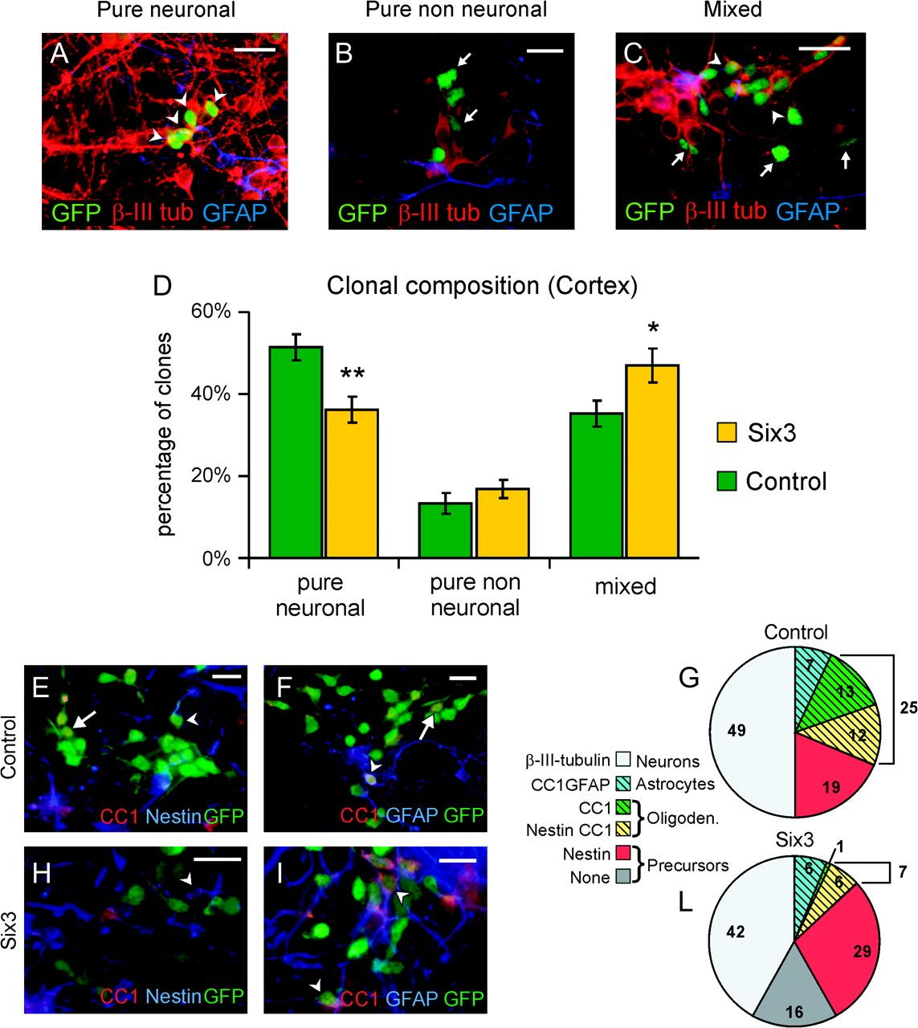
Figure 2. Effect of retroviral transduction of Six3 on differentiation of neural progenitor cells. (A–C) Triple ...
Notes:
Figure 2. Effect of retroviral transduction of Six3 on differentiation of neural progenitor cells. (A–C) Triple immunostaining with anti-GFP (green), anti-β-III-tubulin (red), and anti-GFAP (blue) antibodies. Micrographs show examples of the 3 classes of clones formed by precursors cells 7 days after transduction with the Six3 retroviral vector: (A) pure neuronal, (B) pure nonneuronal, and (C) mixed clone. Arrowheads point to neurons and arrows to nonneuronal cells. Scale bar = 25 μm. (D) Proportion of clones belonging to the class of pure neuronal, pure nonneuronal, and mixed clones, in cortical precursors cells, 7 days after transduction with the control or the Six3 retroviral vectors. Statistical significance: **P(t-test) ≤ 0.01; *P(t-test) ≤ 0.05. (E, F, H, I) Triple immunostaining with anti-GFP (green), CC1 (red), and (E, H) anti-Nestin or (F, I) anti-GFAP (blue) antibodies. Arrowheads point to triple-labeled cells and arrows to GFP-CC1 double-labeled cells; see also Supplementary figure 5. (G, L) Pies show the percentage of control (G) or Six3 (L)-transduced cells expressing the indicated markers. Cells expressing none of the indicated markers are labeled as “none.” Cell population representing less than 2% in both control and Six3 are not shown.
Unless provided in the caption above, the following copyright applies to the content of this slide: © The Author 2007. Published by Oxford University Press. All rights reserved. For permissions, please e-mail: journals.permissions@oxfordjournals.org

Slide 3
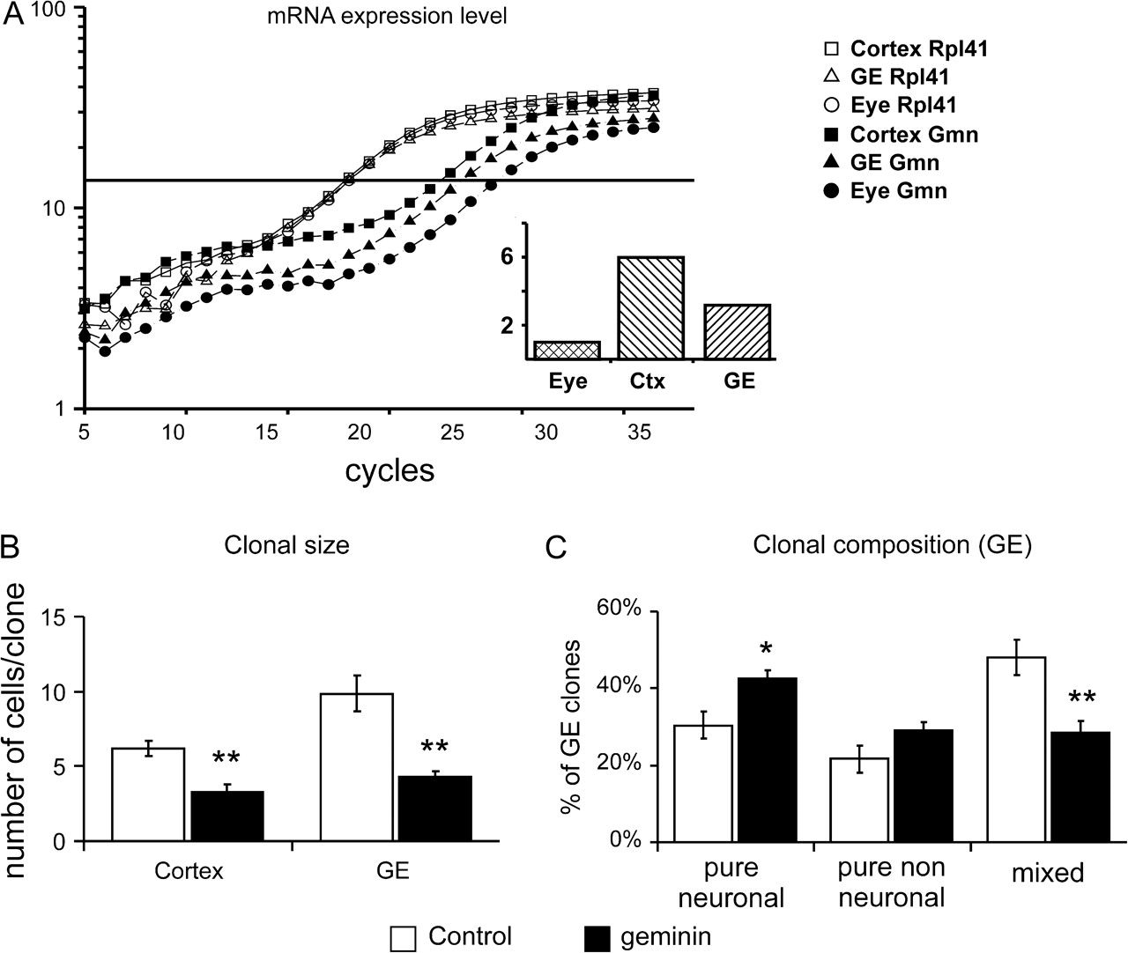
Figure 3. Effect of geminin misexpression on proliferation and differentiation. (A) Expression level of geminin and of ...
Notes:
Figure 3. Effect of geminin misexpression on proliferation and differentiation. (A) Expression level of geminin and of the housekeeping gene Rpl41 in E14 cerebral cortex, GEs, and eye as determined by real-time PCR. The inset represents the relative amount of geminin mRNA in the different tissues, normalized to the level present in the eye. (B) Clonal size (average number of cells per clone) formed by precursor cells derived from cortex and GEs. Cells were analyzed 7 days after infection with the control or geminin-expressing vectors. (C) Percentage of pure neuronal, pure nonneuronal, and mixed clones formed by GEs precursor cells 7 days post-transduction with the control or the geminin carrying retroviral vectors. Statistical significance: **P(t-test) ≤ 0.01; *P(t-test) ≤ 0.05.
Unless provided in the caption above, the following copyright applies to the content of this slide: © The Author 2007. Published by Oxford University Press. All rights reserved. For permissions, please e-mail: journals.permissions@oxfordjournals.org

Slide 4
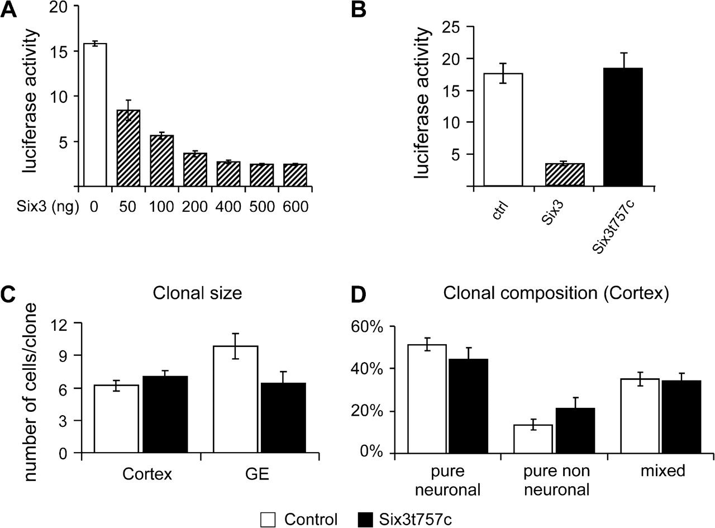
Figure 4. Role of Six3 transcriptional activity. (A, B) Relative activity of the firefly luciferase from a ...
Notes:
Figure 4. Role of Six3 transcriptional activity. (A, B) Relative activity of the firefly luciferase from a Six3-responsive reporter plasmid normalized to the value of the Renilla luciferase activity from a constitutive control plasmid. Histograms show the relative activity after cotransfection with increasing amounts of Six3 (A) or with fixed amount (100 ng) of, respectively, the control, the Six3, and the mutant Six3t757c vectors (B). (C) Clonal sizes of precursor cells from cortex and GEs 7 days post-transduction with the control or the Six3t757c-expressing vectors. (D) Percentage of pure neuronal, pure nonneuronal, and mixed clones in transduced cortical precursor cells 7 days post-transduction with the control or the Six3t757c-expressing vectors.
Unless provided in the caption above, the following copyright applies to the content of this slide: © The Author 2007. Published by Oxford University Press. All rights reserved. For permissions, please e-mail: journals.permissions@oxfordjournals.org

Slide 5
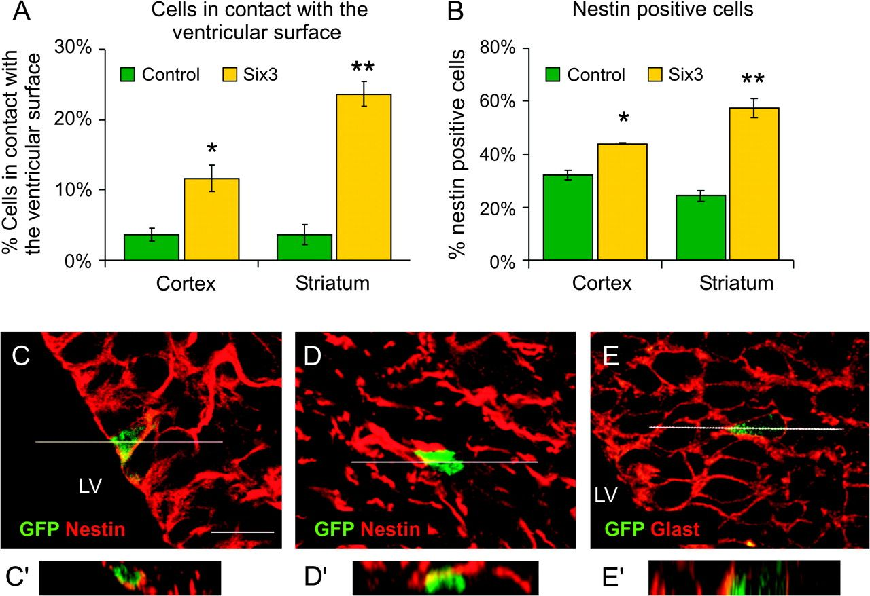
Figure 5. In vivo misexpression of Six3 prolongs immature state of neural progenitors. (A, B) Percentage of cells in ...
Notes:
Figure 5. In vivo misexpression of Six3 prolongs immature state of neural progenitors. (A, B) Percentage of cells in contact with the ventricular surface (A) and nestin-positive cells (B) in P0 cortex and striatum following in vivo injection of the control or the Six3 viruses in the telencephalic lateral ventricles at E14 stage. (C–E) Single optical sections of a P0 brain, injected with the Six3-containing retroviral vector and stained with the indicated antibodies. (C′–E′) are reconstructions of confocal sections in the Z axes at the levels indicated by the white line in the corresponding pictures (C–E). (C) shows a representative case of a cell in contact with the ventricle at the cortical level. (D–E) show cells lacking contact with the ventricle in the basal ganglia. Scale bar = 25 μm. Statistical significance: **P(t-test) ≤ 0.01; *P(t-test) ≤ 0.05.
Unless provided in the caption above, the following copyright applies to the content of this slide: © The Author 2007. Published by Oxford University Press. All rights reserved. For permissions, please e-mail: journals.permissions@oxfordjournals.org

Slide 6
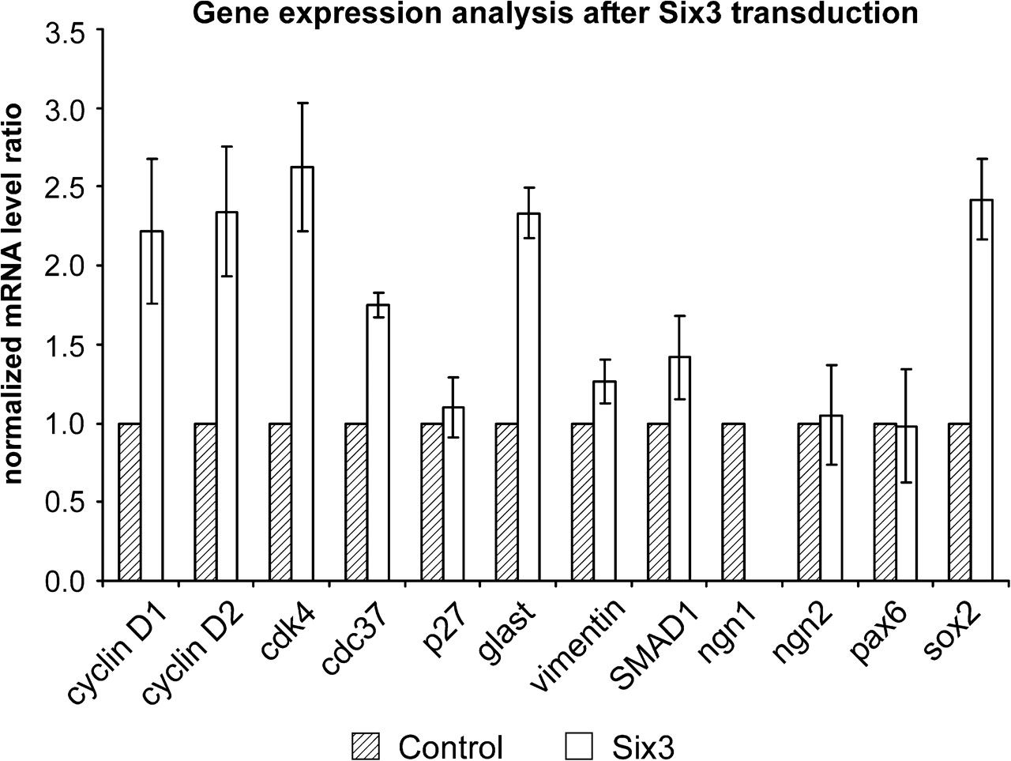
Figure 6. Analysis of putative downstream target genes of Six3. mRNA levels of the indicated candidate genes in ...
Notes:
Figure 6. Analysis of putative downstream target genes of Six3. mRNA levels of the indicated candidate genes in Six3-transduced cortical precursors as detected by real-time PCR. All values are normalized to the level of the housekeeping Rlp41 gene and to the corresponding mRNA level in control transduced cells.
Unless provided in the caption above, the following copyright applies to the content of this slide: © The Author 2007. Published by Oxford University Press. All rights reserved. For permissions, please e-mail: journals.permissions@oxfordjournals.org

