Slide 1
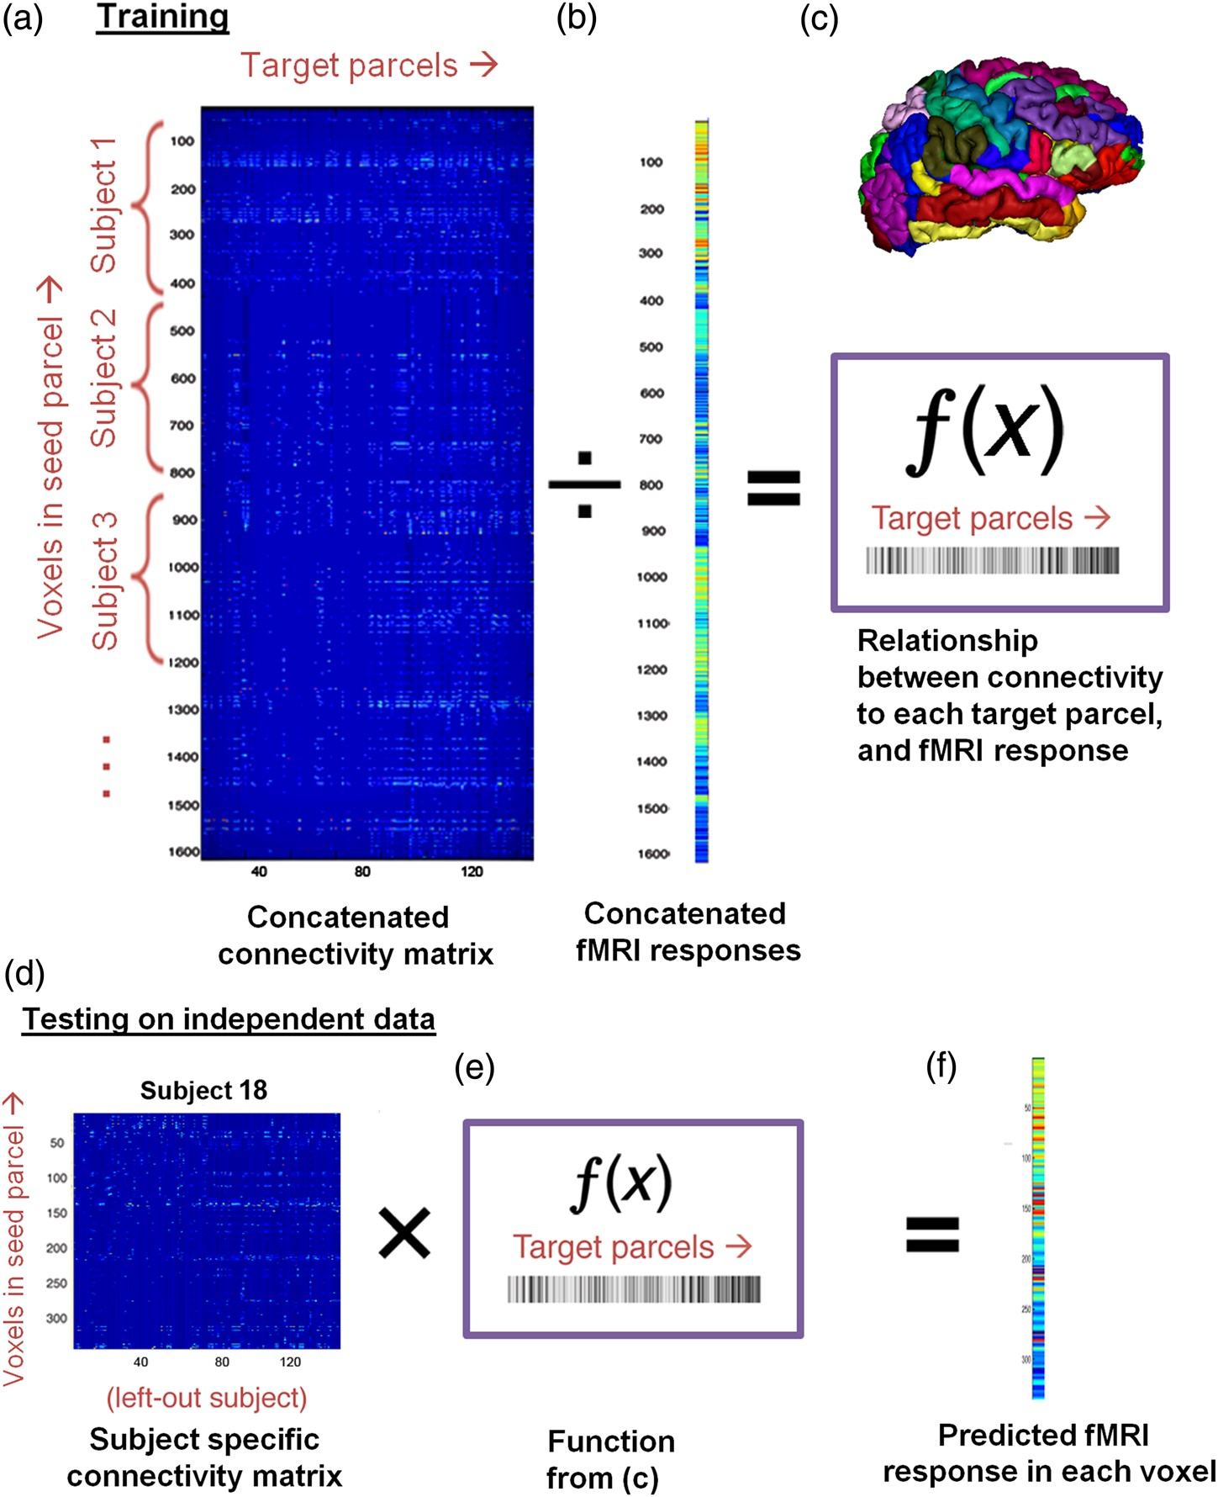
Figure 1. Schematic of processing pipeline. Each individual's anatomical image is first divided into 148 parcels, shown ...
Notes:
Figure 1. Schematic of processing pipeline. Each individual's anatomical image is first divided into 148 parcels, shown on the colored brain. For each parcel, the following procedure is carried out (i.e., each parcel is modeled separately). (a) Connectivity from each seed voxel to every other parcel is calculated for each individual, and the connectivity matrices from all individuals except for one (the left-out subject) are concatenated. Voxels are shown in rows (this number will vary for each individual) and the 148 target parcels are in columns; connection probability is depicted in color. (b) Concatenate the fMRI response (depicted as a colored vector) to the contrast of interest (e.g., Faces > Objects) such that every voxel is matched with its vector of connectivity in (a). (c) A linear regression (represented as ÷) models the relationship between (a) and (b). This relationship (ƒ(x)) is a vector of coefficients the same length as the number of columns in (a). It reflects the contribution of each target parcel to predicting fMRI responses, and is depicted as the grayscale vector. (d) The left-out participant also has a connectivity matrix of n voxels × 148 parcels. (e) ƒ(x) is applied to each voxel in the left-out participant's connectivity matrix, which yields (f) a predicted fMRI response for every voxel. Thus, the left-out participant now has an fMRI response that is predicted from his/her own DWI connectivity alone. The predicted responses are then compared with that participant's actual fMRI responses per voxel. Every participant is left-out iteratively such that independent predictions are generated for each participant, in their own native space. This procedure is repeated for each parcel, and for each contrast. After all of group 1 participants have been predicted, a final ƒ(x) is learned from all the participants (i.e., no one is left-out). This final ƒ(x) is then applied to new participants from an independent group (group 2). Steps (d–f) are thus repeated for each group 2 participant to generate predicted fMRI responses for every voxel, for every parcel, and for every contrast.
Unless provided in the caption above, the following copyright applies to the content of this slide: © The Author 2015. Published by Oxford University Press. All rights reserved. For Permissions, please e-mail: journals.permissions@oup.com

Slide 2
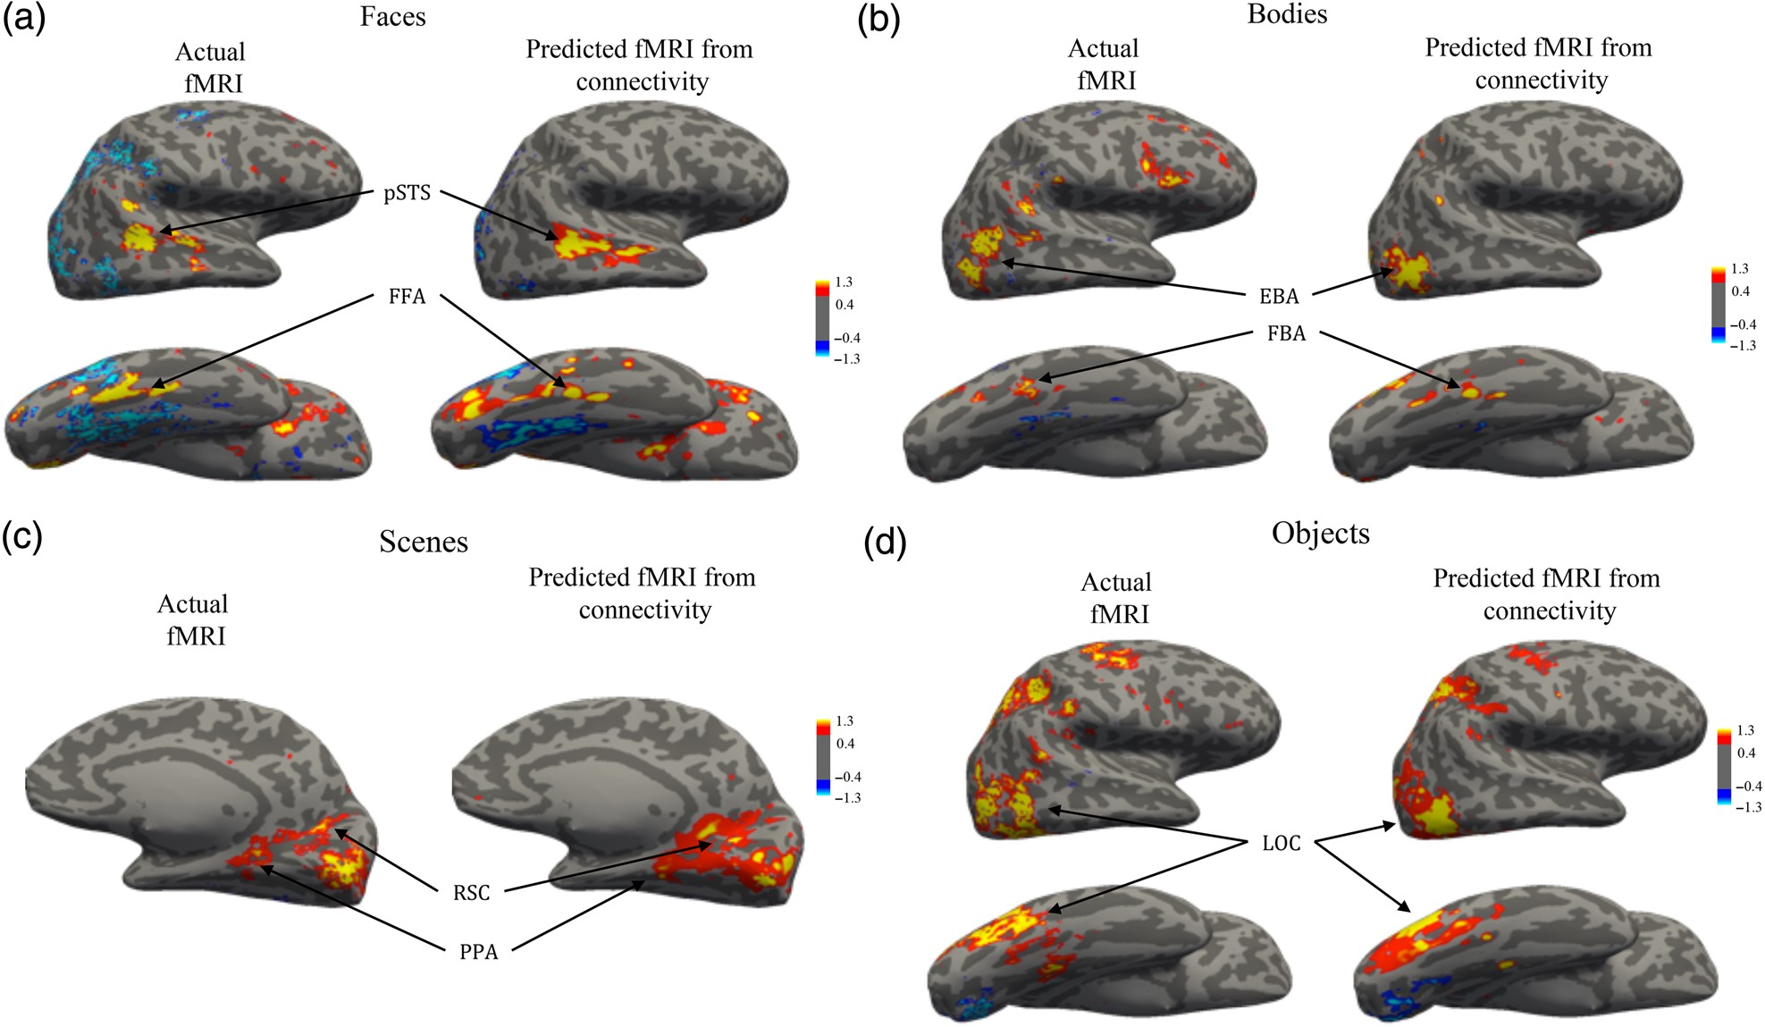
Figure 2. Visualization of prediction results on an example subject. Representative subject's actual and predicted ...
Notes:
Figure 2. Visualization of prediction results on an example subject. Representative subject's actual and predicted activation images are up-sampled from the DWI structural image to the same participant's structural scan, and projected onto the participant's inflated brain surface. Predicted fMRI activation values (right column of each panel) for each visual category contrast closely match the actual fMRI values (left columns) for that contrast, especially in regions commonly identified as being functionally selective for that particular visual category (i.e., fROIs; see Table 1). (a) Faces (b) Bodies (c) Scenes (d) Objects.
Unless provided in the caption above, the following copyright applies to the content of this slide: © The Author 2015. Published by Oxford University Press. All rights reserved. For Permissions, please e-mail: journals.permissions@oup.com

Slide 3
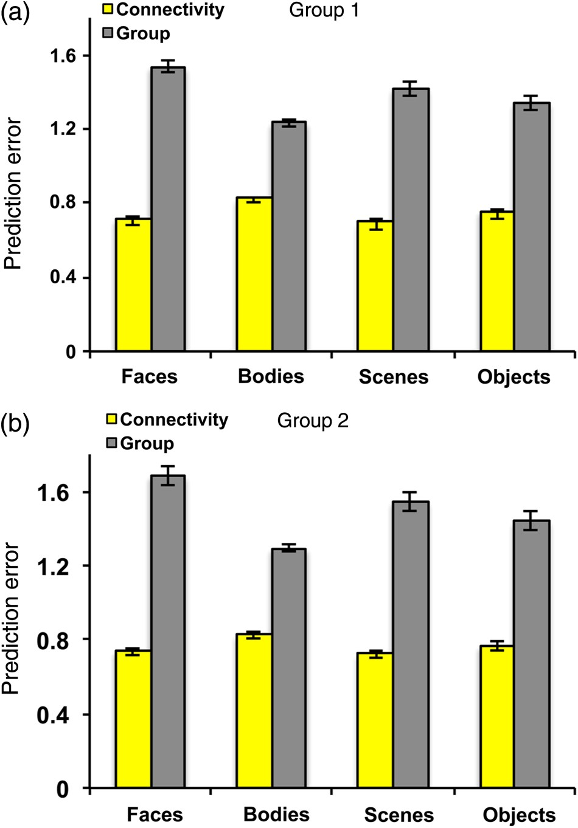
Figure 3. Mean prediction errors and comparison to benchmark. Prediction errors (i.e., mean absolute errors) across all ...
Notes:
Figure 3. Mean prediction errors and comparison to benchmark. Prediction errors (i.e., mean absolute errors) across all voxels for the predicted fMRI activation by connectivity and the group-average benchmark are plotted for each functional contrast for participants in (a) group 1 and (b) group 2. For both groups 1 and 2, predictions from the connectivity models were significantly more accurate (lower error) than predictions from the group-analysis benchmark.
Unless provided in the caption above, the following copyright applies to the content of this slide: © The Author 2015. Published by Oxford University Press. All rights reserved. For Permissions, please e-mail: journals.permissions@oup.com

Slide 4
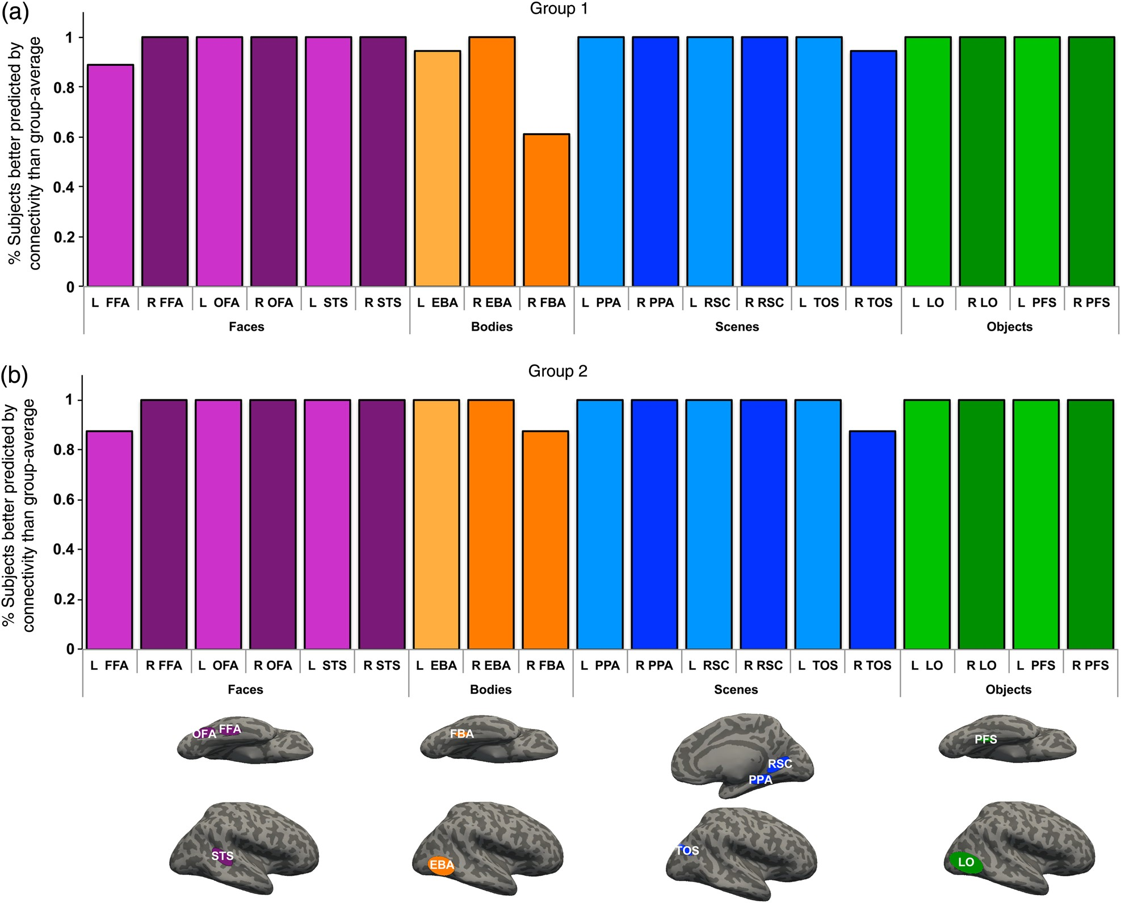
Figure 4. Predictive accuracy across subjects for connectivity versus group-analysis benchmark. For each of the fROIs ...
Notes:
Figure 4. Predictive accuracy across subjects for connectivity versus group-analysis benchmark. For each of the fROIs (depicted on the inflated brains, see Julian et al. (2012) for ROI nomenclature), we calculated the percentage of subjects whose connectivity patterns better predicted their activation patterns than a group-based prediction (paired t-test of voxel-wise prediction errors for connectivity vs. group average per subject, P < 0.05 Bonferroni corrected for total number of fROIs times the total number of subjects across both groups, i.e., 26 × 19) in (a) the cross-validation group (group 1) and (b) replication test group (group 2). Lighter colors indicate left-hemisphere fROIs (some fROIs did not have a left-hemisphere counterpart).
Unless provided in the caption above, the following copyright applies to the content of this slide: © The Author 2015. Published by Oxford University Press. All rights reserved. For Permissions, please e-mail: journals.permissions@oup.com

Slide 5
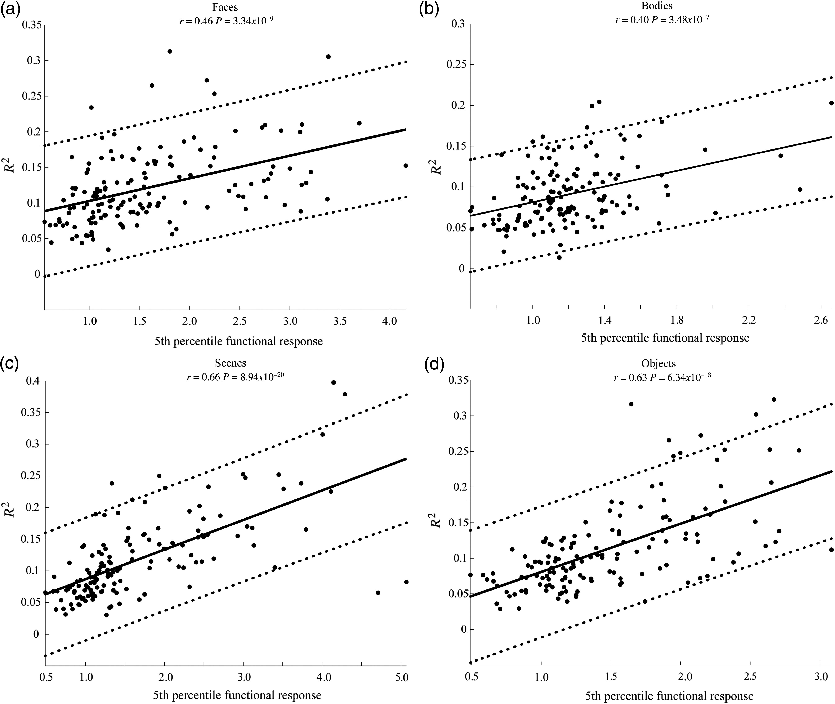
Figure 5. Model fits positively correlate with functional selectivity per anatomical parcel. The fits or R² ...
Notes:
Figure 5. Model fits positively correlate with functional selectivity per anatomical parcel. The fits or R2 values for the final models of connectivity and function per anatomical region were significantly and positively correlated with the mean absolute contrast responses for voxels in the 5th percentile for each parcel. These values reflect the response selectivity of each parcel to the functional contrast, (a) Faces, (b) Bodies, (c) Scenes, and (d) Objects. Parcels with better model fits had greater functional selectivity for that functional contrast.
Unless provided in the caption above, the following copyright applies to the content of this slide: © The Author 2015. Published by Oxford University Press. All rights reserved. For Permissions, please e-mail: journals.permissions@oup.com

Slide 6
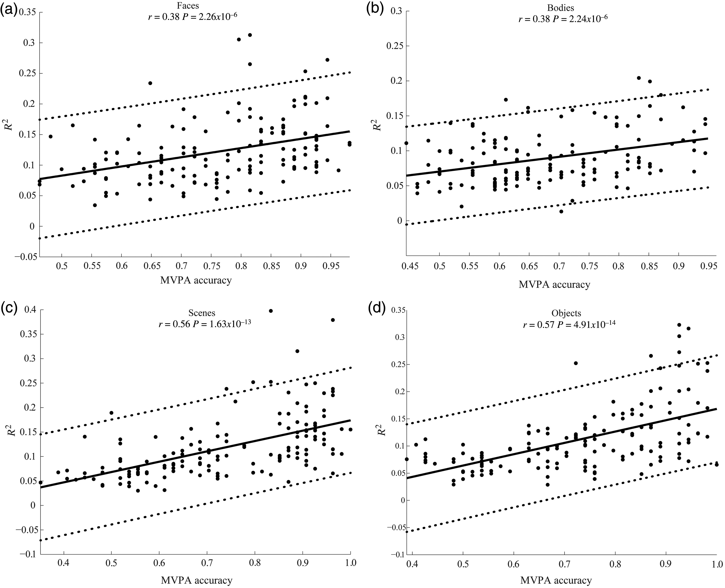
Figure 6. Model fits positively correlate with MVPA accuracy per anatomical parcel. The fits or R² values ...
Notes:
Figure 6. Model fits positively correlate with MVPA accuracy per anatomical parcel. The fits or R2 values for the final models of connectivity and function per anatomical region were significantly and positively correlated with MVPA accuracies to each functional contrast, which reflect the cooperative selectivity of the response patterns across voxels within each region (a) Faces, (b) Bodies, (c) Scenes, and (d) Objects. Parcels with better model fits had higher MVPA accuracy for that functional contrast.
Unless provided in the caption above, the following copyright applies to the content of this slide: © The Author 2015. Published by Oxford University Press. All rights reserved. For Permissions, please e-mail: journals.permissions@oup.com

Slide 7
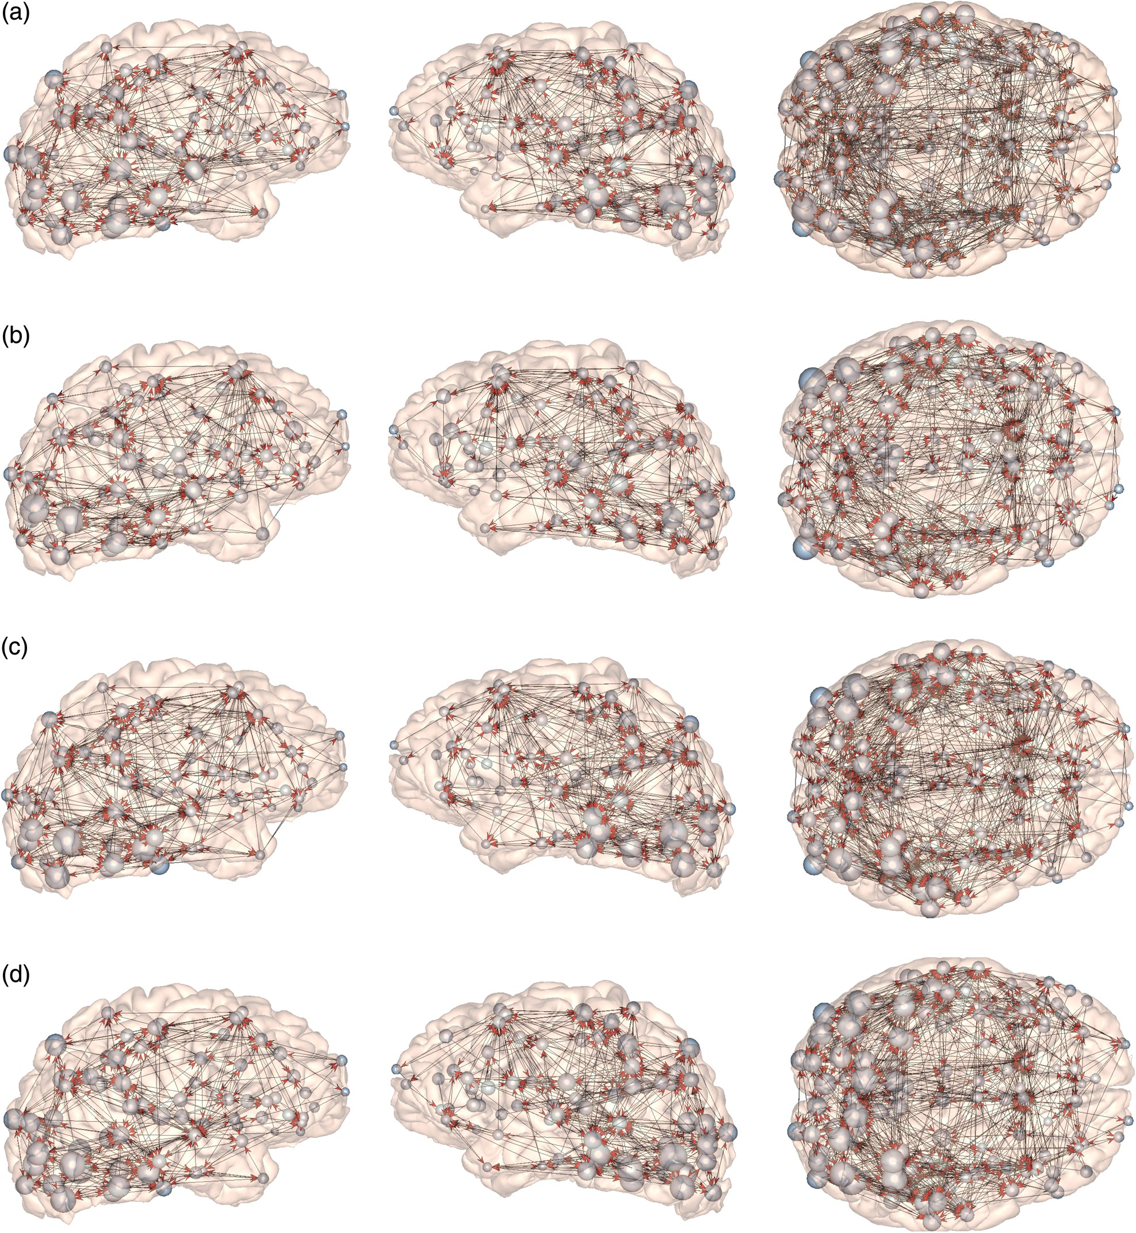
Figure 7. Functionally relevant networks. The functionally relevant networks (FRNs) for (a) Faces, (b) Bodies, (c) ...
Notes:
Figure 7. Functionally relevant networks. The functionally relevant networks (FRNs) for (a) Faces, (b) Bodies, (c) Scenes, and (d) Objects are visualized as directed graphs. Left column: right lateral surface; center column: left lateral surface; right column: ventral surface (with right hemisphere on top). In this graphical view, nodes reflect parcels, and edges are the anatomical connections that are significant predictors of neural responses. Edges originate from significant predictors, and their arrows point toward the parcels whose neural responses are predicted. For example, if node A predicts node B, then an arrow would originate from node A and point toward node B. Node size scales with selectivity, such that larger spheres represent parcels with higher selectivity.
Unless provided in the caption above, the following copyright applies to the content of this slide: © The Author 2015. Published by Oxford University Press. All rights reserved. For Permissions, please e-mail: journals.permissions@oup.com

Slide 8
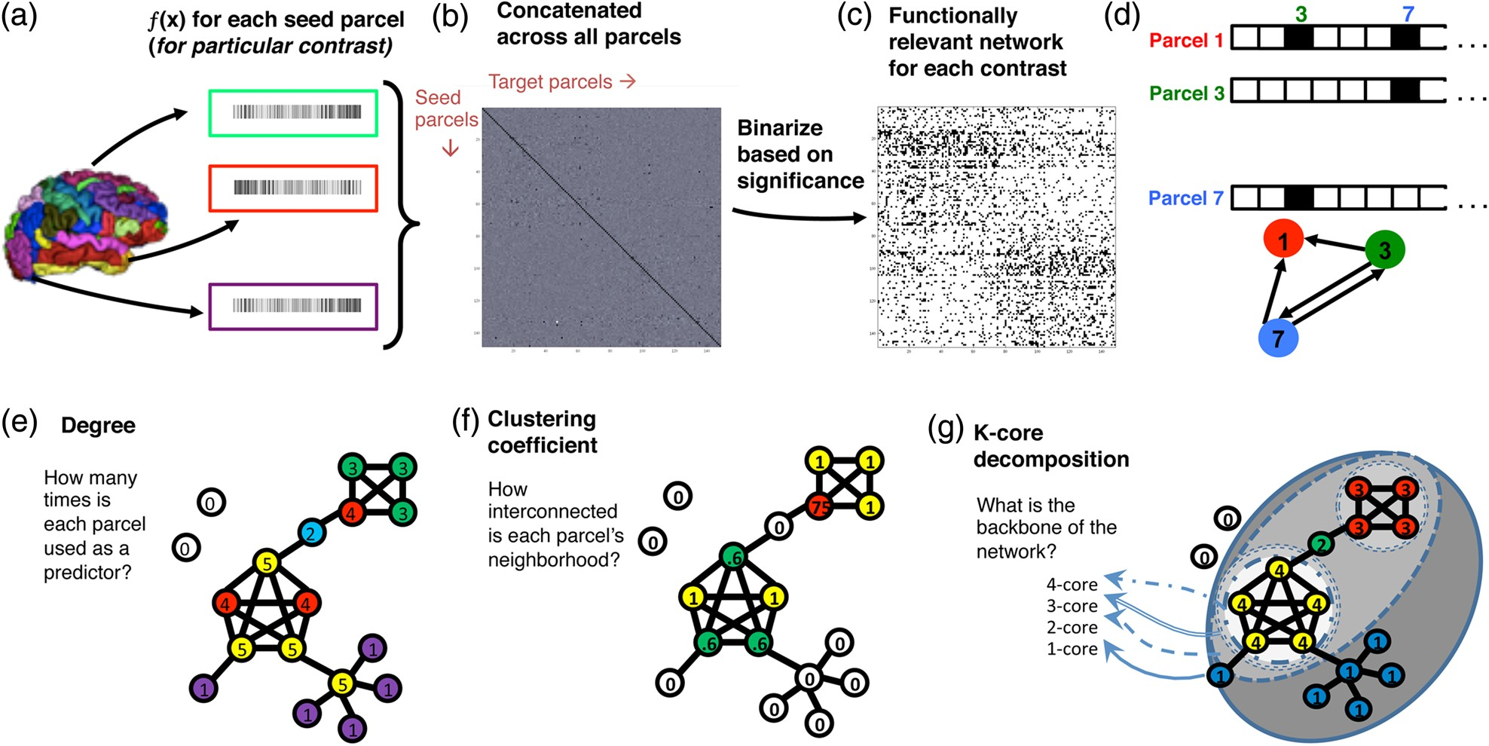
Figure 8. Schematic of whole-brain network analyses. (a) A final model (ƒ(x)) for each parcel and for each contrast is ...
Notes:
Figure 8. Schematic of whole-brain network analyses. (a) A final model (ƒ(x)) for each parcel and for each contrast is computed (see Fig. 1). (b) ƒ(x) from all parcels are concatenated to yield a 148 × 148 matrix; rows are seed parcels and columns are target parcels (predictors). This matrix is then (c) binarized based on significance (i.e., each ƒ(x) is assigned 1 or “true” for coefficients that make a significant contribution to the model). This matrix is the functionally relevant network (FRN) for a particular fMRI contrast. Here, black squares are “true” (i.e., significant predictors) and white squares are false; the diagonal is white because a parcel cannot predict itself. (d) A closer look at a few rows of an FRN illustrates the type of information that can be gleaned about a network. For example, in the FRN for Face responses, parcels 3 and 7 predict responses in parcel 1, but parcel 1 does not predict parcels 3 and 7; instead, parcel 3′s responses are predicted by 7 and vice versa. We can represent this relationship as a directed network, with arrows pointing “from” the predictors “to” the parcels that they predict. This network diagram is used to visualize the predictor–predictee relationship for all parcels for each contrast (see Fig. 7). (e–g) We further explored this complex network using graph theory and calculated 3 metrics that reflected the role of each parcel in predicting responses in other parcels. The values for each of these metrics are shown in the nodes of a rhetorical network. (e) We calculated out-degree, which is the number of times each parcel was predictive of functional responses in every other parcel. (f) We also calculated the clustering coefficient of each parcel, which measures how interconnected the secondary network of a node is (e.g., a parcel with a high clustering coefficient would predict function in a set of other parcels, and these parcels would also predict function in one another). (g) Lastly, we calculated the core number of each parcel using k-core decomposition, which identifies the underlying backbone of a network through iterative pruning of nodes. We identified subnetworks (k-cores) by successively removing all nodes with a degree smaller than k until all remaining nodes have a degree equal to or larger than k (e.g., prune nodes with degree less than k; if the resulting subnetwork contains nodes with degree less than k, remove them, until all nodes have degree of at least k). Each successive k-core contains a deeper infrastructure of interconnected components. The core number of a node is the highest k-core that it belongs to.
Unless provided in the caption above, the following copyright applies to the content of this slide: © The Author 2015. Published by Oxford University Press. All rights reserved. For Permissions, please e-mail: journals.permissions@oup.com

