Slide 1
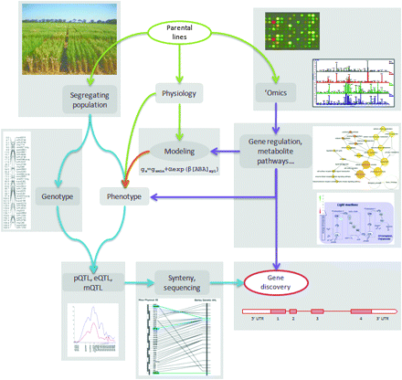
Fig. 1. Schematic representation of the pathway from parental lines selection to gene discovery. The diagram shows ...
Notes:
Fig. 1. Schematic representation of the pathway from parental lines selection to gene discovery. The diagram shows the role of physiological analysis, population development, and phenotyping and the various ‘omics technologies in supporting a gene discovery path. Given the complexity and variability of the droughted environment, the first task is defining the type of drought regime or regimes that are being investigated. The second issue is selecting germplasm that will be suitable for the target environments and is likely to reveal major loci associated with tolerance. These lines are used to develop the segregating populations that form the base for the genetic analysis. Mathematical models of physiological traits and omics of parental and selected recombinant lines provide functional data to select candidate genes for the QTL. A further component in the process of defining target regions and candidates for drought tolerance in wheat is the use of the sequenced cereal genomes. The strong conservation of gene order between the grasses means that the rice and Brachypodium genomes provide a valuable resource in developing markers for fine mapping in a target region and for identifying candidate genes for the QTL.
Unless provided in the caption above, the following copyright applies to the content of this slide: © The Author [2010]. Published by Oxford University Press [on behalf of the Society for Experimental Biology]. All rights reserved. For Permissions, please e-mail: journals.permissions@oxfordjournals.org

Slide 2
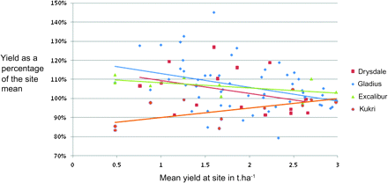
Fig. 2. Relative yield of mapping parents in low-yielding environments in 2009. The data are taken from the National ...
Notes:
Fig. 2. Relative yield of mapping parents in low-yielding environments in 2009. The data are taken from the National Variety Trials (http://www.nvtonline.com.au/home.htm). The yields of the four varieties are expressed as a percentage of the site mean. RAC875 was not included in these trials.
Unless provided in the caption above, the following copyright applies to the content of this slide: © The Author [2010]. Published by Oxford University Press [on behalf of the Society for Experimental Biology]. All rights reserved. For Permissions, please e-mail: journals.permissions@oxfordjournals.org

