Slide 1
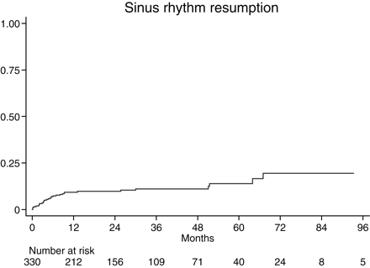
Figure 1 Kaplan–Meier estimation of cumulative SR resumption. Patients at risk are reported below the curve.
Notes:
Figure 1 Kaplan–Meier estimation of cumulative SR resumption. Patients at risk are reported below the curve.
Unless provided in the caption above, the following copyright applies to the content of this slide: Published on behalf of the European Society of Cardiology. All rights reserved. © The Author 2010. For permissions please email: journals.permissions@oxfordjournals.org

Slide 2
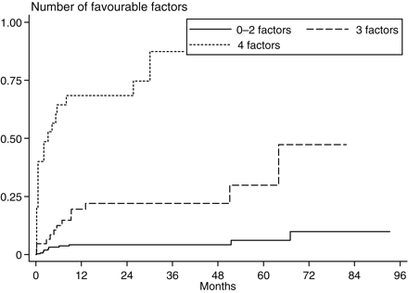
Figure 2 Kaplan–Meier estimation of cumulative SR resumption according to the number of favourable factors present ...
Notes:
Figure 2 Kaplan–Meier estimation of cumulative SR resumption according to the number of favourable factors present (derived from the multivariable analysis). Cox model P < 0.001. Three vs. zero to two predictors HR = 3.5 for SRR, four vs. three predictors HR=5.7 for SRR.
Unless provided in the caption above, the following copyright applies to the content of this slide: Published on behalf of the European Society of Cardiology. All rights reserved. © The Author 2010. For permissions please email: journals.permissions@oxfordjournals.org

Slide 3
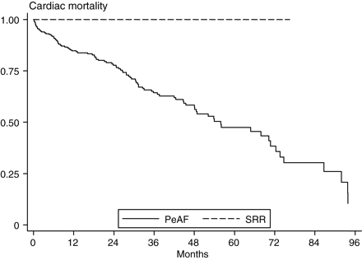
Figure 3 Kaplan–Meier analysis of cardiac survival stratified according to resumption to sinus rhythm and no ...
Notes:
Figure 3 Kaplan–Meier analysis of cardiac survival stratified according to resumption to sinus rhythm and no resumption. Include patients with a minimum 6-month follow-up after CRT. Months of follow-up are computed beginning at the sixth month assessment. PeAF, permanent atrial fibrillation at 6 months; SR resume, resumption of sinus rhythm at 6 months.
Unless provided in the caption above, the following copyright applies to the content of this slide: Published on behalf of the European Society of Cardiology. All rights reserved. © The Author 2010. For permissions please email: journals.permissions@oxfordjournals.org

