Slide 1
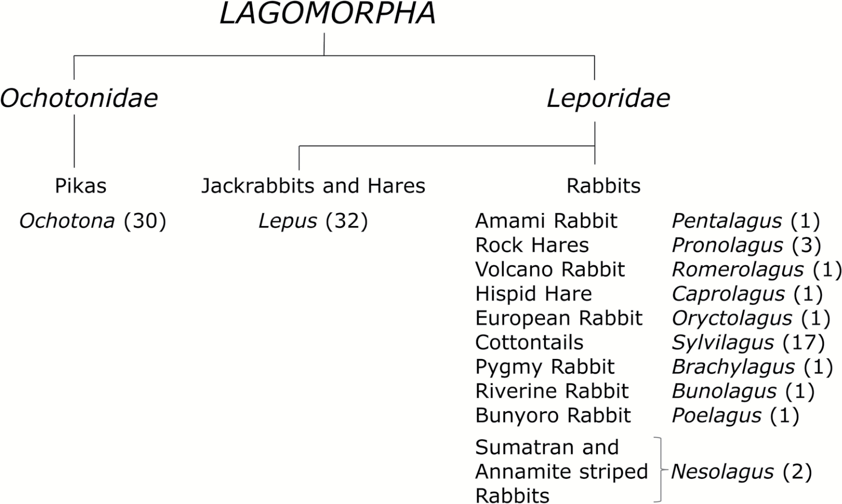
Figure 1. Overview of systematics of the order Lagomorpha (number in parenthesis indicates the number of species within ...
Notes:
Figure 1. Overview of systematics of the order Lagomorpha (number in parenthesis indicates the number of species within the genera; Hoffmann and Smith 2005; Alves and Hacklander 2008).
Unless provided in the caption above, the following copyright applies to the content of this slide: © The American Genetic Association. 2016. All rights reserved. For permissions, please e-mail: journals.permissions@oup.com

Slide 2
Figure 2. Official logo of the Lagomorph Genomics (LaGomiCs) Consortium.
Notes:
Figure 2. Official logo of the Lagomorph Genomics (LaGomiCs) Consortium.
Unless provided in the caption above, the following copyright applies to the content of this slide: © The American Genetic Association. 2016. All rights reserved. For permissions, please e-mail: journals.permissions@oup.com

