Slide 1
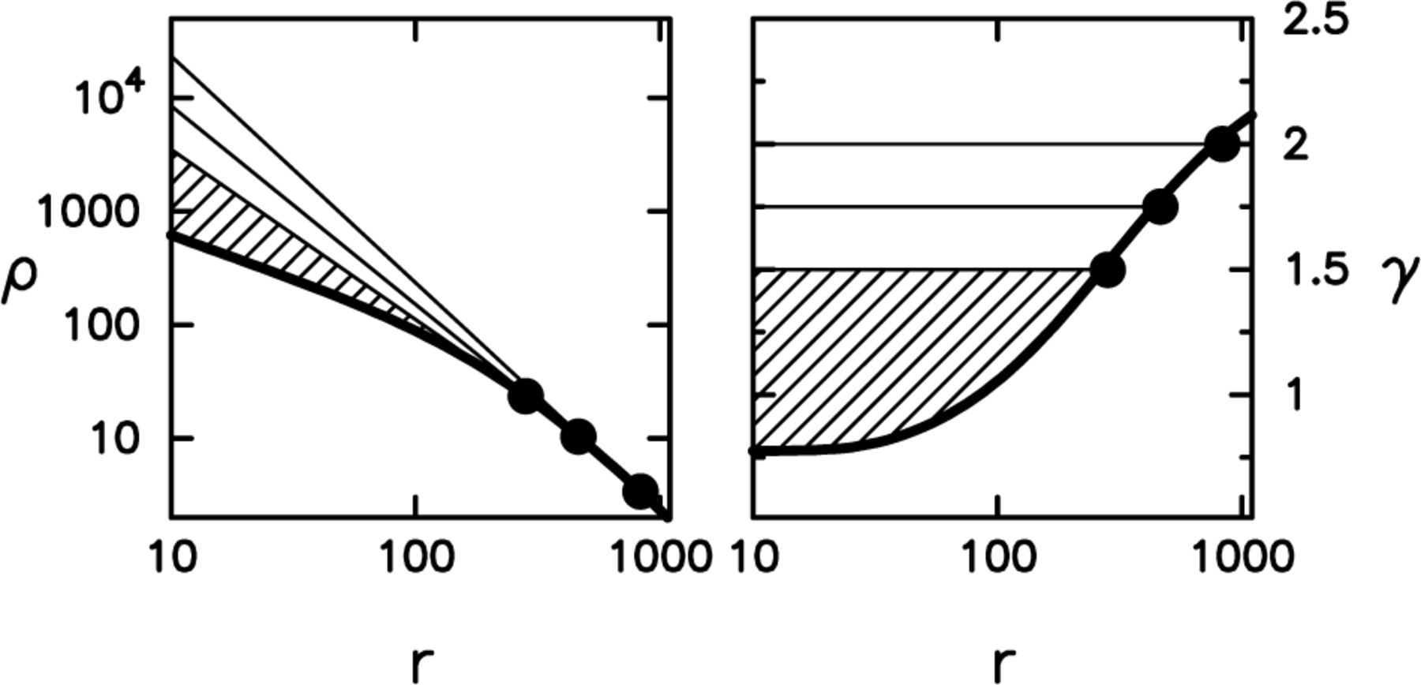
Figure 1. Definition of the mass deficit, illustrated using the profile of NGC 5903. Left panel: density in ...
Notes:
Figure 1. Definition of the mass deficit, illustrated using the profile of NGC 5903. Left panel: density in M⊙ pc−3 as a function of radius in pc (thick line); hypothetical original density cusps for fiducial slopes γ0=2, 1.75, 1.5 (thin lines). Dots indicate the corresponding break radii. Shaded region is the mass deficit for γ0=1.5. Right panel: the negative logarithmic derivative of the density profile, γ≡-d log ρ/d log r. Break radii are defined as the radii where γ=γ0.
Unless provided in the caption above, the following copyright applies to the content of this slide: © 2002 RAS

Slide 2
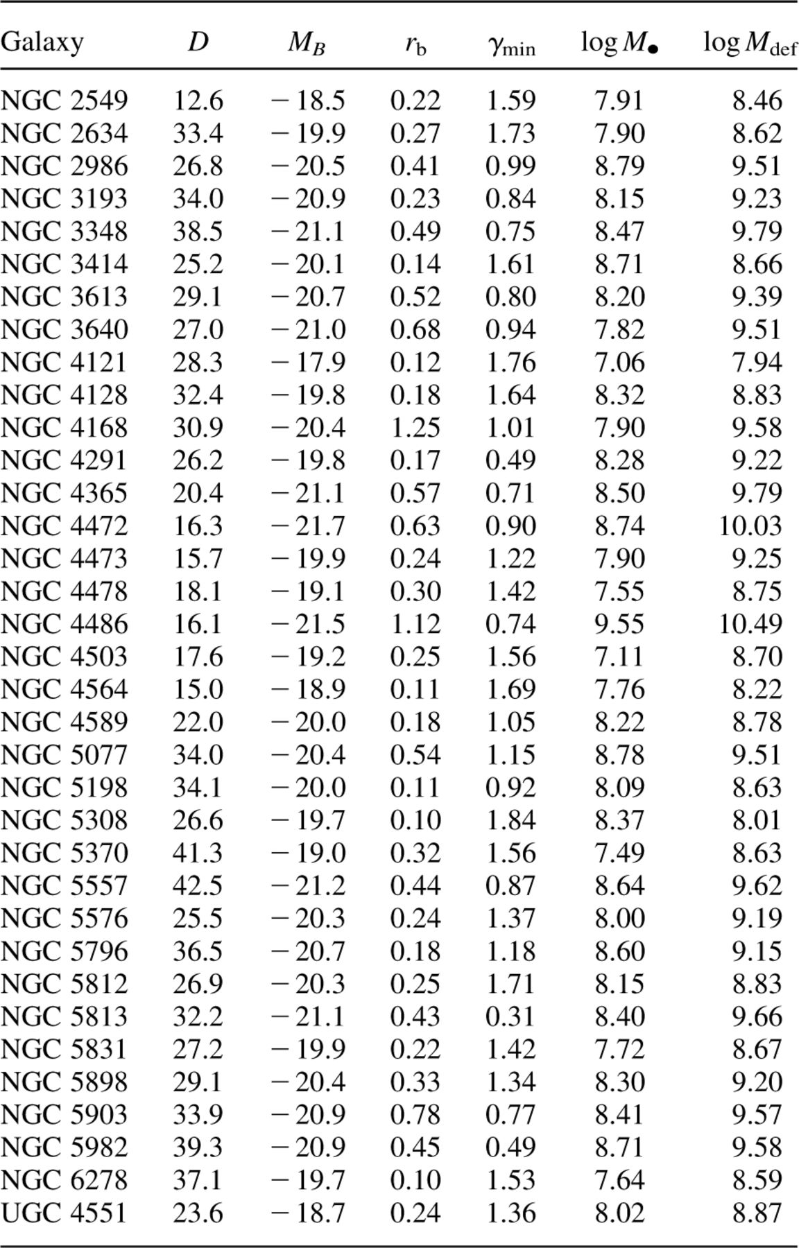
Table 1. Galaxies with γ_{min} ≤2; D is distance in Mpc; r_{b} is break radius in kpc; γ_{min} ...
Notes:
Table 1. Galaxies with γmin ≤2; D is distance in Mpc; rb is break radius in kpc; γmin is the minimum logarithmic slope; M● and Mdef are in solar masses.
Unless provided in the caption above, the following copyright applies to the content of this slide: © 2002 RAS

Slide 3
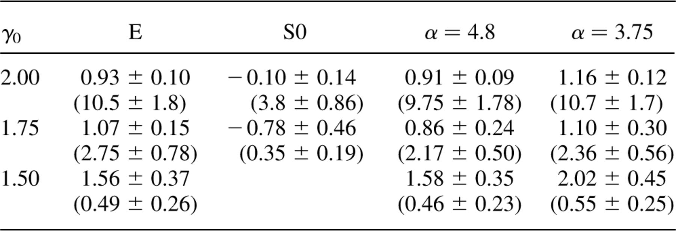
Table 2. Linear regression fits to the (log M●, log M_{def}) data for three values of the fiducial ...
Notes:
Table 2. Linear regression fits to the (log M●, log Mdef) data for three values of the fiducial logarithmic slope γ0. Values in parentheses are Mdef/M● interpolated from the fit at M● = 108 M⊙. Fourth and fifth columns are, respectively, fits of the entire data set (including the galaxies with dynamical estimates of Mdef) using the Ferrarese & Merritt (2000) and the Gebhardt et al. (2000) values of the M● −σ relation exponent α.
Unless provided in the caption above, the following copyright applies to the content of this slide: © 2002 RAS

Slide 4
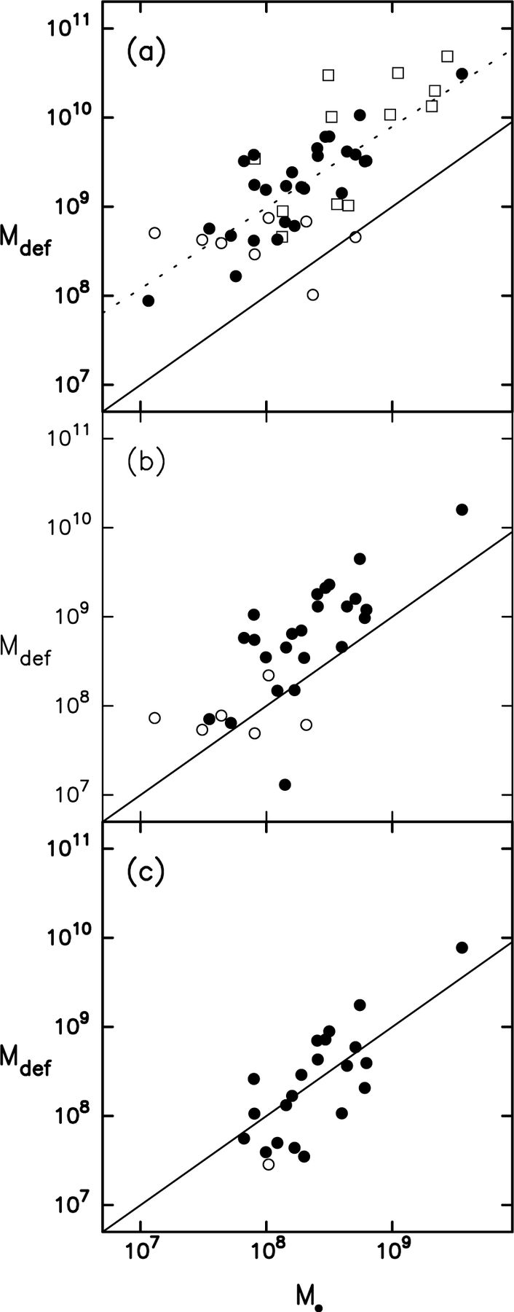
Figure 2. Mass deficit versus BH mass for three different values of γ₀, the assumed logarithmic slope of the ...
Notes:
Figure 2. Mass deficit versus BH mass for three different values of γ0, the assumed logarithmic slope of the density cusp before energy input from BHs. (a) γ0=2; (b) γ0=1.75; (c) γ0=1.5. Filled circles are elliptical galaxies and empty circles are lenticulars. Squares show dynamical estimates of Mdef for the sample of galaxies considered in Ferrarese & Merritt (2000). Solid line is the Mdef=M• relation. Dotted line in panel (a) is a linear regression fit to all galaxies (see Table 2).
Unless provided in the caption above, the following copyright applies to the content of this slide: © 2002 RAS

