Slide 1
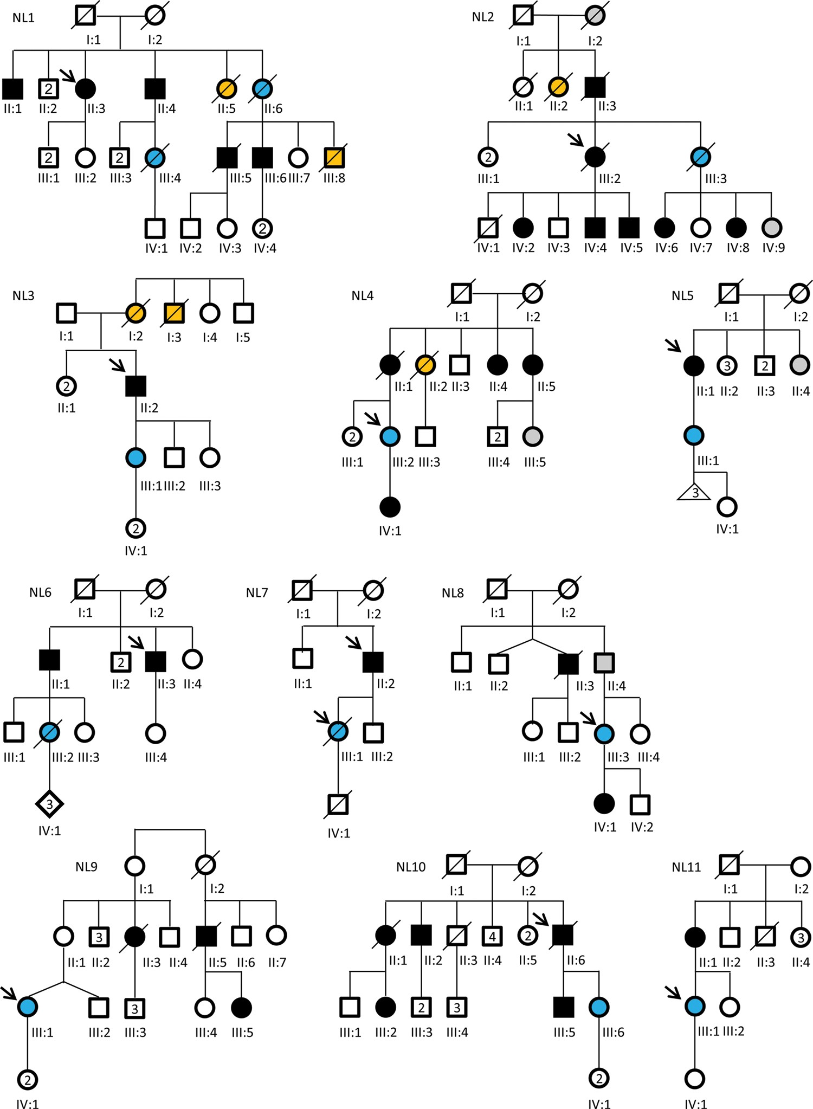
Figure 1 Pedigrees of the Dutch families (NL1-11). Square symbols indicate men; circles, women; diamonds, unknown sex; ...
Notes:
Figure 1 Pedigrees of the Dutch families (NL1-11). Square symbols indicate men; circles, women; diamonds, unknown sex; and triangles, miscarriage. Blue symbols indicate a clinical diagnosis of peripartum cardiomyopathy; black symbols, (mild) dilated cardiomyopathy; grey symbols, possible dilated cardiomyopathy; orange symbols, sudden cardiac death. Diagonal lines through symbols indicate deceased; arrows indicate patients selected for targeted next-generation sequencing; and the number in a symbol indicates the number of individuals with this symbol (question mark if unknown).
Unless provided in the caption above, the following copyright applies to the content of this slide: Published on behalf of the European Society of Cardiology. All rights reserved. © The Author 2014. For permissions please email: journals.permissions@oup.com

Slide 2
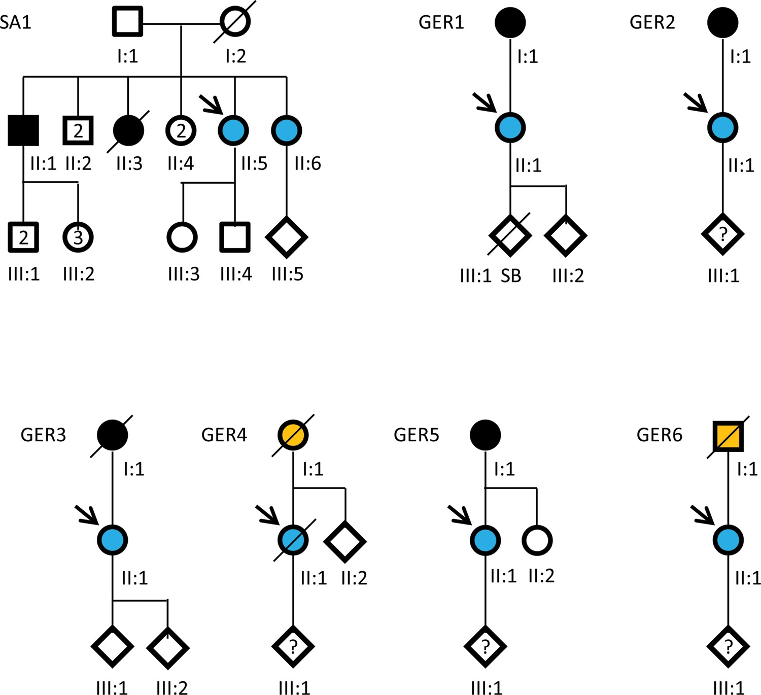
Figure 2 Pedigrees of the South African (SA1) and German families (GER1-6). Square symbols indicate men; circles, ...
Notes:
Figure 2 Pedigrees of the South African (SA1) and German families (GER1-6). Square symbols indicate men; circles, women; diamonds, unknown sex. Blue symbols indicate clinical diagnosis of peripartum cardiomyopathy; black symbols, (mild) dilated cardiomyopathy; orange symbol, sudden cardiac death. Diagonal lines through symbols indicate deceased; arrows indicate patients selected for targeted next-generation sequencing; the number in a symbol indicates the number of individuals with this symbol (question mark if unknown); and SB indicates still birth.
Unless provided in the caption above, the following copyright applies to the content of this slide: Published on behalf of the European Society of Cardiology. All rights reserved. © The Author 2014. For permissions please email: journals.permissions@oup.com

Slide 3
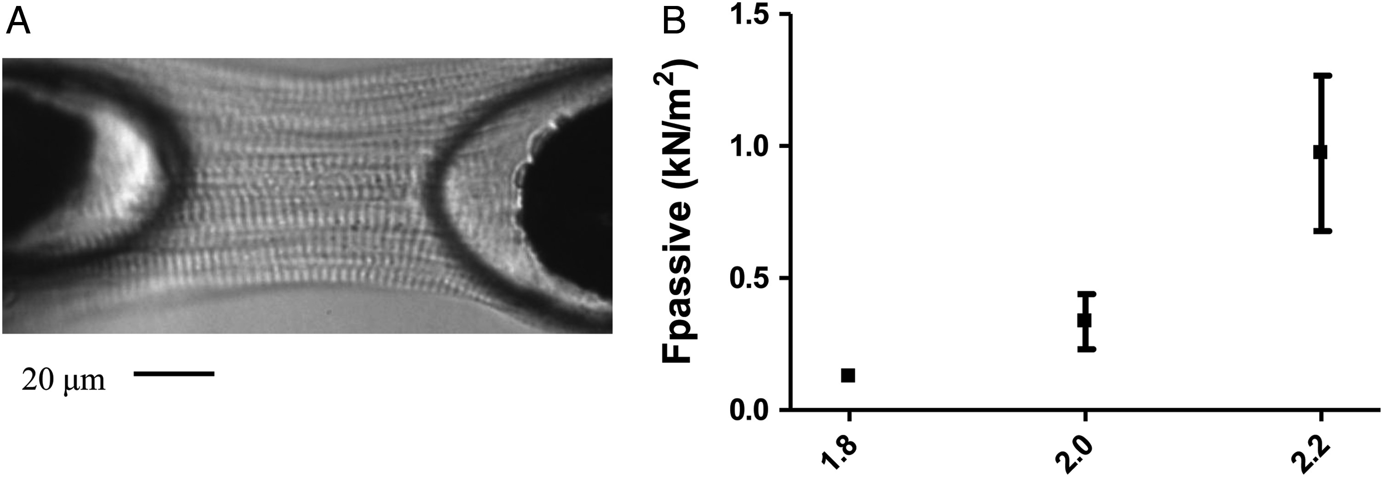
Figure 3 Force measurements in heart tissue of GER4 II:1. Single cardiomyocyte of the peripartum cardiomyopathy heart ...
Notes:
Figure 3 Force measurements in heart tissue of GER4 II:1. Single cardiomyocyte of the peripartum cardiomyopathy heart sample (A). Passive force development was measured at sarcomere lengths of 1.8, 2.0, and 2.2 μm (B).
Unless provided in the caption above, the following copyright applies to the content of this slide: Published on behalf of the European Society of Cardiology. All rights reserved. © The Author 2014. For permissions please email: journals.permissions@oup.com

