Slide 1
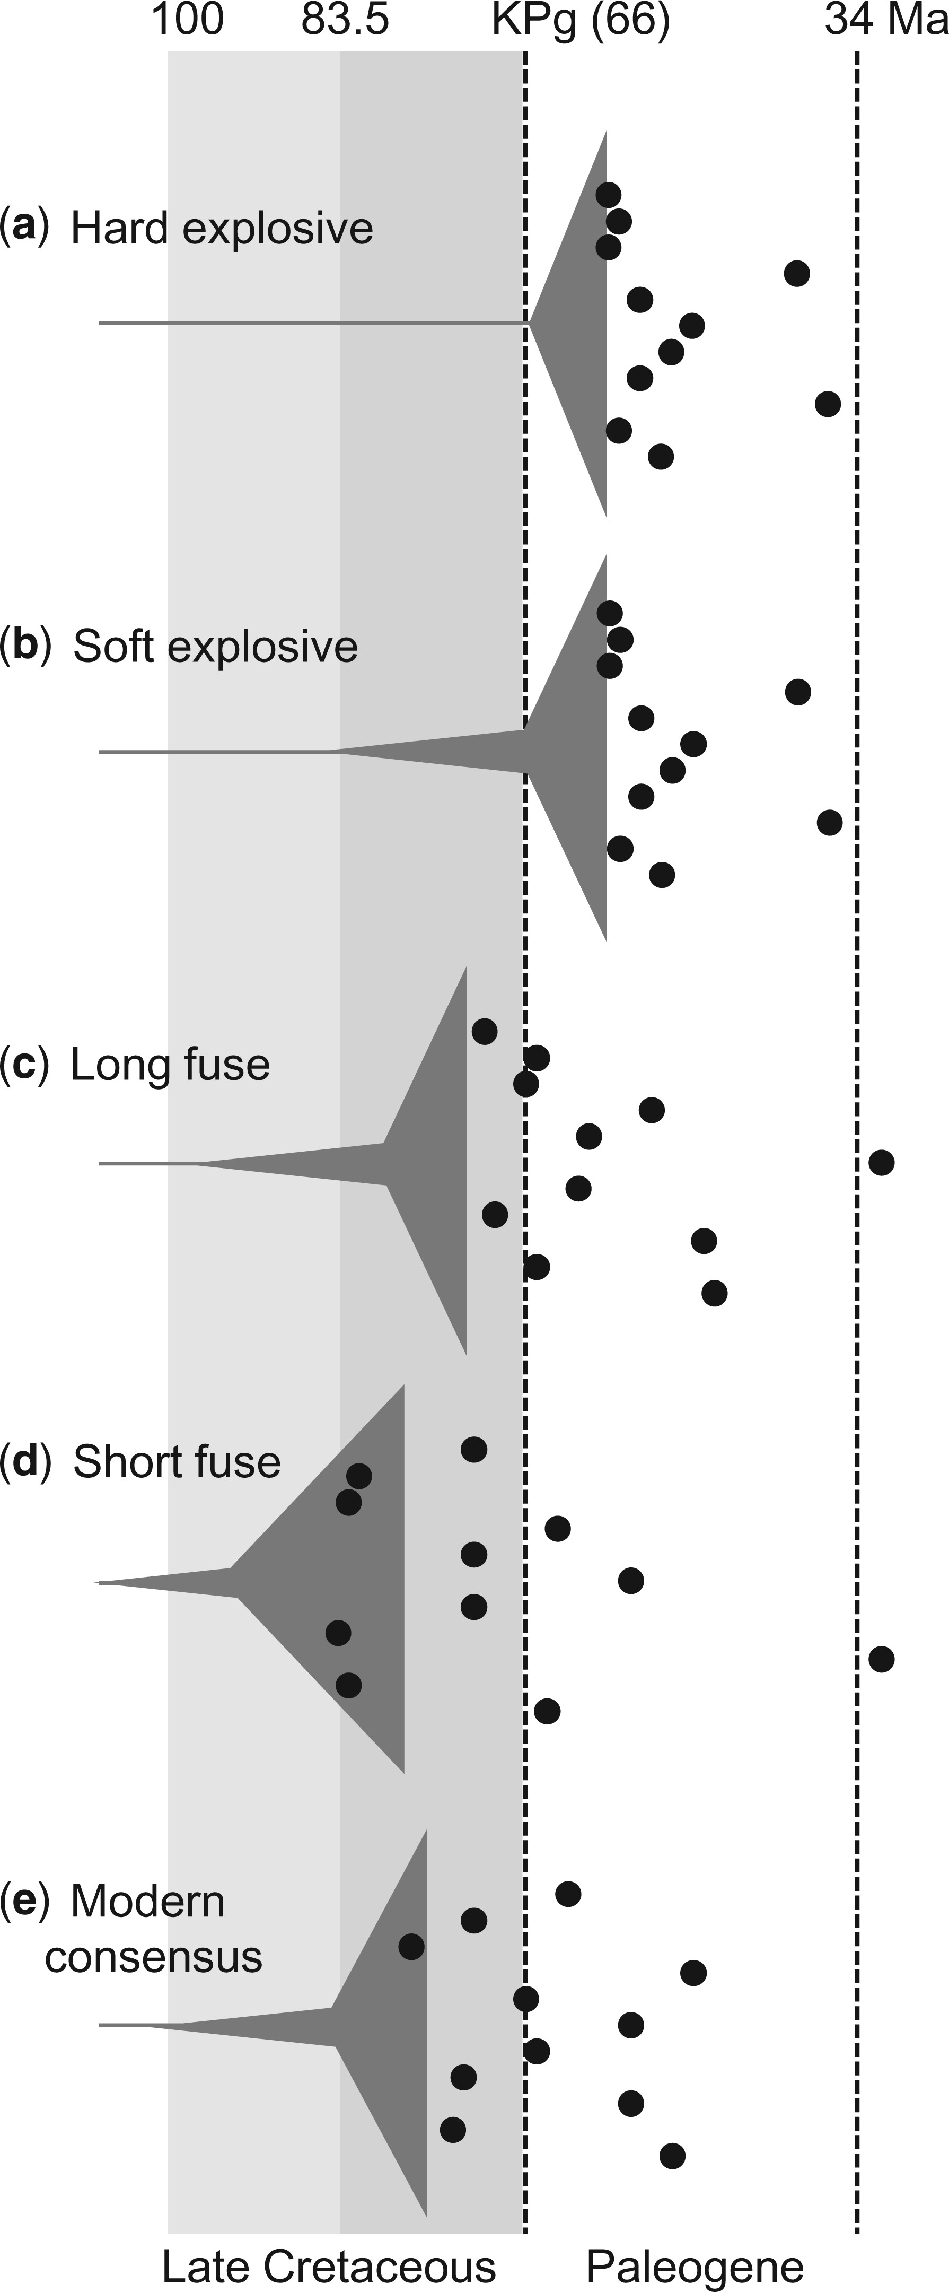
Figure 1. The timing of placental mammal evolution. Dark gray triangles show the pattern of superordinal divergences, ...
Notes:
Figure 1. The timing of placental mammal evolution. Dark gray triangles show the pattern of superordinal divergences, beginning with the placental crown origin. Black circles show the crown origins for the 11 orders generally agreed upon as being Paleogene or older, in each case arranged from top to bottom: Xenarthra, Afrosoricida, Lipotyphla, Carnivora, Chiroptera, Perissodactyla, Artiodactyla, Primates, Scandentia, Rodentia, and Lagomorpha. (a) The hard explosive model is based on O'Leary et al. (2013) . (b) The soft explosive model differs only by extending the earliest few placental superordinal divergences into the Cretaceous. (c) The long fuse model is based on dos Reis et al. (2012) . (d) The short fuse model is based on Bininda-Emonds et al. (2007) . (e) The majority consensus of recent molecular dating estimates is represented here by Meredith et al. (2011) .
Unless provided in the caption above, the following copyright applies to the content of this slide: © The Author(s) 2015. Published by Oxford University Press, on behalf of the Society of Systematic Biologists. All rights reserved. For Permissions, please email: journals.permissions@oup.com

Slide 2
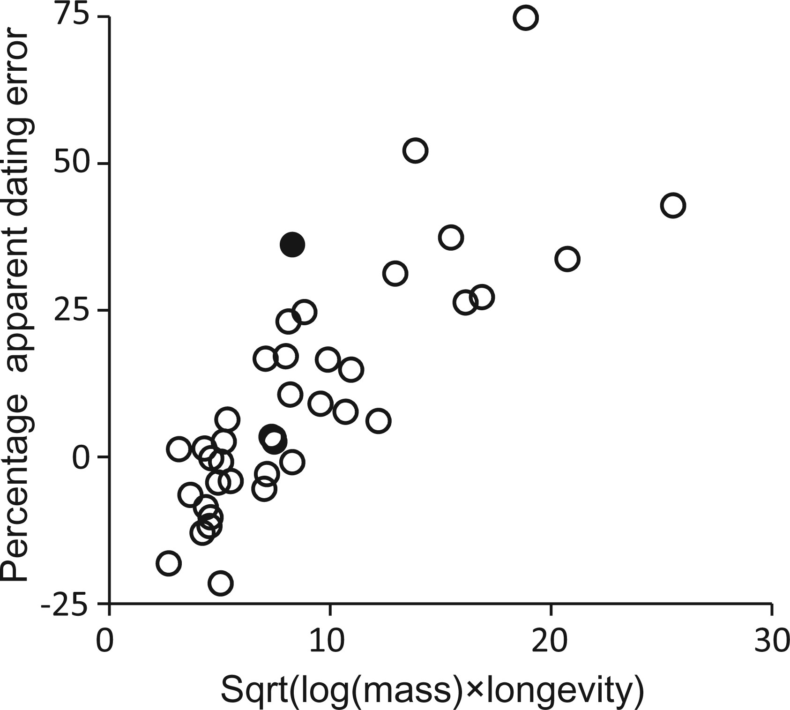
Figure 2. Apparent dating error as a function of body mass and longevity. The apparent dating error is the percentage ...
Notes:
Figure 2. Apparent dating error as a function of body mass and longevity. The apparent dating error is the percentage node age difference between the soft-bound fully and nominally calibrated relaxed clock trees for each placental taxon pair. The average of Sqrt(log(mass) × longevity) for the two taxa in each pair was calculated from average adult body mass ( Jones et al. 2009 ) and maximum longevity ( De Magalhães and Costa 2009 ). R2=0.655 . The nominal tree was scaled to minimize the overall node age difference to the fully calibrated tree. The filled circle represents Lorisiformes, and shifts up to 92% apparent dating error if the 37.1 Ma minimum age of Saharagalago is instead hard bound.
Unless provided in the caption above, the following copyright applies to the content of this slide: © The Author(s) 2015. Published by Oxford University Press, on behalf of the Society of Systematic Biologists. All rights reserved. For Permissions, please email: journals.permissions@oup.com

Slide 3
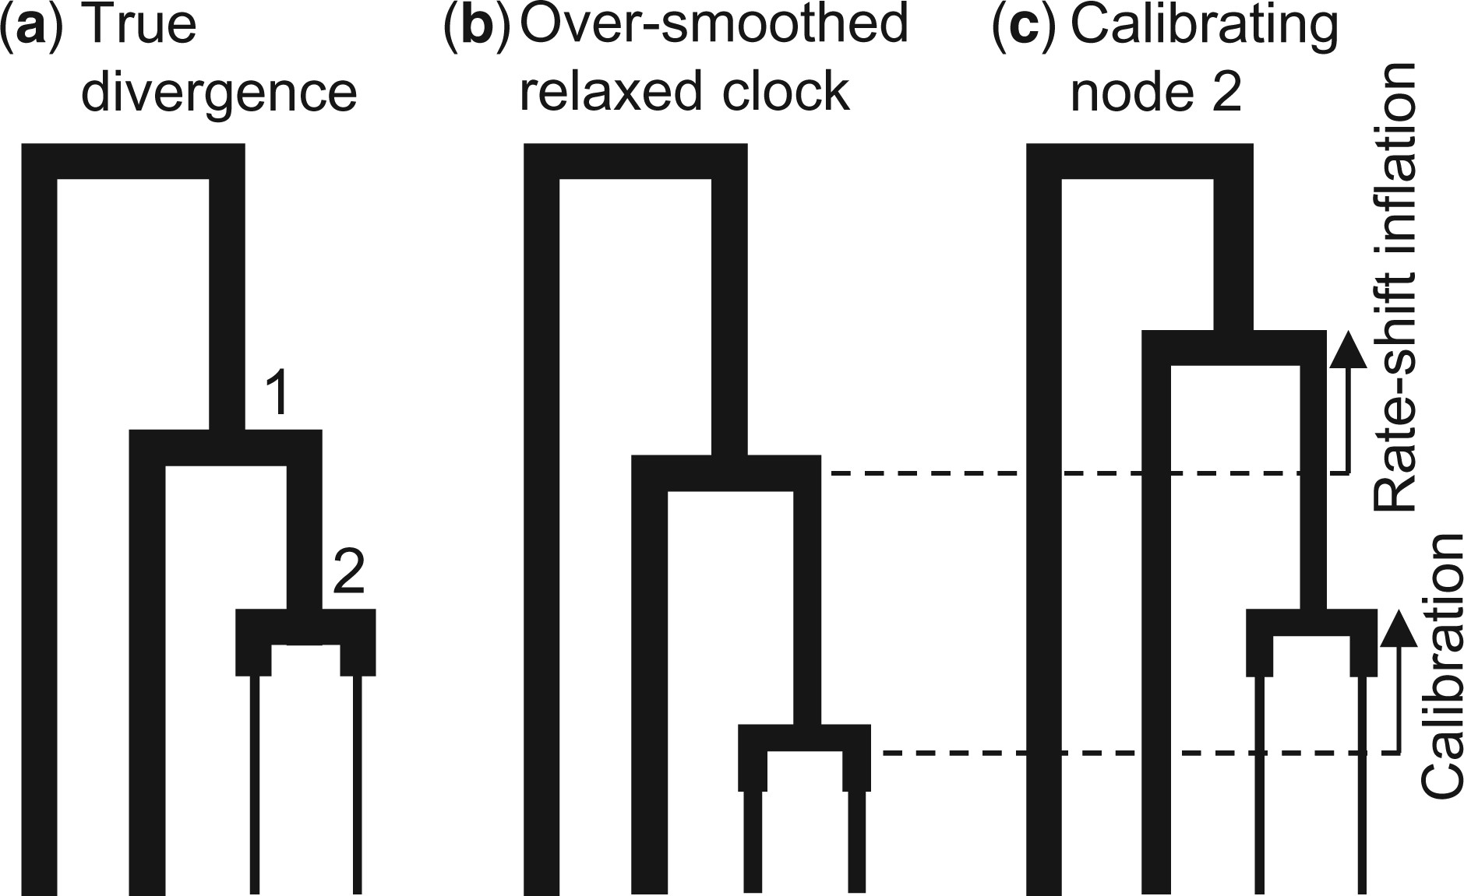
Figure 3. Rate-shift inflation of divergence estimates. Rates are indicated by branch widths for (a) a hypothetical ...
Notes:
Figure 3. Rate-shift inflation of divergence estimates. Rates are indicated by branch widths for (a) a hypothetical example similar to placentals (clade 1) being subtended by the cow/whale (clade 2) divergence, with large size and low rates of molecular evolution evolving in parallel. (b) The over-smoothing tendency of relaxed clocks (which helps explain the result in Fig. 2 ) spreads the parallel crown rate deceleration to the stem lineage, such that the age of clade 2 is underestimated. (c) Calibrating clade 2 then shifts the error stemwards, inflating the age of clade 1. This is because the underlying misspecification remains (underestimating stem relative to crown rates for clade 2). In the reverse situation where far higher rates evolved along the node 2 daughter lineages, over-smoothed relaxed clocks would instead induce rate-shift deflation, upon node 2 being calibrated.
Unless provided in the caption above, the following copyright applies to the content of this slide: © The Author(s) 2015. Published by Oxford University Press, on behalf of the Society of Systematic Biologists. All rights reserved. For Permissions, please email: journals.permissions@oup.com

Slide 4
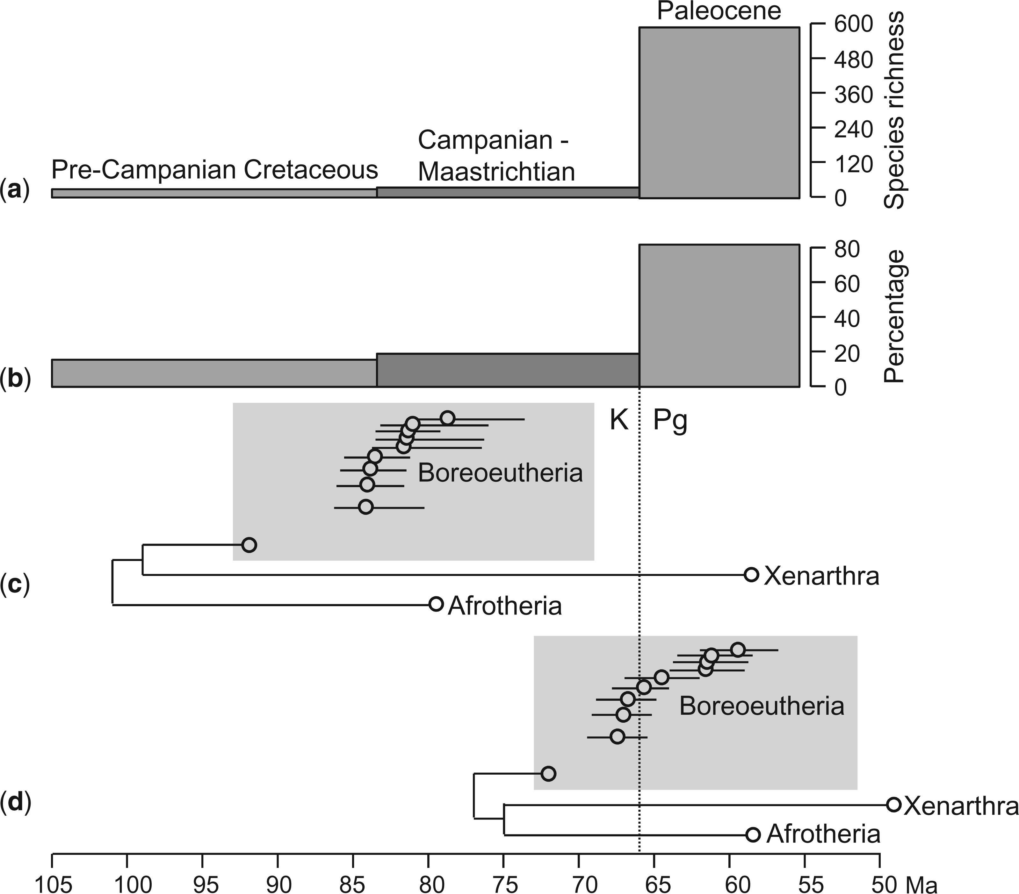
Figure 4. Timeline of placental mammal evolution. (a) Fossil record species richness of eutherian mammals, and (b) to ...
Notes:
Figure 4. Timeline of placental mammal evolution. (a) Fossil record species richness of eutherian mammals, and (b) to reduce any sampling biases, expressed as the eutherian percentage of mammal species during the pre-Campanian Cretaceous (30 of 195 species), Campanian–Maastrichtian (34 of 175 species), and Paleocene (591 of 725 species). (c–d) MCMCtree geomolecular dates for placental interordinal divergences, including log lineage through time plots for Boreoeutheria, with circles denoting divergences and lines showing 95% HPDs, for (c) Meredith et al.'s (2011) calibration set, and (d) dos Reis et al. (2012) calibrations, supplemented with revised maximum bounds for primates, rodents, and bats. Each analysis employed the 26-gene matrix of Meredith et al. (2011) , independent rates and soft-bound calibrations. With the autocorrelated rates model the median date among the boreoeutherian diversification cluster (open circles) shifts from 64.6 Ma to 66.9 Ma (see Supplementary Fig. S2d, available on Dryad at http://dx.doi.org/10.5061/dryad.s43f8 ).
Unless provided in the caption above, the following copyright applies to the content of this slide: © The Author(s) 2015. Published by Oxford University Press, on behalf of the Society of Systematic Biologists. All rights reserved. For Permissions, please email: journals.permissions@oup.com

Slide 5
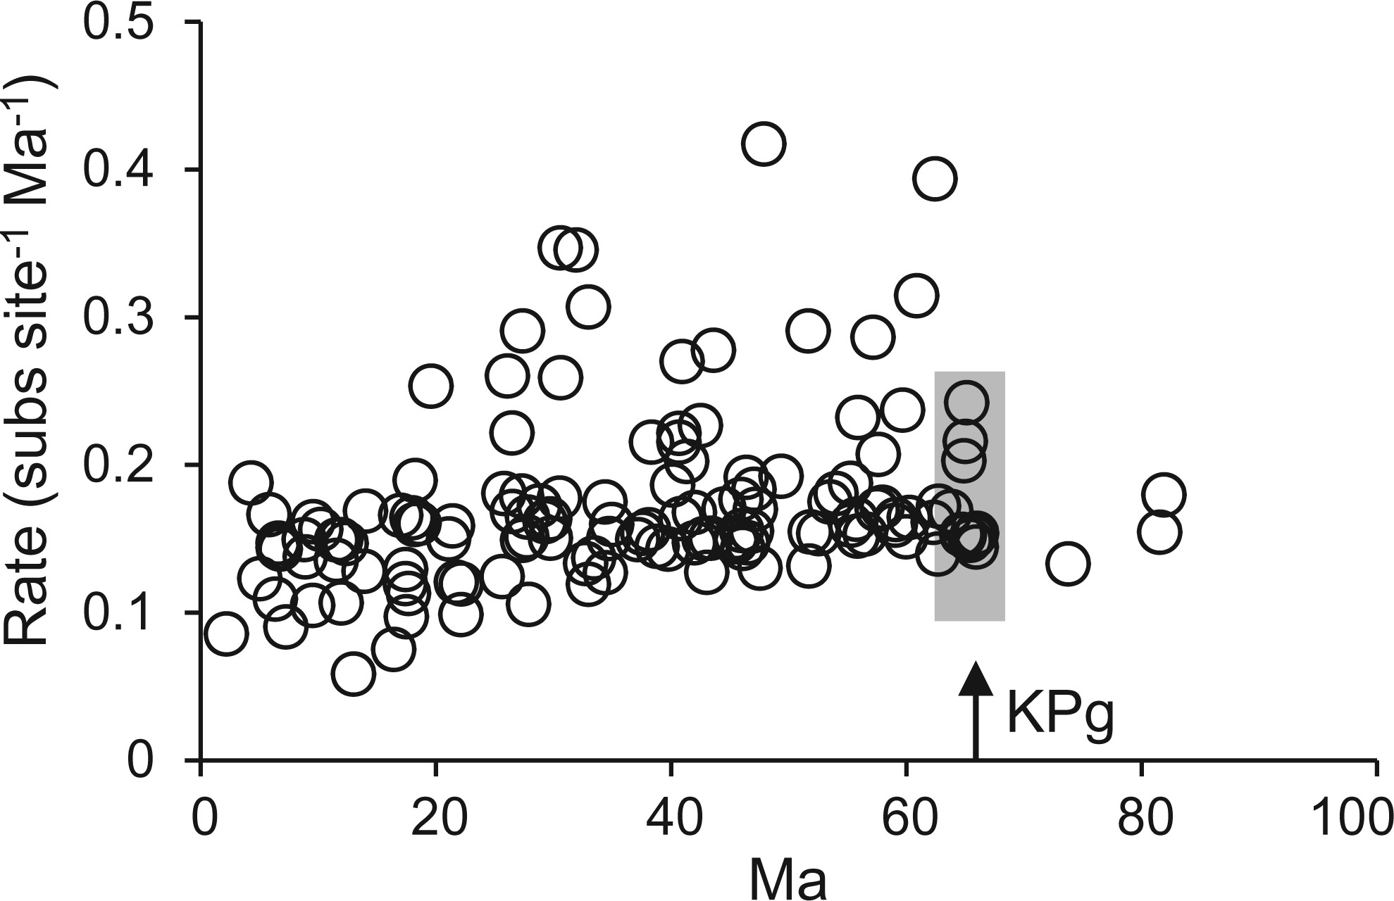
Figure 5. Inferred rates of molecular evolution among placentals, with the four basal crown clades: Laurasiatheria, ...
Notes:
Figure 5. Inferred rates of molecular evolution among placentals, with the four basal crown clades: Laurasiatheria, Euarchontoglires, Afrotheria, and Xenarthra constrained to post-date the 66 Ma Cretaceous–Paleogene (KPg) boundary. Otherwise the calibration scheme follows the “exclusion” Meredith et al. (2011) treatment from Table 2 . Rates correspond to the parent lineage of each dated node. The gray box covers superordinal rates for lineages that cross or immediately follow the KPg (all interordinal divergences within Laurasiatheria and Euarchontoglires occur from 62.5 to 66 Ma). Lower rates of molecular evolution over the most recent 20 myr correspond to increased sampling among large/long-lived groups, such as whales and seals.
Unless provided in the caption above, the following copyright applies to the content of this slide: © The Author(s) 2015. Published by Oxford University Press, on behalf of the Society of Systematic Biologists. All rights reserved. For Permissions, please email: journals.permissions@oup.com

