Slide 1
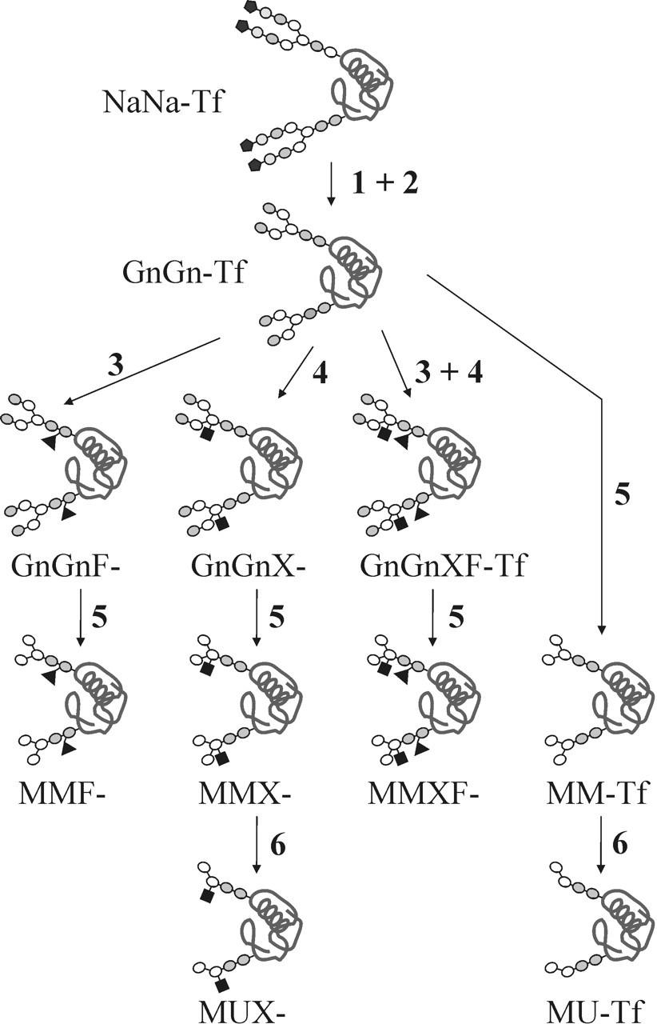
Fig. 1. Scheme of the glycomodifications performed with human apo-transferrin. Open ellipses depict mannose residues, ...
Notes:
Fig. 1. Scheme of the glycomodifications performed with human apo-transferrin. Open ellipses depict mannose residues, gray ellipses GlcNAc, white circles galactose, black pentangles sialic acid, black triangles fucose, and black squares xylose. The structures of GnGnX and GnGnF are also shown in Figure 2. NaNa-Tf denotes the untreated Tf with disialylated N-glycans. Figures indicate the enzymes used: 1, neuraminidase; 2, β-galactosidase; 3, core α1,3-fucosyltransferase; 4, β-xylosyl-transferase; 5, β-N-acetylglucosaminidase; 6, α-mannosidase.
Unless provided in the caption above, the following copyright applies to the content of this slide: Glycobiology vol. 14 no. 5 © Oxford University Press 2004; all rights reserved.

Slide 2
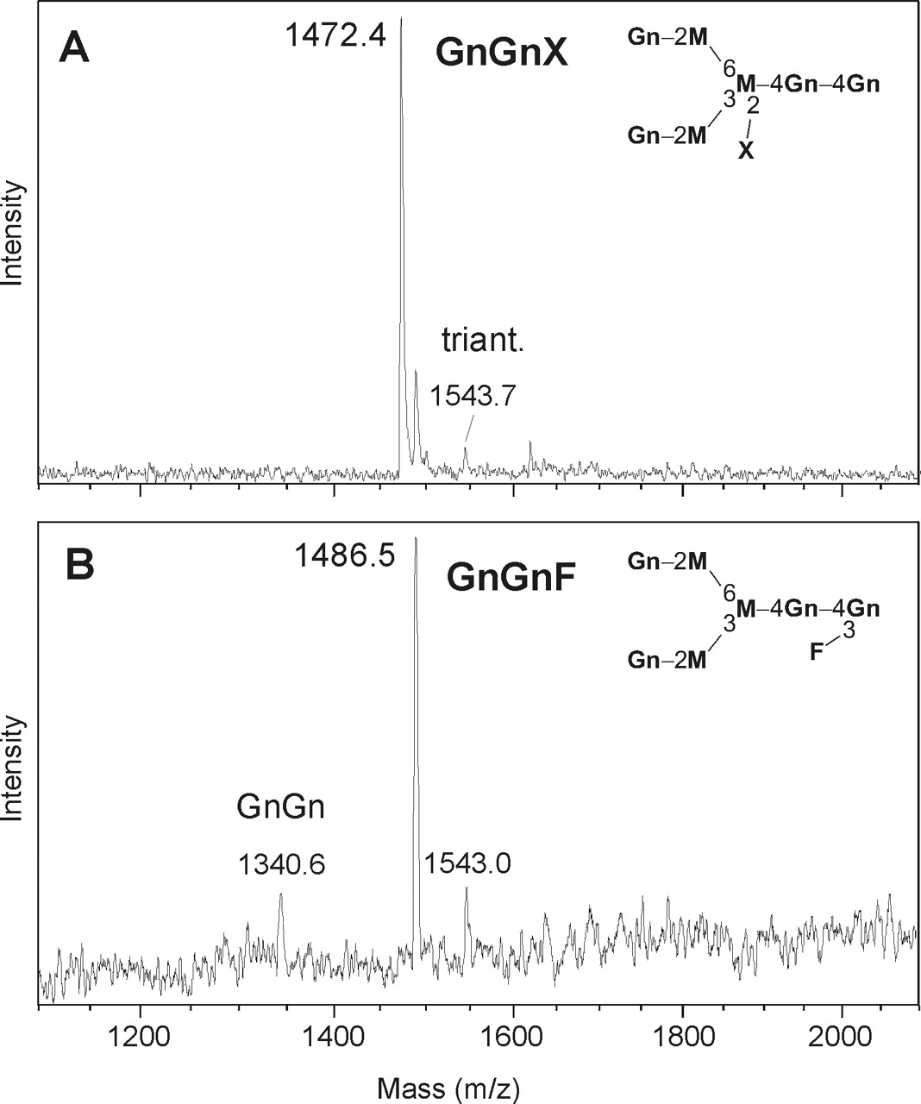
Fig. 2. Modification of the N-glycans of Tf: The MALDI time-of-flight spectrum of oligosaccharides released after ...
Notes:
Fig. 2. Modification of the N-glycans of Tf: The MALDI time-of-flight spectrum of oligosaccharides released after incubation of transferrin with xylosyltransferase (A) and fucosyltransferase (B) shows the (almost) complete conversion of the substrate glycan GnGn (1340 Da) to GnGnX (1472 Da) or GnGnF (1486 Da), respectively.
Unless provided in the caption above, the following copyright applies to the content of this slide: Glycobiology vol. 14 no. 5 © Oxford University Press 2004; all rights reserved.

Slide 3
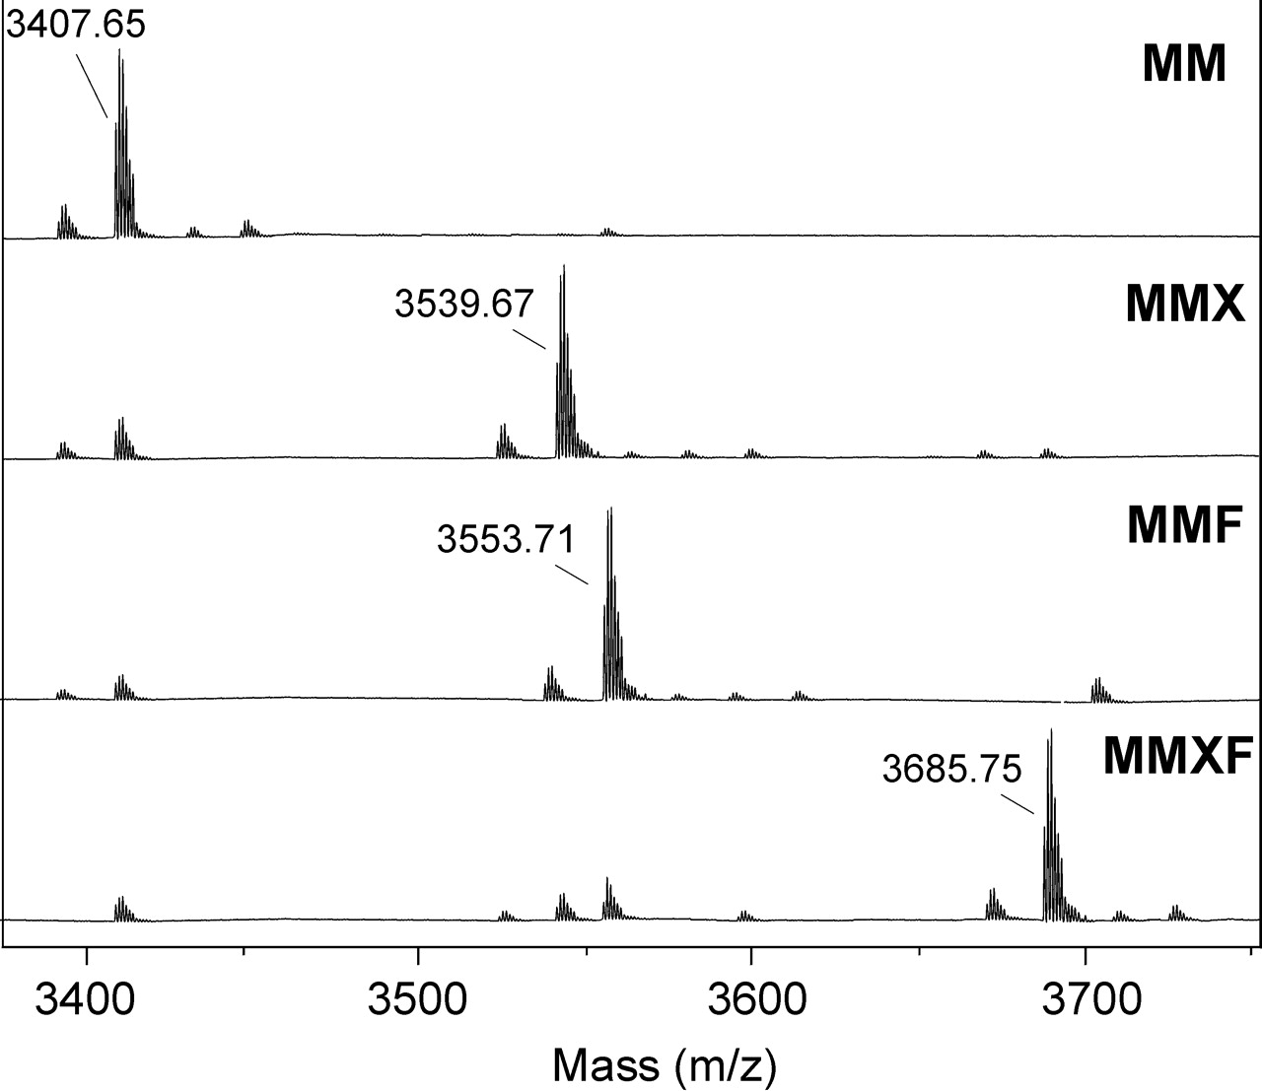
Fig. 3. MALDI-TOF spectra of glycopeptides from MM-, MMX-, MMF-, and MMFX-Tf reveal the almost quantitative ...
Notes:
Fig. 3. MALDI-TOF spectra of glycopeptides from MM-, MMX-, MMF-, and MMFX-Tf reveal the almost quantitative conversion to the desired glycoforms. Major peaks correspond to peptide 622–642 with carboxamidomethylated cysteine (mass of M + H+ = 2515.125). The mass differences indicate the composition of the attached oligosaccharide. The theoretical masses of the glycopeptides (M + H+) of the peptides with MM-, MMX-, MMF-, and MMXF-glycans are 3407.44, 3539.49, 3553.50, and 3685.54, respectively.
Unless provided in the caption above, the following copyright applies to the content of this slide: Glycobiology vol. 14 no. 5 © Oxford University Press 2004; all rights reserved.

Slide 4
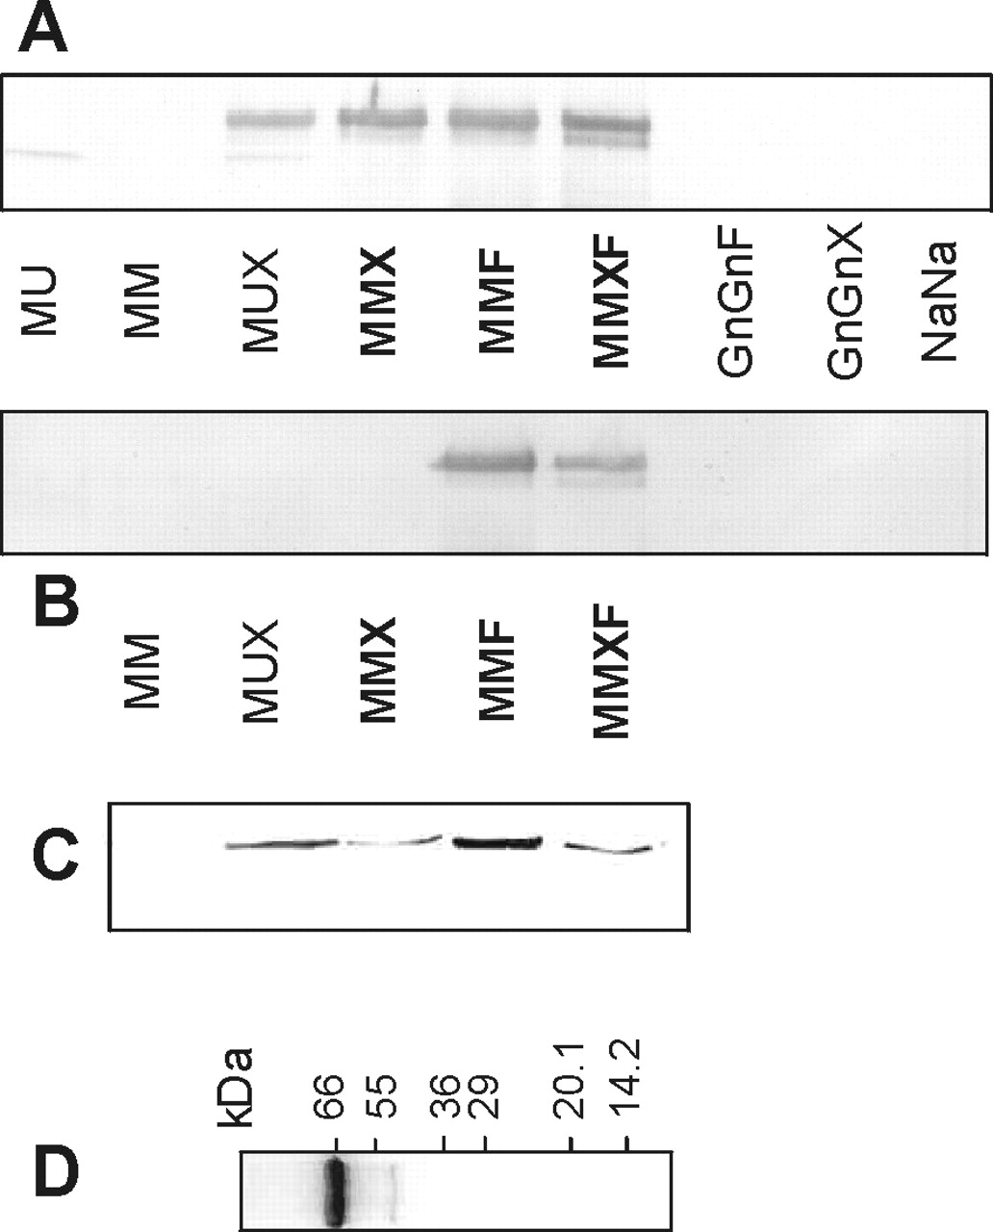
Fig. 4. Western blot of glycomodified transferrins with anti-rabbit anti-HRP serum (A), anti–bee venom serum (B), and ...
Notes:
Fig. 4. Western blot of glycomodified transferrins with anti-rabbit anti-HRP serum (A), anti–bee venom serum (B), and rat monoclonal YZ1/2.23 (C). The silver stain of MMF-Tf (D) reveals a major band at the expected size of ∼70 kDa accompanied by a faint band at ∼41 kDa. Although both sera bind to MMF and MMFX, that is, to the core α1, 3-fucosylated forms, only the anti-HRP serum recognizes the xylosylated forms MMX and MUX. Native sialylated transferrin (NaNa) as well as the GnGnX and GnGnF glycoforms are not stained by either antiserum. The lanes of MU- and MUX-Tf exhibit a new band at ∼60 kDa that originates from the mannosidase.
Unless provided in the caption above, the following copyright applies to the content of this slide: Glycobiology vol. 14 no. 5 © Oxford University Press 2004; all rights reserved.

Slide 5
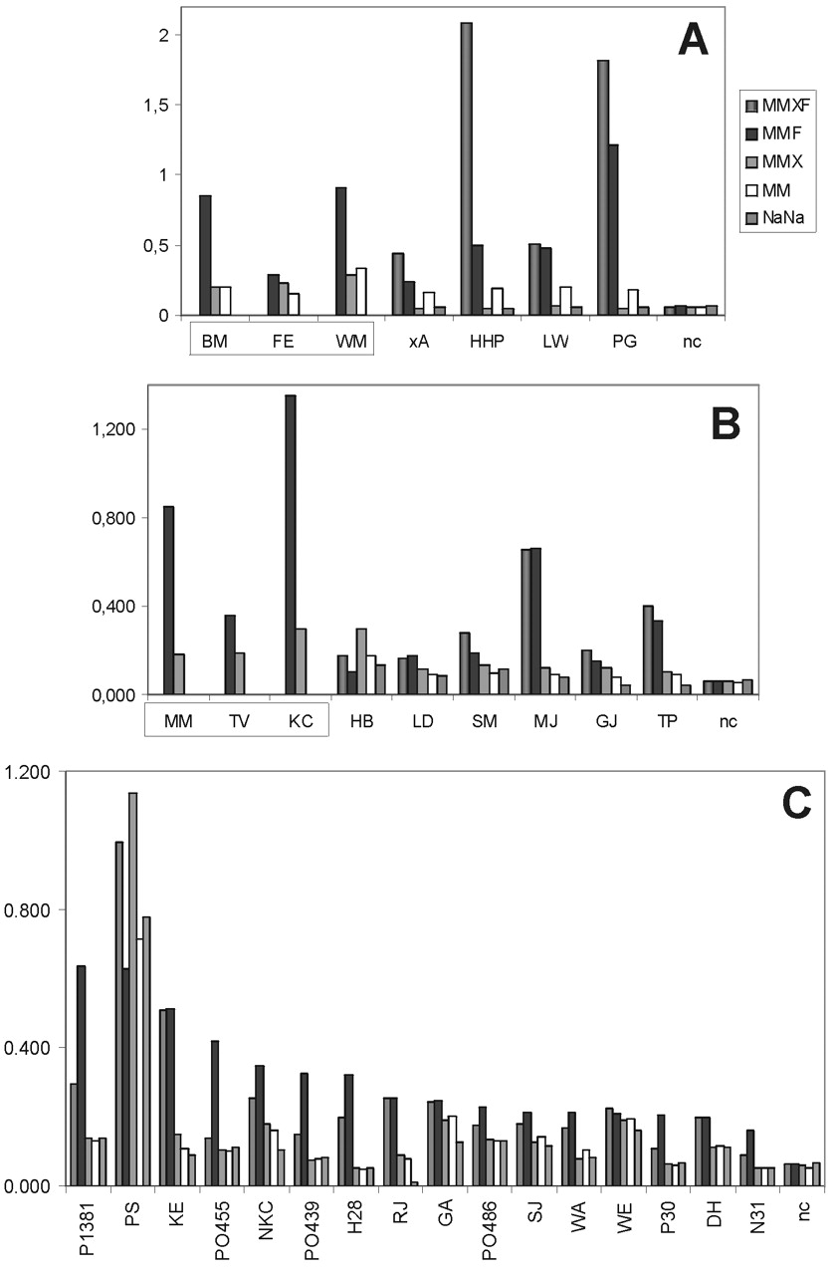
Fig. 5. Binding to MMXF-, MMF-, MMX-, and MM-transferrin of IgE from sera of honeybee/wasp venom double-sensitized ...
Notes:
Fig. 5. Binding to MMXF-, MMF-, MMX-, and MM-transferrin of IgE from sera of honeybee/wasp venom double-sensitized patients (A), OSR-reactive patients (B), and patients with polyvalent reactivity (C). The great majority of these data were recorded in triplicate. The average SD in absorbance units was 0.010. To mark those patients where experiments could only be performed with MMF-, MMX-, and MM-Tf in A and B, their acronyms have been put in a box. n.c. = normal healthy control.
Unless provided in the caption above, the following copyright applies to the content of this slide: Glycobiology vol. 14 no. 5 © Oxford University Press 2004; all rights reserved.

Slide 6
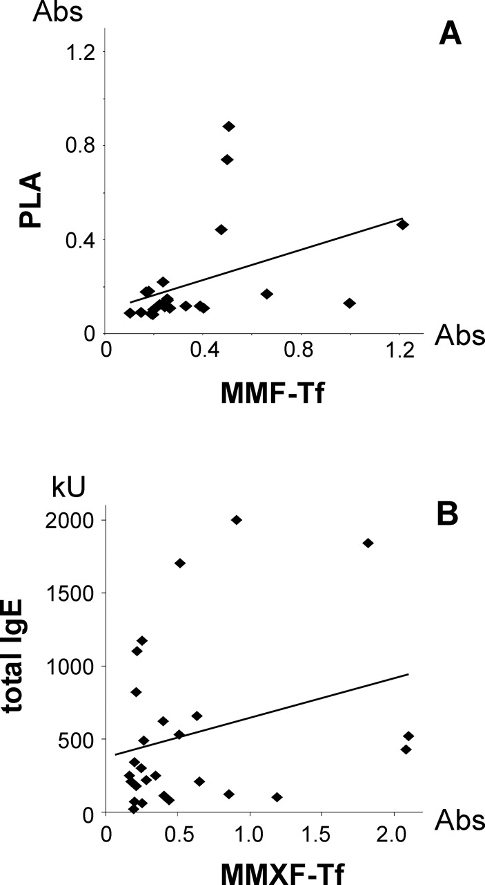
Fig. 6. Correlations for patients' IgE. The dots represent the absorbencies of patients from the OSR, the insect ...
Notes:
Fig. 6. Correlations for patients' IgE. The dots represent the absorbencies of patients from the OSR, the insect venom, and the polyvalent pollen groups. Only sera showing binding to these antigens were considered. The line shows the correlation between data sets. (A) The correlation (R = 0.41) between results obtained with MMF-Tf and with bee venom phospholipase, which likewise contains core α1,3-linked fucose. (B) Absence of a correlation between anti-CCD IgE as measured with MMXF-Tf.
Unless provided in the caption above, the following copyright applies to the content of this slide: Glycobiology vol. 14 no. 5 © Oxford University Press 2004; all rights reserved.

