Slide 1
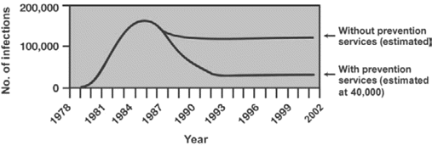
Figure 1 Estimated annual numbers of HIV infections in the presence or absence of HIV prevention services. Adapted ...
Notes:
Figure 1 Estimated annual numbers of HIV infections in the presence or absence of HIV prevention services. Adapted with permission from the following article published by Lippincott Williams & Wilkins: Holtgrave DR. Estimating the effectiveness and efficiency of US HIV prevention efforts using scenario and cost-effectiveness analysis. AIDS 2002; 16(17):2347–9.
Unless provided in the caption above, the following copyright applies to the content of this slide: © 2007 by the Infectious Diseases Society of America

Slide 2
Table 1 Modeling the effectiveness and efficiency of overall national response to HIV infection in the United States, ...
Notes:
Table 1 Modeling the effectiveness and efficiency of overall national response to HIV infection in the United States, 1985–2000.
Unless provided in the caption above, the following copyright applies to the content of this slide: © 2007 by the Infectious Diseases Society of America

Slide 3
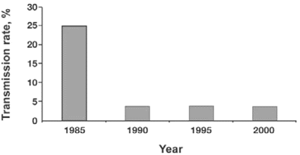
Figure 2 Estimated percentages of US persons living with HIV/AIDS who transmitted HIV to ⩾1 person. Data are from ...
Notes:
Figure 2 Estimated percentages of US persons living with HIV/AIDS who transmitted HIV to ⩾1 person. Data are from [2].
Unless provided in the caption above, the following copyright applies to the content of this slide: © 2007 by the Infectious Diseases Society of America

Slide 4
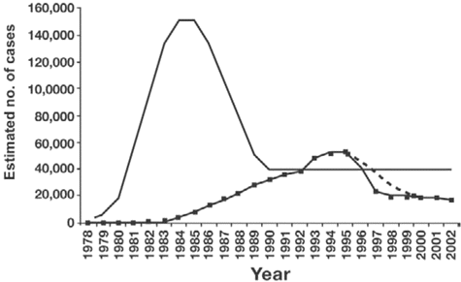
Figure 3 Epidemiologic characteristics of the HIV/AIDS epidemic. Boxed line, number of deaths due to AIDS; dashed ...
Notes:
Figure 3 Epidemiologic characteristics of the HIV/AIDS epidemic. Boxed line, number of deaths due to AIDS; dashed line, number of deaths due to AIDS had HAART not been developed; solid line, annual incidence of HIV infection. Adapted with permission from the following article published by Royal Society of Medicine Press, London: Holtgrave DR. Causes of the decline in AIDS deaths, United States, 1995–2002: prevention, treatment or both? Int J STD AIDS 2005; 16:777–81.
Unless provided in the caption above, the following copyright applies to the content of this slide: © 2007 by the Infectious Diseases Society of America

Slide 5
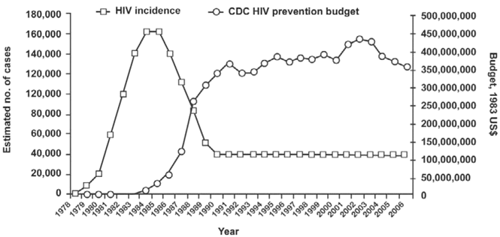
Figure 4 US incidence of HIV infection and Centers for Disease Control and Prevention (CDC) budget for preventing HIV ...
Notes:
Figure 4 US incidence of HIV infection and Centers for Disease Control and Prevention (CDC) budget for preventing HIV infection. Adapted with permission from the following article published by Elsevier: Holtgrave DR, Kates J. HIV incidence and CDC's HIV prevention budget: an exploratory correlational analysis. Am J Prev Med 2007; 32:63–7.
Unless provided in the caption above, the following copyright applies to the content of this slide: © 2007 by the Infectious Diseases Society of America

Slide 6
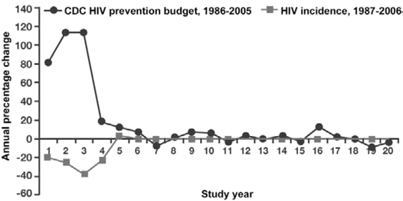
Figure 5 Percentage changes in the US incidence of HIV infection and the Centers for Disease Control and Prevention ...
Notes:
Figure 5 Percentage changes in the US incidence of HIV infection and the Centers for Disease Control and Prevention (CDC) budget for preventing HIV infection (adjusted to 1983 US dollars), with a 1-year lag. Adapted with permission from the following article published by Elsevier: Holtgrave DR, Kates J. HIV incidence and CDC's HIV prevention budget: an exploratory correlational analysis. Am J Prev Med 2007; 32:63–7.
Unless provided in the caption above, the following copyright applies to the content of this slide: © 2007 by the Infectious Diseases Society of America

Slide 7
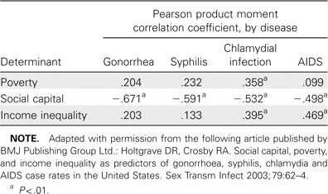
Table 4 Social determinants of sexually transmitted diseases and AIDS in the United States, 1999.
Notes:
Table 4 Social determinants of sexually transmitted diseases and AIDS in the United States, 1999.
Unless provided in the caption above, the following copyright applies to the content of this slide: © 2007 by the Infectious Diseases Society of America

Slide 8
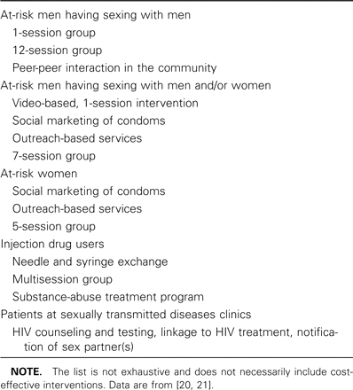
Table 3 Cost-saving behavioral interventions to prevent HIV infection.
Notes:
Table 3 Cost-saving behavioral interventions to prevent HIV infection.
Unless provided in the caption above, the following copyright applies to the content of this slide: © 2007 by the Infectious Diseases Society of America

Slide 9
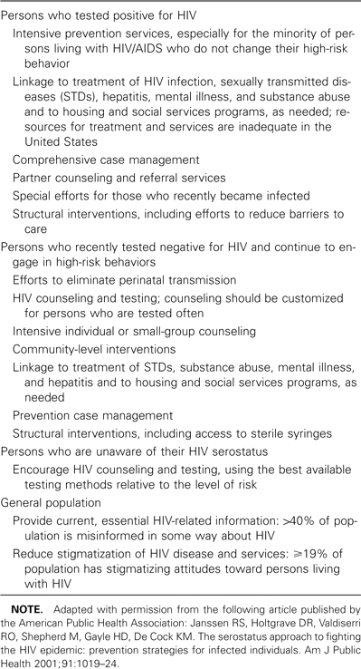
Table 2 HIV prevention recommendations from the Serostatus Approach to Fighting the Epidemic program, by population.
Notes:
Table 2 HIV prevention recommendations from the Serostatus Approach to Fighting the Epidemic program, by population.
Unless provided in the caption above, the following copyright applies to the content of this slide: © 2007 by the Infectious Diseases Society of America

