Slide 1
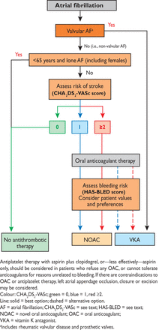
Figure 1 Choice of anticoagulant.
Notes:
Figure 1 Choice of anticoagulant.
Unless provided in the caption above, the following copyright applies to the content of this slide: © The European Society of Cardiology 2012. All rights reserved. For permissions please email: journals.permissions@oup.com.

Slide 2
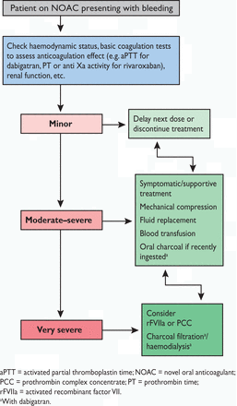
Figure 2 Management of bleeding in patients taking novel oral anticoagulants.
Notes:
Figure 2 Management of bleeding in patients taking novel oral anticoagulants.
Unless provided in the caption above, the following copyright applies to the content of this slide: © The European Society of Cardiology 2012. All rights reserved. For permissions please email: journals.permissions@oup.com.

Slide 3
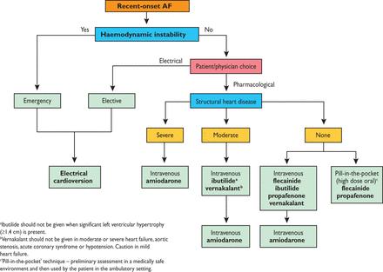
Figure 3 Indications for electrical and pharmacological cardioversion, and choice of antiarrhythmic drugs for ...
Notes:
Figure 3 Indications for electrical and pharmacological cardioversion, and choice of antiarrhythmic drugs for pharmacological cardioversion in patients with recent-onset AF.
Unless provided in the caption above, the following copyright applies to the content of this slide: © The European Society of Cardiology 2012. All rights reserved. For permissions please email: journals.permissions@oup.com.

Slide 4
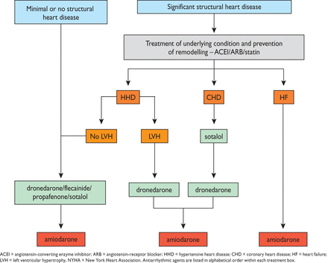
Figure 4 Choice of antiarrhythmic drug according to underlying pathology.
Notes:
Figure 4 Choice of antiarrhythmic drug according to underlying pathology.
Unless provided in the caption above, the following copyright applies to the content of this slide: © The European Society of Cardiology 2012. All rights reserved. For permissions please email: journals.permissions@oup.com.

Slide 5
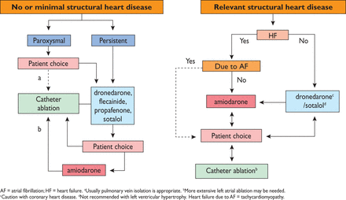
Figure 5 Antiarrhythmic drugs and/or left atrial ablation for rhythm control in AF.
Notes:
Figure 5 Antiarrhythmic drugs and/or left atrial ablation for rhythm control in AF.
Unless provided in the caption above, the following copyright applies to the content of this slide: © The European Society of Cardiology 2012. All rights reserved. For permissions please email: journals.permissions@oup.com.

