Slide 1
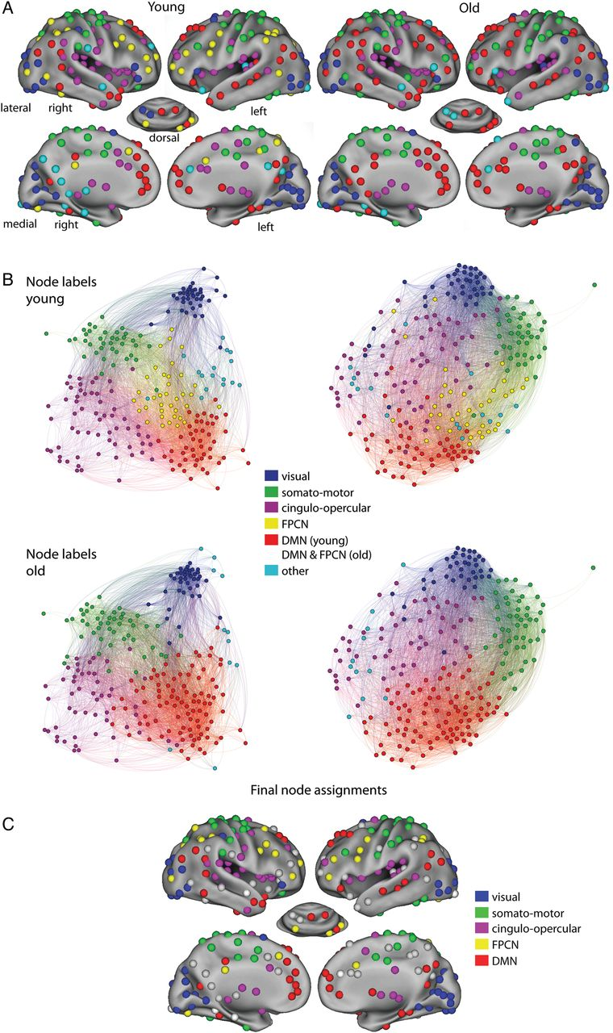
Figure 1. (A) The different modules are shown separately for older (right) and younger (left) participants. The colors ...
Notes:
Figure 1. (A) The different modules are shown separately for older (right) and younger (left) participants. The colors indicate the nodes that belong to each module. Nodes are pasted on an inflated surface rendering of the human brain using the CARET program (Van Essen et al. 2001). (B) The graphs for younger (left) and older (right) participants are visualized using a force atlas layout implemented in Gephi (Bastian et al. 2009). The top row shows the graphs of younger and older participants with the node assignments of the younger participants. The bottom row shows the graphs for both groups with the node assignments of the older participants. (C) Final node–module assignments based on the intersection of node assignments in both groups. Gray nodes were not assigned to any of the modules.
Unless provided in the caption above, the following copyright applies to the content of this slide: © The Author 2014. Published by Oxford University Press. All rights reserved. For Permissions, please e-mail: journals.permissions@oup.com

Slide 2
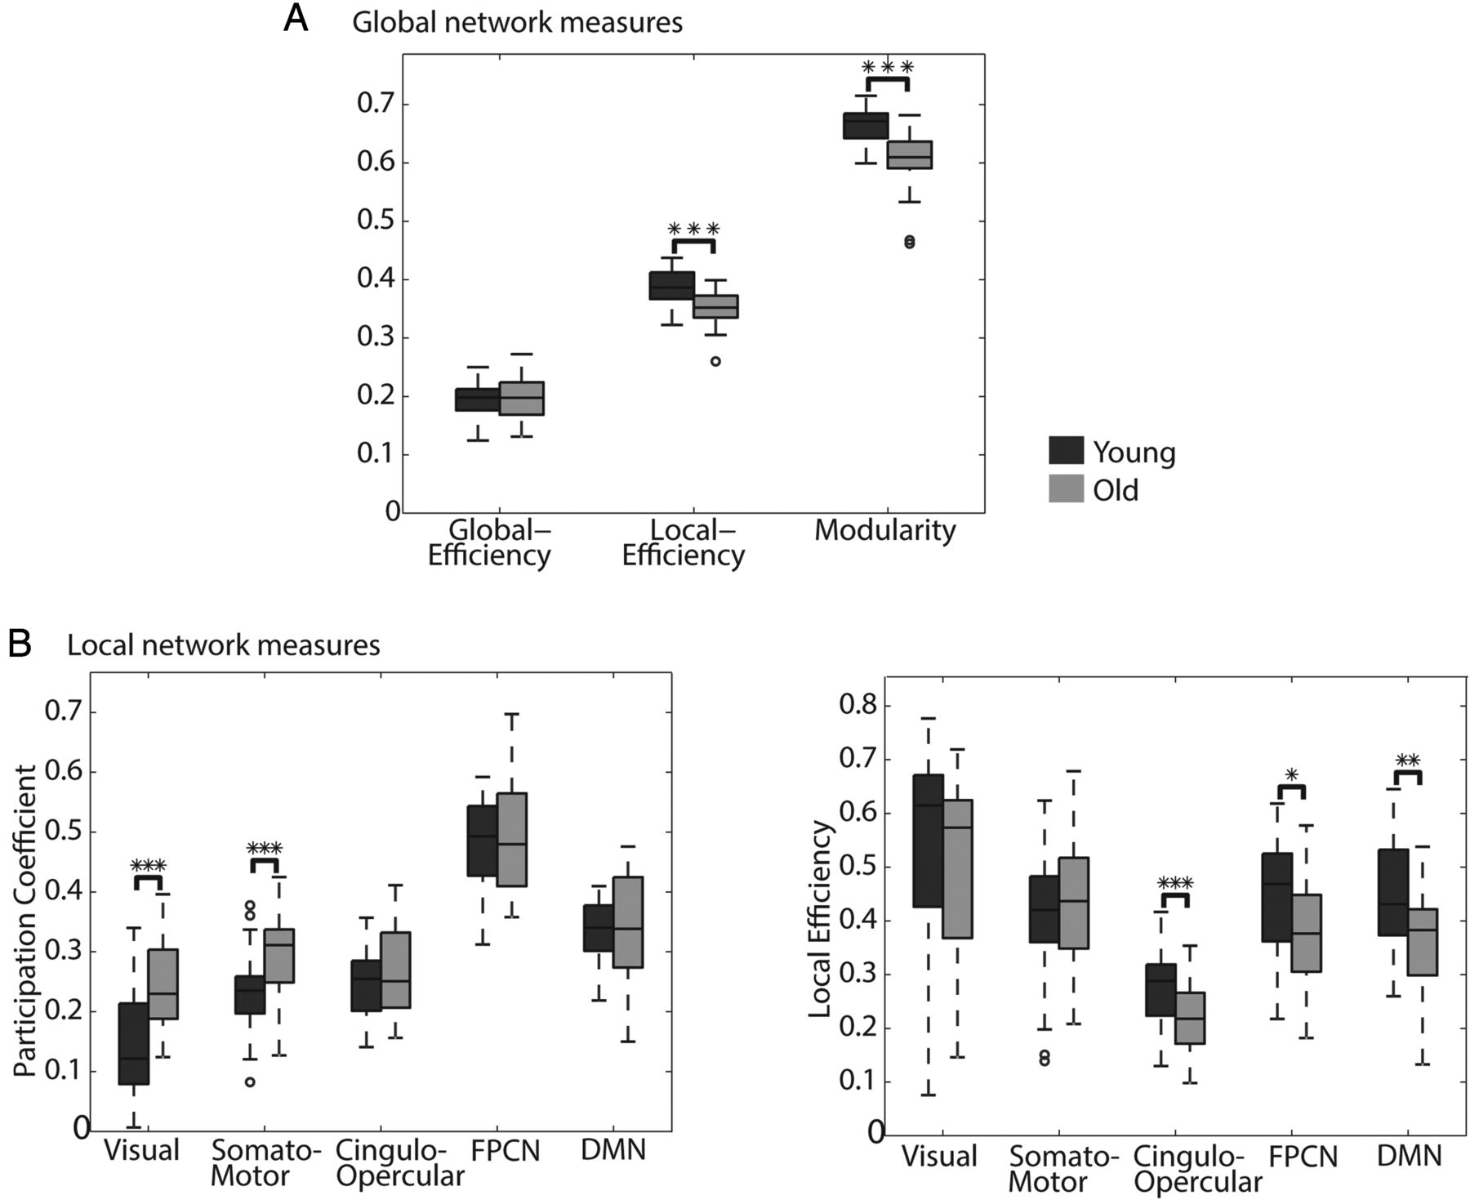
Figure 2. (A) Global network measures are presented in boxplots for older (lighter) and younger (darker) participants. ...
Notes:
Figure 2. (A) Global network measures are presented in boxplots for older (lighter) and younger (darker) participants. From left to right, global efficiency, local efficiency, and modularity. Stars indicate a significant difference between the older and younger participants (***P < 0.001). (B) For each of the functional networks (modules), participation coefficient, and local efficiency are displayed in boxplots for younger and older participants. The darker boxplots represent the younger participants, the lighter boxplots the older participants. Difference between the older and younger groups; *P < 0.05, **P < 0.005, and ***P < 0.001.
Unless provided in the caption above, the following copyright applies to the content of this slide: © The Author 2014. Published by Oxford University Press. All rights reserved. For Permissions, please e-mail: journals.permissions@oup.com

Slide 3
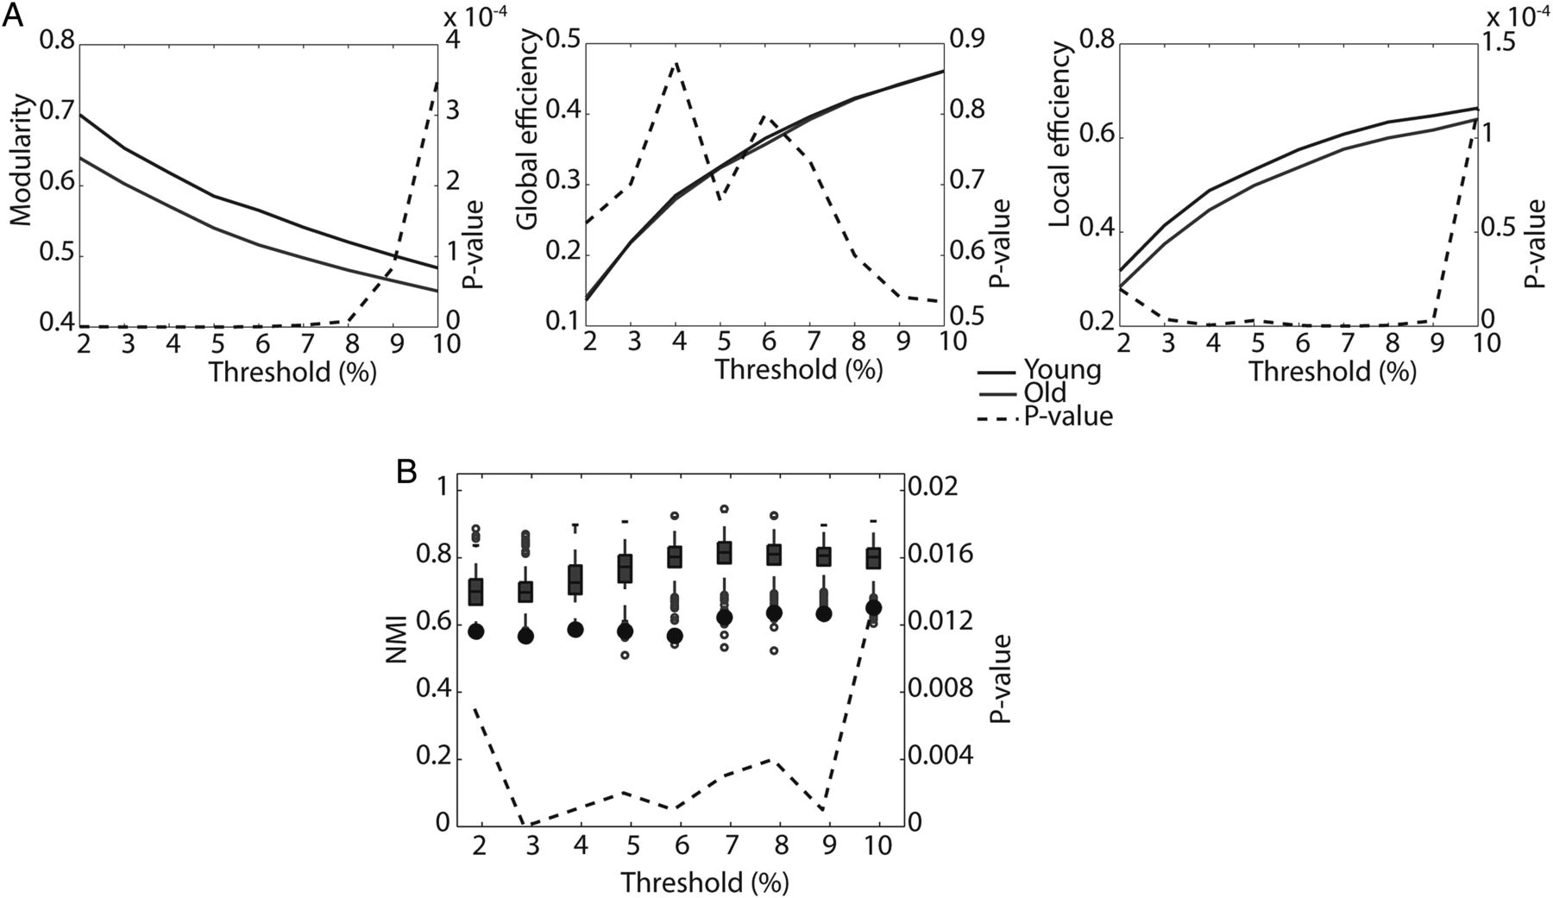
Figure 3. (A) Differences between old and young participants in modularity, global efficiency and local efficiency are ...
Notes:
Figure 3. (A) Differences between old and young participants in modularity, global efficiency and local efficiency are plotted for thresholds between 2% and 10% of all possible connections. The dashed line indicates the P-values corresponding to the difference between the 2 groups, these values are presented on the right y-axis. (B) A test of age-related differences in module decomposition is shown over a range of thresholds. The null distribution of NMI values resulting from the permutation testing procedure is shown in the boxplots. The black dot represents the actual NMI value of the correspondence between the 2 age groups.
Unless provided in the caption above, the following copyright applies to the content of this slide: © The Author 2014. Published by Oxford University Press. All rights reserved. For Permissions, please e-mail: journals.permissions@oup.com

Slide 4
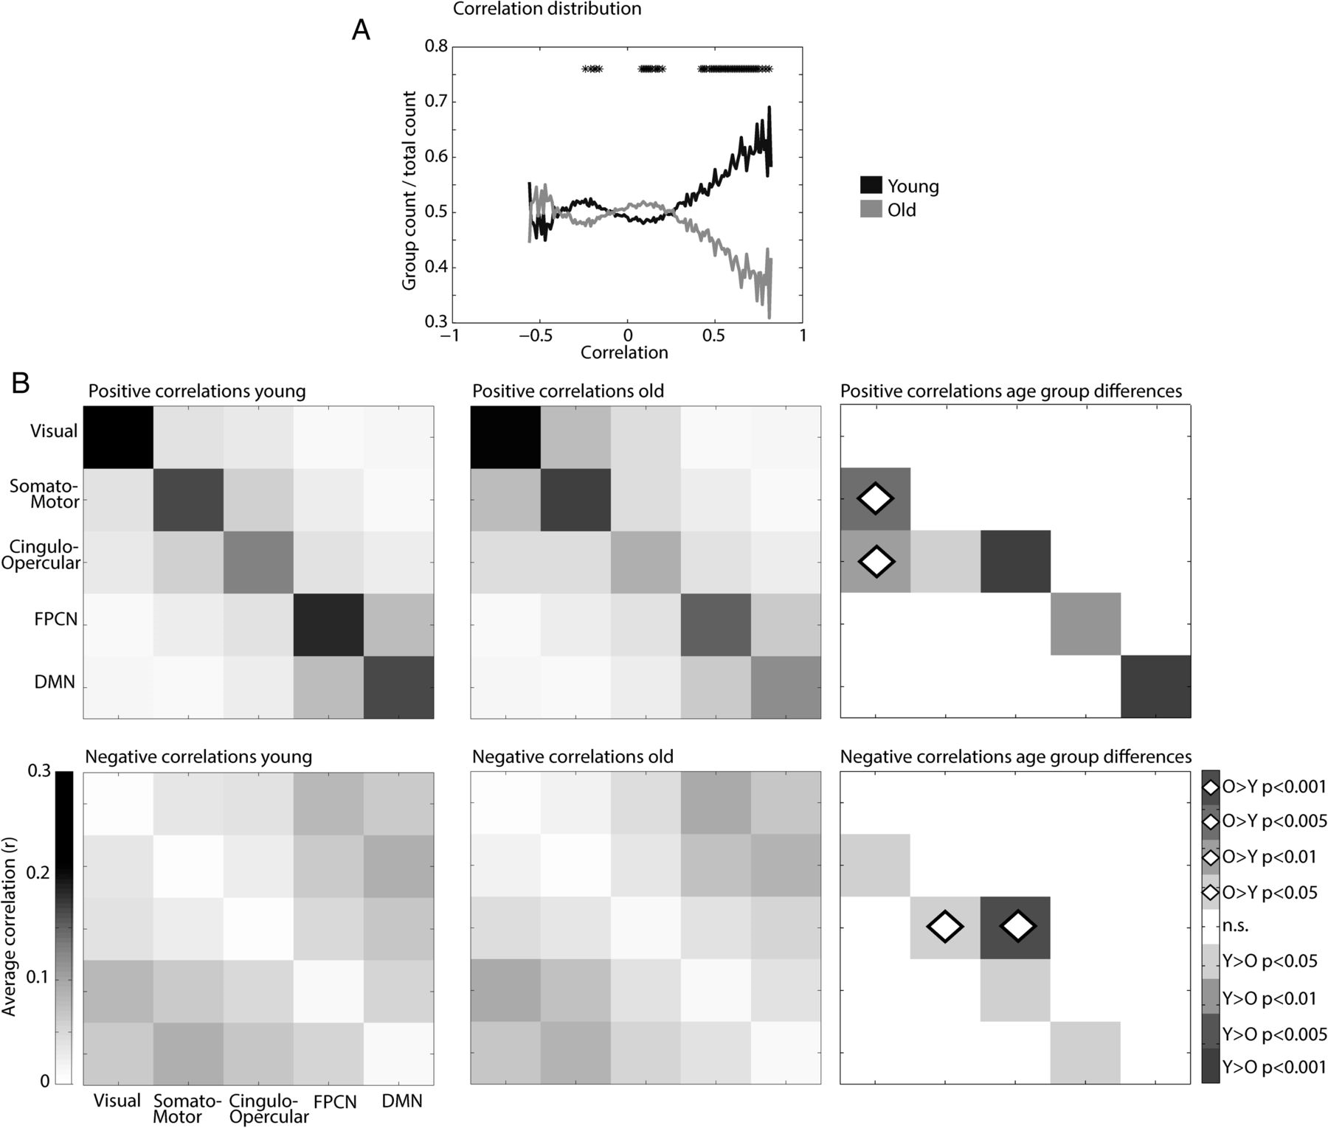
Figure 4. (A) The distribution of correlations shown for older (lighter) and younger (darker) participants. The number ...
Notes:
Figure 4. (A) The distribution of correlations shown for older (lighter) and younger (darker) participants. The number of correlations was counted in the separate bins with a size of 0.01. On the y-axis, the average number of correlations within the group, divided by the average number of correlations across both groups is depicted. A bin was included if at least half of the participants had one or more correlations in that particular bin. Stars indicate bins showing a significant difference between older and younger participants (*P < 0.05). (B) Average total functional connectivity (representing both strength and number of correlations) within and between networks is shown for younger (left) and older (middle) participants. The upper row demonstrates the changes in positive correlations, whereas the bottom row demonstrates the changes in negative correlations. The right panel shows significant differences in functional connectivity between both age groups. A fully filled square indicates decreased total correlations with age, a filled square with a diamond shape indicates increased total correlations with age.
Unless provided in the caption above, the following copyright applies to the content of this slide: © The Author 2014. Published by Oxford University Press. All rights reserved. For Permissions, please e-mail: journals.permissions@oup.com

