Slide 1
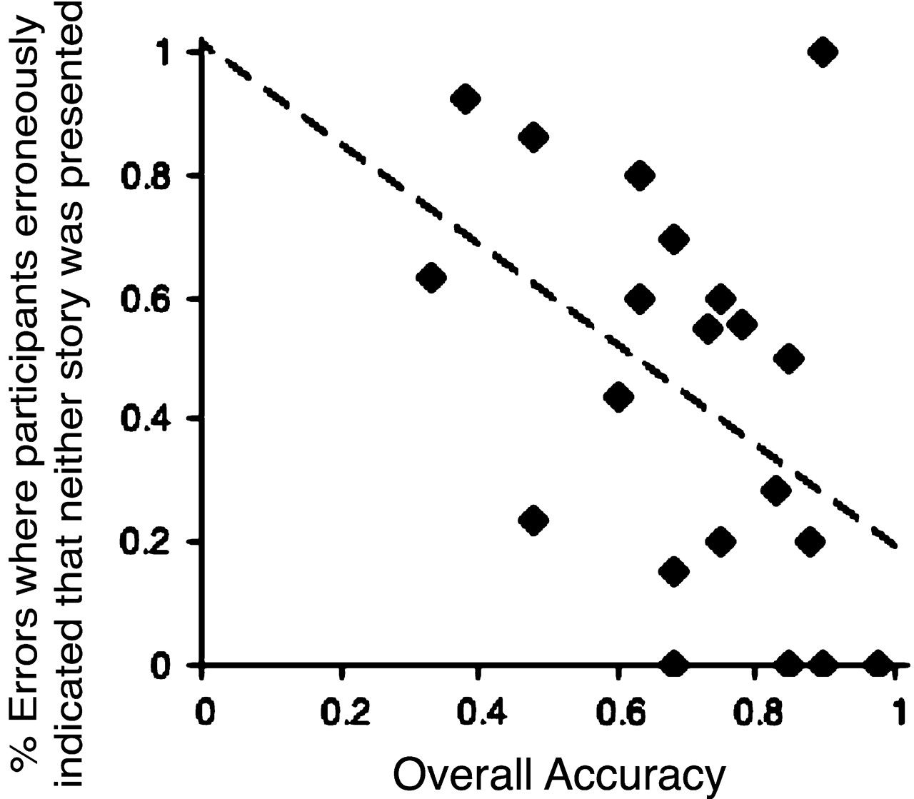
Figure 1. Individual performance on forced-choice memory test. The scatter diagram plots each participant's overall ...
Notes:
Figure 1. Individual performance on forced-choice memory test. The scatter diagram plots each participant's overall performance in the forced-choice memory test against the proportion of errors where they wrongly indicated that neither story was presented.
Unless provided in the caption above, the following copyright applies to the content of this slide: © The Author 2007. Published by Oxford University Press. All rights reserved. For permissions, please e-mail: journals.permissions@oxfordjournals.org

Slide 2
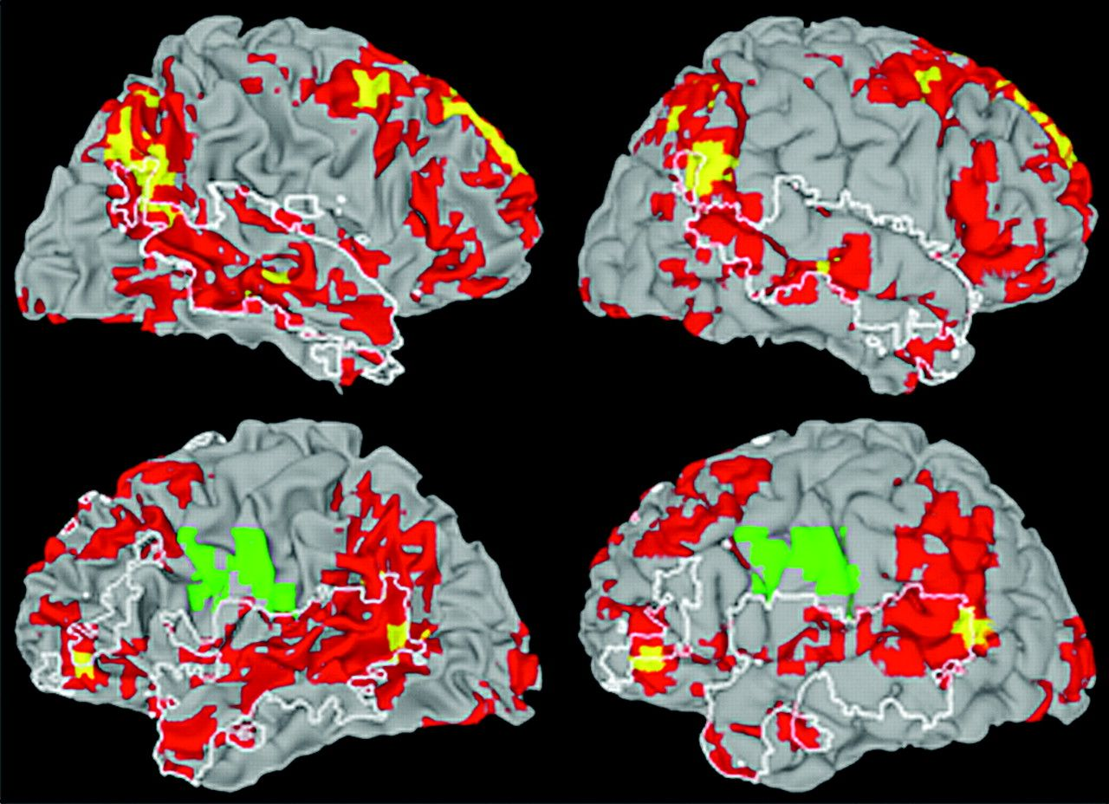
Figure 2. Effects of context. Data are projected onto white matter and gray matter views of standard Montreal ...
Notes:
Figure 2. Effects of context. Data are projected onto white matter and gray matter views of standard Montreal Neurological Institute template. Comprehension of concluding discourse segments was generally associated with greater neural activity when those segments were more informative (yellow: voxel threshold P < 0.001, P < 0.05 corrected; red: voxel threshold P < 0.05, P < 0.05 corrected; green: regions showing greater activity in the LI condition, voxel threshold P < 0.05, P < 0.05 corrected). Regions showing above-baseline activity in both conditions are marked in white outline (see text).
Unless provided in the caption above, the following copyright applies to the content of this slide: © The Author 2007. Published by Oxford University Press. All rights reserved. For permissions, please e-mail: journals.permissions@oxfordjournals.org

Slide 3
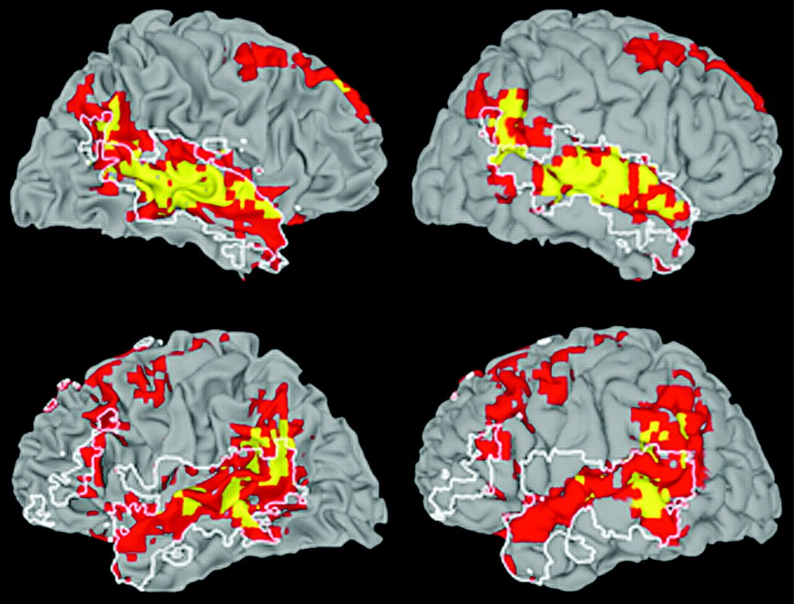
Figure 3. Correlates of subsequent memory for discourse. Data are projected onto white matter and gray matter views of ...
Notes:
Figure 3. Correlates of subsequent memory for discourse. Data are projected onto white matter and gray matter views of standard Montreal Neurological Institute template. Successful subsequent memory was associated with greater neural activity that was found in both regional clusters (red: voxel threshold P < 0.05, P < 0.05 corrected) and more localized clusters (yellow: voxel threshold P < 0.001, P < 0.05 corrected). Regions showing above-baseline activity in both conditions are marked in white outline (see text).
Unless provided in the caption above, the following copyright applies to the content of this slide: © The Author 2007. Published by Oxford University Press. All rights reserved. For permissions, please e-mail: journals.permissions@oxfordjournals.org

Slide 4
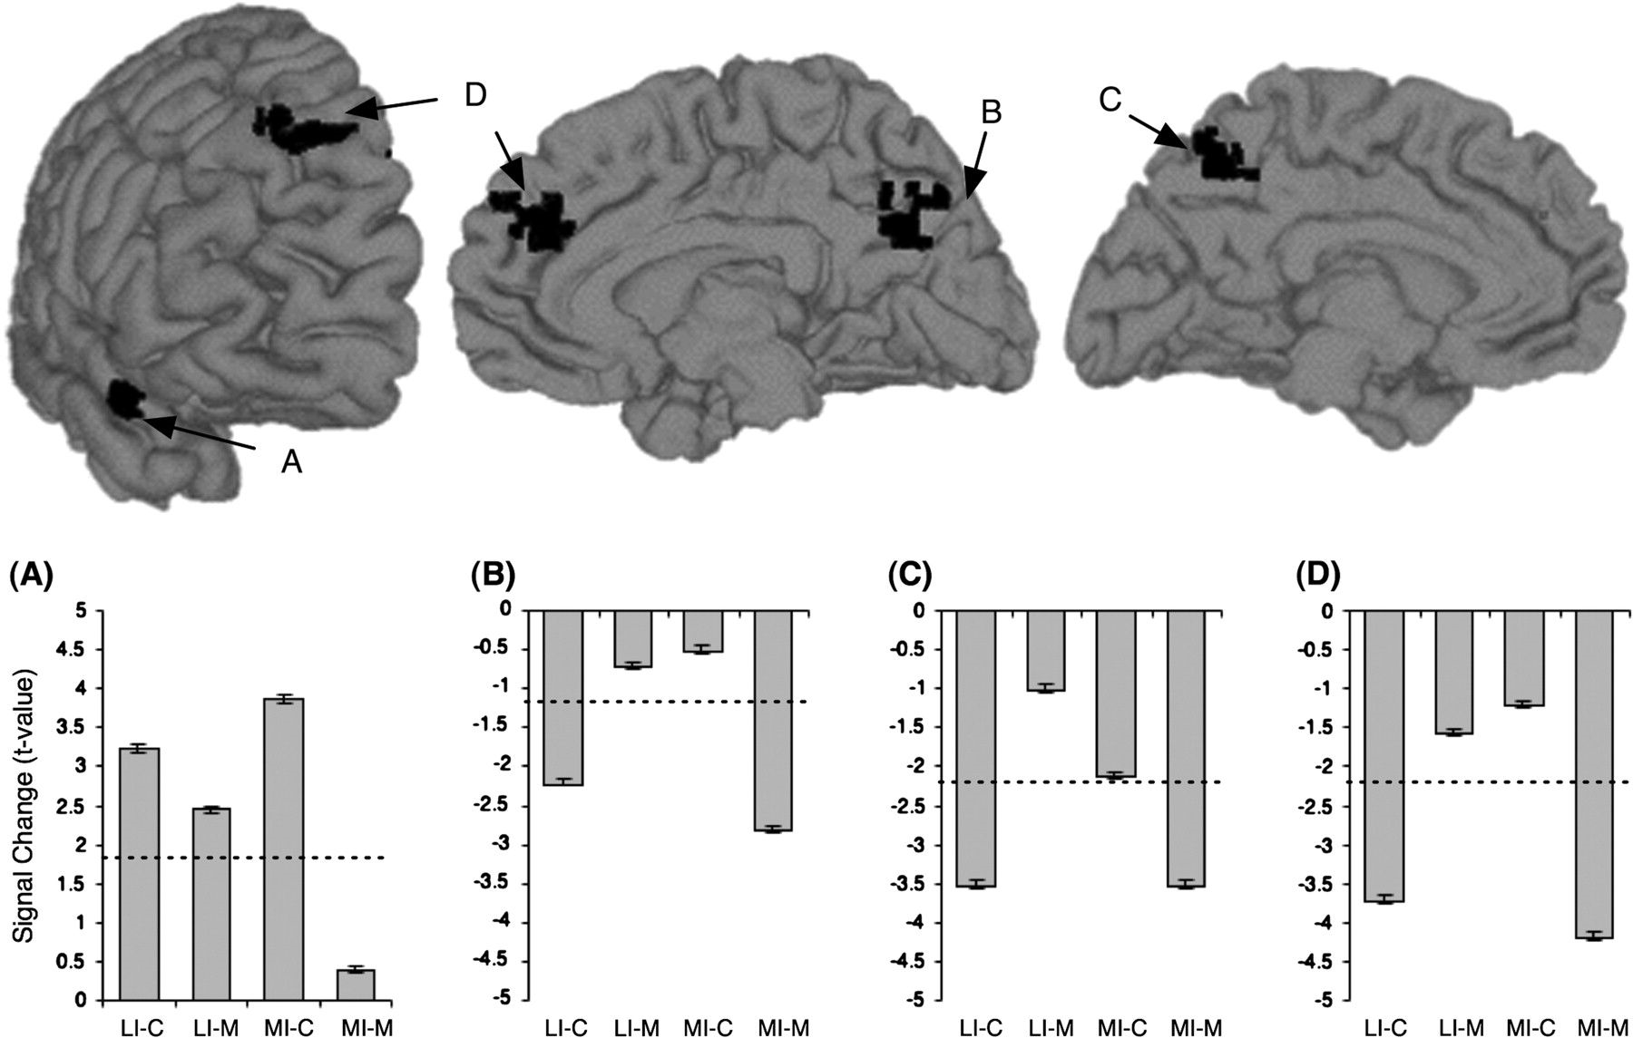
Figure 4. Localized clusters showing an interaction between discourse context and memory performance. These clusters ...
Notes:
Figure 4. Localized clusters showing an interaction between discourse context and memory performance. These clusters (voxel threshold P < 0.001, P < 0.05 corrected) correspond to (A) the R. STG, (B) R. precuneus, (C) L. precuneus, and (D) R. medial frontral gyrus. LI-C = less-informative correct, LI-M = less-informative mistake, MI-C = more-informative correct, MI-M = more-informative mistake. Error bars show standard error of the mean calculated over voxels. Dashed lines mark the mean activity in each cluster for the filler condition, which consisted of meaningful sentences that did not make up a coherent narrative.
Unless provided in the caption above, the following copyright applies to the content of this slide: © The Author 2007. Published by Oxford University Press. All rights reserved. For permissions, please e-mail: journals.permissions@oxfordjournals.org

Slide 5
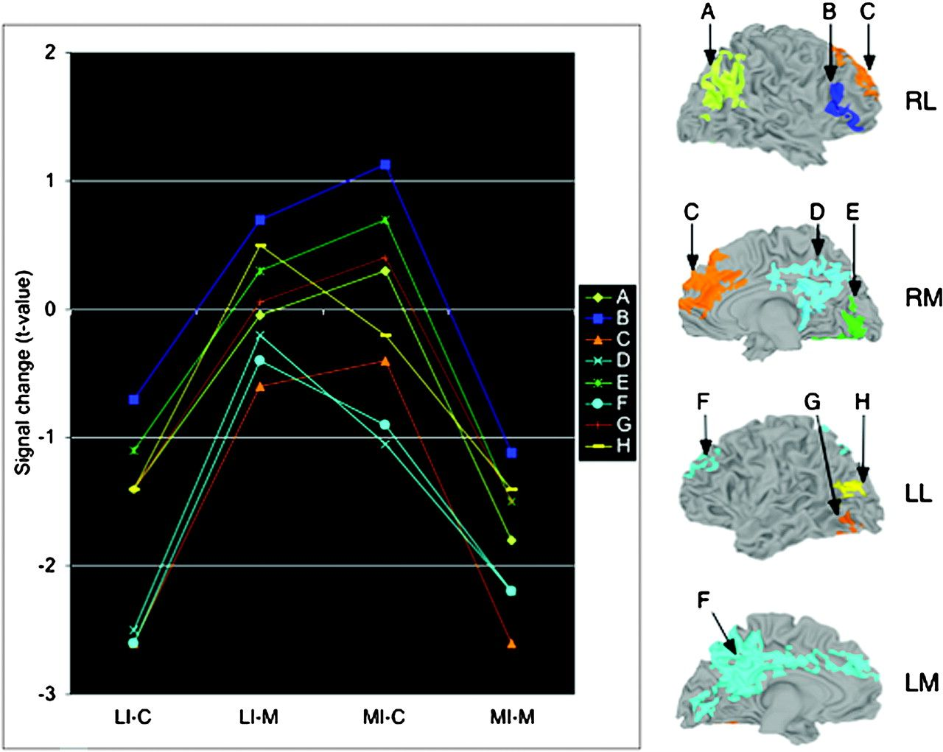
Figure 5. Regional clusters showing an interaction between discourse context and memory performance. Interaction ...
Notes:
Figure 5. Regional clusters showing an interaction between discourse context and memory performance. Interaction effects (voxel threshold P <0.05, P < 0.05 corrected) are marked on lateral and medial views of the right and left hemispheres (RL, RM, LL, LM), with the mean activity in each region for each experimental condition given in the accompanying graph (condition abbreviations as in Fig. 4). The labels of plots in the graph correspond to the subscripts of the marked regions: (A) R. inferior parietal lobule, (B) R. IFG, (C) R. prefrontal cortex, (D) R. posterior midline regions, (E) R. fusiform, (F) L. midline regions, (G) L. fusiform, and (H) L. MTG.
Unless provided in the caption above, the following copyright applies to the content of this slide: © The Author 2007. Published by Oxford University Press. All rights reserved. For permissions, please e-mail: journals.permissions@oxfordjournals.org

Slide 6
Figure 6. Individual differences in memory accuracy as function of neural activity in inferior frontal and temporal ...
Notes:
Figure 6. Individual differences in memory accuracy as function of neural activity in inferior frontal and temporal regions. The scatter diagrams plot individual memory accuracy as a function of mean percent signal change in 6 anatomical regions, for the more- and less-informative conditions (MI, LI). For each region, this relation is plotted for the left hemisphere (triangles, unbroken trendline) and right hemisphere homologs (circles, dashed trendline). *P < 0.05, **P < 0.01, ***P < 0.001.
Unless provided in the caption above, the following copyright applies to the content of this slide: © The Author 2007. Published by Oxford University Press. All rights reserved. For permissions, please e-mail: journals.permissions@oxfordjournals.org

Slide 7
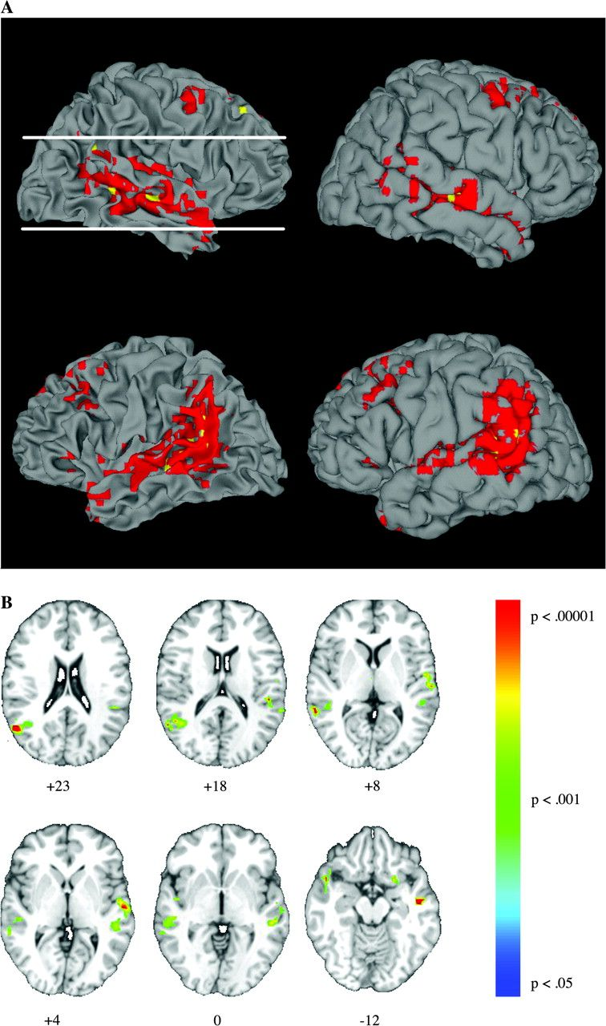
Figure 7. Regions showing both an effect of context and an effect of subsequent memory. (A) Regions showing both ...
Notes:
Figure 7. Regions showing both an effect of context and an effect of subsequent memory. (A) Regions showing both effects: Regions in red showed both a reliable effect of context and a reliable effect of subsequent memory (each thresholded at an individual voxel threshold of P < 0.05, P < 0.05 corrected, see text). Regions in yellow reflect areas independently reliable at an individual voxel threshold of P < 0.001 in each contrast (joint probability, P < 0.000001). (B) Clusters demonstrating a positive correlation between the magnitude of participants' context and subsequent memory effects (see text). Axial slices are in region bound by the 2 white horizontal lines in (A). Slices presented in radiological convention (left is right).
Unless provided in the caption above, the following copyright applies to the content of this slide: © The Author 2007. Published by Oxford University Press. All rights reserved. For permissions, please e-mail: journals.permissions@oxfordjournals.org

