Slide 1
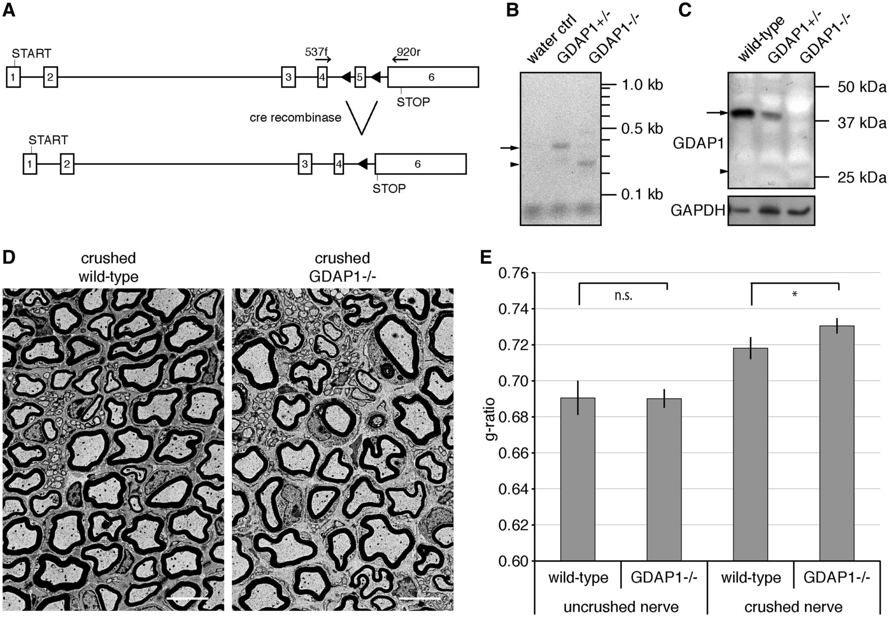
Figure 1 Gdap1^{−/−} animals display hypomyelination after nerve crush. (A) The ablation of exon 5 in the ...
Notes:
Figure 1 Gdap1−/− animals display hypomyelination after nerve crush. (A) The ablation of exon 5 in the Gdap1 locus generates a premature stop codon in exon 6 as a result of a frame shift (triangles: introduced loxP sites; START: translation start codon; STOP: translational stop codon; arrows indicate primer pairs used for reverse transcriptase-PCR). (B) Reverse transcriptase-PCR demonstrates the trans-splicing from exon 4 to 6 in Gdap1−/− animals. The sizes of the predicted PCR products for the wild-type transcript (arrow; 383 bp) and the trans-spliced transcript (arrow head; 269 bp) are indicated. (C) Loss of GDAP1 protein in mutant mice (arrow: wild-type protein; arrowhead: size of the predicted GDAP1 K193fsX219 protein: note that the antiserum detects the amino-terminus of GDAP1). Glyceraldehyde 3-phosphate dehydrogenase (GAPDH) served as loading control. (D) Representative ultrathin sections of unilaterally crush-lesioned sciatic nerves of 4-month-old wild-type and Gdap1−/− mice analysed by transmission electron microscopy. Two month post crush sections were obtained 3 mm distal to the site of injury. Scale bar = 5 µm. (E) Quantitative morphological analysis of sciatic nerve sections. One hundred randomly selected axons per crushed and uncrushed nerve were measured per animal. Values represent mean and standard error of three animals per genotype: n.s. = not significant, *P < 0.05.
Unless provided in the caption above, the following copyright applies to the content of this slide: © The Author (2014). Published by Oxford University Press on behalf of the Guarantors of Brain.This is an Open Access article distributed under the terms of the Creative Commons Attribution Non-Commercial License (http://creativecommons.org/licenses/by-nc/3.0/), which permits non-commercial re-use, distribution, and reproduction in any medium, provided the original work is properly cited. For commercial re-use, please contact journals.permissions@oup.com

Slide 2
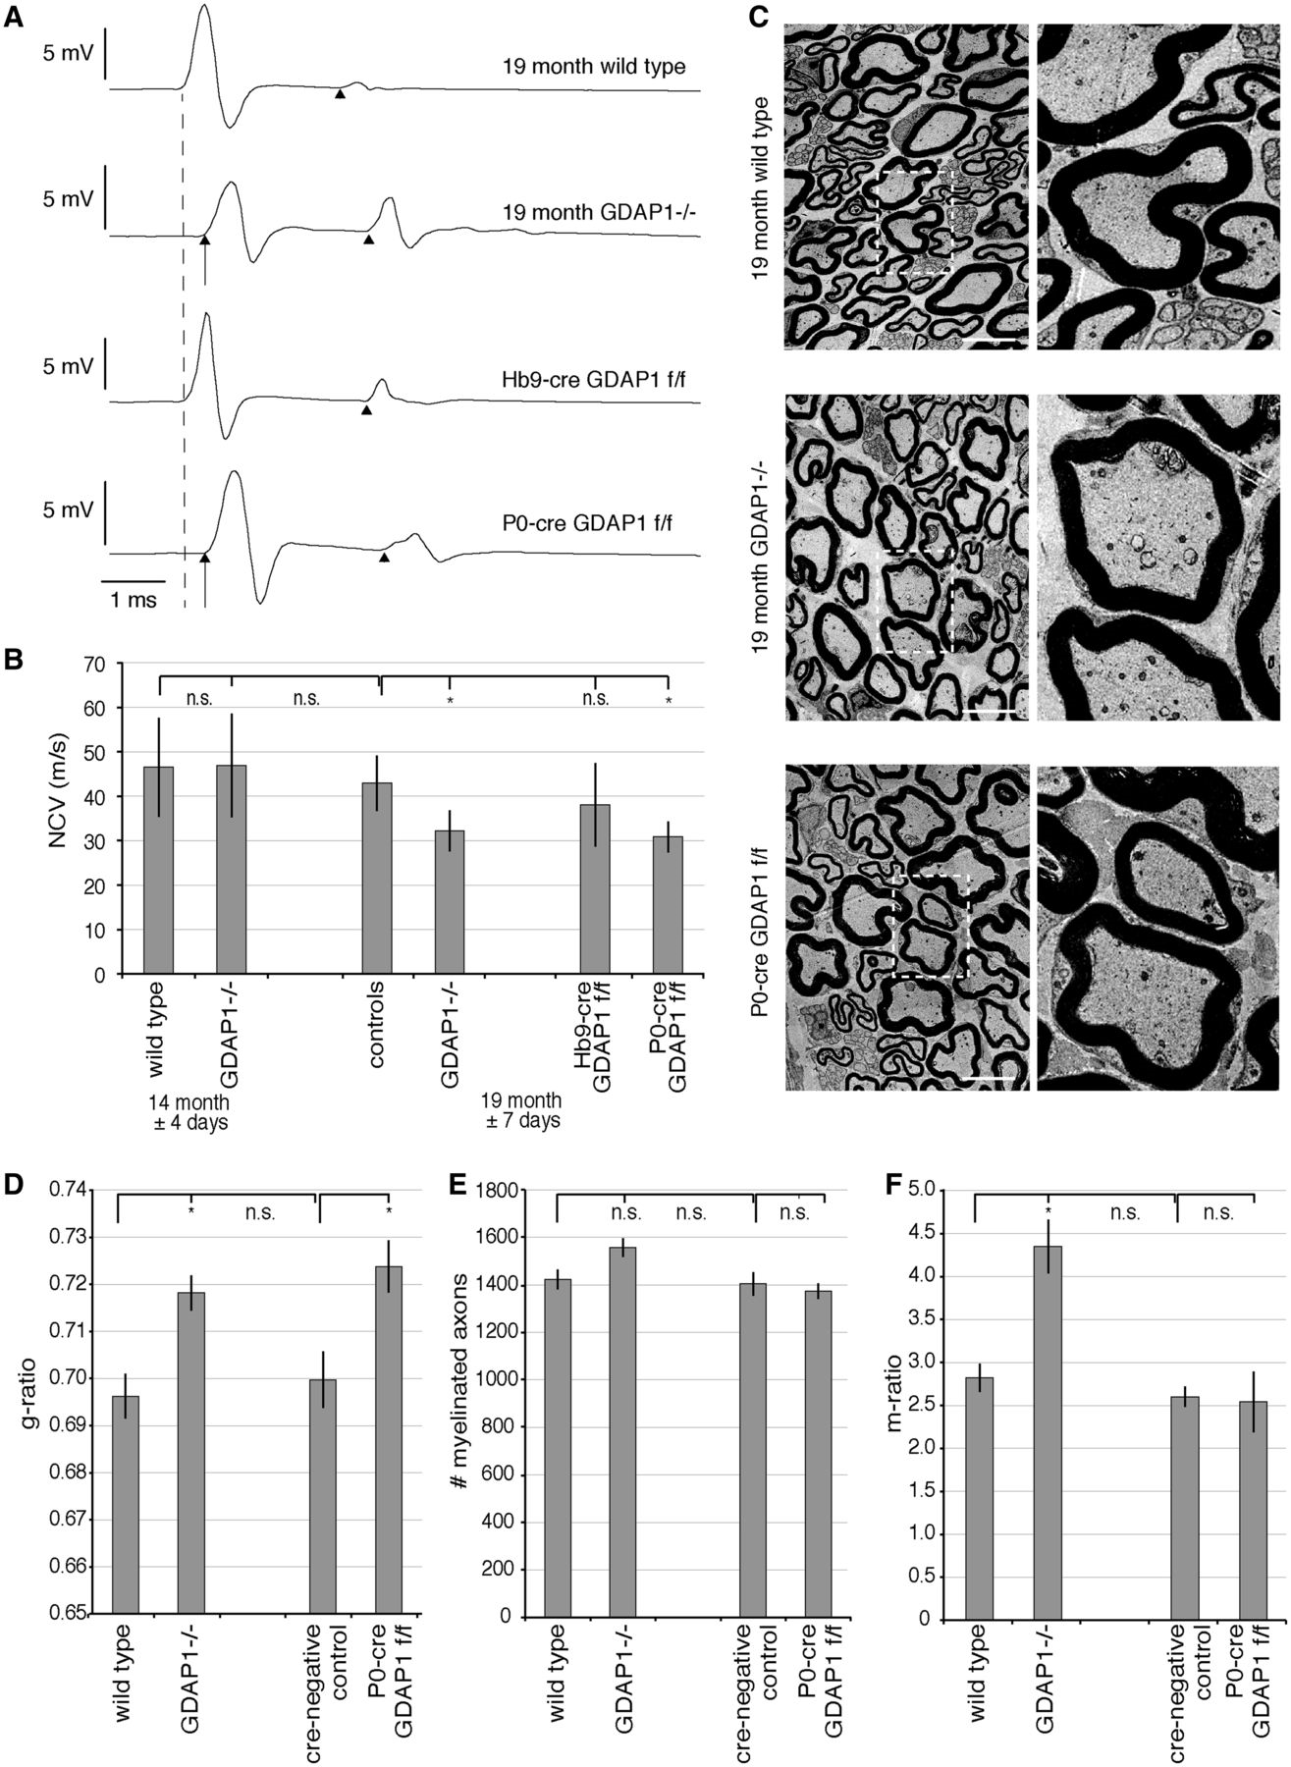
Figure 2 Aged Gdap1^{−/−} mice develop a hypomyelinating peripheral neuropathy. (A) Nerve conduction velocity ...
Notes:
Figure 2 Aged Gdap1−/− mice develop a hypomyelinating peripheral neuropathy. (A) Nerve conduction velocity (NCV) measurements of 19-month-old mice with different genotypes are shown as representative original recordings. The broken line represents onset (distal latency) of compound muscle action potentials in unaffected mice. Arrows denote a delayed compound muscle action potential onset (prolonged distal latency) in affected mice. Note that there is no relevant difference in shape and duration of compound muscle action potentials. F-waves are identified by arrowheads. (B) Nerve conduction velocities are represented as means and standard error, n = 6 to 11 animals per genotype and age group; variations of age are indicated as standard error; controls are a group of wild-type and cre-negative animals. n.s. = not significant, *P < 0.05. (C) Transverse ultrathin sections of plantar nerves of 19-month-old Gdap1−/− and P0-cre Gdap1flox/flox (f/f) animals reveal hypomyelination compared to age-matched controls. Scale bars = 5 µm, squares are shown at higher magnification. (D) Quantitative morphological analysis of ultrathin plantar nerve sections at 19 months showing hypomyelination in Gdap1−/− and P0-cre Gdap1flox/flox animals compared with wild-type and cre-negative controls. (E) Quantitative analysis of the total number of myelinated axons in the plantar nerve. (F) The m-ratio, defined as the percentage of the area covered by intra-axonal mitochondria divided by the total area of the axon, is significantly increased only in Gdap1−/− animals. (D and F) One hundred randomly selected myelinated axons were measured per animal. (D–F) represent the means and standard error of independent experiments; cre-negative controls and P0-cre Gdap1flox/flox: n = 3 animals each; wild-type and Gdap1−/−n = 4 animals each; n.s. = not significant, *P < 0.05.
Unless provided in the caption above, the following copyright applies to the content of this slide: © The Author (2014). Published by Oxford University Press on behalf of the Guarantors of Brain.This is an Open Access article distributed under the terms of the Creative Commons Attribution Non-Commercial License (http://creativecommons.org/licenses/by-nc/3.0/), which permits non-commercial re-use, distribution, and reproduction in any medium, provided the original work is properly cited. For commercial re-use, please contact journals.permissions@oup.com

Slide 3
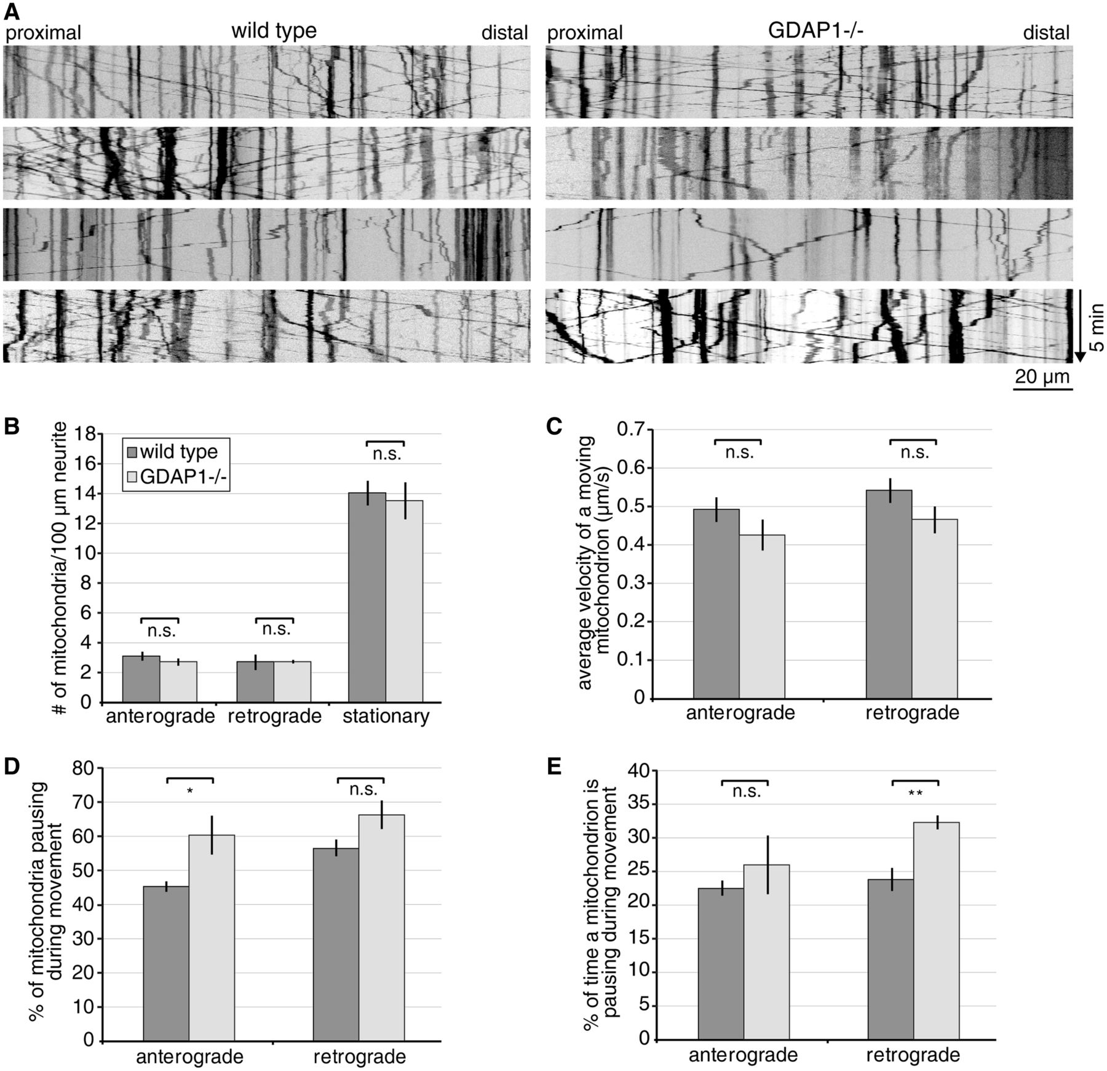
Figure 3 Gdap1^{−/−} dorsal root ganglia explant cultures reveal mild mitochondrial transport impairment. Five ...
Notes:
Figure 3 Gdap1−/− dorsal root ganglia explant cultures reveal mild mitochondrial transport impairment. Five to nine dorsal root ganglion neurons expressing mitochondrially targeted DsRed were imaged per genotype and experiment, resulting in the analysis of 200 to 400 mitochondria per genotype and preparation. The movies were converted into kymographs (A) and quantified (B–E). (A) Representative kymographs of wild-type and Gdap1−/− neurons reveal no obvious impairment of mitochondrial transport. Vertical lines represent stationary mitochondria, lines crossing from left to right or right to left represent antero- or retrograde transport, respectively. (B) Quantification of the number of stationary and moving mitochondria (subdivided in anterograde or retrograde direction) per 100 µm of neurite length reveals no difference between Gdap1−/− and wild-type cultures. (C) The velocity of moving mitochondria is not altered in anterograde and retrograde direction in Gdap1−/− neurons. (D) During the acquisition period of 5 min, significantly more mitochondria moving in anterograde direction pause, (E) and the time a retrograde-moving mitochondrion spends pausing is significantly longer in Gdap1−/− cultures compared to wild-type controls. (B–E) Graphs represent means and standard error of n = 4 independent culture preparations per genotype, n.s. = not significant, *P < 0.05, **P < 0.01.
Unless provided in the caption above, the following copyright applies to the content of this slide: © The Author (2014). Published by Oxford University Press on behalf of the Guarantors of Brain.This is an Open Access article distributed under the terms of the Creative Commons Attribution Non-Commercial License (http://creativecommons.org/licenses/by-nc/3.0/), which permits non-commercial re-use, distribution, and reproduction in any medium, provided the original work is properly cited. For commercial re-use, please contact journals.permissions@oup.com

Slide 4
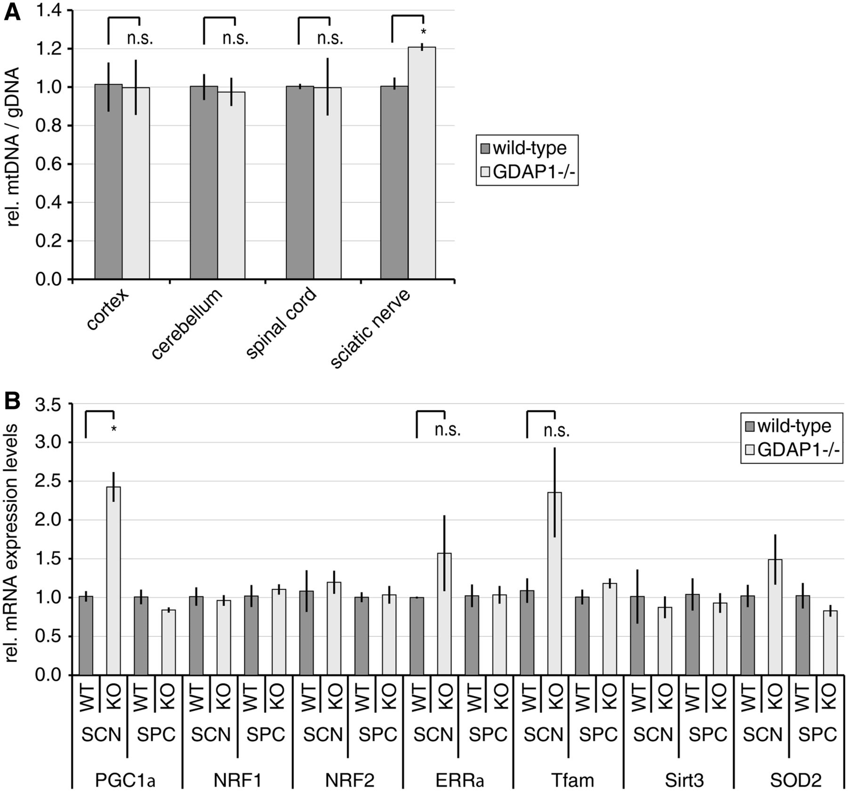
Figure 4 Mitochondrial DNA biogenesis is increased in sciatic nerves of Gdpa1^{−/−} mice. (A) DNA of the ...
Notes:
Figure 4 Mitochondrial DNA biogenesis is increased in sciatic nerves of Gdpa1−/− mice. (A) DNA of the indicated tissues was isolated from 19-month-old Gdap1−/− and wild-type mice. The relative amount of mitochondrial DNA (mtDNA) in relation to genomic DNA (gDNA) was determined by quantitative PCR. (B) Total RNA was isolated from sciatic nerve (SCN) and spinal cord (SPC) lysates from 19-month-old Gdap1−/− and wild-type mice. The relative expression levels of nuclear factors involved in mitochondrial biogenesis and redox protection were determined by quantitative PCR in relation to β-actin levels. (A and B) Graphs represent means and standard error of tissues of n = 3 animals per genotype, n.s. = not significant, *P < 0.05.
Unless provided in the caption above, the following copyright applies to the content of this slide: © The Author (2014). Published by Oxford University Press on behalf of the Guarantors of Brain.This is an Open Access article distributed under the terms of the Creative Commons Attribution Non-Commercial License (http://creativecommons.org/licenses/by-nc/3.0/), which permits non-commercial re-use, distribution, and reproduction in any medium, provided the original work is properly cited. For commercial re-use, please contact journals.permissions@oup.com

Slide 5
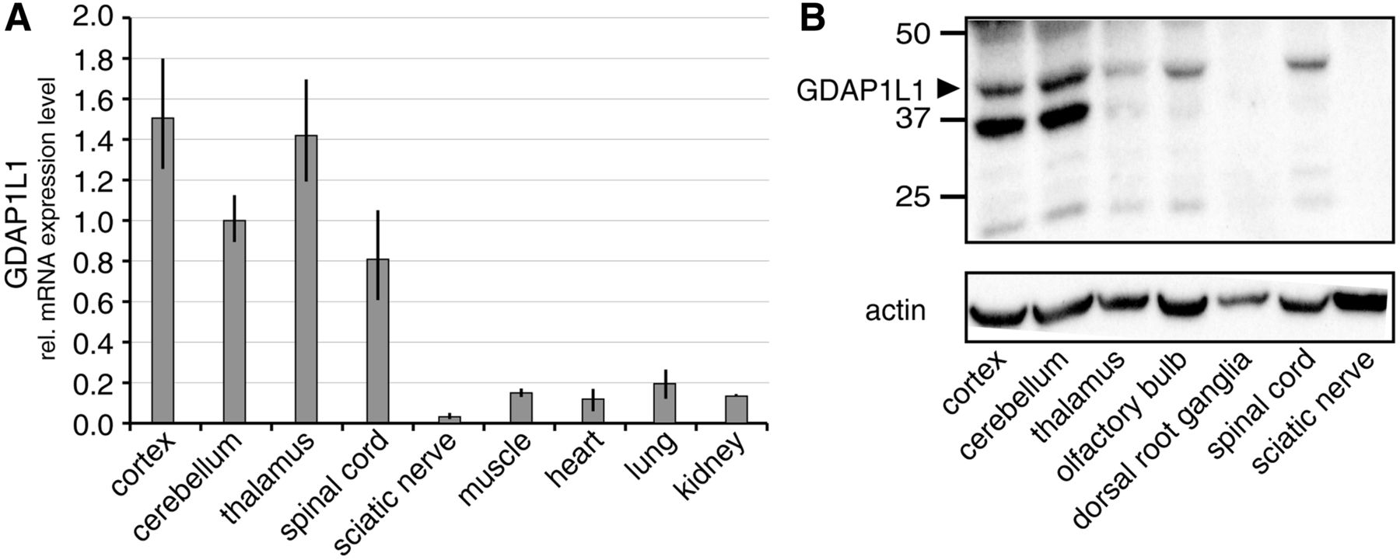
Figure 5 The paralogue of Gdap1, Gdap1l1, is expressed in the CNS. (A) Relative Gdap1l1 messenger RNA (mRNA) ...
Notes:
Figure 5 The paralogue of Gdap1, Gdap1l1, is expressed in the CNS. (A) Relative Gdap1l1 messenger RNA (mRNA) expression levels in mouse tissues were determined by quantitative reverse transcriptase PCR in relation to 18S ribosomal RNA. (B) GDAP1L1 protein expression was determined by western blot using 12 µg protein lysate of indicated murine tissues and anti-GDAP1L1 antiserum (Supplementary Fig. 4A). β-actin served as loading control. Arrowhead = predicted molecular weight of GDAP1L1.
Unless provided in the caption above, the following copyright applies to the content of this slide: © The Author (2014). Published by Oxford University Press on behalf of the Guarantors of Brain.This is an Open Access article distributed under the terms of the Creative Commons Attribution Non-Commercial License (http://creativecommons.org/licenses/by-nc/3.0/), which permits non-commercial re-use, distribution, and reproduction in any medium, provided the original work is properly cited. For commercial re-use, please contact journals.permissions@oup.com

Slide 6
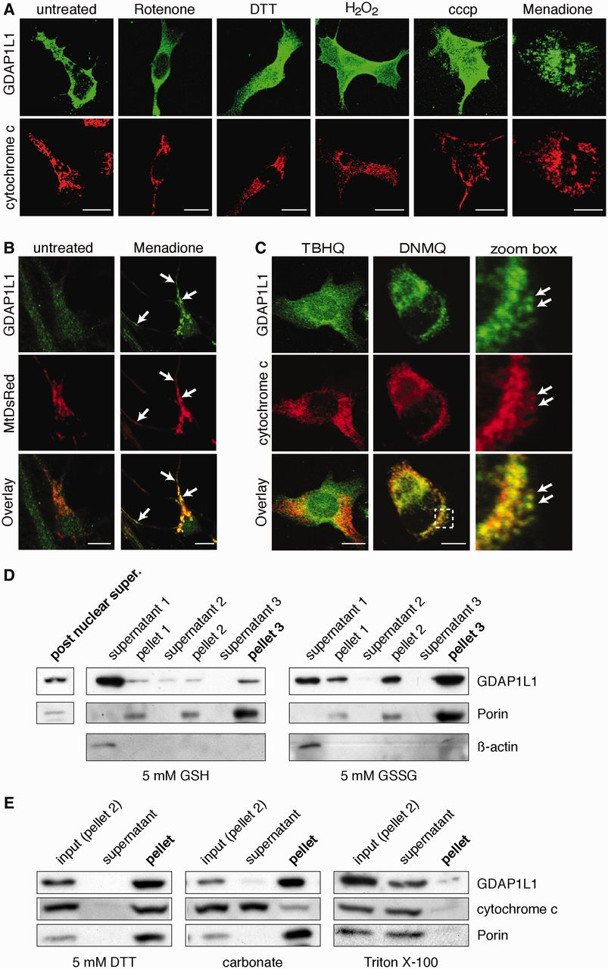
Figure 6 Translocation of GDAP1L1 to mitochondria. (A) N1E-115 cells were transiently transfected with GDAP1L1 ...
Notes:
Figure 6 Translocation of GDAP1L1 to mitochondria. (A) N1E-115 cells were transiently transfected with GDAP1L1 expression constructs and treated for 2 h as indicated. Cells were fixed, stained for GDAP1L1 and cytochrome c and examined by immunofluorescence. Single plane confocal images are shown. GDAP1L1 has mainly a cytosolic localization, which is altered upon treatment with menadione (right). (B) Primary hippocampal neurons were infected with lentivirus encoding mitochondrially targeted DsRed (MtDsRed). Four days post-infection, cells were treated for 2 h with menadione or left untreated, fixed and stained for endogenously expressed GDAP1L1. Single plane confocal images are shown. (C) Twenty-four hours post-transfection with GDAP1L1 expression constructs and subsequent 2 h treatment with the indicated reagents, N1E-115 cells were analysed on single plane confocal pictures. 2,3-dimethoxy-1,4-naphthoquinoe (DNMQ, 20 µM) led to a redistribution of GDAP1L1 to mitochondria as visualized by the colocalization with the mitochondrial marker cytochrome c (arrows). In contrast, tert-butylhydroquinone (TBHQ, 100 µM) had no impact on the subcellular distribution of GDAP1L1. Broken line indicates area shown in higher magnification. (D) N1E-115 cells were transiently transfected with GDAP1L1 expression constructs and homogenized using a Dounce homogenizer on the next day. The post-nuclear supernatant of the lysate was divided in two and incubated with reduced glutathione (GSH) or oxidized glutathione (GSSG). In differential sedimentation steps, cytosolic proteins were removed as demonstrated by western blot of all purification steps against the cytosolic marker β-actin. In the oxidized glutathione (GSSG)-treated fraction of the post nuclear supernatant, more GDAP1L1 co-sediments with the mitochondrial marker Porin compared with the reduced glutathione (GSH)-treated fraction. (E) Pellet 2 of GDAP1L1 expressing cells treated with oxidized glutathione was resuspended in buffer plus 5 mM dithiothreitol (DTT), in 0.1 M carbonate (pH 11), or in buffer containing 0.1% Triton™ X-100 and sedimented to separate soluble protein supernatants from membranous pellets. GDAP1L1 and the known transmembrane protein Porin are only solubilized by detergent. (A–C) Scale bars = 10 µm.
Unless provided in the caption above, the following copyright applies to the content of this slide: © The Author (2014). Published by Oxford University Press on behalf of the Guarantors of Brain.This is an Open Access article distributed under the terms of the Creative Commons Attribution Non-Commercial License (http://creativecommons.org/licenses/by-nc/3.0/), which permits non-commercial re-use, distribution, and reproduction in any medium, provided the original work is properly cited. For commercial re-use, please contact journals.permissions@oup.com

Slide 7
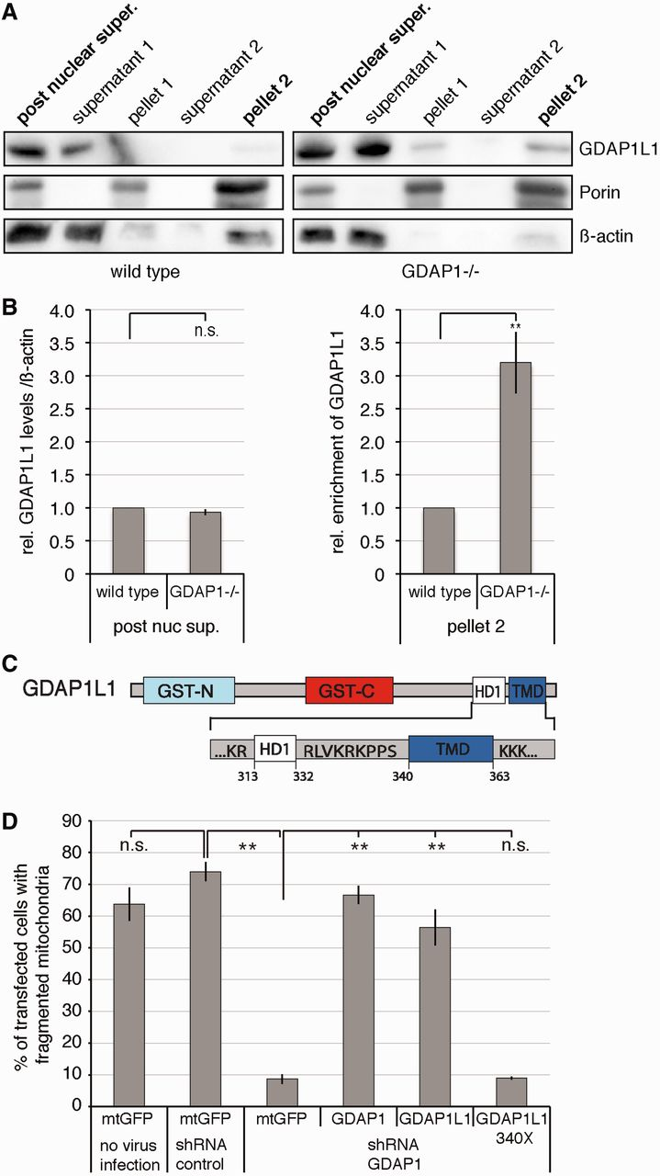
Figure 7 Translocation of GDAP1L1 is needed to compensate for the loss of GDAP1 expression. (A) Spinal cords of ...
Notes:
Figure 7 Translocation of GDAP1L1 is needed to compensate for the loss of GDAP1 expression. (A) Spinal cords of 19-month-old wild-type or Gdap1−/− animals were fractionated by differential centrifugation. In homogenates from Gdap1−/− animals, more GDAP1L1 sediments with the mitochondrial marker Porin compared with age-matched wild-type controls. β-actin served as maker for the cytosolic fraction. (B) The relative amounts of GDAP1L1 were quantified by densitometry in relation to β-actin in the post-nuclear supernatant and the relative enrichment from GDAP1L1 was determined for pellet 2. The values obtained from wild-type animals were set to 1 in each of four independent experiments. Means and standard error of the mean, n = 4. n.s. = not significant, **P < 0.005. (C) The domain structure of GDAP1L1 is illustrated with focus on the carboxy-terminal domains harbouring the hydrophobic domain 1 (HD1) and the transmembrane domain (TMD; GST-N and GST-C: domains conserved in glutathione S-transferases). The tail-anchored domain is formed by the transmembrane domain and surrounding positively charged amino acids. (D) N1E-115 cells were infected with lentiviral particles encoding non-silencing short-hairpin RNA (shRNA control) or short-hairpin RNA against Gdap1 (shGDAP1) or were left uninfected. When the knockdown was detectable (Supplementary Fig. 7A and Supplementary Data), cells were transiently co-transfected with expression constructs encoding mitochondrially targeted DsRed together with mitochondrially targeted green fluorescent protein (mtGFP) as negative control, with GDAP1 as positive control, with GDAP1L1 or with GDAP1L1 340X, lacking the potential tail-anchor domain of GDAP1L1. The next day cells were fixed and stained. In blinded countings, the mitochondrial morphology was assessed by mitochondrially targeted DsRed fluorescence (Niemann et al., 2005). One hundred randomly selected cells were analysed per experiment and condition, means and standard error of the mean, n = 3, n.s. = not significant, **P < 0.01.
Unless provided in the caption above, the following copyright applies to the content of this slide: © The Author (2014). Published by Oxford University Press on behalf of the Guarantors of Brain.This is an Open Access article distributed under the terms of the Creative Commons Attribution Non-Commercial License (http://creativecommons.org/licenses/by-nc/3.0/), which permits non-commercial re-use, distribution, and reproduction in any medium, provided the original work is properly cited. For commercial re-use, please contact journals.permissions@oup.com

