Slide 1
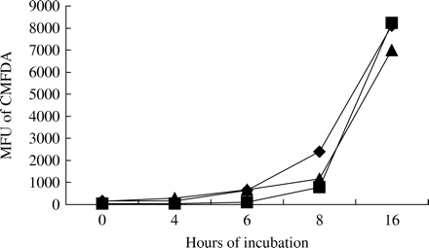
Figure 1. Increase in fluorescence for all Aspergillus species tested over time. Conidia of A. niger (diamonds), A. ...
Notes:
Figure 1. Increase in fluorescence for all Aspergillus species tested over time. Conidia of A. niger (diamonds), A. terreus (squares) and A. fumigatus (triangles) were incubated at 37°C and stained with CMFDA, and MFU were read. All the Aspergillus species tested increased in MFU, with the steepest increase occurring ∼8 h after incubation in the absence of drug.
Unless provided in the caption above, the following copyright applies to the content of this slide: JAC vol.55 no.1 © The British Society for Antimicrobial Chemotherapy 2004; all rights reserved

Slide 2
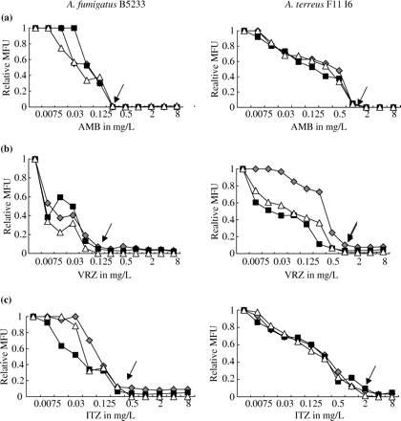
Figure 2. Mean fluorescence of drug-treated fungi relative to growth controls. MIC curves were generated by measurement ...
Notes:
Figure 2. Mean fluorescence of drug-treated fungi relative to growth controls. MIC curves were generated by measurement of mean fluorescence units (MFU). MIC curves for representative Aspergillus isolates with low MICs (left-hand panels) and high MICs (right-hand panels) are shown for three different experiments. Curves generated from individual experiments are represented by different symbols (triangles, squares or diamonds). MFU relative to controls (Relative MFU) are graphed for (a) amphotericin B (AMB), (b) itraconazole (ITZ) and (c) voriconazole (VRZ). The respective NCCLS MICs are indicated with arrows.
Unless provided in the caption above, the following copyright applies to the content of this slide: JAC vol.55 no.1 © The British Society for Antimicrobial Chemotherapy 2004; all rights reserved

