Slide 1
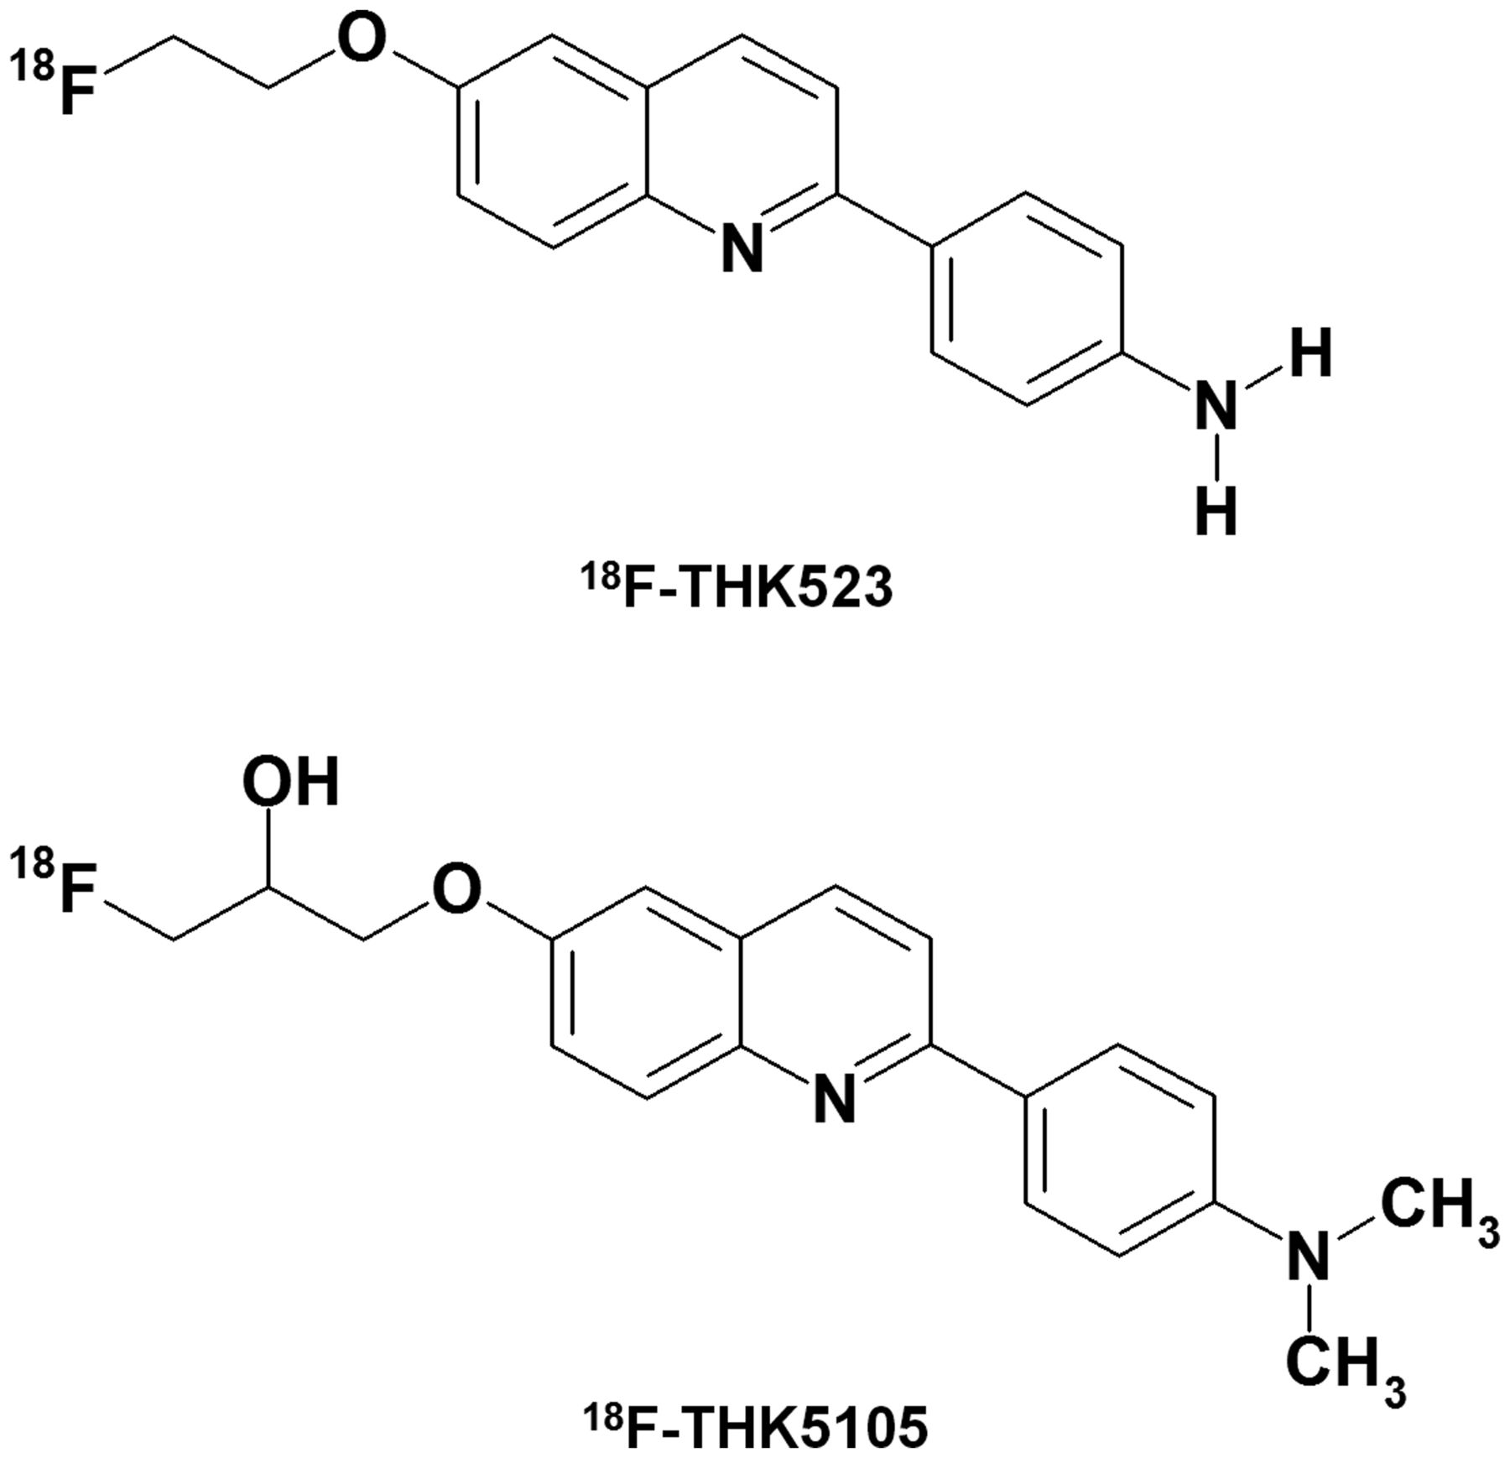
Figure 1 Chemical structures of ¹⁸F-THK523 and ¹⁸F-THK5105.
Notes:
Figure 1 Chemical structures of 18F-THK523 and 18F-THK5105.
Unless provided in the caption above, the following copyright applies to the content of this slide: © The Author (2014). Published by Oxford University Press on behalf of the Guarantors of Brain. All rights reserved. For Permissions, please email: journals.permissions@oup.com

Slide 2
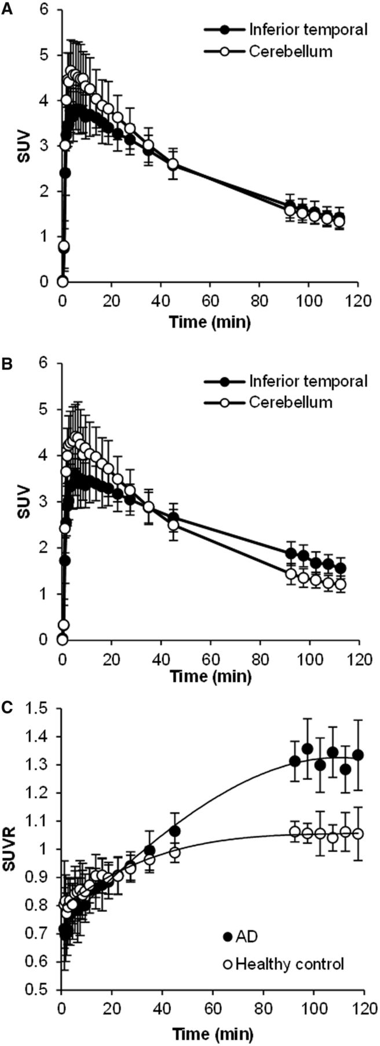
Figure 2 (A and B) ¹⁸F-THK5105 SUV TACs in the cerebellum (open circles) and inferior temporal cortex ...
Notes:
Figure 2 (A and B) 18F-THK5105 SUV TACs in the cerebellum (open circles) and inferior temporal cortex (filled circles) of eight healthy control subjects (A) and eight patients with Alzheimer’s disease (B). (C) SUVR time activity curves of 18F-THK5105 PET in eight healthy control subjects (open circles) and eight patients with Alzheimer’s disease (AD) (filled circles). Each point represents the mean ± SD.
Unless provided in the caption above, the following copyright applies to the content of this slide: © The Author (2014). Published by Oxford University Press on behalf of the Guarantors of Brain. All rights reserved. For Permissions, please email: journals.permissions@oup.com

Slide 3
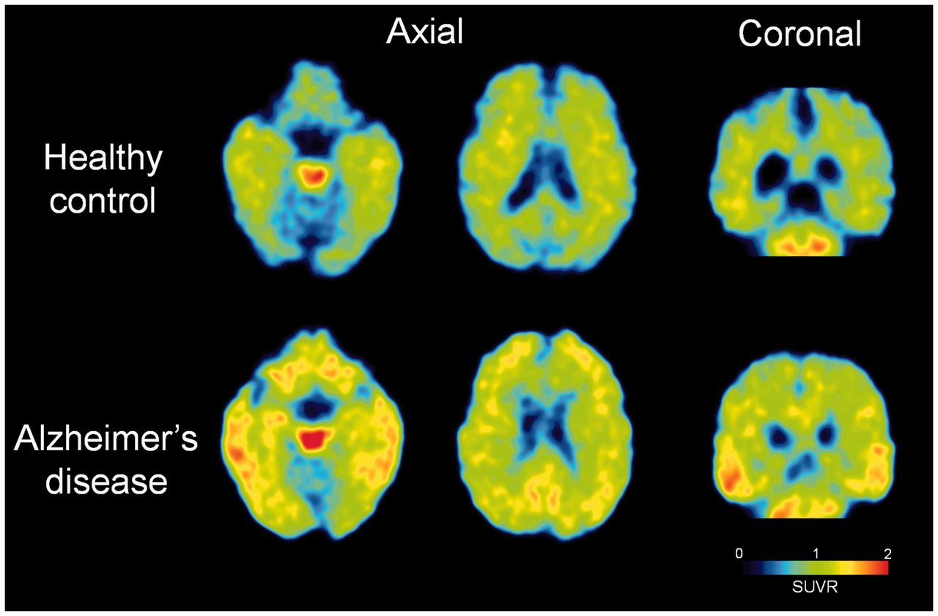
Figure 3 ¹⁸F-THK5105 PET images from 60–80 min post-injection in a healthy control subject (72-years-old, ...
Notes:
Figure 3 18F-THK5105 PET images from 60–80 min post-injection in a healthy control subject (72-years-old, CDR 0, MMSE 29) and a patient with Alzheimer’s disease (68-years-old, CDR 1.0, MMSE 20).
Unless provided in the caption above, the following copyright applies to the content of this slide: © The Author (2014). Published by Oxford University Press on behalf of the Guarantors of Brain. All rights reserved. For Permissions, please email: journals.permissions@oup.com

Slide 4
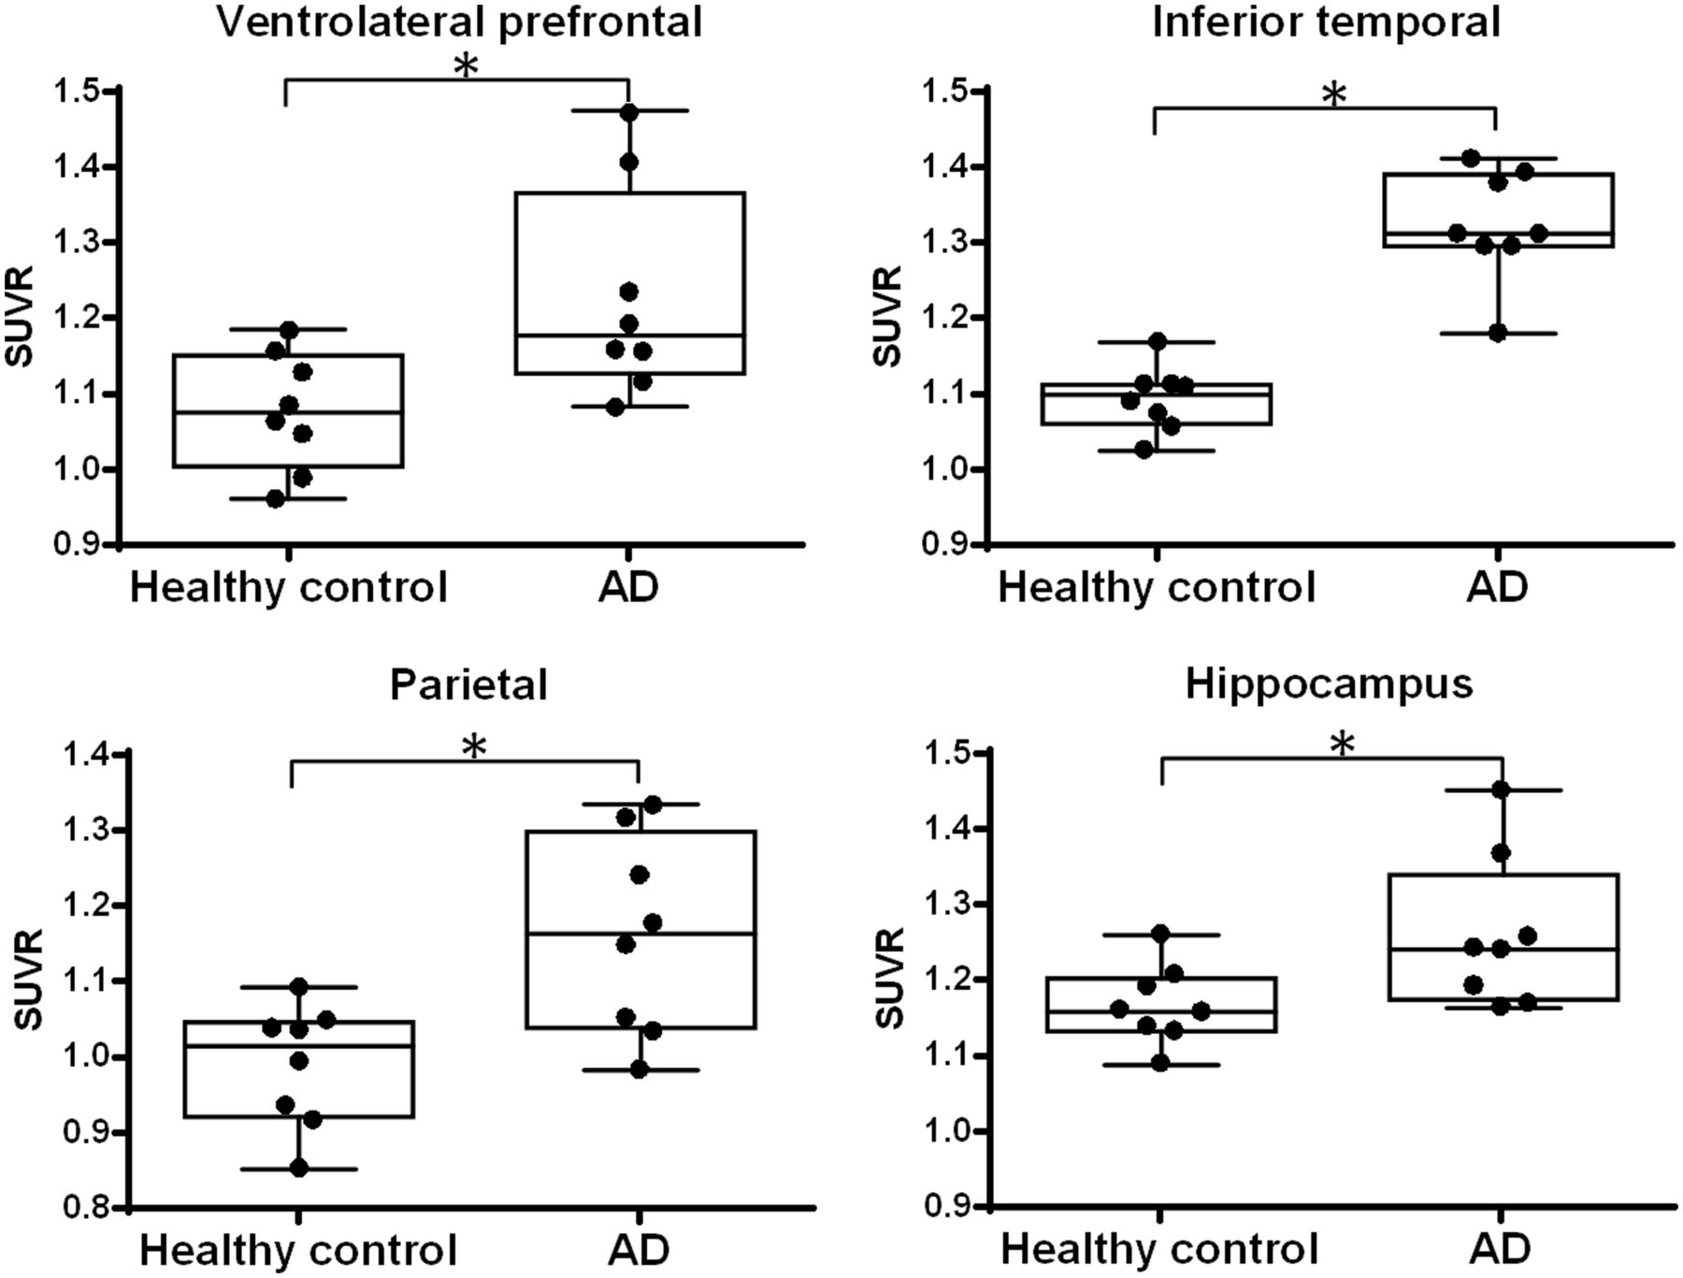
Figure 4 Regional ¹⁸F-THK5105 SUVR values from 60–80 min post-injection in healthy control and Alzheimer’s ...
Notes:
Figure 4 Regional 18F-THK5105 SUVR values from 60–80 min post-injection in healthy control and Alzheimer’s disease (AD) subjects. *P<0.05 by the Mann–Whitney U test.
Unless provided in the caption above, the following copyright applies to the content of this slide: © The Author (2014). Published by Oxford University Press on behalf of the Guarantors of Brain. All rights reserved. For Permissions, please email: journals.permissions@oup.com

Slide 5
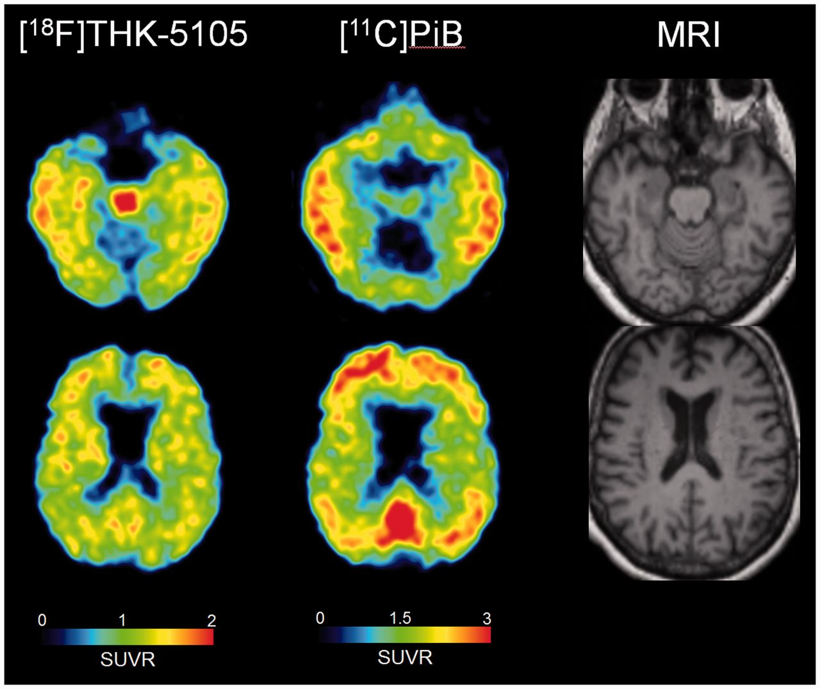
Figure 5 ¹⁸F-THK5105 PET images from 60–80 min post-injection and ¹¹C-PiB PET images from 40–70 ...
Notes:
Figure 5 18F-THK5105 PET images from 60–80 min post-injection and 11C-PiB PET images from 40–70 min post-injection in an Alzheimer’s disease patient (68-years-old, CDR 1.0, MMSE 20). Co-registered magnetic resonance images are shown on the right.
Unless provided in the caption above, the following copyright applies to the content of this slide: © The Author (2014). Published by Oxford University Press on behalf of the Guarantors of Brain. All rights reserved. For Permissions, please email: journals.permissions@oup.com

Slide 6
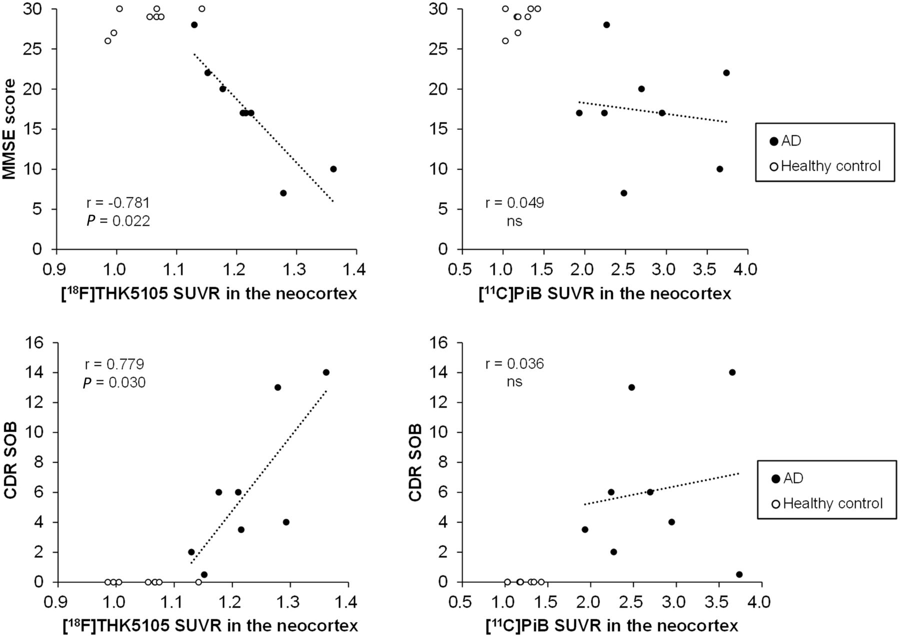
Figure 6 Correlation of neocortical ¹⁸F-THK5105 and ¹¹C-PiB SUVR with MMSE scores (upper) and ...
Notes:
Figure 6 Correlation of neocortical 18F-THK5105 and 11C-PiB SUVR with MMSE scores (upper) and CDR-SOB scores (lower). Data from eight healthy control subjects (open circles) and eight patients with Alzheimer’s disease (AD, filled circles) are shown.
Unless provided in the caption above, the following copyright applies to the content of this slide: © The Author (2014). Published by Oxford University Press on behalf of the Guarantors of Brain. All rights reserved. For Permissions, please email: journals.permissions@oup.com

Slide 7
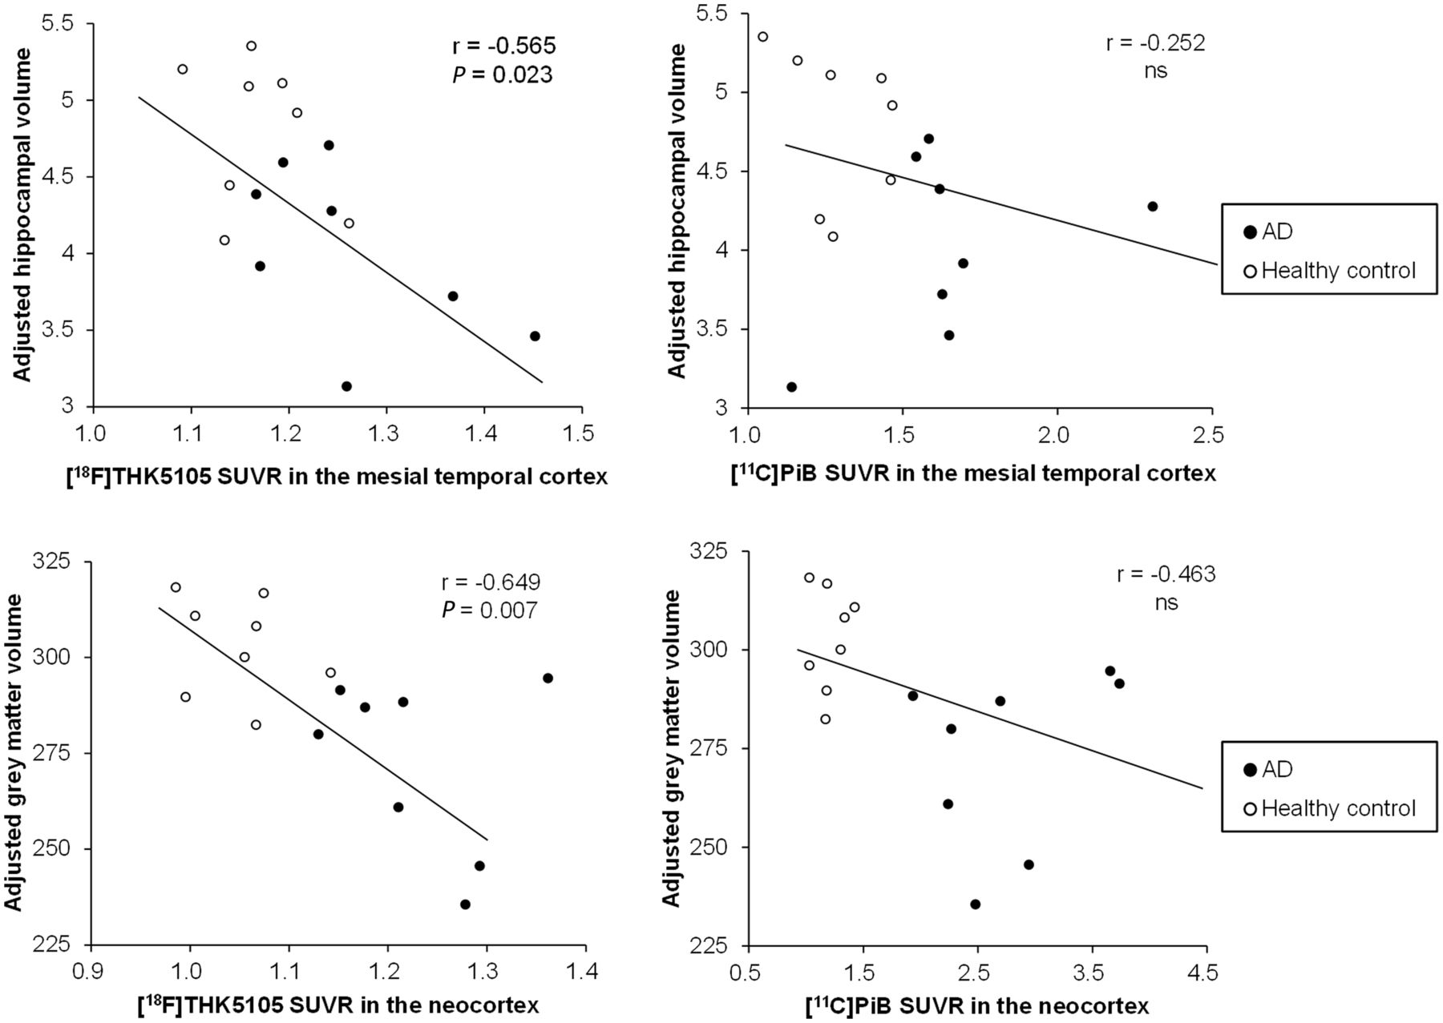
Figure 7 Correlation of ¹⁸F-THK5105 and ¹¹C-PiB SUVR with adjusted hippocampal volumes (upper) ...
Notes:
Figure 7 Correlation of 18F-THK5105 and 11C-PiB SUVR with adjusted hippocampal volumes (upper) or grey matter volumes (lower). Data from eight healthy control subjects (open circles) and eight patients with Alzheimer’s disease (AD, filled circles) are shown.
Unless provided in the caption above, the following copyright applies to the content of this slide: © The Author (2014). Published by Oxford University Press on behalf of the Guarantors of Brain. All rights reserved. For Permissions, please email: journals.permissions@oup.com

