Slide 1
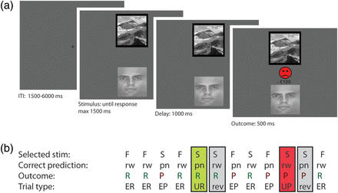
Figure 1. (a) Two stimuli, a face (F) and a scene (S), were simultaneously presented. One of the 2 stimuli was ...
Notes:
Figure 1. (a) Two stimuli, a face (F) and a scene (S), were simultaneously presented. One of the 2 stimuli was highlighted with a black border and the participant's task was to predict, with a right or left button press, whether this stimulus was followed by a reward (rw, a happy smiley with a + €100 sign) or a punishment (pn, a sad smiley with a −€100 sign). The actual outcome was presented after the participant's prediction (100% deterministic). (b) An example of a trial sequence. The participant learned to predict reward and punishment for the face and scene, respectively; expected reward (ER) or expected punishment (EP). After 4–6 consecutive correct predictions, the stimulus–outcome associations were reversed, which were signaled by either unexpected reward (UR) or unexpected punishment (UP). Performance was measured on reversal trials (rev) immediately after the unexpected outcomes.
Unless provided in the caption above, the following copyright applies to the content of this slide: © The Author 2012. Published by Oxford University Press. All rights reserved. For Permissions, please e-mail: journals.permissions@oup.com

Slide 2
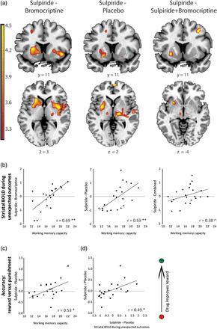
Figure 2. Working memory capacity predicts dopaminergic drug effects during reward and punishment reversal learning. ...
Notes:
Figure 2. Working memory capacity predicts dopaminergic drug effects during reward and punishment reversal learning. (a) Results from simple regression analyses showing regions where there is a linear relationship between working memory and effects of sulpiride relative to bromocriptine (left), sulpiride relative to placebo (middle), and sulpiride relative to combined administration (right) on striatal BOLD signal during unexpected–expected outcomes (data presented at puncorrected <0.001, effects are significant within our SV of interest [psv_fwe <0.05]). (b) Linear relationship between working memory and drug effects on average striatal BOLD signal change (extracted parameter estimates from the striatum, anatomically defined as the bilateral caudate and putamen selected from the AAL atlas) for bromocriptine relative to sulpiride (left), sulpiride relative to placebo (middle), and sulpiride relative to combined administration of sulpiride and bromocriptine (right). (c) Correlation between working memory and effects of sulpiride (relative to placebo) on reward versus punishment learning. (d) Correlation between effects of sulpiride (relative to placebo) on striatal BOLD signal during both unexpected outcomes and effects of sulpiride (relative to placebo) on reward versus punishment learning. Diamonds indicate individual data points. **P < 0.005, *P < 0.05, ^P < 0.1.
Unless provided in the caption above, the following copyright applies to the content of this slide: © The Author 2012. Published by Oxford University Press. All rights reserved. For Permissions, please e-mail: journals.permissions@oup.com

