Slide 1
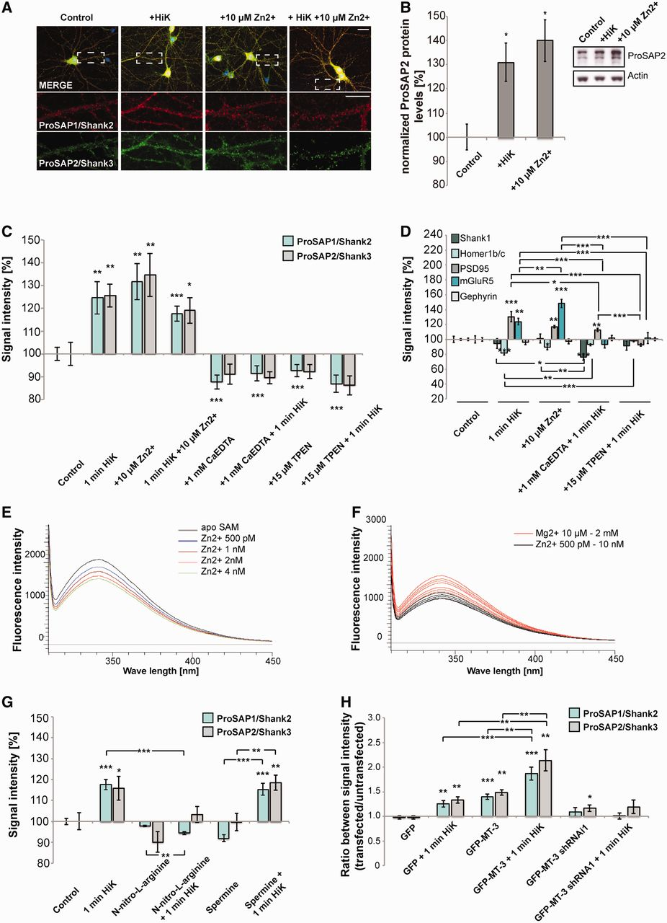
Figure 1 Synaptic levels of zinc-binding ProSAP/Shank family members change under Zn²⁺-supplementation and ...
Notes:
Figure 1 Synaptic levels of zinc-binding ProSAP/Shank family members change under Zn2+-supplementation and depletion in a MT-3 and NO-dependent manner. Hippocampal neurons (14 days in vitro) were treated with HiK+ and/or Zn2+-chelators (TPEN, CaEDTA) and/or were supplemented with Zn2+. (A, C, D, G and H) A puncta by puncta analysis of the synaptic signal intensity was performed from 10 cells (14 days in vitro, n = 10) of each treatment group. Signal intensities were normalized against untreated cells (Control) or in case of transfected cells (H) against an untransfected cell in the same optic field of view. (A) Example images are shown; merged images additionally show DAPI staining of the nucleus (scale bar = 20 µm). (B) Protein biochemistry confirms an increase of ProSAP2/Shank3 normalized against actin after HiK+ stimulation and Zn2+-supplementation in the P2 fraction of hippocampal neurons (14 days in vitro, n = 3). (C and D) Quantification of the signal intensities obtained by immunofluorescence. A Zn2+-concentration dependent regulation of ProSAP1/Shank2 and ProSAP2/Shank3 can be observed. HiK+ stimulation and Zn2+-supplementation do not show additive effects. Zn2+ chelation prevents changes induced by HiK+ [no significant differences were detected between HiK+ stimulation, Zn2+-supplementation and HiK+ stimulation plus Zn2+-supplementation, whereas treatment with CaEDTA or TPEN with or without HiK+ stimulation leads to a highly significant (P < 0.001) decrease compared to the HiK+, Zn2+, and HiK++Zn2+ conditions]. (D) Along with the regulation of ProSAP1/Shank2 and ProSAP2/Shank3, the level of PSD95 and mGluR5 receptors at the synapse changes. However, Shank1 and Gephyrin signals do not increase with Zn2+-supplementation. Homer1b/c levels seem to decrease with synaptic stimulation and Zn2+-supplementation, but are unaffected by Zn2+-depletion. (E and F) Intrinsic fluorescence spectroscopy experiments show Zn2+ and Mg2+ titration for the ProSAP2/Shank3 SAM domain. Mg2+ and Zn2+ titration of the ProSAP2/Shank3 SAM domain led to a decrease in Trp fluorescence emission. The apo-SAM domain exhibited a decrease in Trp fluorescence in the range of 3–4 nM. Higher Zn2+-concentrations led to precipitation of the protein (data not shown). As Zn2+-binding of the protein will always occur in the presence of Mg2+ titration we also performed Zn2+ titration of the Mg2+ bound-SAM domain and found here a decrease in Trp fluorescence in the lower nanomolar but not picomolar range. (E) Zn2+ titration of the apo-SAM domain with low nM Zn2+ decreases fluorescence intensity. (F) Mg2+ titration of the apo-SAM domain decreases fluorescence intensity and Zn2+ titration in the low nanomolar range to Mg2+ bound protein further decreases the fluorescence intensity. (G) HiK+ stimulation of cells significantly increases ProSAP1/Shank2 and ProSAP2/Shank3 levels compared with control cells treated with N-nitro-l-arginine, and cells treated with spermine. Stimulation of cells in the presence of a NO agonist or antagonist shows that HiK+ together with NO antagonist (N-nitro-l-arginine) blocks the increase in ProSAP1/Shank2 and ProSAP2/Shank3. (H) Overexpression of MT-3 (10–14 days in vitro) increases synaptic ProSAP1/Shank2 and ProSAP2/Shank3 levels. Stimulation of neurons increases ProSAP1/Shank2 and ProSAP2/Shank3 levels in control (GFP transfected) cells and even further increases the levels in MT-3 overexpressing cells. In contrast, stimulation-induced changes are prevented by knockdown of MT-3 (10–14 days in vitro). No significant differences were detected between HiK+ stimulated and unstimulated GFP-MT-3 shRNA transfected cells. The ratio between transfected and untransfected neurons within the same optic field are shown. All values were normally distributed and tested for significance using t-test followed by ANOVA. *P < 0.05; **P < 0.01; ***P < 0.001.
Unless provided in the caption above, the following copyright applies to the content of this slide: © The Author (2013). Published by Oxford University Press on behalf of the Guarantors of Brain. All rights reserved. For Permissions, please email: journals.permissions@oup.com

Slide 2
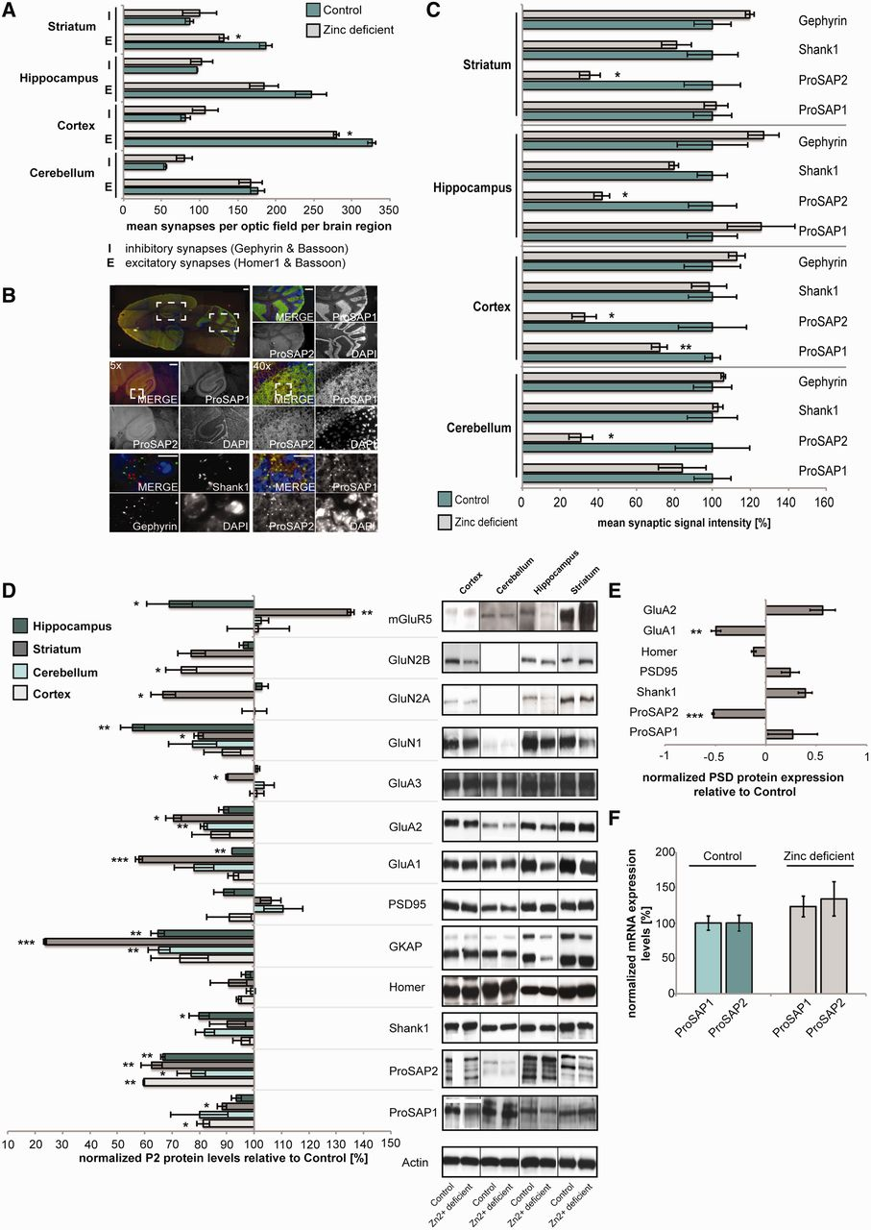
Figure 2 Dietary Zn²⁺ deficiency reduces the amount of ProSAP/Shank and postsynaptic density (PSD) ...
Notes:
Figure 2 Dietary Zn2+ deficiency reduces the amount of ProSAP/Shank and postsynaptic density (PSD) proteins. (A) Sections of three control and three Zn2+-deficient mice (18 weeks of age) were stained for bassoon, homer1 and gephyrin and the number of immune-reactive signals counted in at least three optic fields of view per region. Bassoon- and gephyrin-positive signals correspond to inhibitory synapses, whereas bassoon- and homer1-positive signals were considered as excitatory synapses. A significant decrease in excitatory synapse density in cortex and striatum can be seen in Zn2+-deficient animals. A trend towards an increase in inhibitory synapse numbers can be seen, although not significant in Zn2+-deficient animals. (B and C) Sections of three control and three Zn2+-deficient mice were stained for ProSAP1/Shank2, ProSAP2/Shank3, Shank1 and gephyrin and the signal intensity of synaptic puncta evaluated [scale bar = 500 µm (overview and ×5); scale bar = 20 µm (×40 and enlargements)]. A significant decrease of ProSAP2/Shank3 (all brain regions) and ProSAP1/Shank2 (cortex) could be detected. The levels of Shank1 and gephyrin were not altered. (D) Protein biochemistry using P2 fractions of four brain regions of Zn2+-deficient and control mice (n = 3). Protein concentrations were normalized to actin and are shown relative to the expression in control mice. A decrease of ProSAP2/Shank3 in all brain regions can be confirmed as well as a loss of GluA1 and GluN1 receptors most prominent in hippocampus and striatum. (E) Protein biochemistry using synaptic junction fractions of three Zn2+-deficient and three control mice normalized against actin and relative to the expression levels of control mice. A significant decrease in ProSAP2/Shank3 and GluA1 levels can be seen. (F) Quantitative real-time PCR shows no differences in ProSAP1/Shank2 and ProSAP2/Shank3 messenger RNA expression levels between Zn2+-deficient and control mice (n = 3). All values were normally distributed and tested for significance using t-test followed by ANOVA. *P < 0.05; **P < 0.01; ***P < 0.001.
Unless provided in the caption above, the following copyright applies to the content of this slide: © The Author (2013). Published by Oxford University Press on behalf of the Guarantors of Brain. All rights reserved. For Permissions, please email: journals.permissions@oup.com

Slide 3
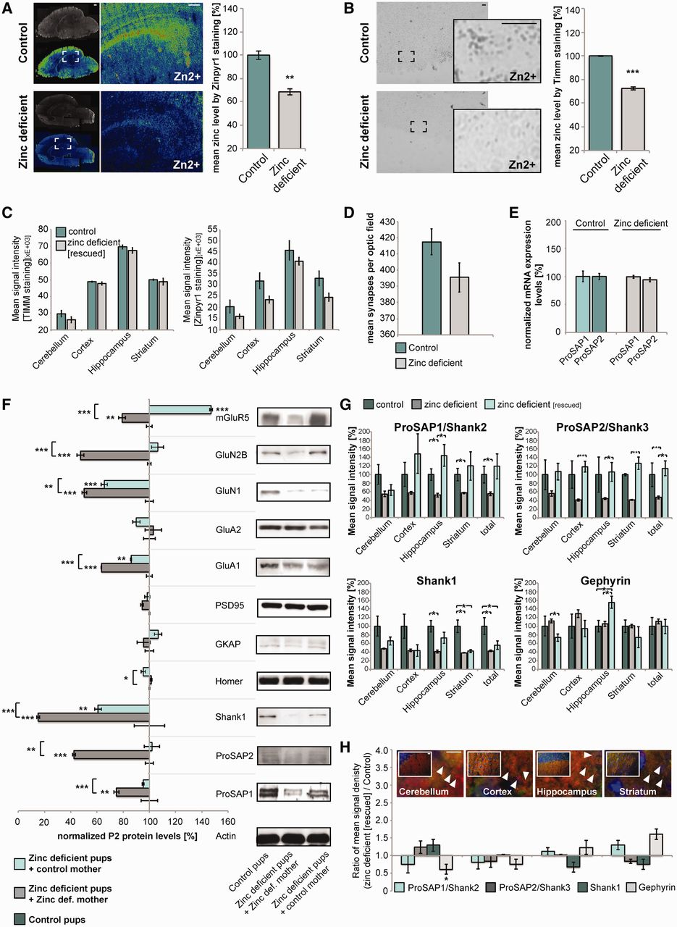
Figure 3 Maternal Zn²⁺ deficiency reduces the amount of ProSAP/Shank and postsynaptic density proteins in ...
Notes:
Figure 3 Maternal Zn2+ deficiency reduces the amount of ProSAP/Shank and postsynaptic density proteins in pups. (A) Using the Zn2+ fluorophore Zinpyr1 to evaluate Zn2+-levels reveals a significant reduction in signal intensity in brains from pups (post-natal Day 3, n = 3) from Zn2+-deficient mothers and nursed by Zn2+-deficient mothers. Sections of control and Zn2+-deficient mice were imaged and quantified by measuring at least three optic fields of view (scale bar = 300 µm) and controls were set to 100%. (B) Timm’s staining similarly shows a significant reduction in signal intensity in pups from Zn2+-deficient mice (post-natal Day 3, n = 3, controls set to 100%) (scale bar = 150 µm). (C) Pups (post-natal Day 3) nursed by control mothers show a rescue in Zn2+-levels almost up to brain Zn2+-concentration of control pups. Again Timm’s staining (left) and Zinpyr1 labelling (right) was performed as shown in A and B. (D) Sections of three control and three Zn2+-deficient mice were stained for bassoon and homer1 and the number of positive signals counted in multiple fields of view. Bassoon- and homer1-positive signals were considered as excitatory synapses. A trend towards a decrease in excitatory synapse density, although not significant, can be seen in Zn2+-deficient animals. (E) Quantitative real-time PCR shows no differences in ProSAP1/Shank2 and ProSAP2/Shank3 messenger RNA expression levels normalized to HMBS expression between pups (post-natal Day 3) from Zn2+-deficient and control mice (n = 3). (F) P2 fractions from post-natal Day 3 pups show a significant reduction of all ProSAP/Shank family members in pups from Zn2+-deficient mothers. Along with this, a significant decrease in GluA1, GluN1 and GluN2B can be observed. Pups from Zn2+-deficient mothers that have been nursed by control animals show a significant rescue of ProSAP/Shank and GluA1, GluN1 and GluN2B levels, although Shank1, GluA1 and GluN1 stay significantly reduced compared with control animals. Expression levels were normalized against actin and are shown relative to the expression of control mice (n = 3). (G) Sections from three control, Zn2+-deficient pups (post-natal Day 3) raised by control mothers, and Zn2+-deficient pups (post-natal Day 3) raised by Zn2+-deficient mothers were stained for ProSAP1/Shank2, ProSAP2/Shank3, Shank1 and gephyrin and the signal intensity of synaptic puncta evaluated. Similar to the western blot results shown in (F), a significant decrease of ProSAP1/Shank2, ProSAP2/Shank3 and Shank1 (total of all brain regions) could be detected in Zn2+-deficient pups. The levels of ProSAP1/Shank2 and ProSAP2/Shank3 in rescued Zn2+-deficient pups (raised by control mothers) were not different from control animals. The levels of Shank1 however, were still significantly reduced considering the average values of all brain regions. The synaptic concentration of gephyrin for all brain regions is not altered, although a decrease in cerebellum and an increase in hippocampus is seen in rescued Zn2+-deficient pups. The data are shown normalized to signal intensity values of controls. (H) Sections of three control and three Zn2+-deficient pups (post-natal Day 3) raised by control mothers were stained for ProSAP1/Shank2, ProSAP2/Shank3, Shank1 and gephyrin and the mean number of positive signals counted per optic field from five images. The data are shown normalized to signal density values of controls. A significant decrease in gephyrin-positive signals can be seen in Zn2+-deficient pups raised by control mothers. The signal density of ProSAP/Shank immunoreactive puncta was not significantly different from control pups [images show exemplary stainings of ProSAP1/Shank2 (green), ProSAP2/Shank3 (red) and DAPI (blue) of the analysed brain regions] (scale bar = 10 µm). Although ratios are shown, statistical tests were performed using the actual signal density of the Zn2+-deficient (rescued) animals compared to the actual signal density of control animals. (A–H) All values were normally distributed and tested for significance using t-test followed by ANOVA. *P < 0.05; **P < 0.01; ***P < 0.001.
Unless provided in the caption above, the following copyright applies to the content of this slide: © The Author (2013). Published by Oxford University Press on behalf of the Guarantors of Brain. All rights reserved. For Permissions, please email: journals.permissions@oup.com

Slide 4
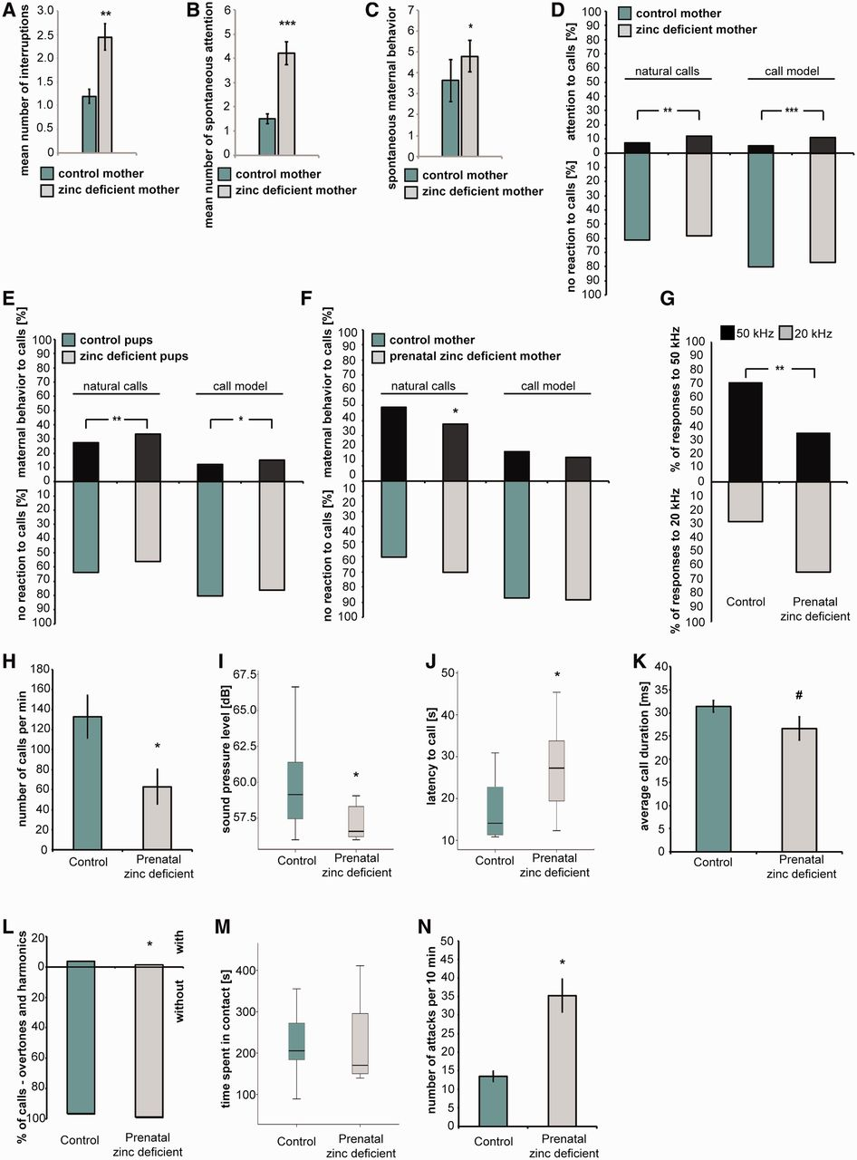
Figure 4 Behavioural deficits in a mouse model for acute and prenatal Zn²⁺-deficiency. (A–E) Acute ...
Notes:
Figure 4 Behavioural deficits in a mouse model for acute and prenatal Zn2+-deficiency. (A–E) Acute Zn2+-deficient mice demonstrated increased activity and reactivity in the situation of maternal care compared to normal mothers. (A) In a test for maternal behaviour, adult Zn2+-deficient mice (n = 20, A–E) demonstrate a significantly higher number of interruptions of nursing/warming position compared to controls (n = 18, A–E, t-test). Additionally, Zn2+-deficient mice showed significantly more spontaneous attention behaviour (lifting or turning the head, U-test) (B) and spontaneous maternal behaviour (C) in the absence of calls independent of the Zn2+ status of pups (U-test) (Supplementary Fig. 6D–F). (D) The attention response to natural wriggling calls and the synthesized call model was significantly increased in Zn2+-deficient mothers independent of the Zn2+ status of pups (Chi square test) (Supplementary Fig. 6G). (E) Maternal behaviour (licking, change in nursing position, nest building) of both groups of mothers was increased in response to calls of Zn2+-deficient pups and to the call model (Chi square test) (Supplementary Fig. 6H and Supplementary Data). (F) In the same test for maternal behaviour (A–E) conducted with mice that suffered from prenatal Zn2+-deficiency, over-responsiveness and hyperactivity were not detected. However, prenatal Zn2+-deficient mice (n = 6, 15 weeks of age) showed significantly less maternal behaviour in response to the natural calls of pups compared to control mice (n = 7, Chi square test) (F). (G) A pup retrieval test revealed that prenatal Zn2+-deficient mice (n = 24, 14 weeks of age with pups post-natal Day 4–5) responded significantly more to the neutral 20 kHz sound stimulus and thus significantly less to the biologically meaningful 50 kHz sound compared with control mice (n = 42). Data of both groups were compared with the sign test according to Dixon and Mood. The comparison of the number of choices between the two tones was done using Chi-square test. Moreover, prenatal Zn2+-deficient male mice (n = 7, 15 weeks of age) showed impaired ultrasonic vocalization compared with control mice (n = 13) (H–L). The number of calls per minute (H) was significantly decreased (t-test), the loudness was significantly reduced (U-test) (I) and the latency to start calling significantly increased (U-test) (J) compared with control animals. Prenatal Zn2+-deficient males additionally showed a trend towards a reduced call duration (#P = 0.073, t-test) (K) and significantly less vocalizations with overtones and harmonics (L) compared with control animals (Chi-square test). (M) A maternal resident intruder test revealed that, although the time a mother spent in contact with an intruding male was not significantly different between prenatal Zn2+-deficient and control mothers (U-test) (M), the number of attacks was significantly increased in prenatal Zn2+-deficient mothers (n = 5, t-test) (N). *P < 0.05; **P < 0.01.
Unless provided in the caption above, the following copyright applies to the content of this slide: © The Author (2013). Published by Oxford University Press on behalf of the Guarantors of Brain. All rights reserved. For Permissions, please email: journals.permissions@oup.com

Slide 5
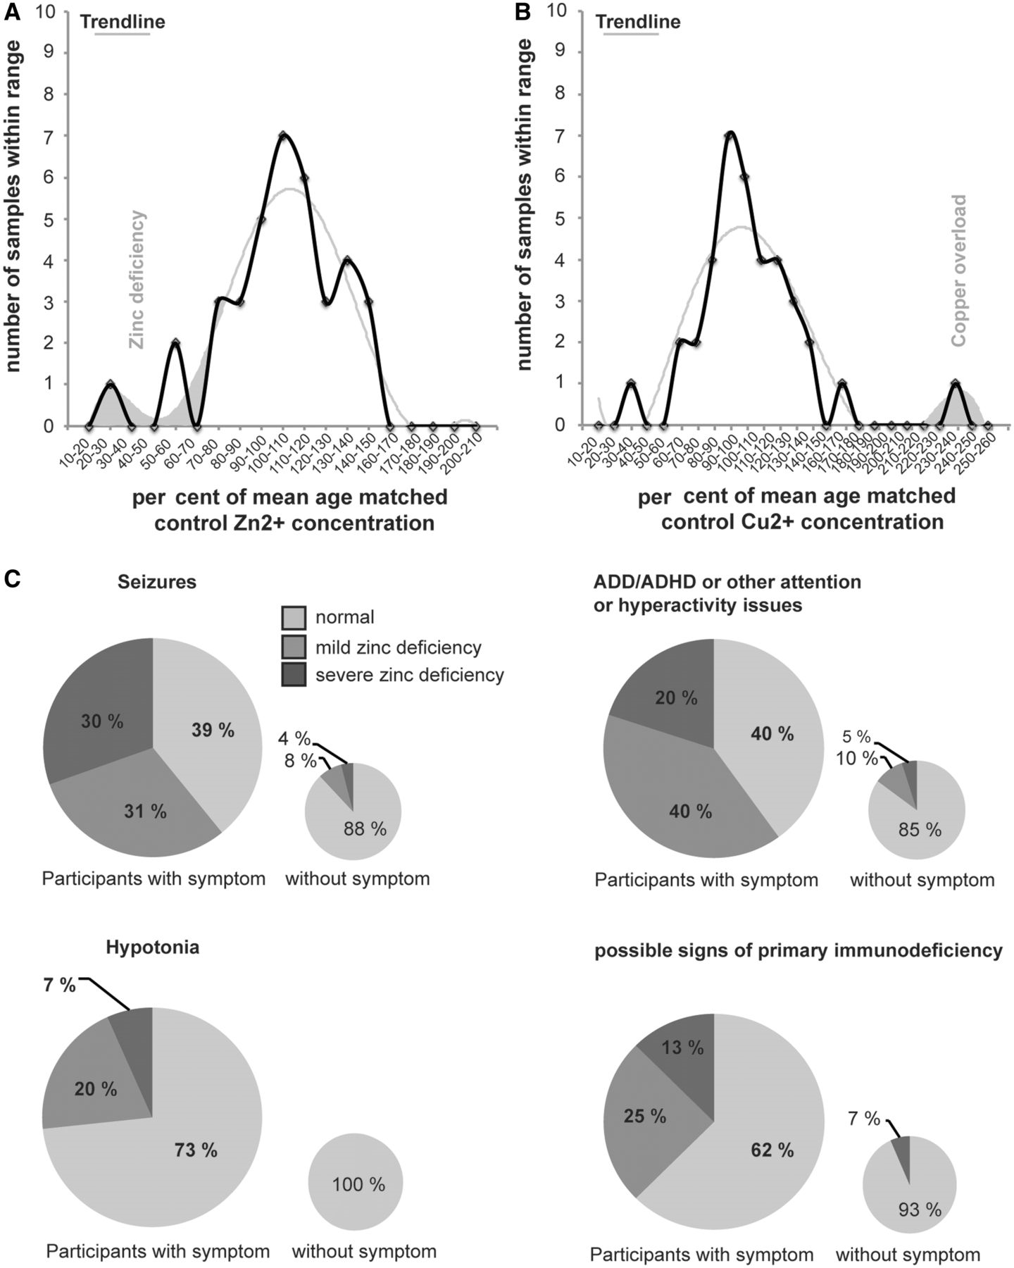
Figure 5 Zn²⁺ deficiency is associated with an increased rate of seizures, attention or hyperactivity ...
Notes:
Figure 5 Zn2+ deficiency is associated with an increased rate of seizures, attention or hyperactivity issues, hypotonia and possible signs of primary immunodeficiency in patients with Phelan-McDermid syndrome. (A and B) Using atomic absorption spectroscopy, Cu2+ and Zn2+-levels in blood samples of 38 participants diagnosed with Phelan-McDermid syndrome were evaluated. (A) From 37 participants, 30 were found to have normal blood Zn2+-levels, four showed a mild Zn2+-deficiency and three a severe Zn2+-deficiency. (B) A copper overload was detected in four participants. (A and B) The measured values are shown in per cent compared with age matched control reference values. (C) A total of 26 categories were analysed based on the participant’s data provided by the Phelan-McDermid Syndrome Registry. The results show that 61% of participants suffering from seizures have Zn2+-deficiency compared with only 12% of participants without seizures (participants with mild and severe Zn2+-deficiency combined) (n = 32 total). Sixty per cent of participants with attention deficit disorder/attention deficit hyperactivity disorder (ADD/ADHD) or other attention of hyperactivity issues were Zn2+-deficient and 27% of participants with hypotonia compared with 15% and 0%, respectively, of participants without the symptom (participants with mild and severe Zn2+-deficiency combined; n = 17 and 24 total, respectively). In the group of participants showing possible signs of primary immunodeficiency (four or more ear infections within 1 year, two or more serious sinus infections within 1 year, two or more pneumonias within 1 year, persistent thrush in mouth or fungal infection of skin, or the need of intravenous antibiotics to clear infections), 38% of participants were found with mild or severe Zn2+-deficiency compared to 7% of participants without any of these symptoms (n = 31 total). Differences between patients with normal Zn2+-levels/mild Zn2+-deficiency and patients with severe Zn2+-deficiency are significant for the occurrence of seizures (P < 0.001), attention deficit disorder/attention deficit hyperactivity disorder or other attention or hyperactivity issues (P < 0.01), possible signs of immunodeficiency (P < 0.01), while only a trend can be observed for hypotonia (P = 0.058) (chi-square Goodness of fit).
Unless provided in the caption above, the following copyright applies to the content of this slide: © The Author (2013). Published by Oxford University Press on behalf of the Guarantors of Brain. All rights reserved. For Permissions, please email: journals.permissions@oup.com

