Slide 1
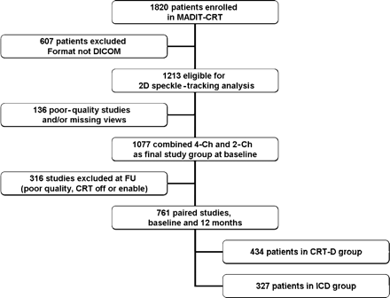
Figure 1 Feasibility of speckle-tracking analysis in consecutive patients.
Notes:
Figure 1 Feasibility of speckle-tracking analysis in consecutive patients.
Unless provided in the caption above, the following copyright applies to the content of this slide: Published on behalf of the European Society of Cardiology. All rights reserved. © The Author 2011. For permissions please email: journals.permissions@oup.com

Slide 2
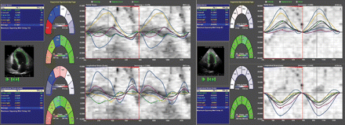
Figure 2 Two-dimensional speckle-tracking imaging in the apical four-chamber view in a patient before (left panel) and ...
Notes:
Figure 2 Two-dimensional speckle-tracking imaging in the apical four-chamber view in a patient before (left panel) and after cardiac resynchronization therapy-defibrillator implantation (right panel). Upper curves represent transverse strain curves, which were used to measure left ventricular dyssynchrony and lower curves represent longitudinal strain that were used to measure contractile function. Improvement in left ventricular dyssynchrony and left ventricular contractile function was shown at follow-up.
Unless provided in the caption above, the following copyright applies to the content of this slide: Published on behalf of the European Society of Cardiology. All rights reserved. © The Author 2011. For permissions please email: journals.permissions@oup.com

Slide 3
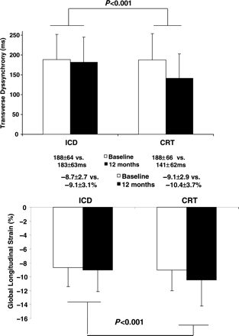
Figure 3 Changes in left ventricular dyssynchrony and contractile function in implantable cardioverter ...
Notes:
Figure 3 Changes in left ventricular dyssynchrony and contractile function in implantable cardioverter defibrillator-only and cardiac resynchronization therapy-defibrillator groups. Data are presented as mean ± SD. Between-treatment-group differences in the change in left ventricular dyssynchrony and left ventricular contractile function measures from baseline to 12 months were assessed in analysis of covariance adjusting for treatment group, ischaemic aetiology, and baseline measure of dyssynchrony or strain.
Unless provided in the caption above, the following copyright applies to the content of this slide: Published on behalf of the European Society of Cardiology. All rights reserved. © The Author 2011. For permissions please email: journals.permissions@oup.com

Slide 4
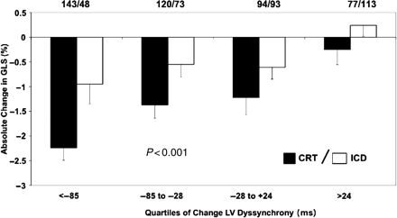
Figure 4 Change in left ventricular contractile function measured by global longitudinal strain according to quartiles ...
Notes:
Figure 4 Change in left ventricular contractile function measured by global longitudinal strain according to quartiles of change in dyssynchrony within-treatment group. Data are expressed as mean ± SEM. Note: the greater the absolute per cent reduction in left ventricular strain, the greater the improvement in left ventricular contractile function.
Unless provided in the caption above, the following copyright applies to the content of this slide: Published on behalf of the European Society of Cardiology. All rights reserved. © The Author 2011. For permissions please email: journals.permissions@oup.com

Slide 5
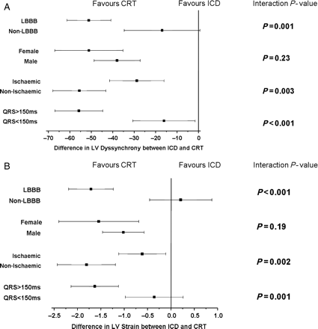
Figure 5 (A) Effect of treatment on left ventricular dyssynchrony in subgroups. (B) Effect of treatment on left ...
Notes:
Figure 5 (A) Effect of treatment on left ventricular dyssynchrony in subgroups. (B) Effect of treatment on left ventricular contractile function in subgroups.
Unless provided in the caption above, the following copyright applies to the content of this slide: Published on behalf of the European Society of Cardiology. All rights reserved. © The Author 2011. For permissions please email: journals.permissions@oup.com

