Slide 1
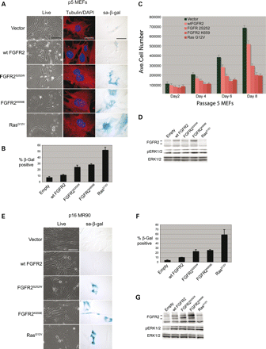
Figure 1. FGFR2 mutants promote senescence in primary cells. (A) Morphology (live cells and tubulin/DAPI stained cells) ...
Notes:
Figure 1. FGFR2 mutants promote senescence in primary cells. (A) Morphology (live cells and tubulin/DAPI stained cells) and sa-β-galactosidase staining of primary MEFs. (B) The mean percentage of β-galactosidase-positive cells and standard deviation based on three independent experiments. (C) Mean number of cell counts and standard deviation from passage 5 MEFs plated at 50 000 cells per dish (day 0) and counted every 2 days. (D) Western blots showing levels of FGFR2, phospho-ERK1/2 (T202/Y204) and total ERK in MEFs. (E) Live and sa-β-galactosidase staining of primary human IMR90 fibroblasts expressing the indicated proteins. (F) Mean percentage of sa-β-galactosidase-positive IMR90 cells and standard deviation based on triplicate samples from three independent experiments. (G) Western blot of IMR90 fibroblasts as in (D). Scale bars: live cells and sa-β-gal—50 μm, tubulin/DAPI—10 μm.
Unless provided in the caption above, the following copyright applies to the content of this slide: © 2009 The Author(s)This is an Open Access article distributed under the terms of the Creative Commons Attribution Non-Commercial License (http://creativecommons.org/licenses/by-nc/2.0/uk/) which permits unrestricted non-commercial use, distribution, and reproduction in any medium, provided the original work is properly cited.

Slide 2
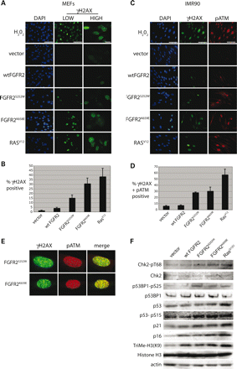
Figure 2. Induction of DNA-damage response by FGFR2 mutants. (A) γH2AX immunoflourescense in primary MEFs expressing ...
Notes:
Figure 2. Induction of DNA-damage response by FGFR2 mutants. (A) γH2AX immunoflourescense in primary MEFs expressing the indicated proteins. Low and higher magnification views are provided to show both the general increase in the number of cells staining for γH2AX, and the speckled pattern of γH2AX staining in positive cells. (B) Mean percentage of γH2AX-positive MEFs with standard deviation from three independent experiments. (C) γH2AX and p(ser1981)-ATM staining in IMR90 cells expressing the same set of proteins as in (A). (D) Mean percentage of γH2AX- and pATM-positive (cells showing co-localization) IMR90 fibroblasts with standard deviations calculated from three independent experiments. Hydrogen peroxide treated cells were used as a positive control, and DAPI staining was used to visualize nuclei in these experiments. (E) γH2AX and pATM staining showing coincident staining in IMR90 fibroblasts expressing FGFR2S252W or FGFR2K569E as indicated. (F) Immunoblot analysis of the indicated proteins. Residues recognized by phospho-specific antiserums is indicated. Actin was used as a general loading control. Scale bars: all are 50 µm, except ‘high’ (magnification) which is 10 µm.
Unless provided in the caption above, the following copyright applies to the content of this slide: © 2009 The Author(s)This is an Open Access article distributed under the terms of the Creative Commons Attribution Non-Commercial License (http://creativecommons.org/licenses/by-nc/2.0/uk/) which permits unrestricted non-commercial use, distribution, and reproduction in any medium, provided the original work is properly cited.

Slide 3
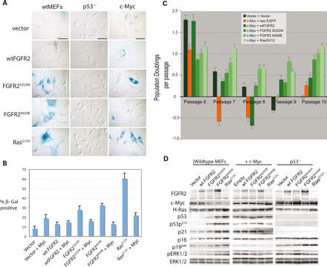
Figure 3. Suppression of mutant FGFR2-induced senescence by coexpression of c-Myc or loss of p53. (A) ...
Notes:
Figure 3. Suppression of mutant FGFR2-induced senescence by coexpression of c-Myc or loss of p53. (A) sa-β-Galactosidase staining of cells infected with retroviruses expressing the indicated proteins in wild-type MEFs, p53-null MEFs or MEFs expressing c-Myc. (B) Mean percentage and standard deviation of sa-β-galactosidase-positive cells for infected wild-type MEFs and MEFs expressing exogenous c-Myc. (C) The average number of population doublings calculated during successive cell passages for the various cell strains expressing c-Myc. Data are from two independent experiments performed in triplicate and standard deviations are shown. (D) Immunoblot analysis of DNA damage and senescence markers in primary wild-type MEFs and p53-null MEFs expressing the indicated proteins. Scale bars: 50 μm.
Unless provided in the caption above, the following copyright applies to the content of this slide: © 2009 The Author(s)This is an Open Access article distributed under the terms of the Creative Commons Attribution Non-Commercial License (http://creativecommons.org/licenses/by-nc/2.0/uk/) which permits unrestricted non-commercial use, distribution, and reproduction in any medium, provided the original work is properly cited.

Slide 4
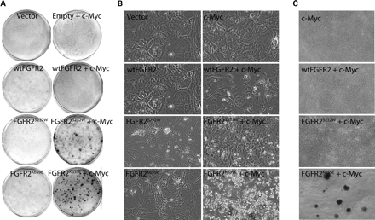
Figure 4. Constitutively activated FGFR2 cooperates with Myc in oncogenic transformation. (A) Focus formation assays, ...
Notes:
Figure 4. Constitutively activated FGFR2 cooperates with Myc in oncogenic transformation. (A) Focus formation assays, (B) live cell morphology and (C) colony formation assays in soft agar with primary MEFs infected with retroviruses expressing the indicated proteins or combinations of proteins.
Unless provided in the caption above, the following copyright applies to the content of this slide: © 2009 The Author(s)This is an Open Access article distributed under the terms of the Creative Commons Attribution Non-Commercial License (http://creativecommons.org/licenses/by-nc/2.0/uk/) which permits unrestricted non-commercial use, distribution, and reproduction in any medium, provided the original work is properly cited.

Slide 5
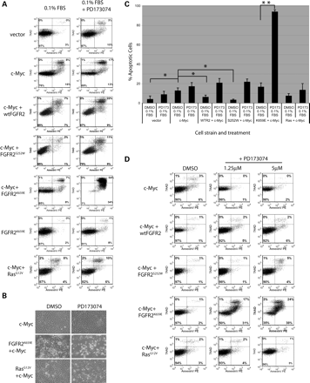
Figure 5. Prosurvival activity of FGF receptor mutants. (A) MEFs expressing the indicated proteins were subjected to ...
Notes:
Figure 5. Prosurvival activity of FGF receptor mutants. (A) MEFs expressing the indicated proteins were subjected to serum deprivation (0.1% FBS) plus DMSO vehicle or FGFR inhibitor PD173074 for 14 h. Cells were stained with AnnexinV and 7AAD and the percentage of AnnexinV-positive apoptotic cells (right-side quadrants) and 7AAD stained cells (lysed/dead cells—upper quadrants) determined by FAC sorting. Data shown are representative of at least two independent experiments performed in triplicate. (B) Live cell images showing the response of the indicated cell lines to serum deprivation with and without PD173074. (C) Bar graph showing mean percentage of AnnexinV-positive cells present following serum-deprivation and either DMSO vehicle or PD173074. *P < 0.005 and **P < 0.0005 for the specific comparisons indicated. Note that the percentage of apoptotic cells observed with the FGFR2K659E plus c-Myc strain treated with PD173074 was significantly greater than in any of the other cell strains tested in this experimental set. (D) MEFs expressing the indicated proteins grown in 10% FBS were subjected to DMSO vehicle or FGFR inhibitor PD173074 treatment at either 1.25 or 5 µM and analyzed for apoptosis as described above. The number of apoptotic cells in the expressing FGFR2K659E plus c-Myc strain was significantly greater (P < 0.0005) than any of the other experimental settings shown in (D).
Unless provided in the caption above, the following copyright applies to the content of this slide: © 2009 The Author(s)This is an Open Access article distributed under the terms of the Creative Commons Attribution Non-Commercial License (http://creativecommons.org/licenses/by-nc/2.0/uk/) which permits unrestricted non-commercial use, distribution, and reproduction in any medium, provided the original work is properly cited.

Slide 6
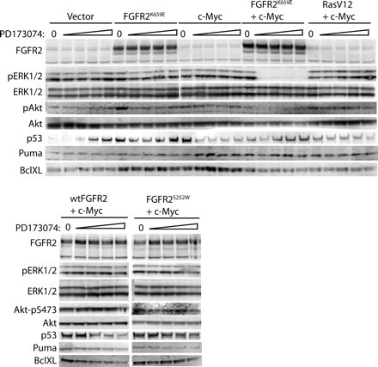
Figure 6. Immunoblot analysis of FGFR signaling in cells treated with PD173074. MEFs expressing the indicated proteins ...
Notes:
Figure 6. Immunoblot analysis of FGFR signaling in cells treated with PD173074. MEFs expressing the indicated proteins were treated with DMSO vehicle (O) or a titration of PD173074 (1.25, 2.5, 5 and 10 µM) for 2 h. Cell lysates were analyzed for expression of the indicated proteins. pAKT–pSer473.
Unless provided in the caption above, the following copyright applies to the content of this slide: © 2009 The Author(s)This is an Open Access article distributed under the terms of the Creative Commons Attribution Non-Commercial License (http://creativecommons.org/licenses/by-nc/2.0/uk/) which permits unrestricted non-commercial use, distribution, and reproduction in any medium, provided the original work is properly cited.

Slide 7
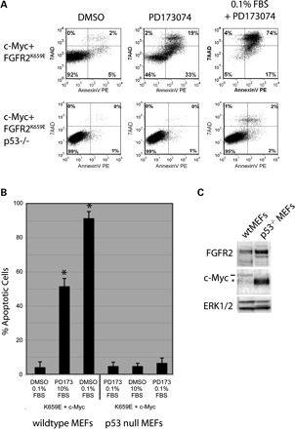
Figure 7. Apoptosis caused by FGFR inhibition in MEFs expressing exogenous c-Myc and FGFR2^{K569E} is p53 ...
Notes:
Figure 7. Apoptosis caused by FGFR inhibition in MEFs expressing exogenous c-Myc and FGFR2K569E is p53 dependent. (A) Primary MEFs and p53-null MEFs, both transformed by co-expression of c-Myc and FGFR2K569E, were treated with DMSO vehicle or 1.25 µM PD173074 in medium containing 10% FBS or in medium containing 0.1% FBS for 14 h. The percentage of AnnexinV and 7AAD positive cells was determined by FACS analysis. Assays were performed in triplicate and mean percentage of total apoptotic cells with standard deviation are shown in (B). *P < 0.0005 when compared with comparably treated p53-null MEFs. (C) Western blot showing expression of FGFR2K569E and c-Myc in the indicated cell lines. The dash indicates endogenous c-Myc and the asterisk indicates the slightly smaller human c-Myc protein that was introduced.
Unless provided in the caption above, the following copyright applies to the content of this slide: © 2009 The Author(s)This is an Open Access article distributed under the terms of the Creative Commons Attribution Non-Commercial License (http://creativecommons.org/licenses/by-nc/2.0/uk/) which permits unrestricted non-commercial use, distribution, and reproduction in any medium, provided the original work is properly cited.

