Slide 1
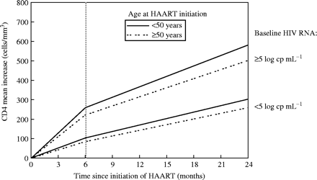
Figure 1. Mean CD4 cell count increase during HAART according to age at treatment initiation and the baseline HIV RNA ...
Notes:
Figure 1. Mean CD4 cell count increase during HAART according to age at treatment initiation and the baseline HIV RNA level in 3015 HIV-infected patients. Adapted with permission from Grabar et al.1
Unless provided in the caption above, the following copyright applies to the content of this slide: © The Author 2005. Published by Oxford University Press on behalf of the British Society for Antimicrobial Chemotherapy. All rights reserved. For Permissions, please e-mail: journals.permissions@oxfordjournals.org

